Slide 1
3 Dimensional Hg Jet Simulation
Yan Zhan
May 9th 2014

Slide 2
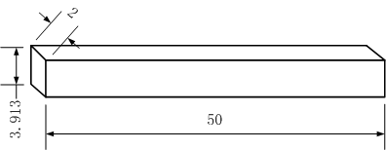
Boundary Conditions
Wall
Velocity Inlet
Pressure Outlet
symmetry
X axis is in the long (3.9 unit) direction
Y axis is in the short (2 unit) direction = bend plane
Z axis is in the very long (50 unit direction = direction of jet
No gravity in the model.
Units on this slide are in jet diameters

Slide 3
Axial Velocity Contour At The Jet Inlet
Outlet at straight pipe with nozzle but no weld
X
Y
u = U + sqrt(2k/3), where k = ½( (u’)^2+(v’)^2+(w’)^2 )
Units on this slide are meters
pipe simulation

Slide 4
Initial Condition At X=0
Units on this slide are meters
Y
At t = 0, v = 20 m/s for all z > 0 and r < 0.5 cm, but the velocity at z = 0 is taken from slide 3.
Y
At t > 0 fluid enters the left boundary (= inlet), always with the parameters of slide 3, ⇒ no time dependence to inlet flow, ⇒ inlet flow is effectively laminar.

Slide 5
Initial Condition At Y=0
X
X
Units on this slide are meters

Slide 6
Results at t = 14ms
Y
At plane X=0
X
At plane Y=0
Units on this slide are meters

Slide 7
Five Inlet Conditions For 3D Jet Simulation
Case # | Half Bend Angle (deg) | Nozzle | Weld | Complete?
1 | 0 | Yes | No | Yes
2 | 90 | Yes | No | Yes
3 | 90 | Yes | Whole weld | Yes
4 | 90 | Yes | Partial weld out of the bend plane | Yes
5 | 90 | Yes | Partial weld in the bend plane | No (about two weeks)

Slide 8
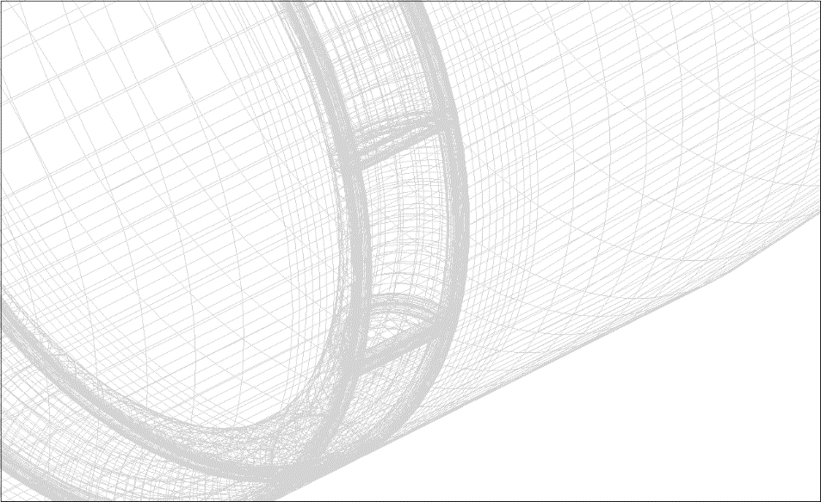
Mesh For New Case Of Partial Weld

