Slide 1
3D Hg Jet Simulations
Yan Zhan
June 20, 2014

Slide 2
Outline
Results of 3D Hg Jet for pipe with 90°/90° bend and 30° weld
Comparison between two 3D Hg Jet simulations

Slide 3
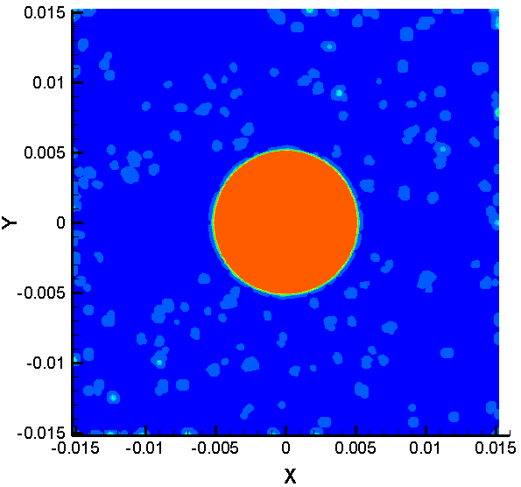
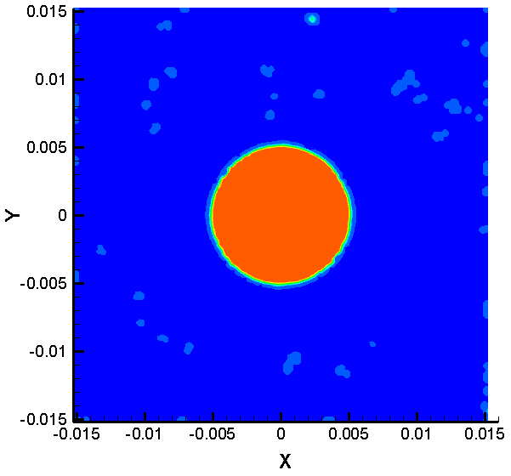
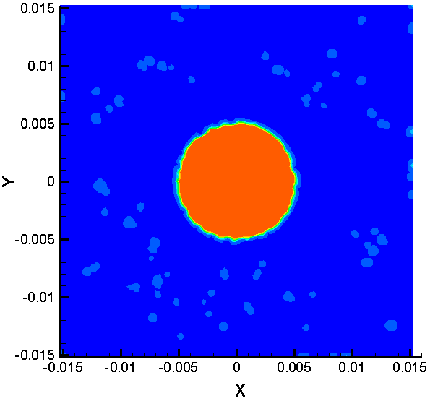
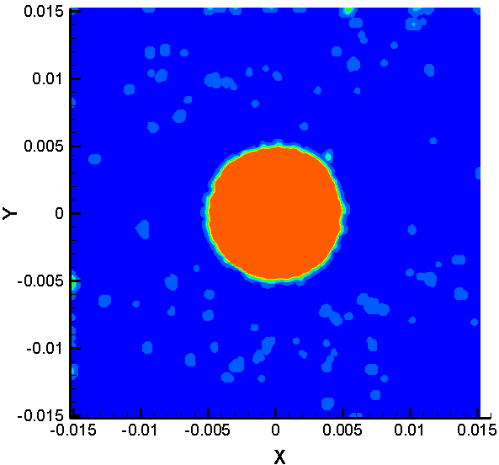
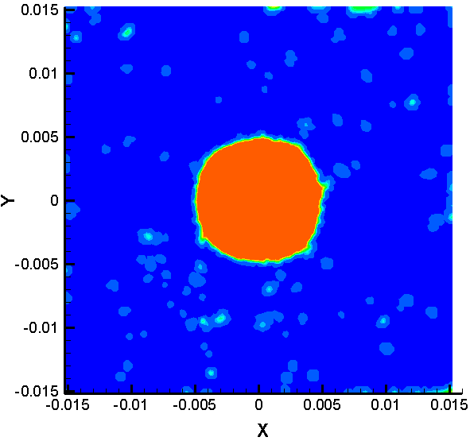
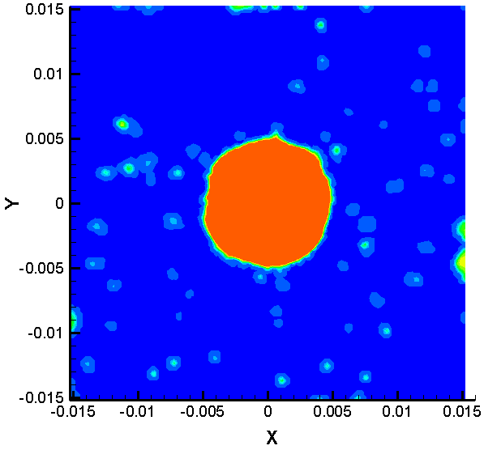
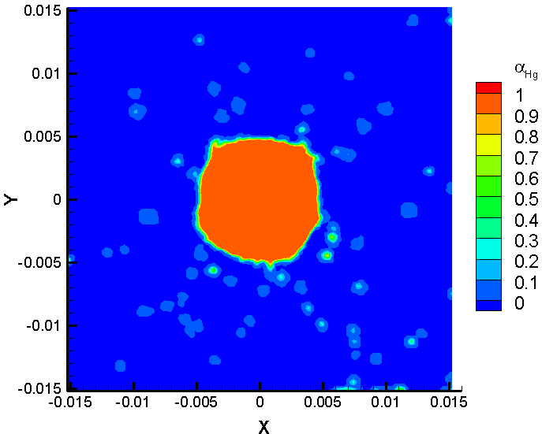
Results of α_{Hg} at t = 112.1 ms
z = 0 cm
z = 1 cm
z = 5 cm
z = 10 cm
z = 15 cm
z = 20 cm
z = 30 cm
z = 45 cm

Slide 4
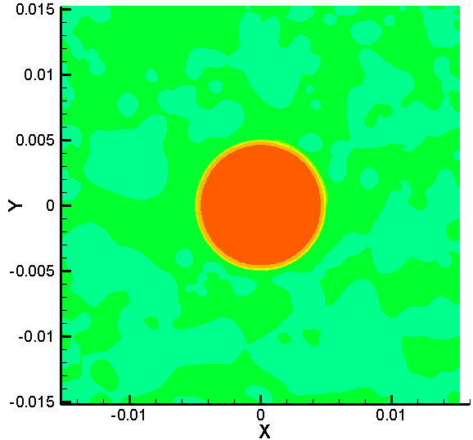
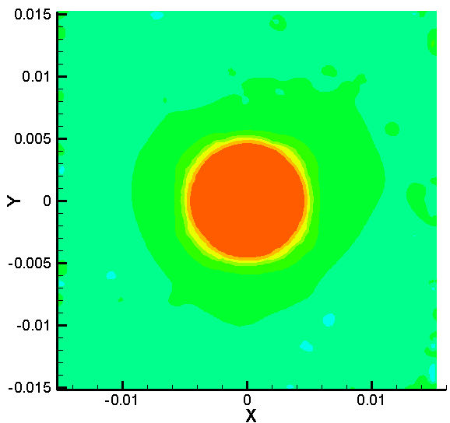
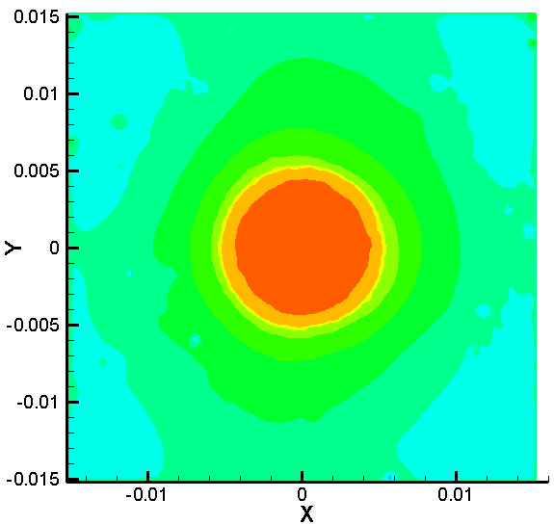
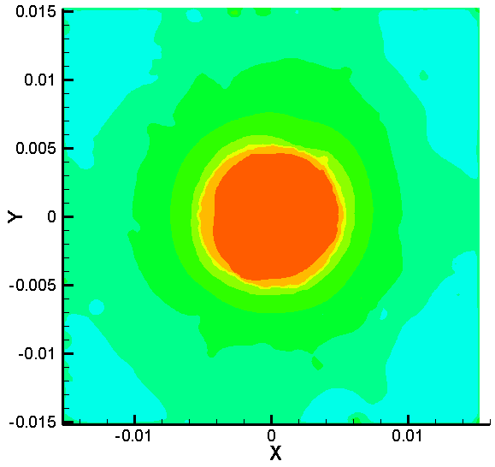
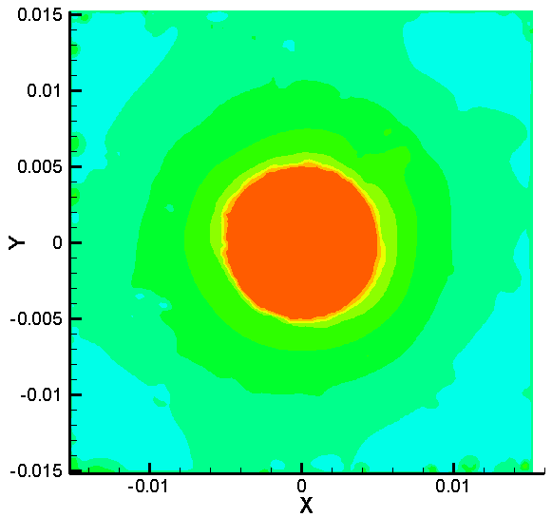
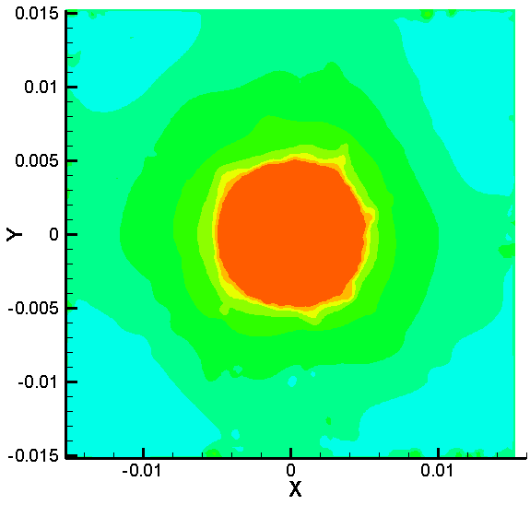
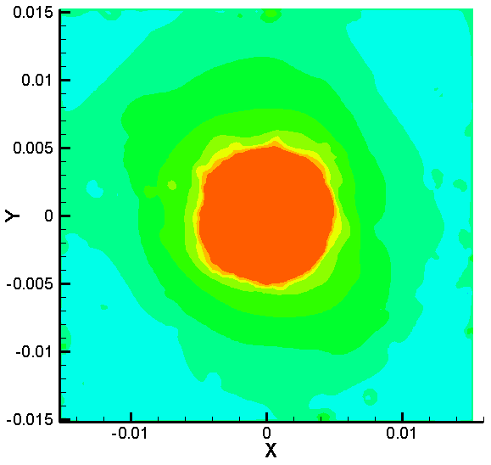
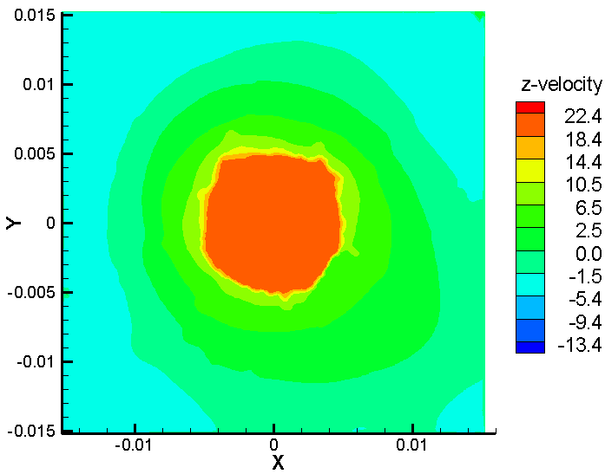
Results of u_{z} at t = 112.1 ms
z = 0 cm
z = 1 cm
z = 5 cm
z = 10 cm
z = 15 cm
z = 20 cm
z = 30 cm
z = 45 cm

Slide 5
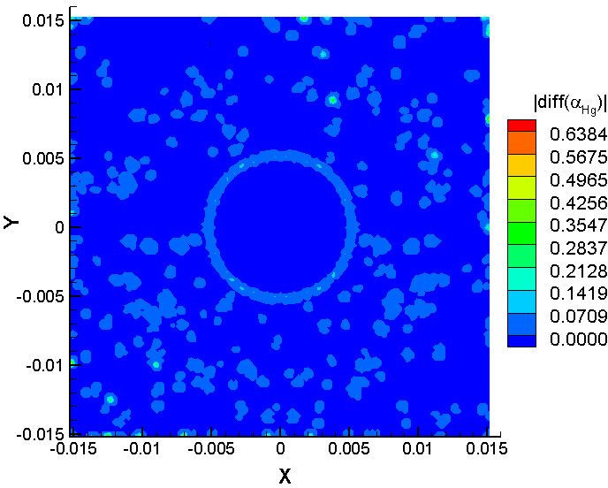
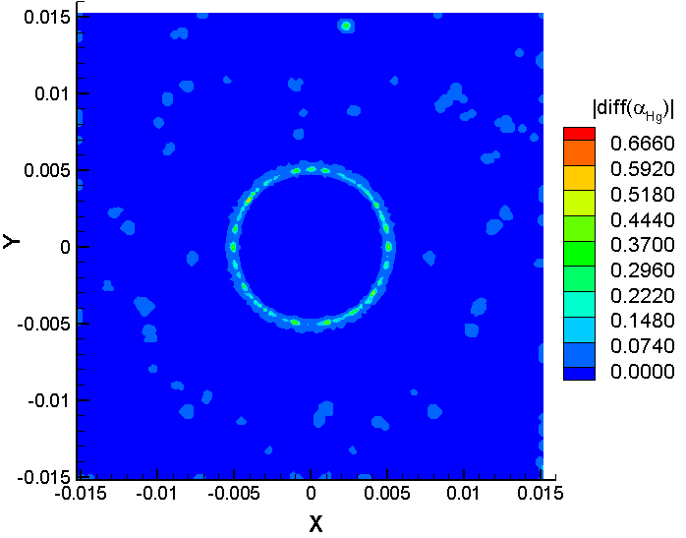
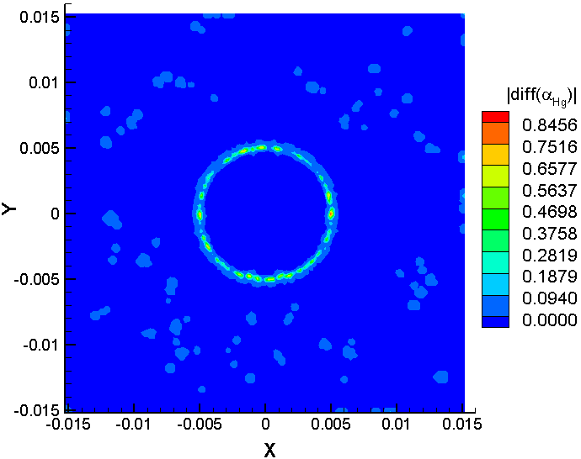
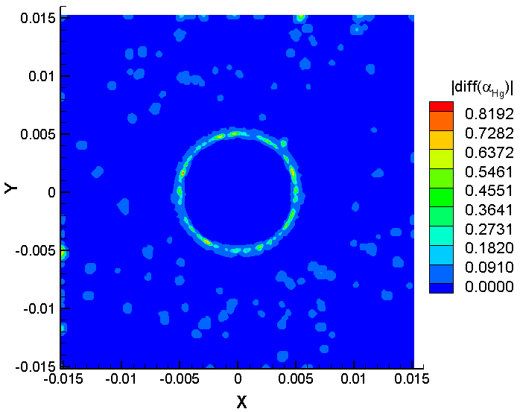
Difference Of α_{Hg} Between Case1 (at = 98.4 ms ) and Case2 (at = 112.1 ms )
z = 0 cm
z = 1 cm
z = 5 cm
z = 10 cm

Slide 6
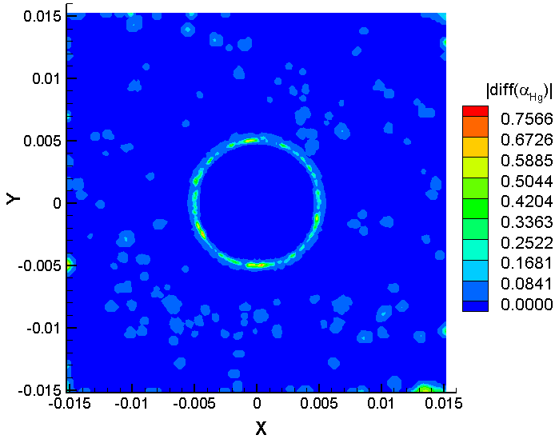
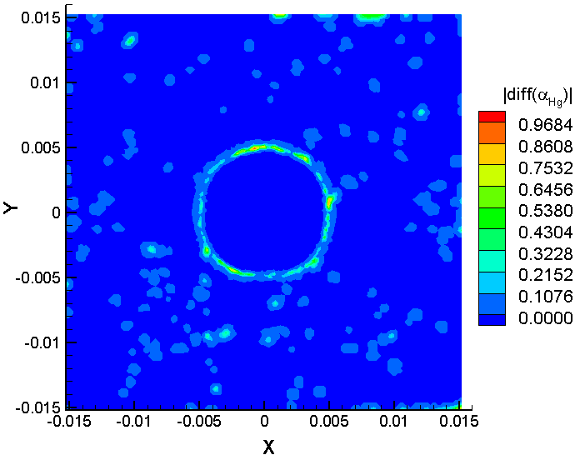
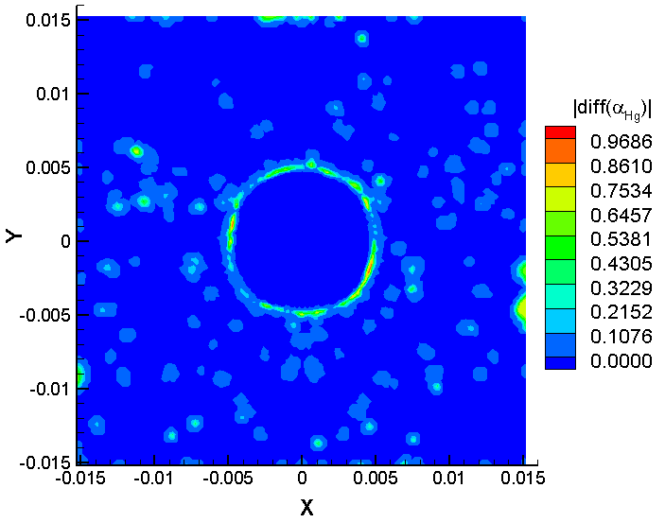
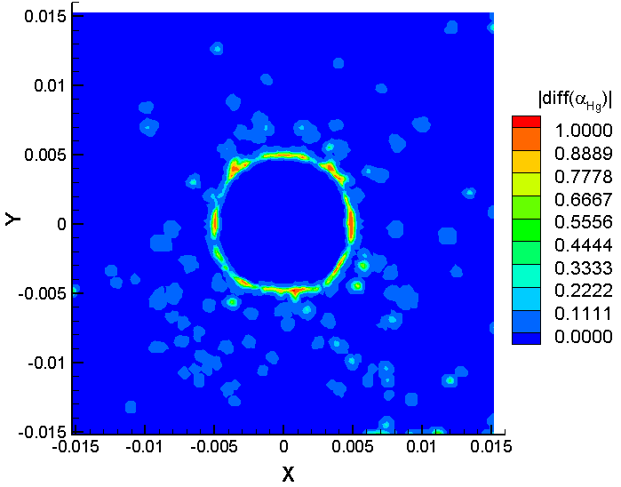
Difference Of α_{Hg} Between Case1 (at = 98.4 ms ) and Case2 (at = 112.1 ms )
z = 15 cm
z = 20 cm
z = 30 cm
z = 45 cm

