Slide 1
3D Hg Jet Simulations
Yan Zhan
June 20, 2014

Slide 2
Outline
Two 3D Hg Jet Simulations
Case1: Outlet of the pipe without a bend and a weld
Case2: Outlet of the pipe with 90°/90° bend and 30° weld
Ellipse Fitting

Slide 3
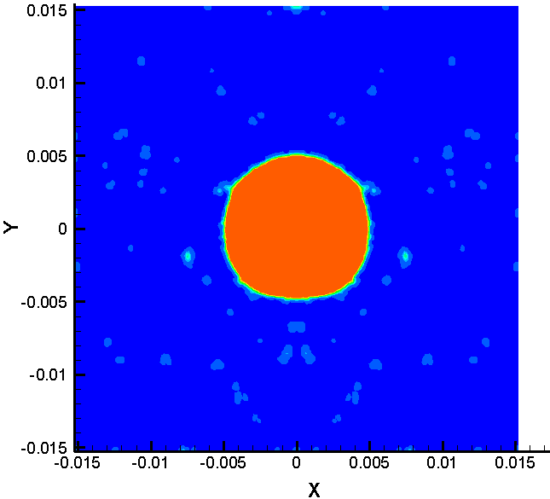
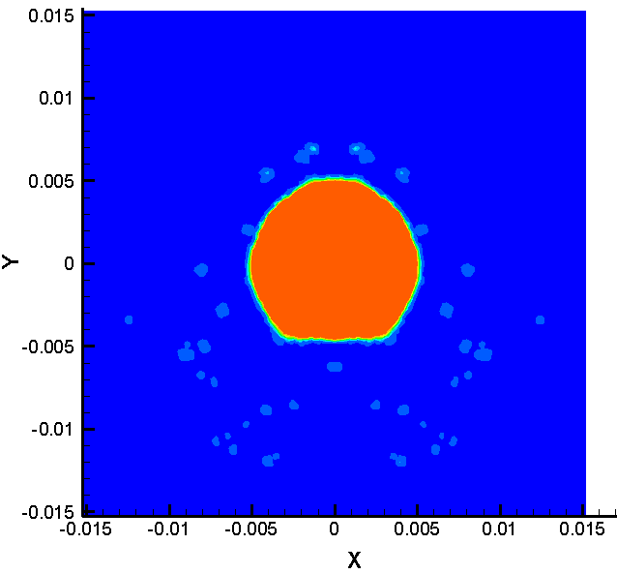
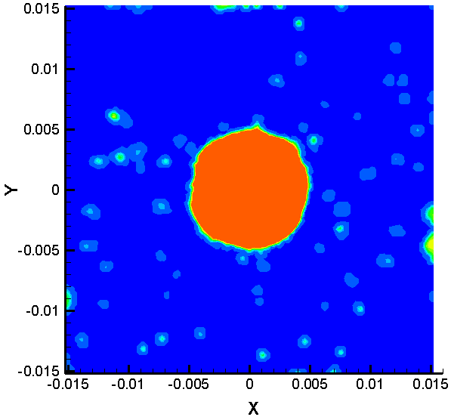
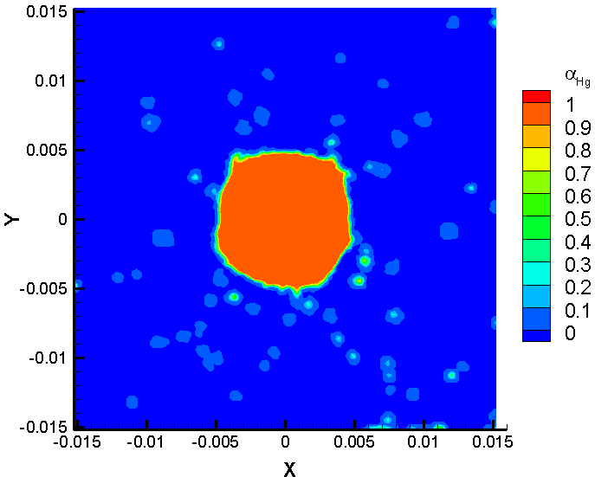
Two 3D Hg Jet Simulations
(a)
z = 30 cm
(b)
z = 45 cm
Case 1
(c)
(d)
Case 2
Results of α_{Hg} of (a) case 1 at z = 30 cm, (b) case 1 at z = 45 cm
(c) case 2 at z = 30 cm, and (d) case 2 at z = 45 cm.

Slide 4
Ellipse Fitting
Ellipticity = major axis / minor axis = a / b
 | a | b | θ | xc | yc | ellipticity
Case 1 at z = 30 cm | 0.0051972 | 0.0050006 | 0 | -9.2935e-07 | 4.3514e-05 | 1.038
Case 1 at z = 45 cm | 0.0051418 | 0.0050082 | 0 | -2.8877e-07 | 3.9837e-05 | 1.027
Case 2 at z = 30 cm | 0.0051095 | 0.0049845 | -26.248° | -2.5908e-05 | 1.8698e-05 | 1.025
Case 2 at z = 45 cm | 0.0051969 | 0.0050490 | 13.165° | -5.2749e-05 | 2.0298e-05 | 1.030
Note: (xc,yc) is the ellipse center, case1: Outlet of the pipe without a bend and a weld, and case2: Outlet of the pipe with 90°/90° bend and 30° weld.
a
y
y
b
a
b
θ
x
θ
x

