Slide 1



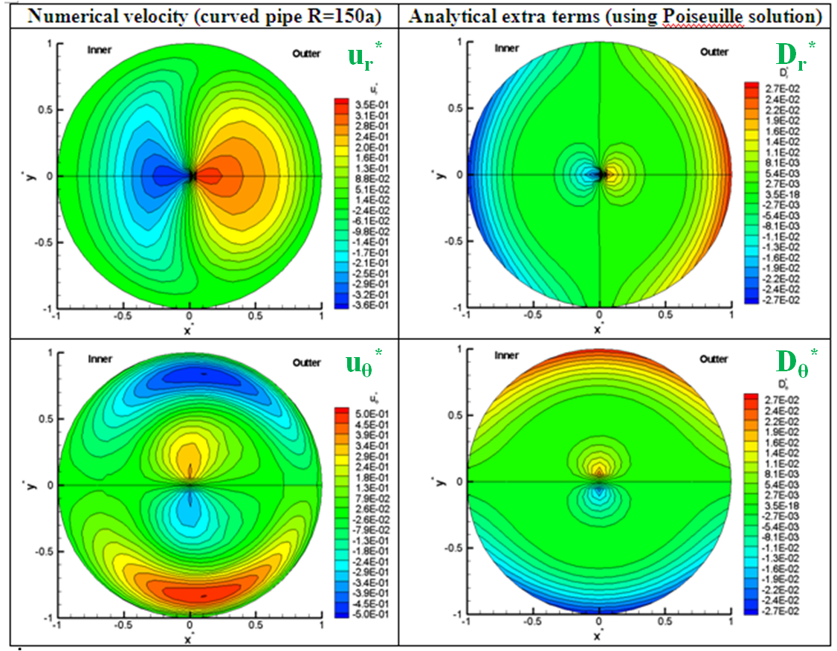
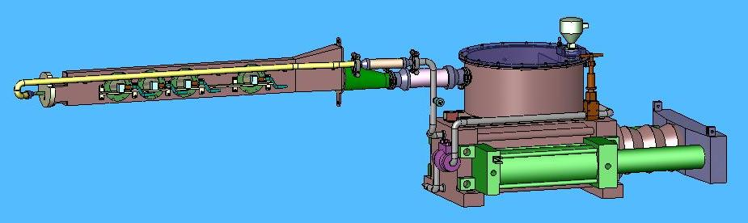
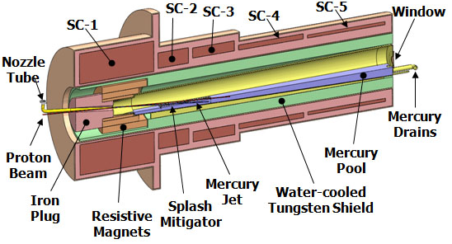
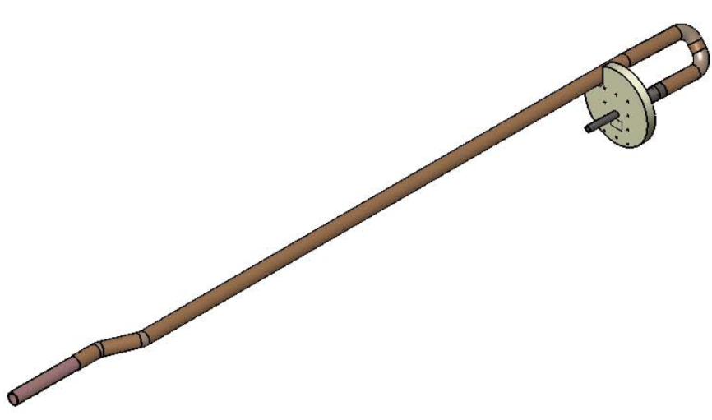
The Effects of Geometrical Configurations on
Curved Pipe Flow for Muon Collider Project
Yan Zhan (SBU), F. Ladeinde (SBU), H. Kirk (BNL), K. McDonald (Princeton University)
Annual Student Research Poster Symposium May 4, 2011
,
,
Department of Mechanical Engineering
College of Engineering and Applied Sciences (CEAS)
Abstract
Analytical Analysis for Laminar Curved Pipe Flow
Discussions
Liquid mercury has been investigated as a potential high-Z target for the Muon Collider project. The objective of this part of the project is to develop a target delivery system that results in the least turbulent flow conditions at the exit of the nozzle. In the present work, several curved pipe configurations have been studied, in which we examined the dynamics of flow in those configurations using theoretical analysis and fluid flow modeling. Steady turbulent flows have been studied for 0°/0°, 30°/30°, 60°/60°, and 90°/90° elbow combinations, using several turbulent models, and comparing the results with experimental data for some of the cases. The generation of vorticity by pipe curvature is critically examined and is reported for the various pipe configurations.
Extra Terms for Laminar Curved Pipe Flow
Extra terms in the θ momentum
Extra terms in the z momentum
Extra terms in the r momentum
Momentum Thickness at the Pipe Exit
(e)
Fig. 2 Assessment of extra terms^{[2][3]}
Fig.7 Comparison of momentum thickness at the pipe exit
(a) 0⁰/0⁰ (b) 30⁰/30⁰ (c) 60⁰/60⁰
(d) 90⁰/90⁰ (e) Planes defined at the exit
Red: without nozzle;
Blue: with nozzle.
Numerical Analysis for Turbulent Curved Pipe Flow (Hg)
Turbulence Models Comparison^{[4]}
(b)
Turbulence Intensity at the Pipe Exit
(a)
Inlet
(a)
(b)
Introduction and Motivation
n_{φ} =75 (dφ=1.2⁰)
n’=375
Target delivery system requires a 90⁰/90⁰ elbow combination for the Hg supply and return
Mercury jet exhausts into vacumm/air
High energy beam interacts with Hg jet
The whole system in the high magnetic field
n=150
Outlet
Fig. 3 (a) Mesh for the 90⁰ test pipe (cross-sectional mesh: n_{r} × n_{θ} =152×64) (b) Longitudinal distribution of static pressure at the inner, outer and bottom of the pipe
(a)
(b)
Solutions for Mercury Flow in Curved Pipe without Nozzle
Fig.8 Turbulence intensity distribution comparison at the pipe exit
(a) Along the horizontal plane (b) Along the vertical plane
(a)
(b)
Merits and Impacts
Turbulent flow conditions are analyzed at the exit of the mercury target supply pipe. The results show :
Realizable k-e turbulence model is able to simulate turbulent mercury flow in curved pipe.
Bend effects: Bigger θ_{t} near the inner side of the curved pipe, which is even obvious in the 90⁰/90⁰ pipe; the 90⁰/90⁰ pipe has advantages of symmetry I.
Nozzle effects: Nozzle decreases θ_{t}, uniforms θ_{t} and reduces I.
(c)
Fig. 1 (a) Mercury delivery system at CERN (b) Concept of a 4-MW target station based on a free mercury jet inside at 20-T solenoid ^{[1]} (c) Mercury supply piping (long curved pipe)
Overall Objects and Procedures
Fig. 4 (a) Geometry of pipes without nozzle in varying angles (φ: 0⁰, 30⁰, 60⁰, 90⁰) (b) Stream-wise velocity and velocity vector plots (φ=60⁰, inner: left, outer: right)
Investigate the fluid dynamics of a liquid Hg target for the Muon Collider Accelerator Project:
Dynamics of the Hg flow in a curved pipe
Effect of magnetic field on Hg pipe flow (MHD)
Hg exhaust jet flow
Effect of magnetic field on jet flow
Effect of high energy deposition on jet flow
Combined effects of magnetic field and high energy deposition on Hg jet flow
Procedures to study Hg flow in a curved pipe:
Analytical analysis for laminar curved pipe flow
Numerical solution for turbulent flow in curved pipe without/with nozzle
Solutions for Mercury Flow in Curved Pipe with Nozzle
Acknowledgement
(a)
(b)
Thanks to the guide from my advisors and the help from the Muon Collider Project group (BNL, CERN, OAK Ridge National Lab, etc)
References
[1]. H.G. Kirk, X. Ding, V.B. Graves,K.T. McDonald, F. Ladeinde, Y. Zhan, J. Back, 2010. A 4-MW Tagert Station for A Muon Collider or Neutrino Factory, Proceedings of IPAC, Kyoto, Japan
[2] Dean, W. R. 1927. Note on the motion of fluid in a curved pipe. Phil. Mag. 4, 208-223
[3] Y. Zhan, F. Ladeinde, H.G. Kirk, K.T. McDonald, 2010. The dynamics of mercury flow in a curved pipe, 63rd annual meeting of the APS Division of Fluid Dynamics, Vol. 55, No. 16
[4] K. Sudo, M. Sumida, H. Hibara, 1998. Experimental investigation on turbulent flow in a circular-sectioned 90-degrees bend, Experiments in Fluids. 25, 42-49.
Fig.5 (a) Geometry of pipes with nozzle in varying angles (φ: 0⁰, 30⁰, 60⁰, 90⁰) (b) Stream-wise velocity and velocity vector plots (φ=60⁰, inner: left, outer: right)
Assessment of Static Pressure Through the Bernoulli’s Law
Fig. 6 Static pressure Contour
for the 90⁰/90⁰ pipe (assume smooth pipe, then the friction loss =zero)

