Slide 1
Tests Using
The “Little Wire Test” Equipment
(Apr. 4, 2013)
J. R. J. Bennett¹, G. Skoro¹⁽²⁾, P. Loveridge¹, A. Ahmad²
Fatigue Life of Tungsten at High Temperatures and High Strain Rates.
Fatigue Life of Tungsten at High Temperatures and Low Strain Rates (quasi-static).
Emissivity of Tungsten and Surface Roughness
Oxidation of Tungsten at High Temperatures
¹ Rutherford Appleton Laboratory, Chilton, Didcot, Oxon, OX11 0QX
² Department of Physics and Astronomy, Sheffield University, Sheffield, S3 7RH

Slide 2
  Schematic diagram of “The Little Wire”
ceramic insulator
outer conductor
graphite jaws
viewing apertures
springs
to
pulsed
power
supply
test wire
cap
inner conductor
chuck
fixed end
free end
laser Doppler vibrometer

Slide 3
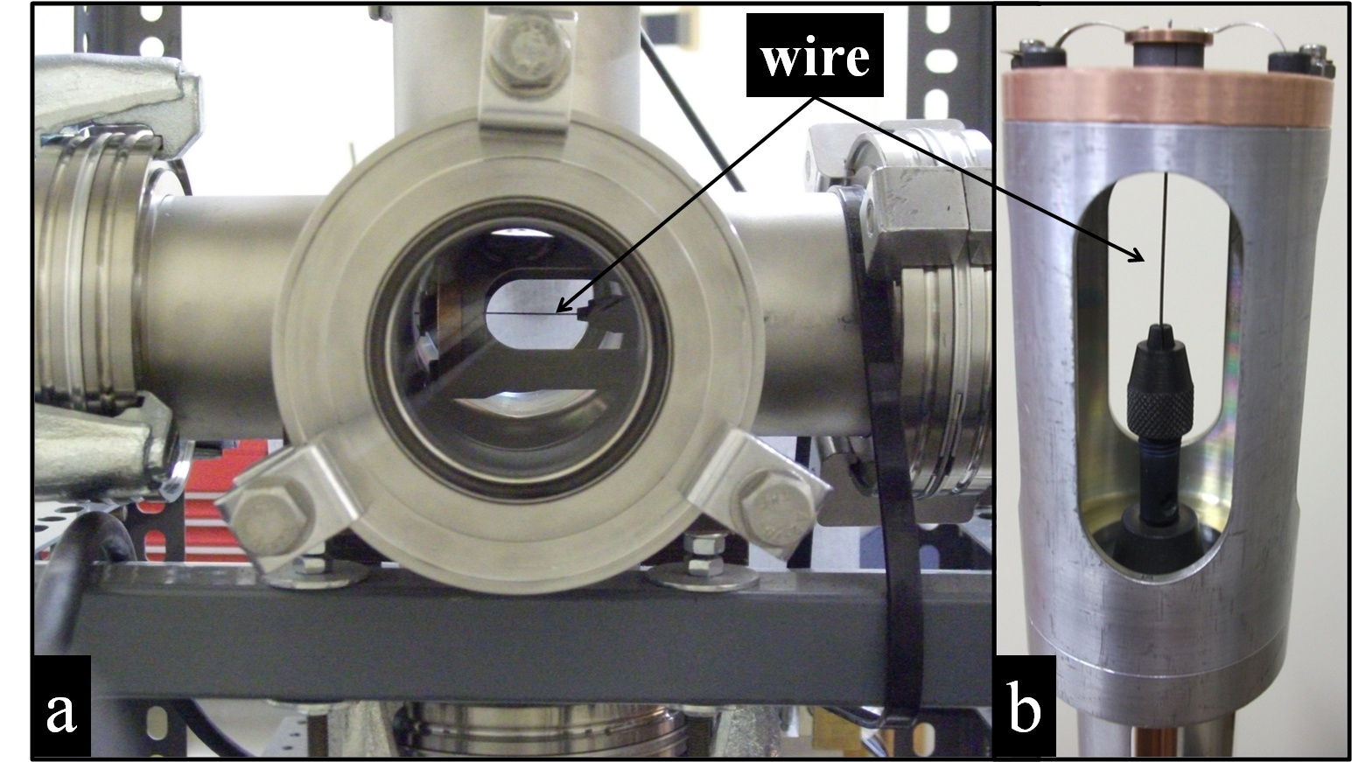
  “The Little Wire” Equipment

Slide 4
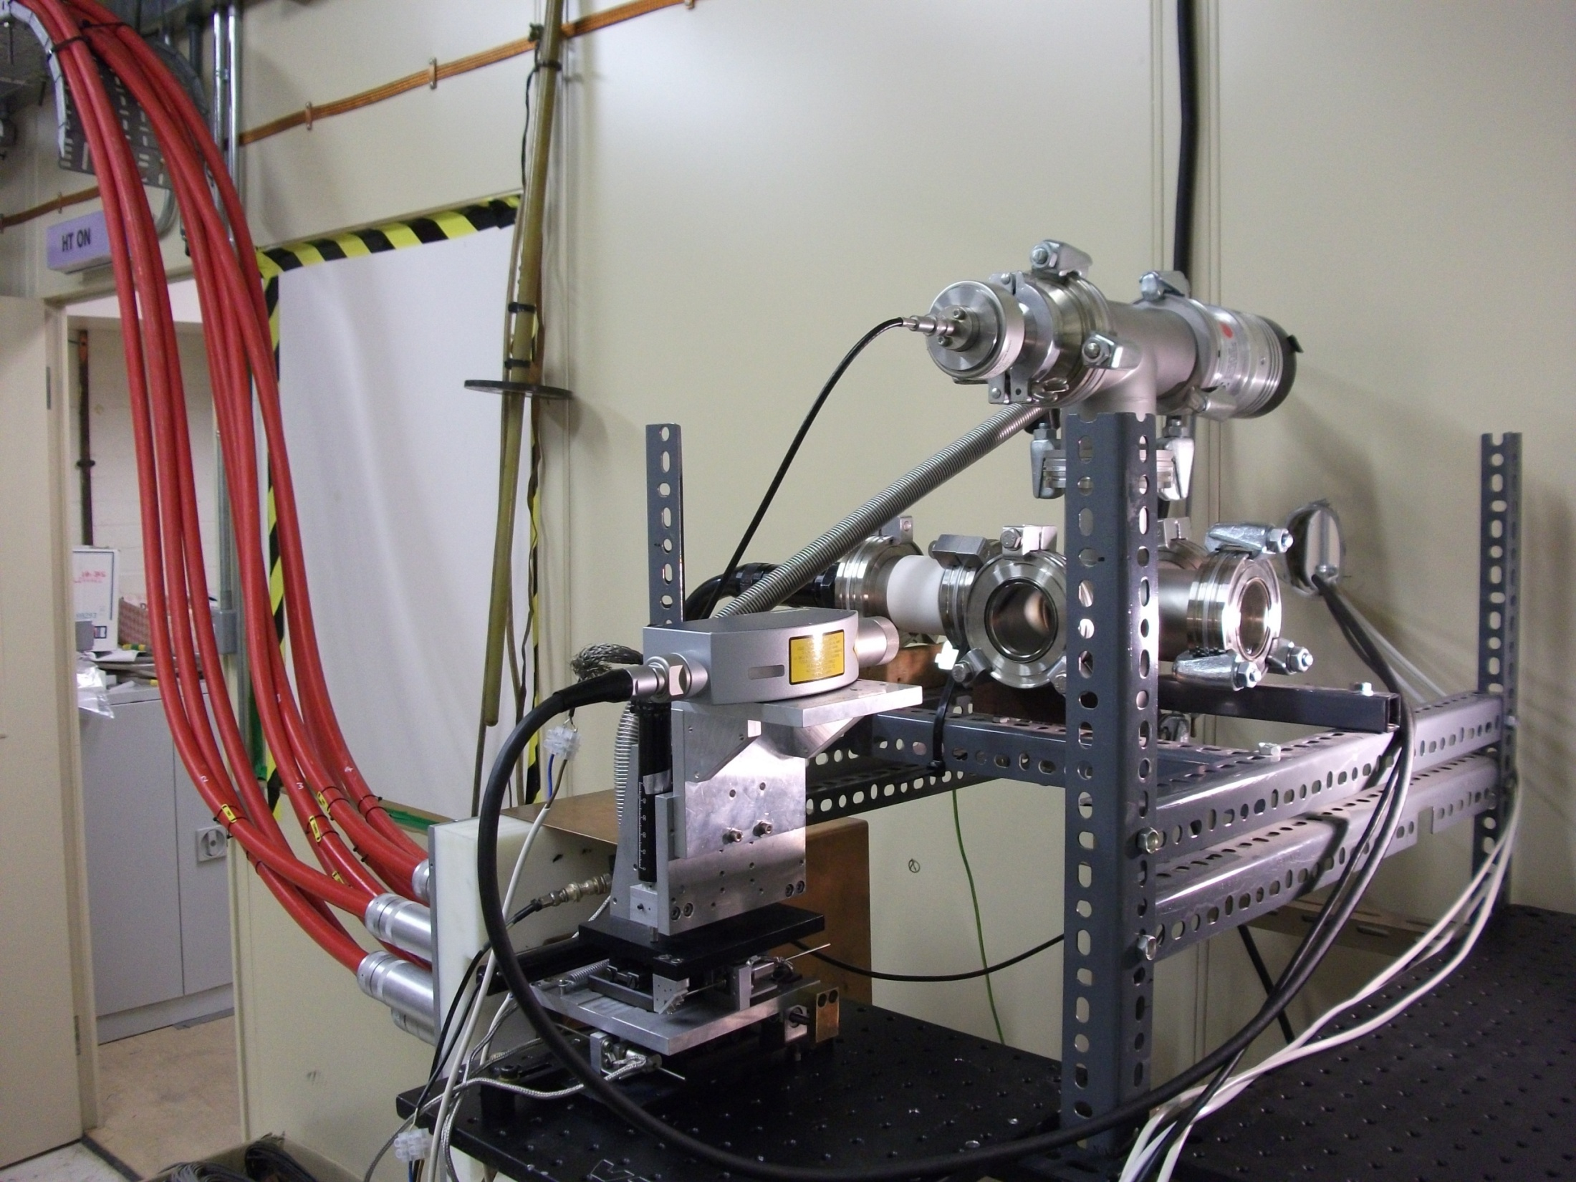
LDV = Laser Doppler Vibrometer
Vacuum chamber
LDV
Coaxial cables (current from power supply)

Slide 5
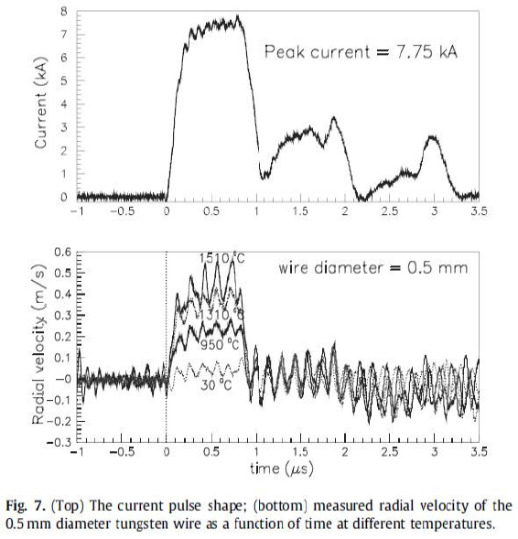
Operating Principle
Magnitude and frequency of wire oscillations measured using LDV
  Characteristic frequency gives a direct measure of the material Elastic Modulus
  Induced dynamic stress is calculated via LS-DYNA simulation and verified by cross-comparison with measured surface velocities
G.P. Skoro et al. / Journal of Nuclear Materials 409 (2011) 40-46

Slide 6
Why High Strain-Rate Measurements?
The main issue for beam-facing materials used in target systems (targets, beam windows, beam dumps, containment vessels, etc.) is the magnitude and the rate of change of deposited energy density (J/cc).
In a regime where beam pulse length is short compared to characteristic expansion times and thermal conduction timescales we can make the following simplifications:
ΔT≈E_{den}/ρ.Cp Thermal Stress ≈ α.E.ΔT
With increasing beam power, and decreasing pulse length, the estimate of material strength and corresponding lifetime based on simple, quasi-static equations is no longer accurate.
In these cases the materials respond dynamically and they behave differently than under quasi-static loading. In order to address this problem the fundamental material properties and corresponding strength have to be measured under dynamic conditions.

Slide 7
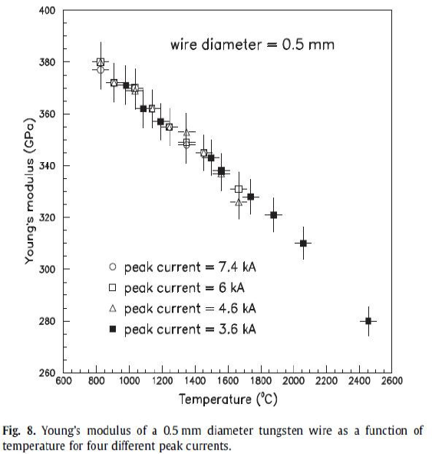
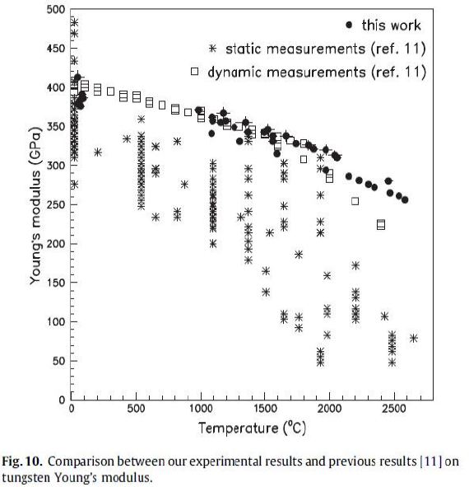
Dynamic Young’s Modulus of Tungsten
G.P. Skoro et al. / Journal of Nuclear Materials 409 (2011) 40-46

Slide 8
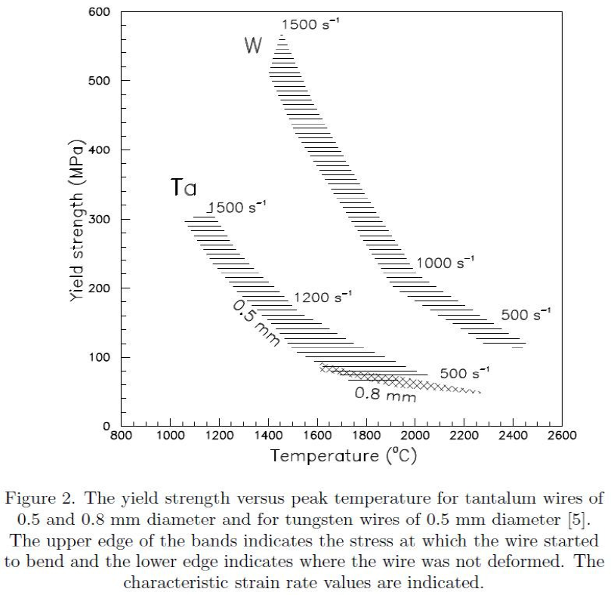
Yield Strength Measurements
J.R.J. Bennett et al., Nucl. Instr. And Meth. A (2011), doi:10.1016/j.nima.2011.03.036

Slide 9
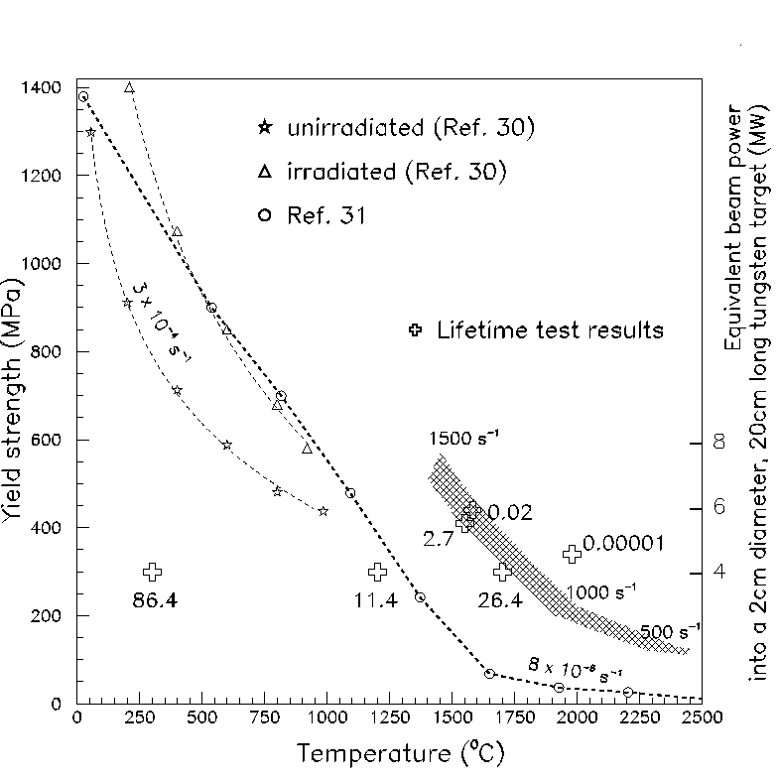
Lifetime Evaluation (Cycles to failure)
Strength of Tungsten versus Temperature
and
Lifetime,
in Millions of Pulses
Strain rates shown in s⁻¹.

Slide 10
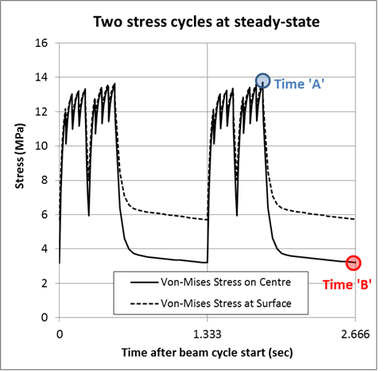
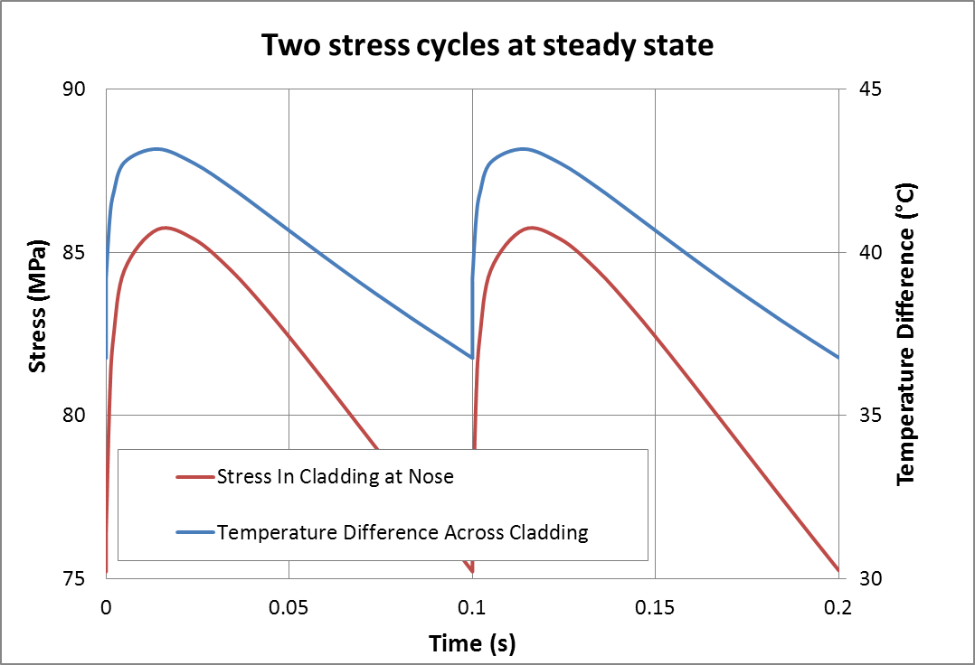
Why Low Strain-Rate Measurements?
In some target applications the rate of change of stress and Strain are ‘low’.
i.e. we have a ‘quasi-static’ state of stress:
e.g. Proposed Mu2e Target:
Unusually long (~50 msec) beam spills give rise to quasi-static cycles
e.g. ISIS target Cladding:
Stresses rise and fall between pulses on the timescale of thermal conduction

Slide 11
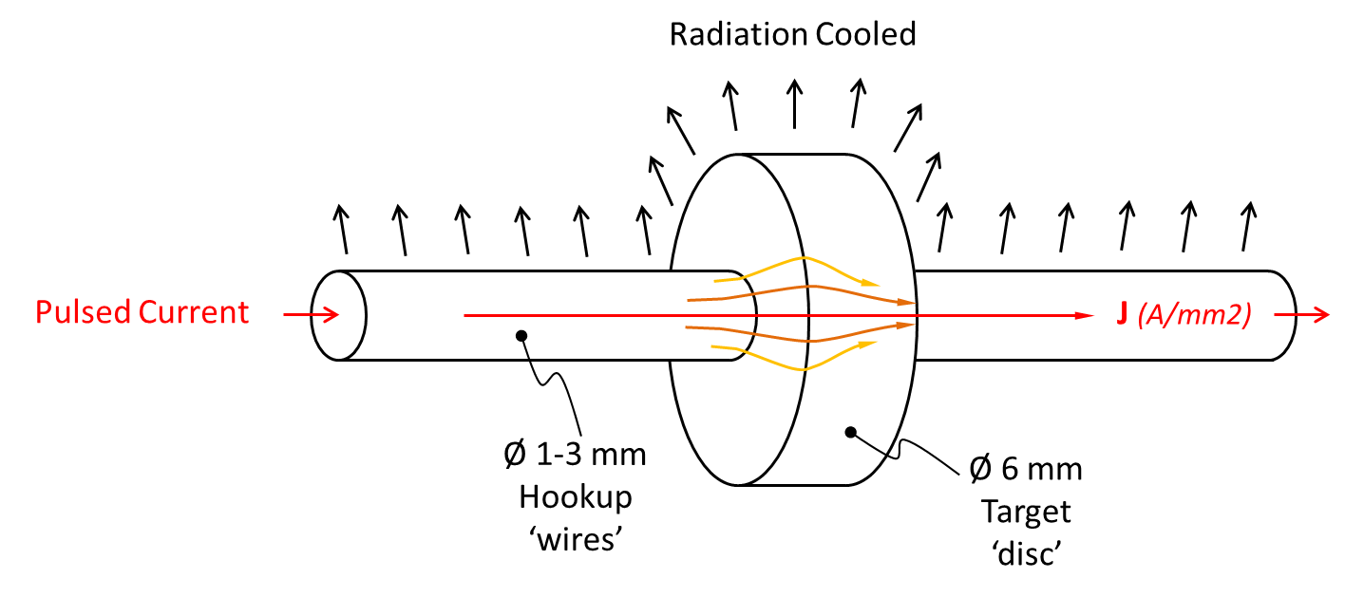
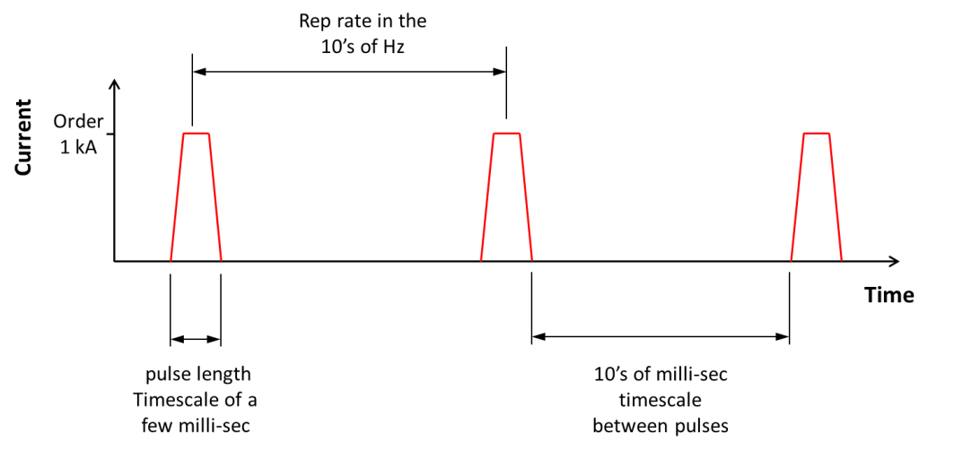
Low Strain Rate Tests in the Little-Wire Test Rig
Operating Principle:
Use resistive (Joule) heating from an electric current pulse to preferentially heat the centre of a disk
Pulse length long enough to give ‘static’ stress field
(do not want inertial stresses)
Inter pulse gap long enough for transient stress component to decay
(on the timescale of thermal conduction)
Rep rate of 10’s of Hz
(to allow accelerated testing of target lifetime cycles)

Slide 12
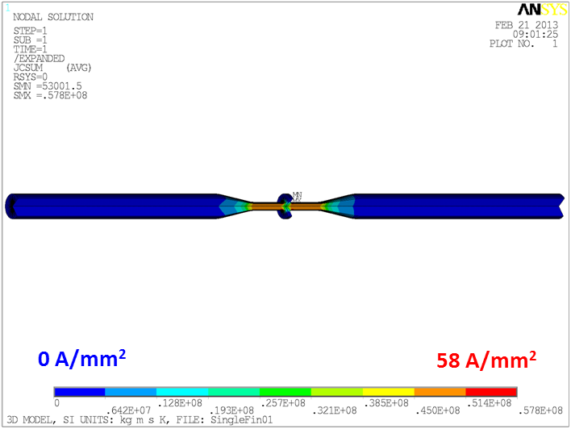
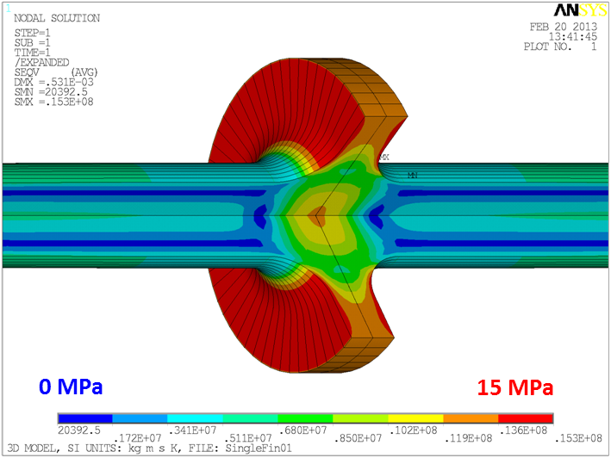
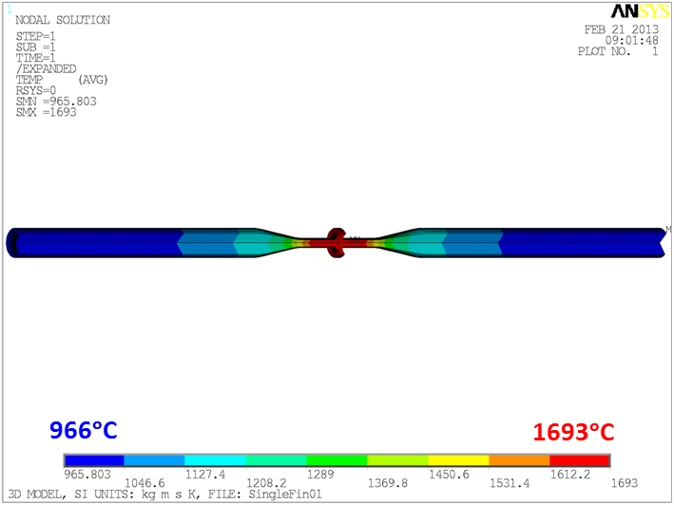
Sample Geometry Concept
D.C. Current Distribution
Example: Mu2e Target Test
  Machine features into a 6mm diameter 160mm long tungsten bar
  i.e. this is a ‘full size’ test
  Means we can test the stock material / surface treatment that we intend to use for the real target!
160A D.C - equivalent heating to
1.6kA 1msec pulses @20 Hz
Volumetric Joule heating (J²ρ) mostly occurs over this length
Steady-State Von-Mises Stress Field
Steady-State Temperature
Tension
Q_{rad} ~ 200W
Compression

Slide 13
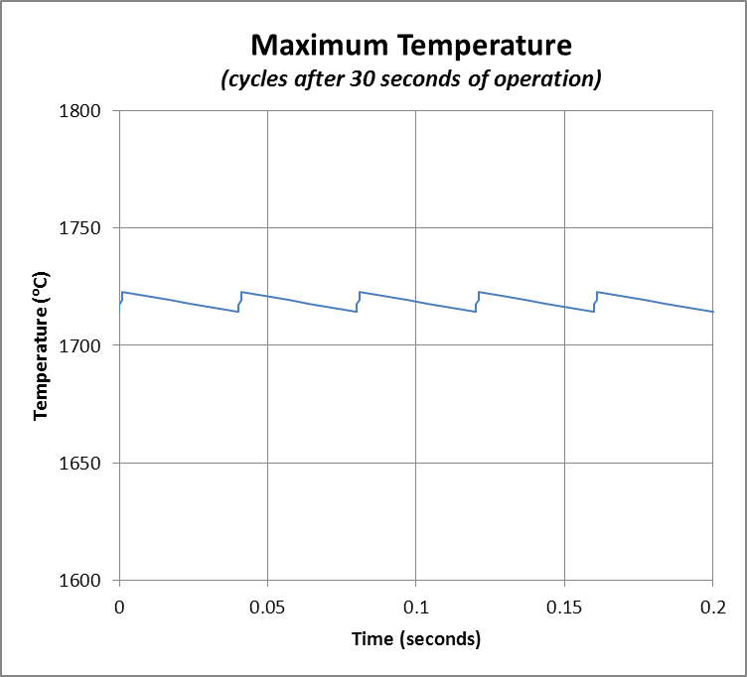
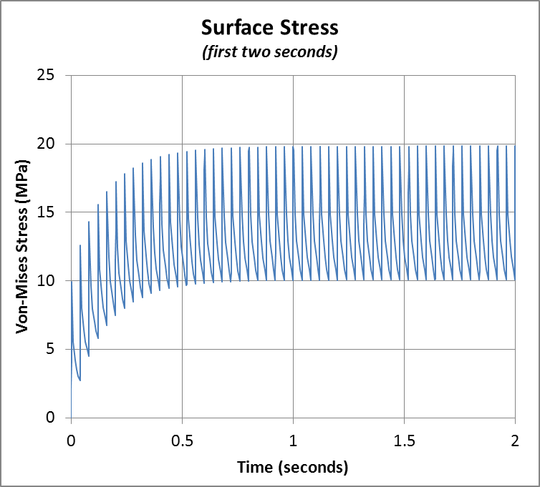
Tuneable Temperature and Stress Cycles
Can tune the sample geometry to achieve representative temperature and stress cycles for a given application
Can fine tune the stress cycle and operating temperature online by varying the peak current and rep rate.
Example: Temperature and stress cycles in the proposed Mu2e test specimen
(1.6 kA, 1 msec half sine-wave current pulses @ 25Hz)
Tuned to match the target operating conditions

Slide 14
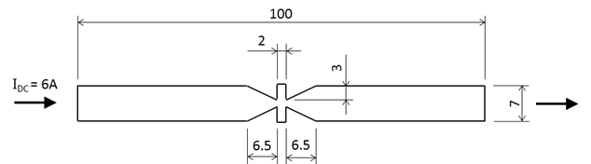
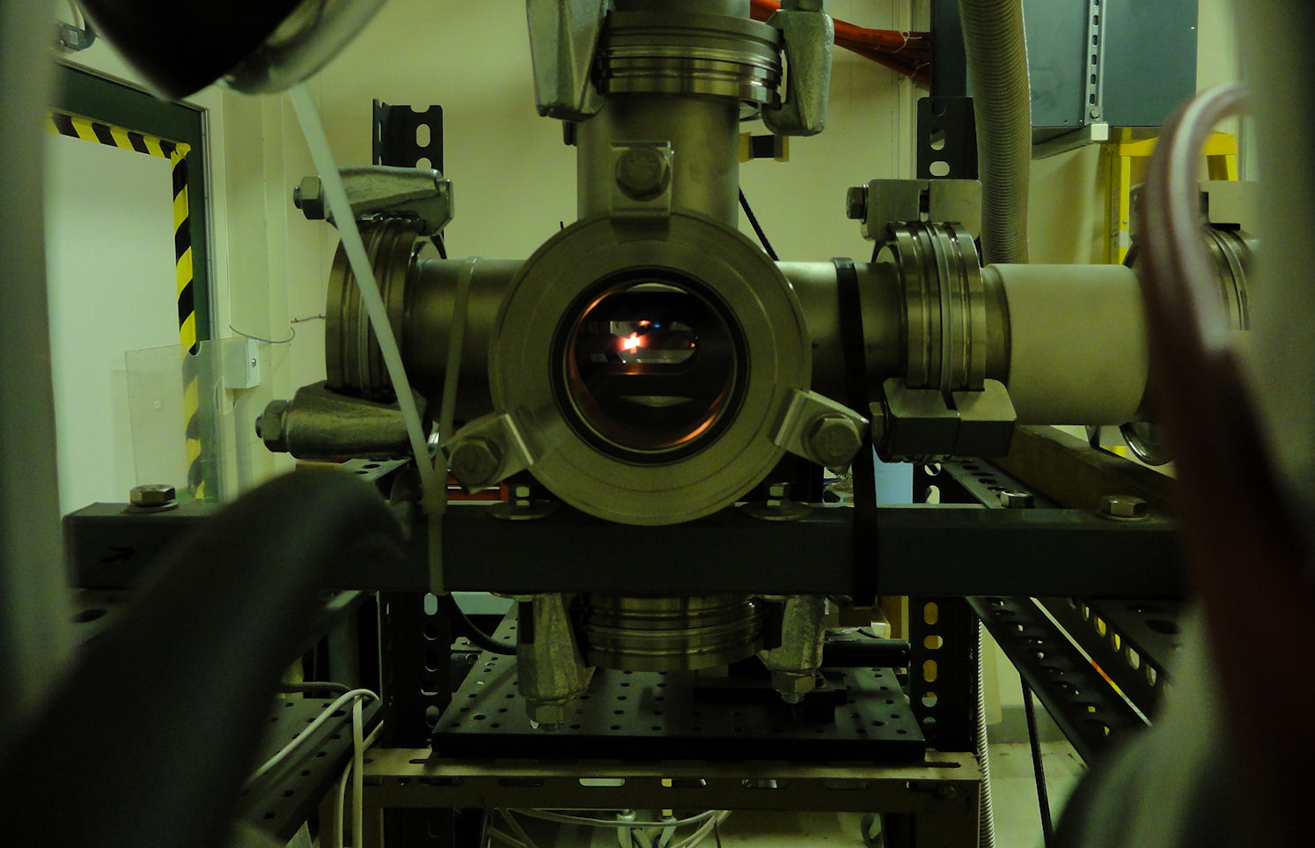
First Tests Using Tantalum Foil
‘2D version’ of the proposed Mu2e test piece
25 μm tantalum foil
1×10⁻⁵ mbar vacuum
DC Current = 6.0 A
Specimen Dimensions (mm)
960 ⁰C
1120 ⁰C
Temperature Measurements
Experimental Setup

Slide 15
Thermal Emissivity and Surface Roughness
The surface roughness alters the emissivity. Measure the emissivity and roughen the surface - with abrasives – cut groves in the surface – etc.
Tungsten tube with a small hole drilled in one side.
(rolled sheet or machine from solid)
Look with optical pyrometer,
Compare outer surface to tube interior (~black body)
D.C. current
Place thermocouple inside for cross-check (optional)
Use an Optical Pyrometer to:
  Measure black body temperature by looking through the hole – T_{bb}
  Measure surface temperature – T_{s}
ε = T_{s}/T_{bb}

Slide 16
Oxidation
Tungsten must be in an inert atmosphere or vacuum to avoid chemical oxidation when hot.
We need to know the maximum vacuum pressure at which the hot tungsten will have a long life.
There are measurements in the literature, - but if they are insufficient we will make our own in the measurements in the “little wire test equipment”.
Pressure gauge
QMA
Leak valve
To high vacuum pump
oxygen, air or water
Hot wire or foil
Schematic diagram of the system

Slide 17
Summary of the “Little Wire Test” Equipment
The equipment is ideally suited to measuring the ultimate strength of materials at very high temperatures at all strain rates.
It has been used to determine the properties of tungsten at high strain-rate :
Lifetime (cycles to failure) as a function of stress and temperature.
Strength as a function of temperature.
Young’s modulus of elasticity as a function of temperature.
It is easily adaptable to a variety of other measurements:
Lifetime evaluation at low strain-rate
Emissivity measurements
Oxidation Lifetime studies

