Slide 1
Experimental targetry at CERN
Adrian Fabich
Transformative Hadron Beamlines Workshop
BNL, 21.-23. July 2014

Slide 2
Overview
Test objects: TARGET = OBSTACLE
  interacting with the beam resulting in energy deposition:
  material damage, material vaporisation, thermal management, radiation damage, beam induced pressure waves, thermal shock
  Benchmarking for simulations, material properties
  Prototyping
  “Thick” targets:
    Production targets
    Collimators
    Accidental exposures of beam elements (e.g. magnets)
  “Thin” targets
    Beam measurement – detectors and monitors
      Also off-beam-axis in parasitic mode (e.g. BLMs)
    Vacuum windows/pipes
    Collimators (bending crystals)
Location of target tests? Parasitic or dedicated?

Slide 3
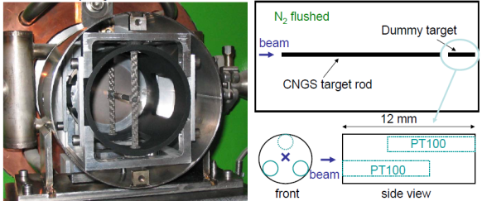
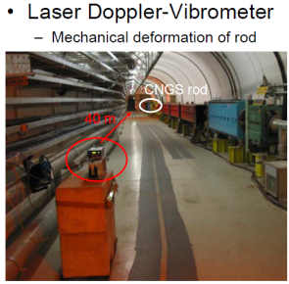
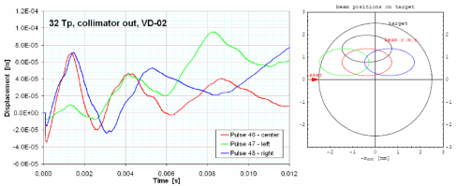
CNGS target
Ad-hoc setup in LHC transfer line (2004)

Slide 4
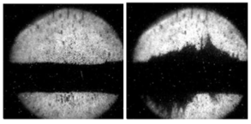
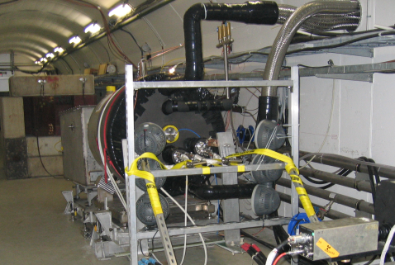
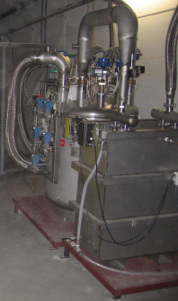
MERIT – mercury target test
Temporary use of nToF primary line
Required installation of all infrastructure
BNL, Princeton, ORNL, CERN, FNAL, RAL, MIT …

Slide 5
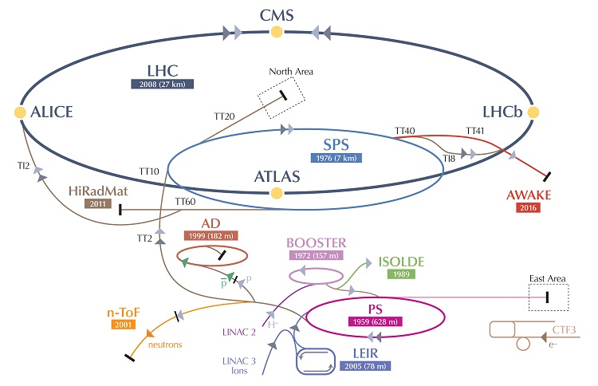
HiRadMat
High-Radiation To Materials http://cern.ch/hiradmat
Dedicated test facility
Protons 440 GeV, also ions possible
  In the higher range for production targets
  With the small focus a higher pulse intensity can be simulated in terms of peak energy deposition.
Maximum 5*10¹³ protons per pulse
Tests with single pulses; HiRadMat is not an irradiation facility
  Limited to ~10¹⁶ protons/year
  Reduces residual radio-activity for manipulation
Destructive tests possible as decoupled from accelerator machine/vacuum.

Slide 6
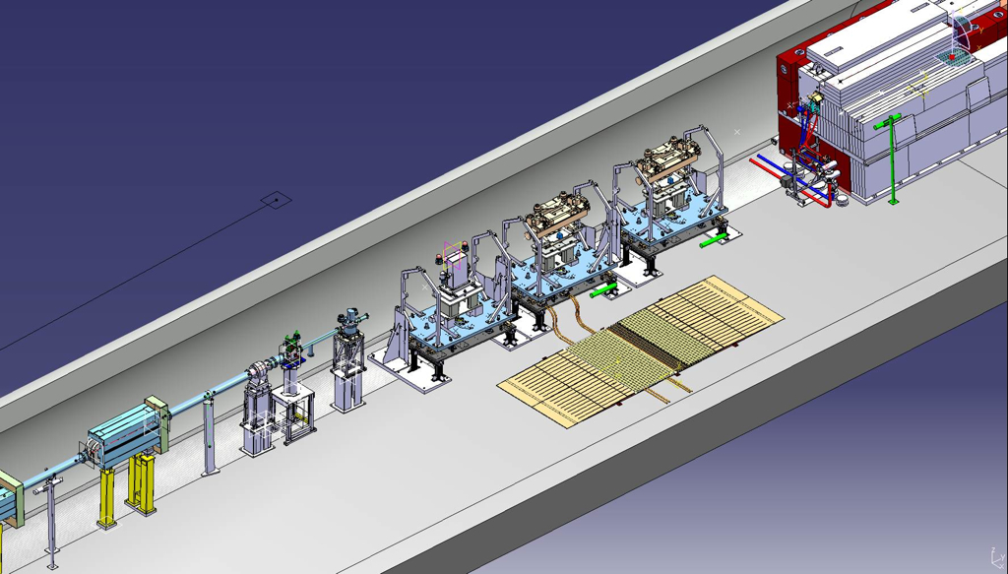
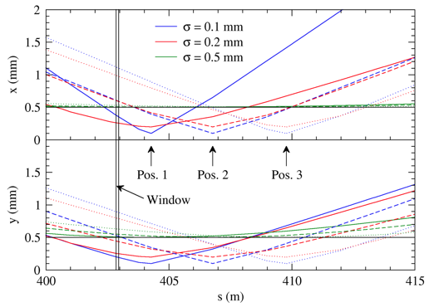
Layout Experimental Area
3 test stands for experiments
- Remote installation of normed support tables
- Standard connections for general infrastructure

Slide 7
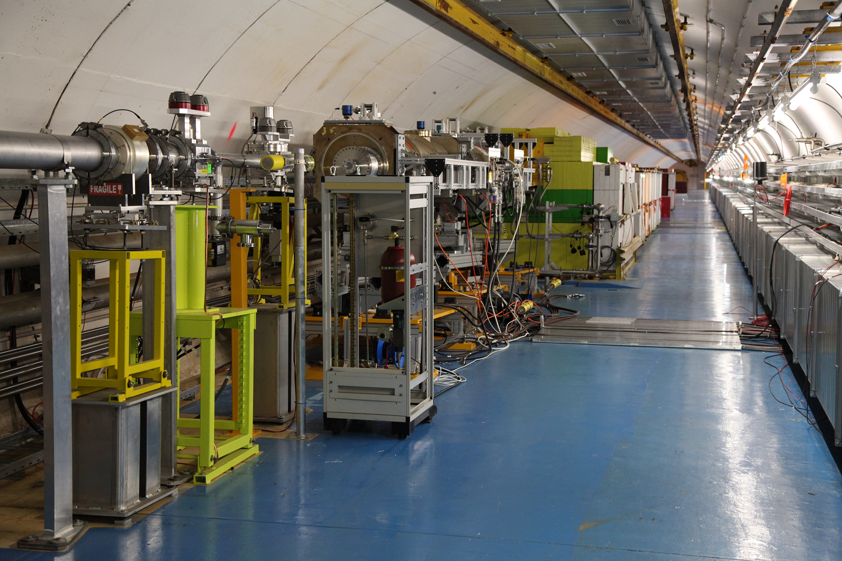
Target area
Experimental setup
beam
Beam monitors
Cool-down zone
dump

Slide 8
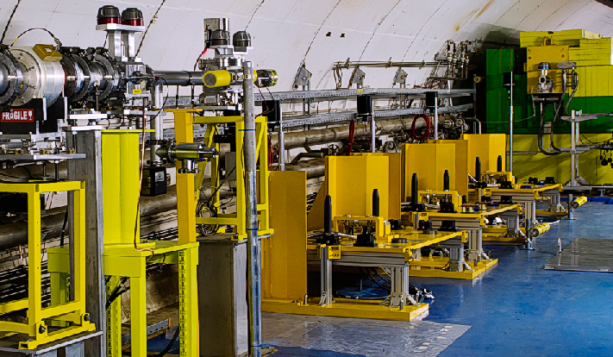
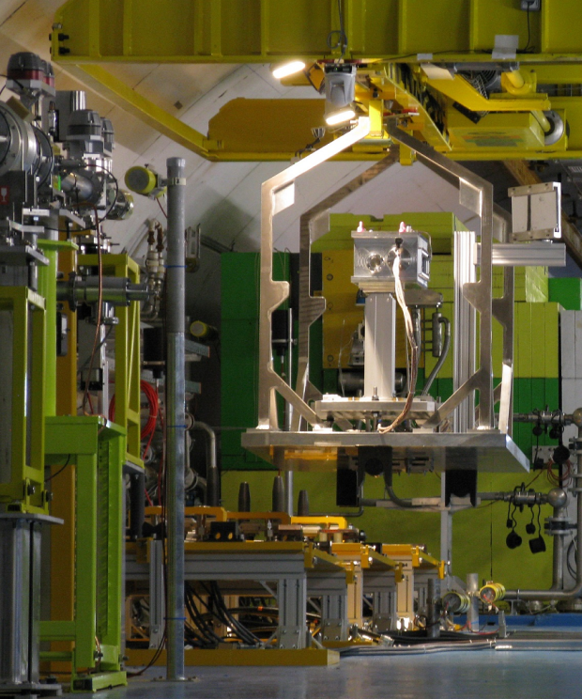
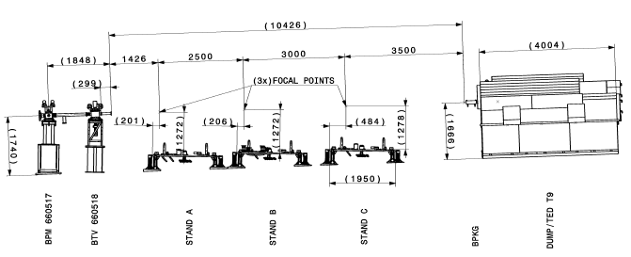
Remote handling
Equipped with automatic connections
  Signals
  Power
  Water

Slide 9
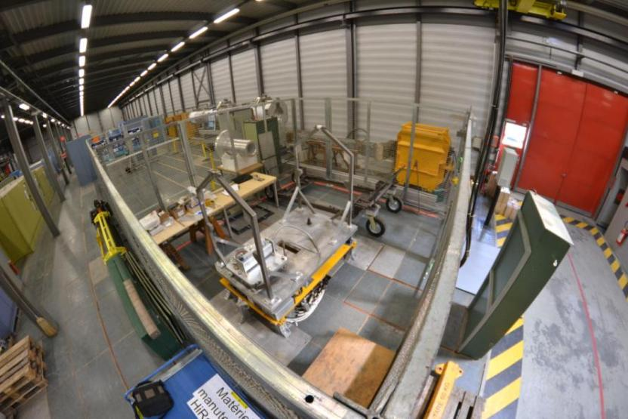
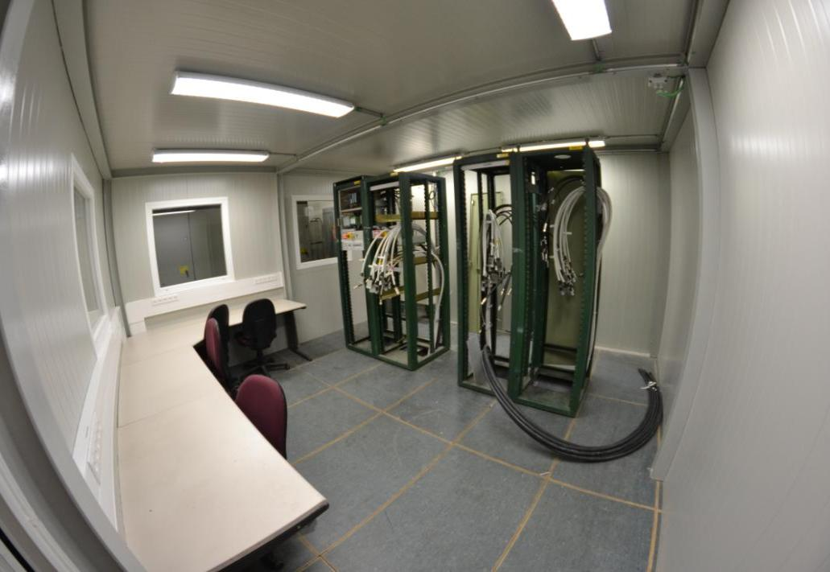
Facility services
Provision of dedicated irradiation infrastructure
Preparation lab at surface
  Same interfaces as in the tunnel
Control room
Irradiation position
  Standardized installation (remote)
  General supplies (water, electricity,
  cabling from the control room)
  Beam monitoring
Observation tools
  Camera, LDV, BLMs (diamond)
Application/logistics/installation at CERN
Safety Advice
Surface lab
Control room

Slide 10
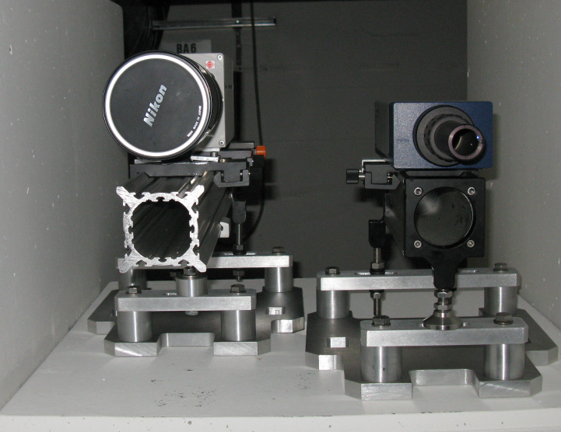
Measurement tools
With the expertise of various groups at CERN
Laser-Doppler vibrometer
  Measuring surface velocities of several m/s
  tens of MHz sampling
Optical high-speed recording
  High-speed camera with several kHz frame rate
Diamond detectors, strain gauges, temperature sensors, microphones …
Transverse beam monitoring
  High precision (< 0.1 mm) alignment to experimental tables
  Based on pCVD diamond detectors
Fast camera LDV
LDV

Slide 11
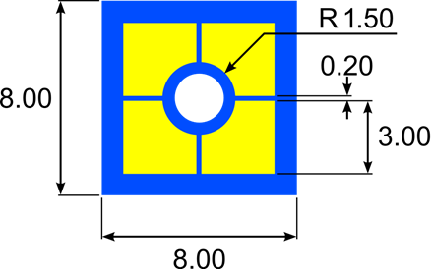
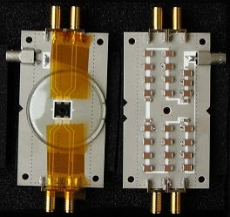
Beam monitoring
Beam parameters to be measured at the test object
Using diamond detectors on beam halo
Requirements:
  Online measurement
  Single bunch resolution
  0.1 mm transverse beam position
    precision at experiment
  Beam sigma measurement
  Full intensity range (up to 10¹⁴ p⁺/pulse)
Au electrode
diamond

Slide 12
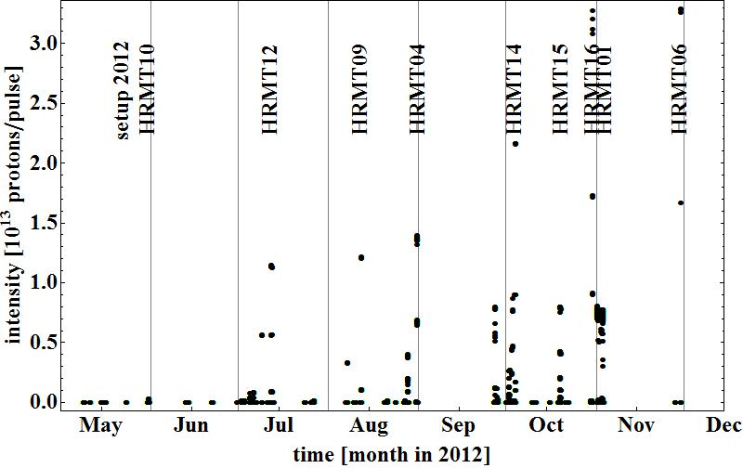
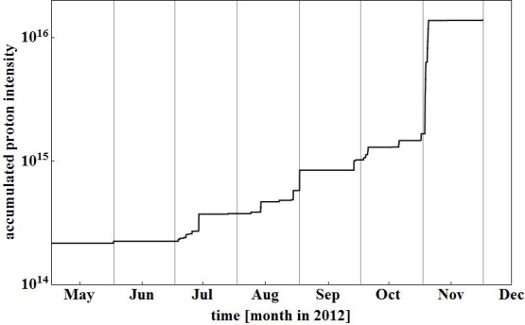
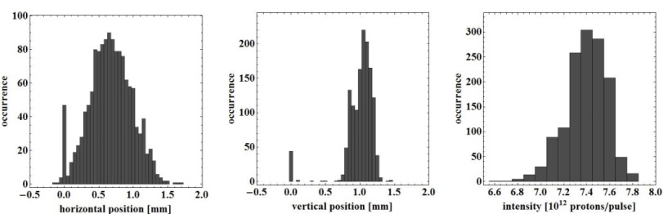
Start-up 2011/2012
2011: commissioning (project leader I. Efthymiopoulos)
2012: first year of operations
  9 experiments completed successfully
  On average every 4 weeks
  1.4*10¹⁶ pot
2012: only 48 hours of SPS cycling with destination HiRadMat

Slide 13
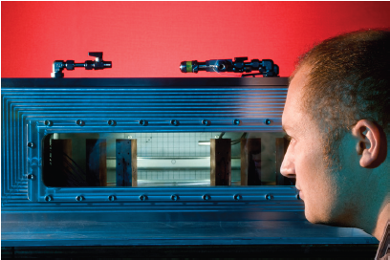
Experiments in 2012
​RIB target R&D
LHC transfer collimator (2x)
BLM validation
RP benchmarking
Crystal collimation
See http://cern.ch/hiradmat for links
Powder target
(HRMT10)
RAL
C. Densham

Slide 14
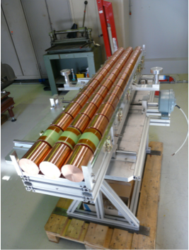
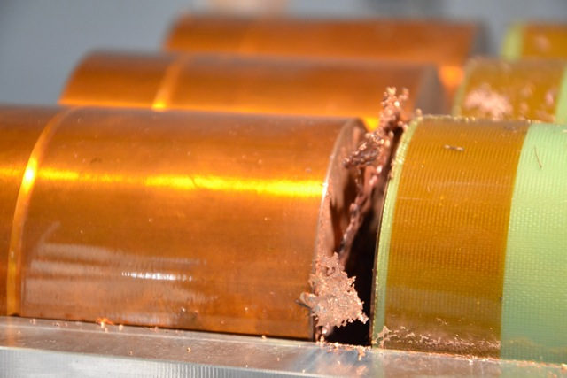
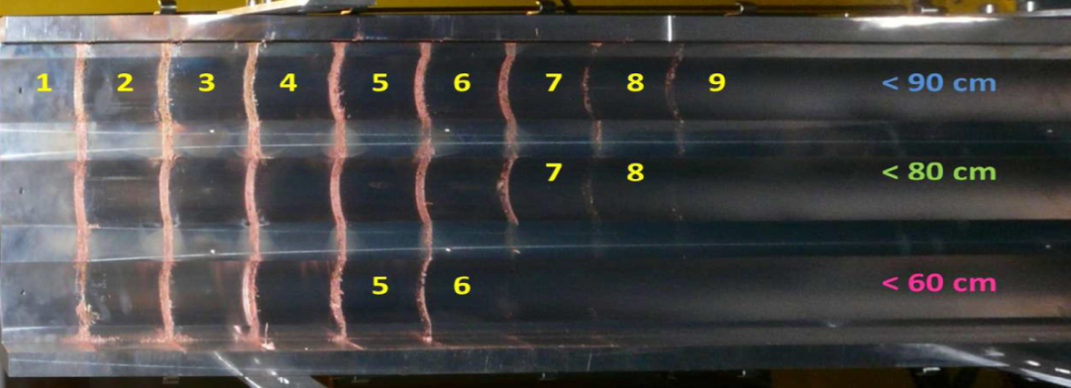
Material tests
Beam tunnelling
(HRMT12)
TE/MPE
R. Schmidt

Slide 15
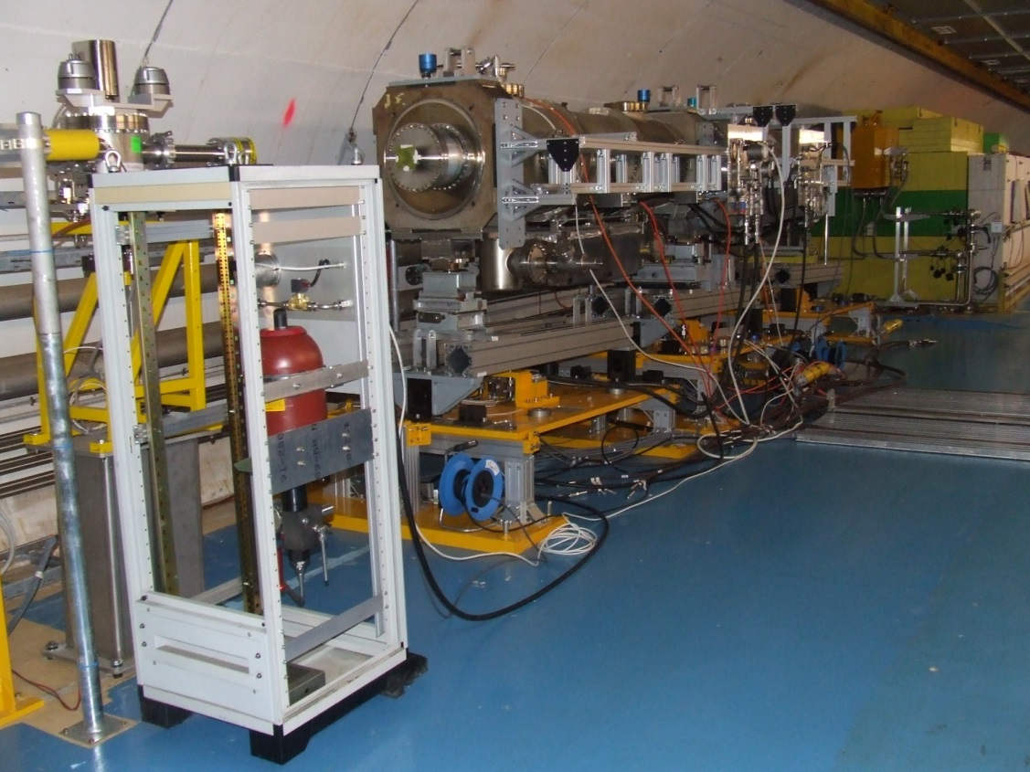
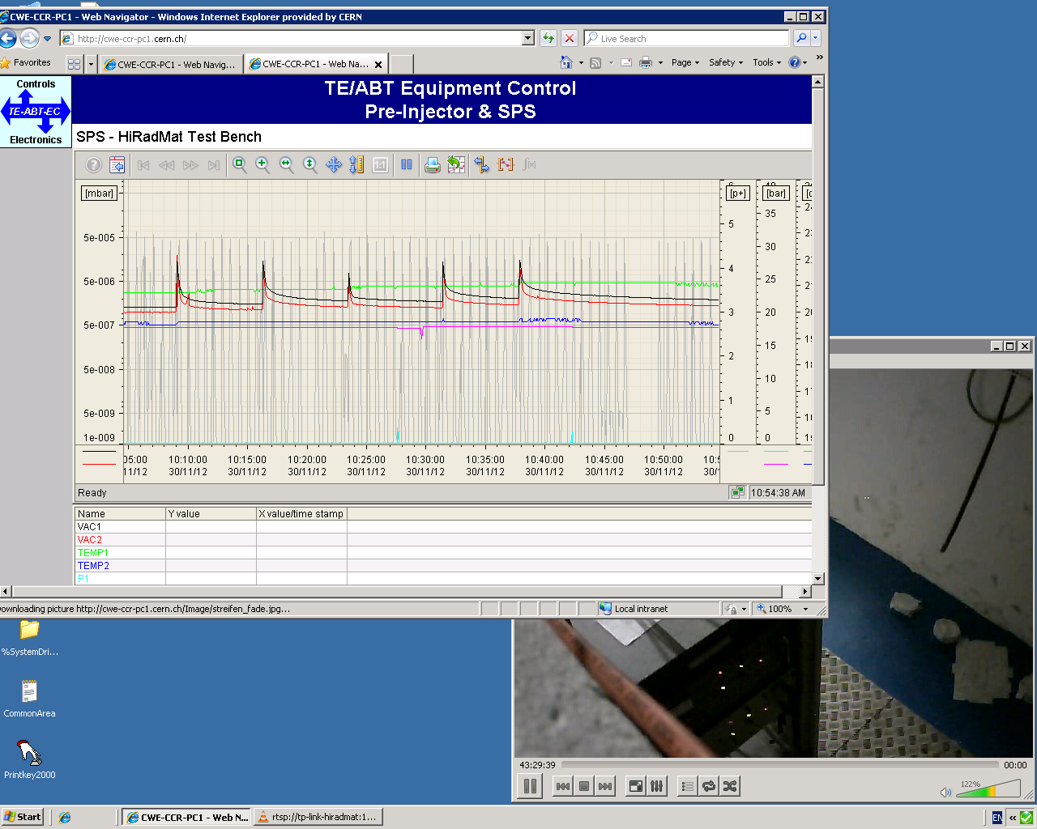
TPSG4 - 2012
Robustness test of a beam septum protection collimator; 9 m long experimental installation
J. Borburgh, CERN TE

Slide 16
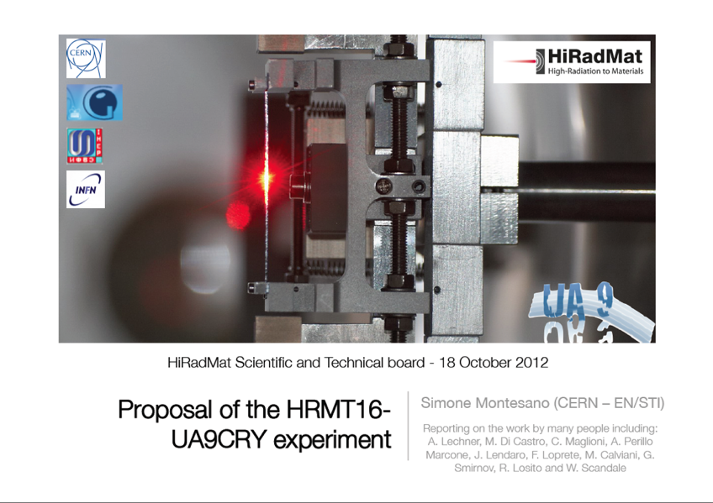
Crystal collimators

Slide 17

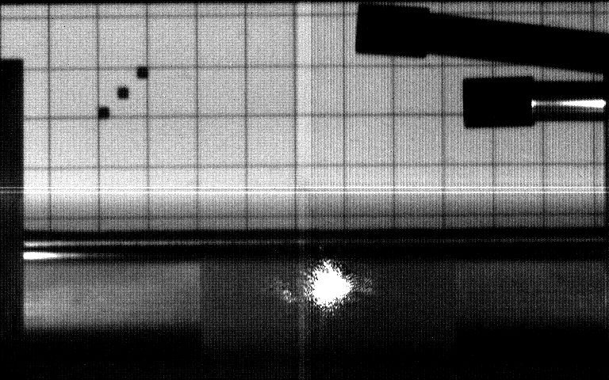
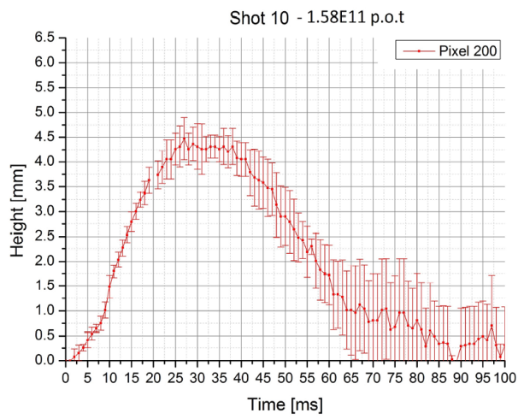


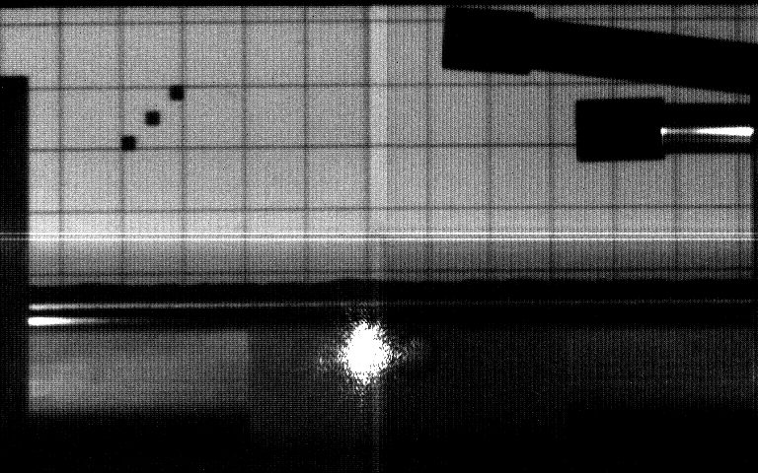
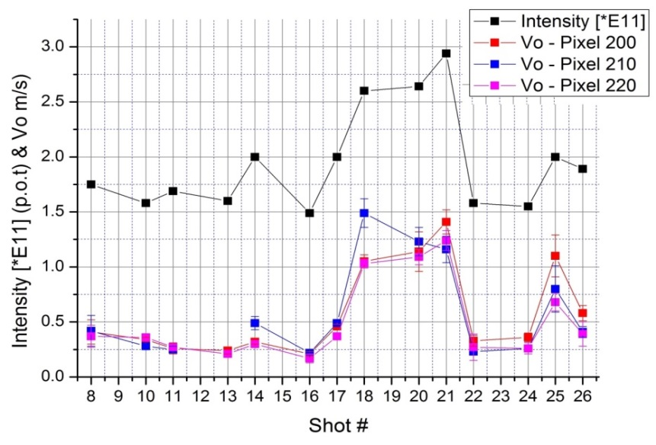
A feasibility experiment of a W-powder target (HRMT-10)
1 cm
1.75E11 p.o.t: First significant disruption
Pressure Sensor
Pressure Sensor
Beam
LDV spot
Recording :2000 fps
Video: 10 fps
1.85E11 p.o.t: Different reaction of the powder. Due to the increased surface roughness.

Slide 18
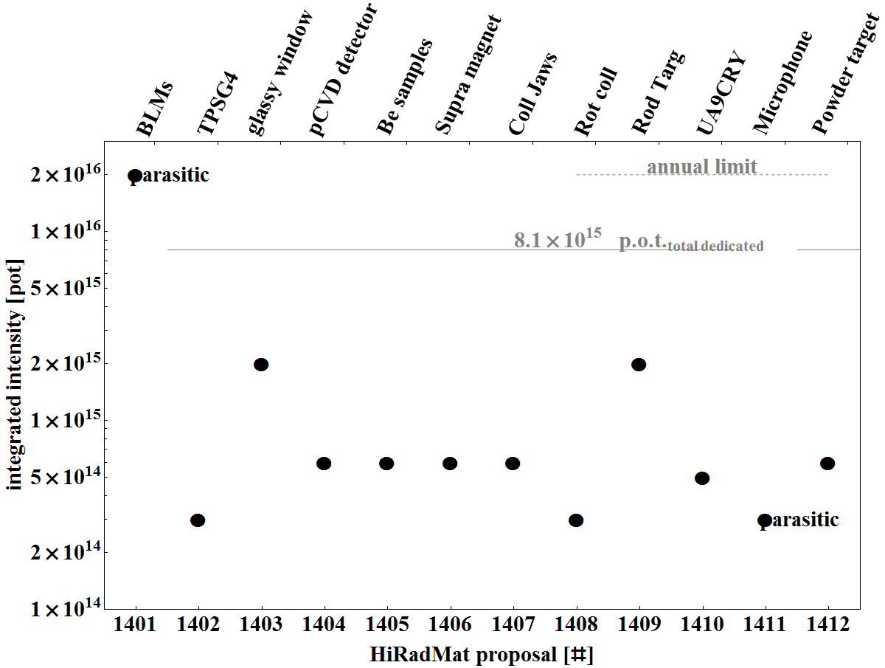
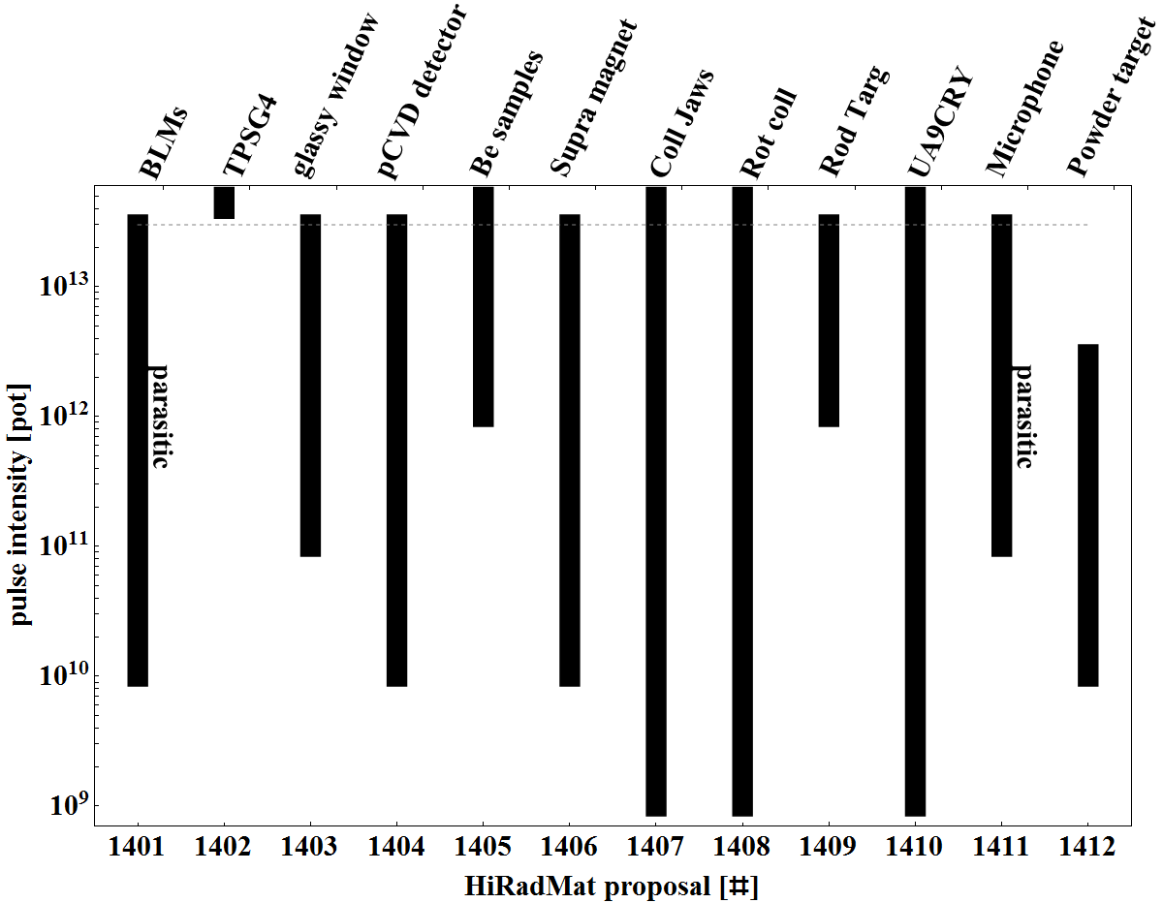
Proposals 2014/2015
Call for proposals in spring 2014
  12 applications
Beam run 2014/15 allows about 12 beam slots
HiRadMat receives support from the EU FP7 grant EuCARD2 within the activity “Transnational Access”.

Slide 19
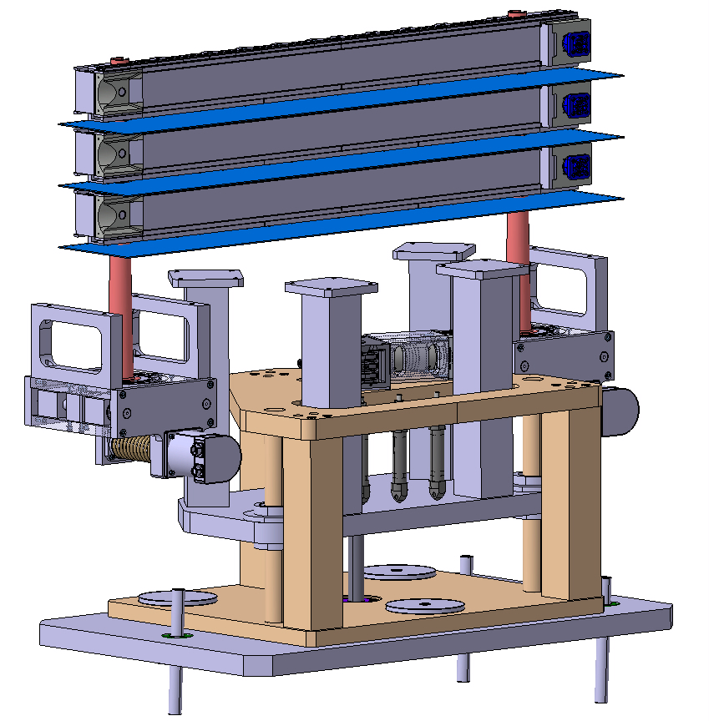
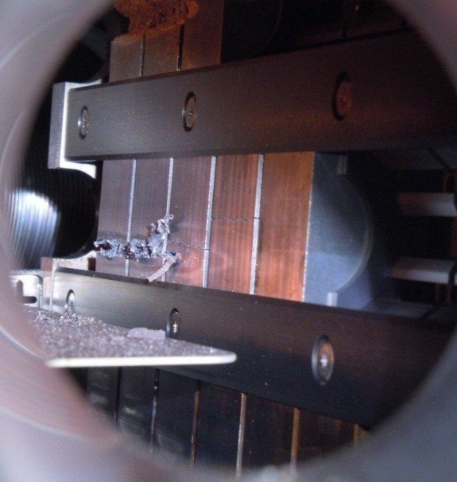
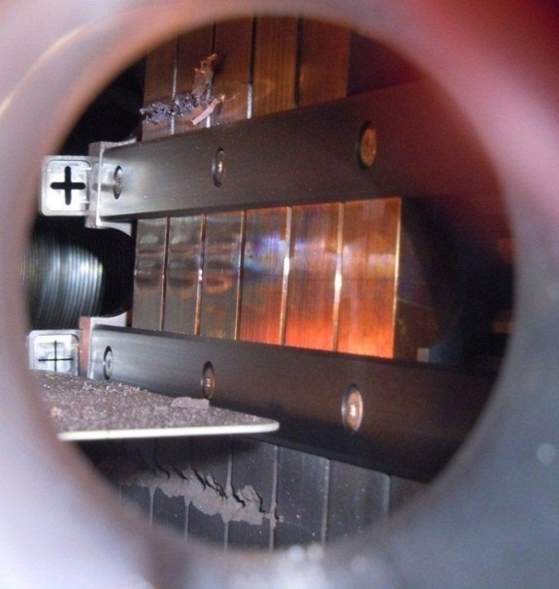
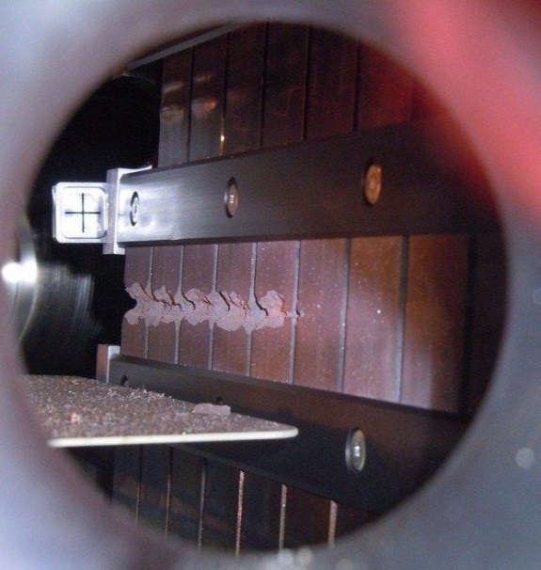
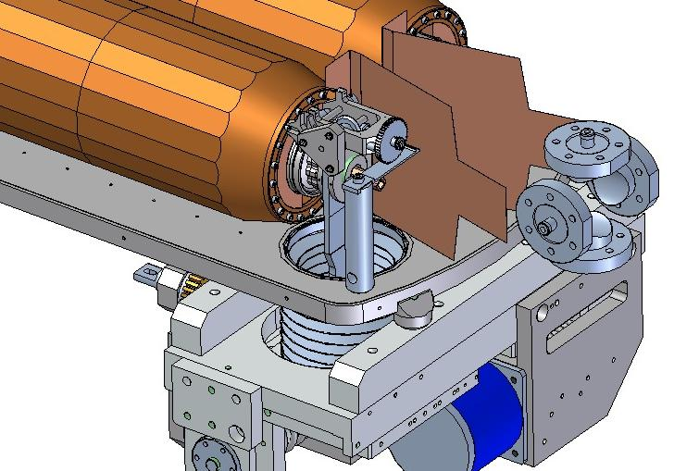
Collimators
  Molybdenum, 72 & 144 bunches
  Glidcop, 72 bunches (2 x)
A. Bertarelli CERN MME
S. Redaelli CERN ABP
et al.
  Molybdenum-Copper-Diamond 144 bunches
SLAC

Slide 20
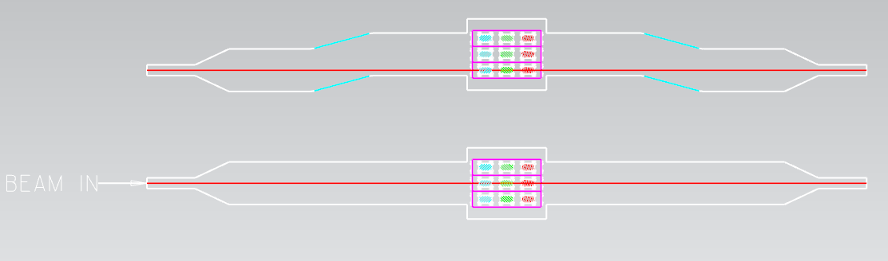
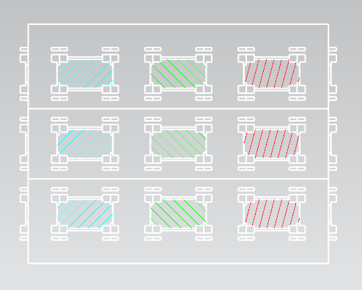
Beryllium specimen
P. Hurh (FNAL), C. Densham (RAL) et al.
Multiple samples exploiting long interaction length in beryllium.
Samples include:
Different commercial grades of Be
Thick & thin windows

Slide 21


pbar target
Pulse intensity ~1-5*10¹² p/pulse
Spot size: 1x1 mm² → 1.5x1.5 mm²
Total number of medium-high intensity pulses: ~300-400
  Ramp-up approach
  Other ~200 low intensity pulses could be anticipated
Integral intensity ~2*10¹⁵ POT
Beam alignment/stability:
  Maximum shift pulse-by-pulse ~100 μm
    Important to have it guaranteed, not only monitor
  Monitor beam asymmetry ~100 μm

Slide 22
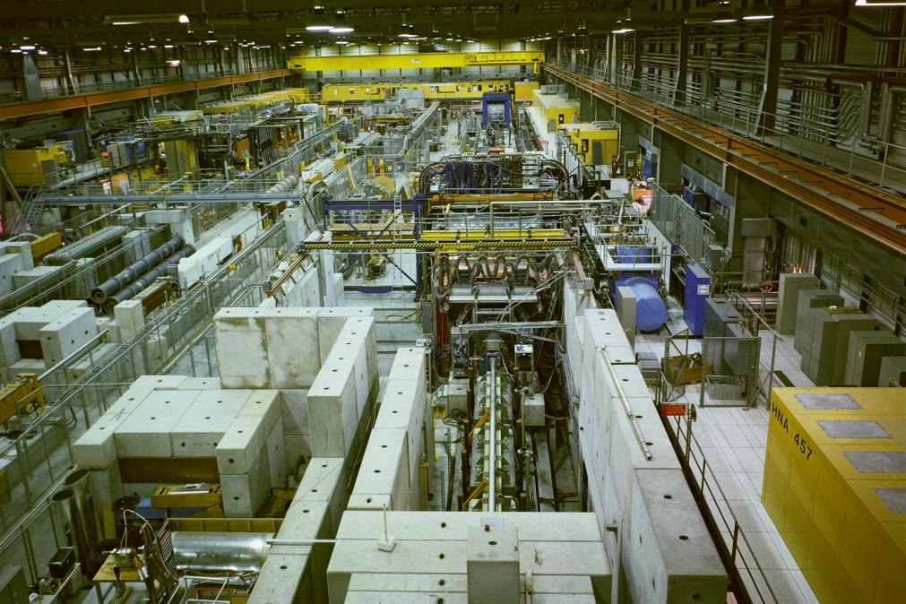
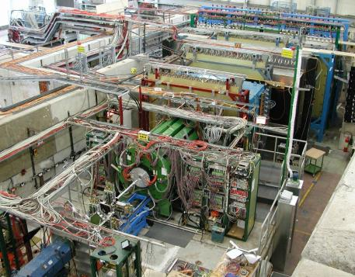
Secondary beamlines
In East (T7, T9, T10) and North Area (H2, H4, H6 …)
E.g. HARP in East Area
See also FNAL sec. beamlines by Erik

Slide 23
Summary
HiRadMat is a dedicated in-beam test facility for single-pulse experiments.
  Avoiding parasitic beam time and operation conflicts
Such a test facility is useful for a large variety of beam obstacles.
Dedicated CERN irradiation facilities exist as well.

