Slide 1
Neutrino Factory Target Cryostat Review
Van Graves
Cale Caldwell
IDS-NF Phone Meeting
August 10, 2010

Slide 2
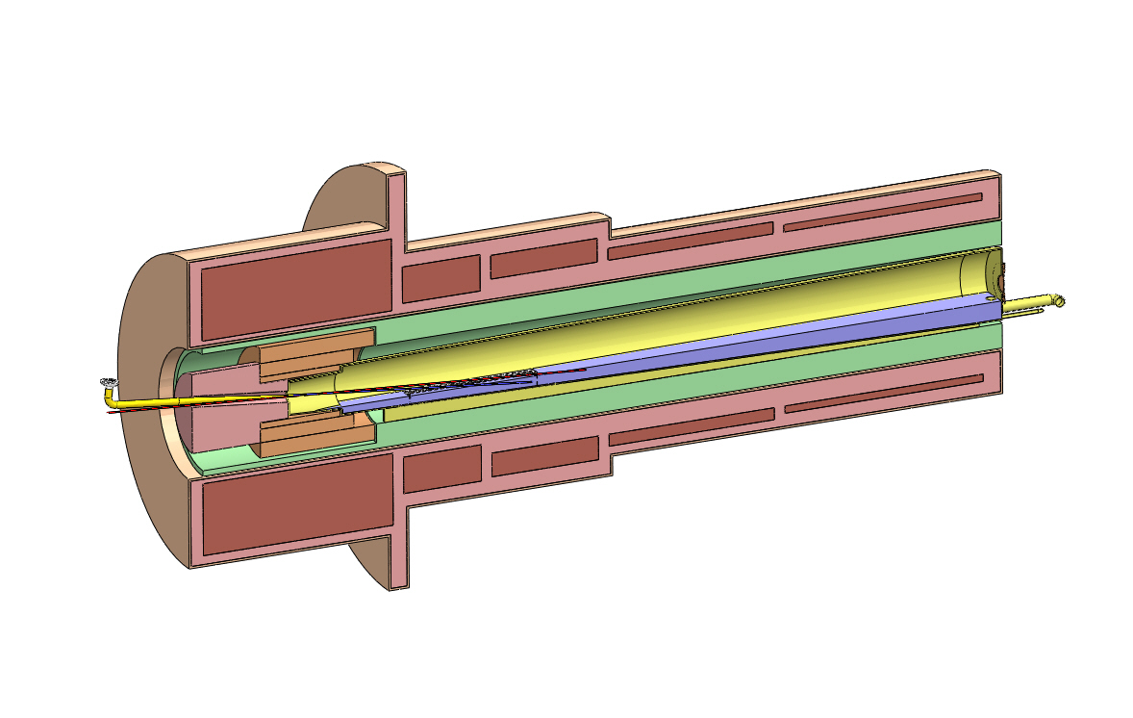
General Target Concept – Downstream Mercury Drain
Neutrino Factory Study 2 Target Concept
SC-2
SC-5
SC-3
SC-4
Window
SC-1
Nozzle
Tube
Mercury
Drains
Proton
Beam
Mercury
Pool
Water-cooled
Tungsten Shield
Mercury
Jet
Iron
Plug
Splash
Mitigator
Resistive
Magnets
ORNL/VG
Mar2009

Slide 3
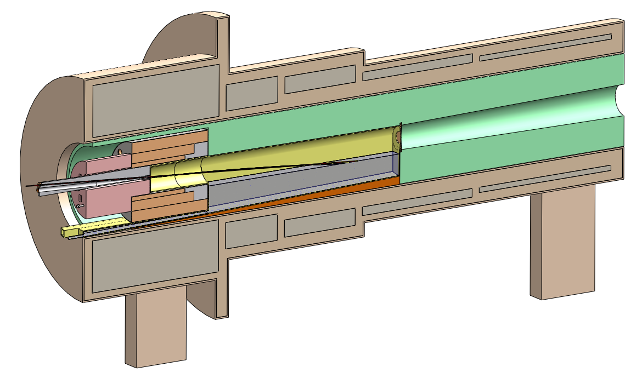
General Target Concept – Upstream Mercury Drain

Slide 4
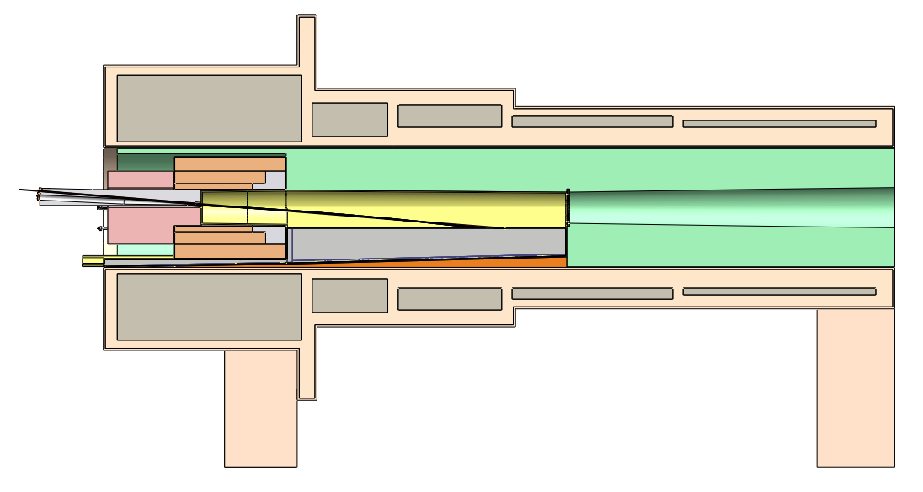
NF Cryostat with Tapered Shielding
Taper matches capture field
No shielding under mercury
Straight W-C bore up to beam window to allow removal of mercury chamber

Slide 5
Tapered Shielding Concept Dimensions

Slide 6
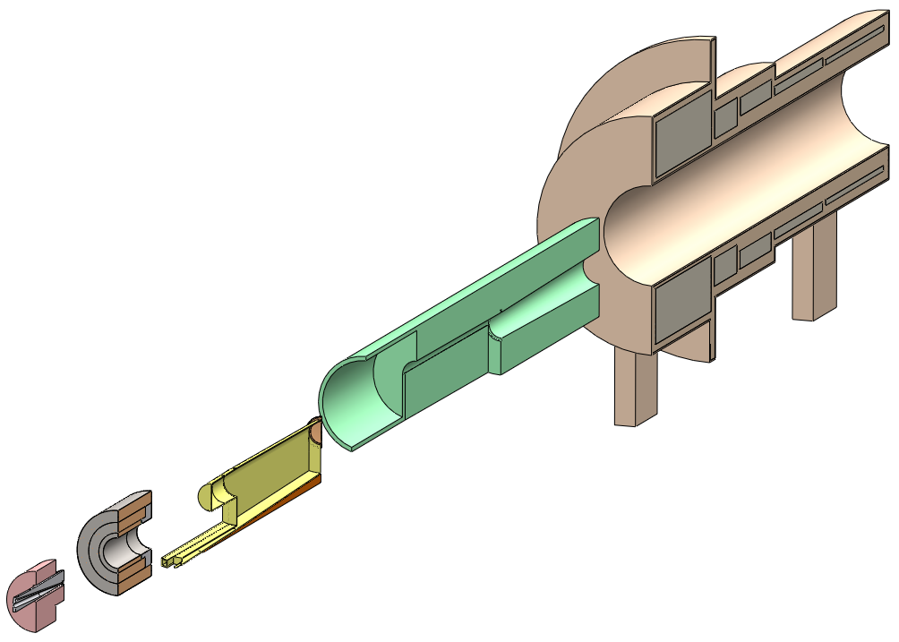
Cryostat Modules
All insertion/extraction from upstream end
Locating & supporting features not shown – will require additional space

Slide 7
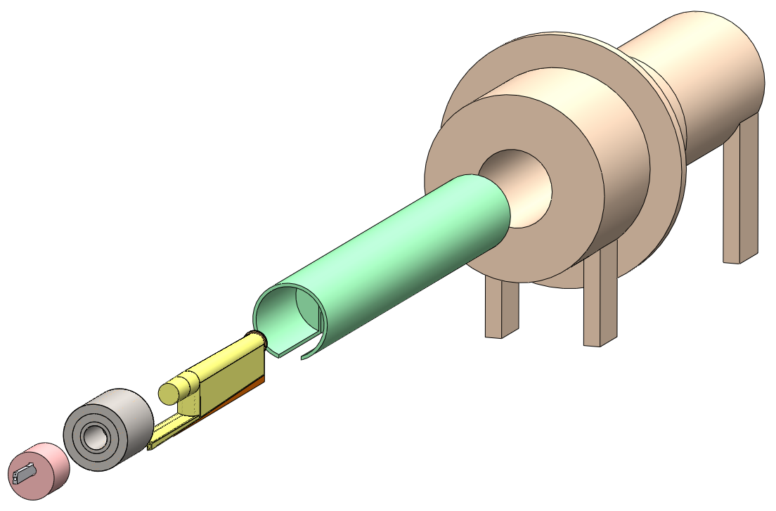
Cryostat Modules Full View
Module weight supported by cryostat? Probably not – another structure required
Remote handling of these modules not trivial
Note slot in shielding module for mercury chamber

Slide 8
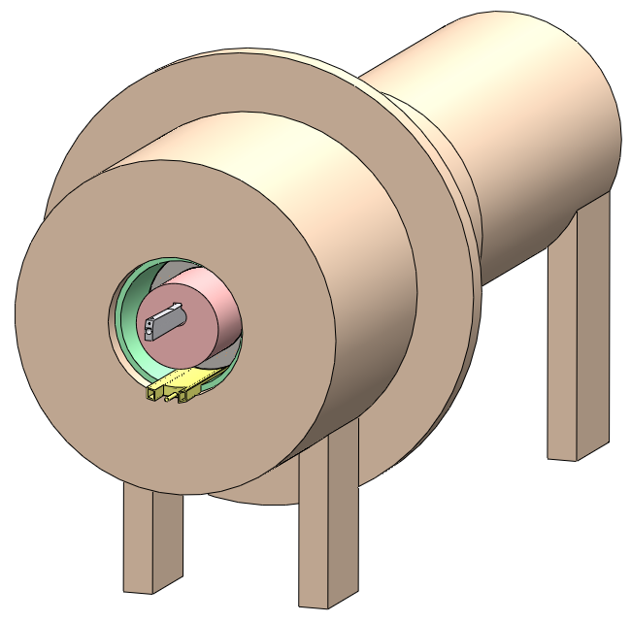
Assembled Cryostat
Resistive magnet leads & water cooling for these modules also enter from upstream

Slide 9
Original: 5cm Shielding at SC1

Slide 10
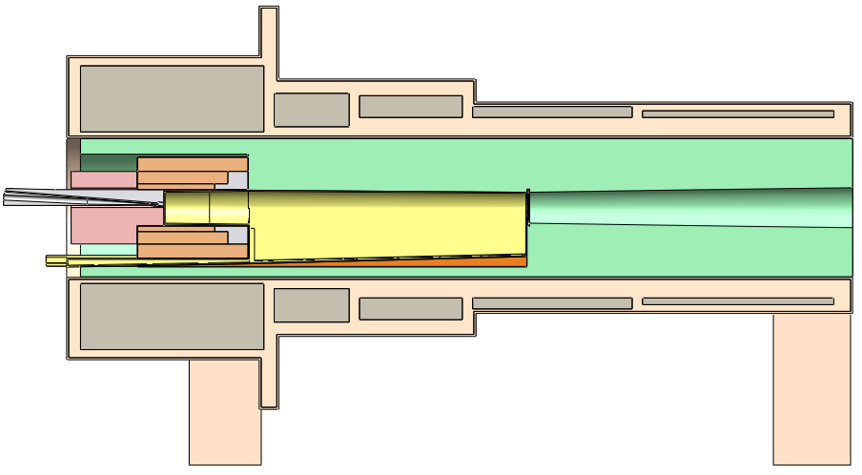
V2: 10cm Shielding Below Resistive Magnets, 15cm Above
Allows mercury drainage below magnets while still providing W-C shielding

Slide 11
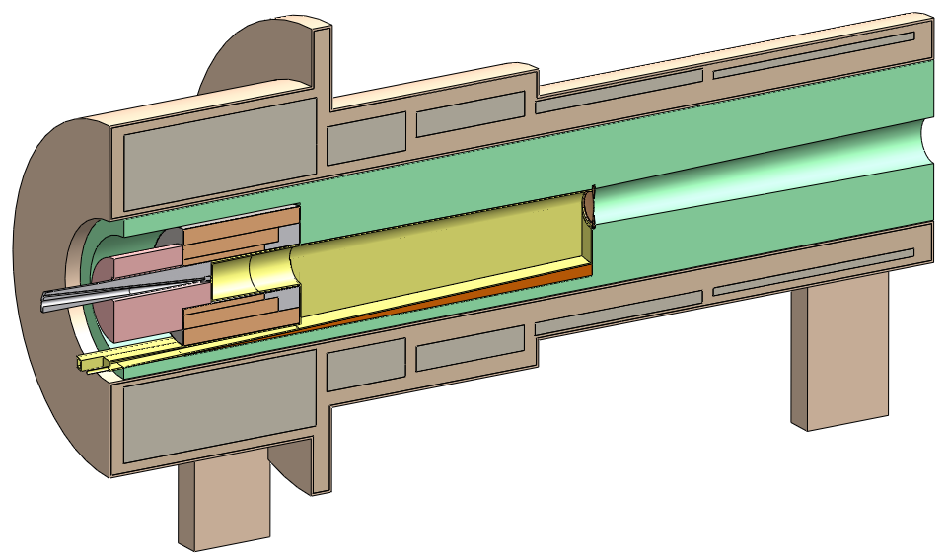
V2 Iso: 10cm Shielding Below Resistive Magnets, 15cm Above
Asymmetric W-C structure, minimal shielding for SC1

Slide 12
V3: 30cm Shielding Below, 35cm Above, Constant ID

Slide 13
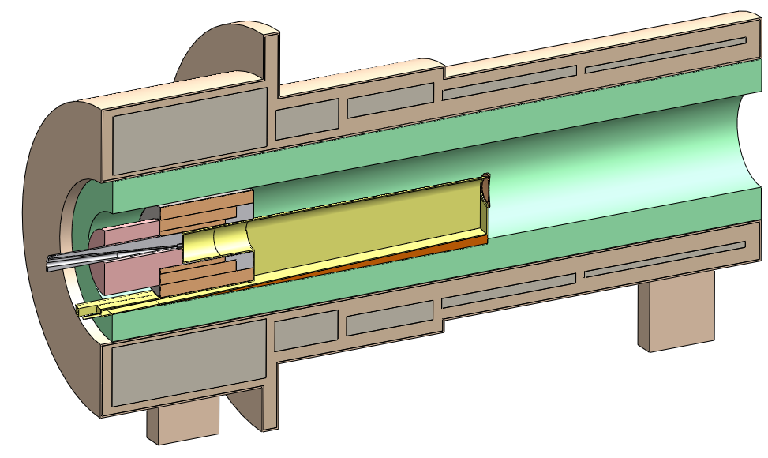
V3 Iso: 30cm Shielding Below, 35cm Above, Constant ID
Simpler W-C shielding fabrication, sized to protect SC1

Slide 14
Some Questions as Design Progresses
Can system perform without iron plug and/or resistive magnets?
  Removal simplifies remote maintenance, provides more space for nozzle & beam dump.
What does internal cryostat structure (weight support, magnet force restraints) look like, and how does it affect overall cryostat size?
Are 5 SC magnets required in this cryostat?
  Downstream beam window should be at end of cryostat for remote maintenance from downstream end.
What shielding thickness is required to protect SC1?
  This will ultimately drive cryostat bore diameter.

Slide 15
Summary & Reminders
Current NF target design based on physics performance characteristics
Further consideration shows it is an assembly of several subsystems, each with different design requirements and trade-offs
  Several areas of engineering-related R&D, including heat removal, Hg flow, nozzle development, beam windows
With Hg target (nor with any other target), hands-on maintenance cannot be assumed at any point in operation
  Remote features must be incorporated into initial design
Final system concept will result from an integrated design approach with input from several technical areas

