Slide 1
A MW Class Target System for Muon Beam Production
  AAC 2014
  San Jose, Ca
  July 14-18, 2014

Slide 2
High-power Targetry Challenges
High-average power and high-peak power issues
  Thermal management
    Target melting
    Target vaporization
  Radiation
    Radiation protection
    Radioactivity inventory
    Remote handling
  Thermal shock
    Beam-induced pressure waves
  Material properties

Slide 3
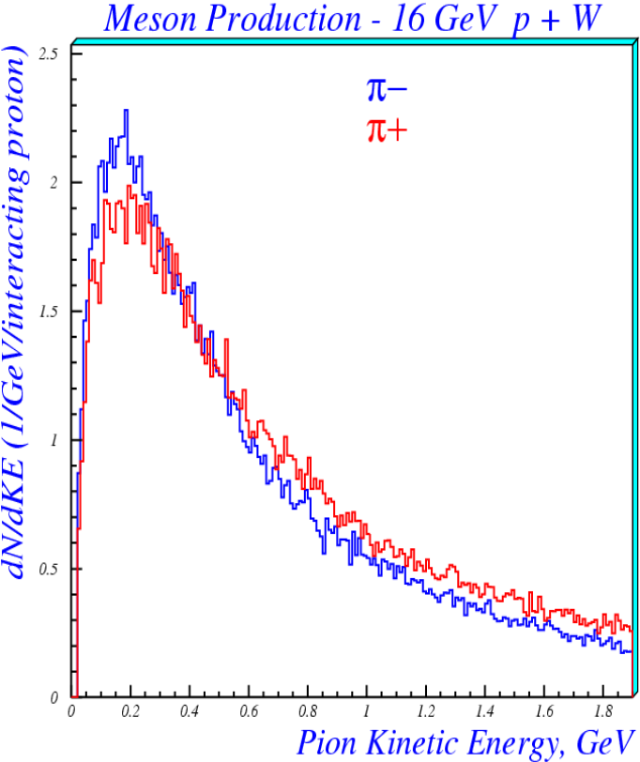
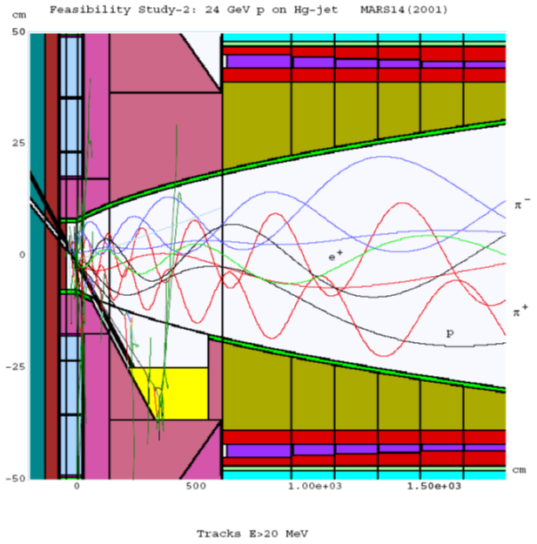
Production of Intense
Muon Beams
Muon beams produced as tertiary beams: p → π → μ

Slide 4
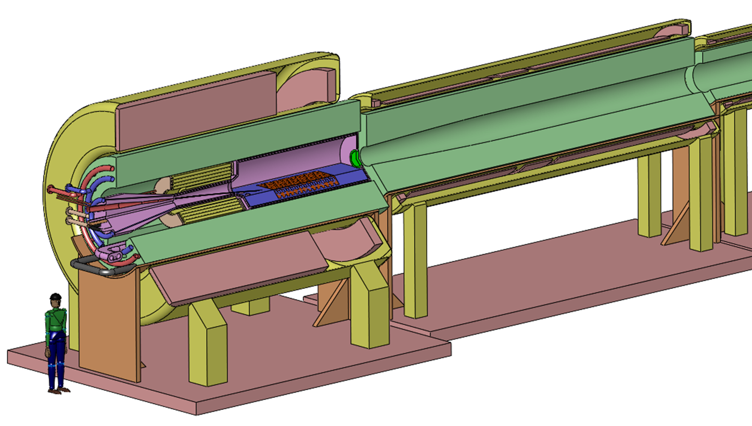
The Capture Solenoid
A Neutrino Factory and/or Muon Collider Facility requires challenging magnet design in several areas:
  Target Capture SC Solenoid (15T with large aperture)
  Stored Energy ~ 3 GJ
  10MW, 5T resistive
  coil in high radiation
  environment
  Possible application
  for High
  Temperature
  Superconducting
  magnet technology

Slide 5
Choice of Target Materials
We consider proton beam powers of 1- ,2- and 4-MW
Solid and liquid targets considered:
  High-Z, eg. W, Hg, PbBi
  Mid-Z, eg. Ga, Cu, Ni
  Low-Z, eg. Be,C

Slide 6
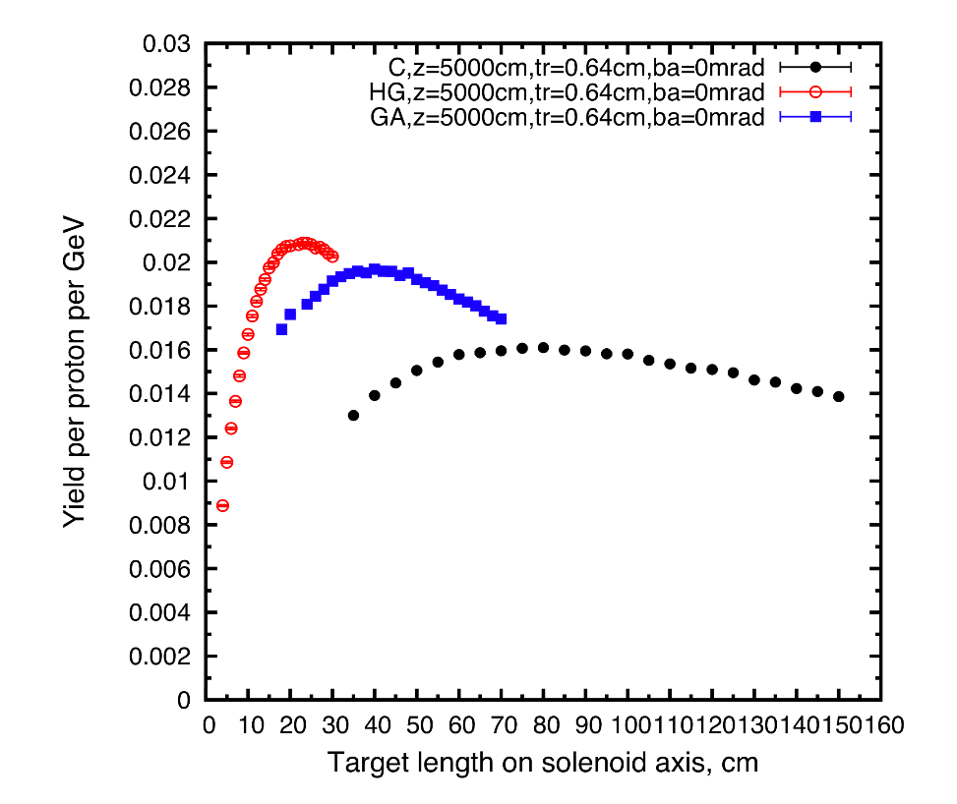
Choice of Target Materials II
High Z (e.g. Hg)
Mid Z (e.g. Ga)
Low Z (e.g. Carbon)
A 25% advantage of using
high-Z Hg compared to
low-Z Carbon
Low-z Carbon is attractive
due to it’s simplicity and
robustness
X. Ding, UCLA
Proton Beam: KE = 6.75 GeV
Normalization: For Hg Σ(μ⁺ + μ⁻)/proton ≈ 30%

Slide 7
Captured Muon Spectra
For p + Hg
Total Captured Muons
per incoming protons
μ⁺/p = 14.6%
μ⁻/p = 14.8%
For 6.75GeV protons
1MW ➔ 10 ¹⁵ protons

Slide 8
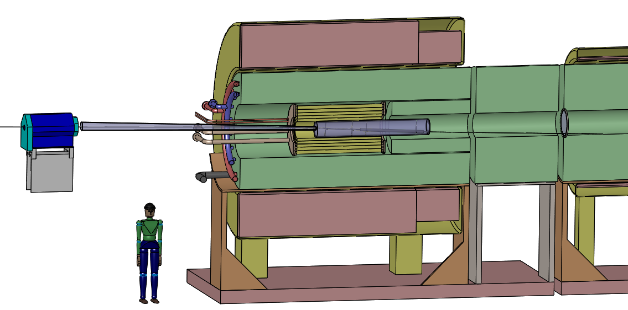
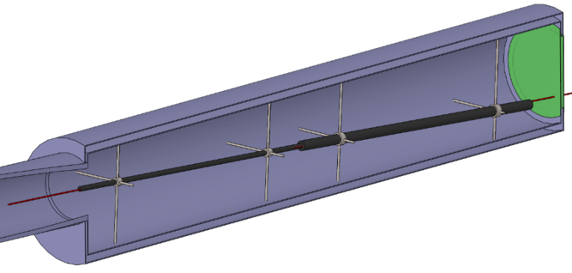
A Graphite Target Core
Proton beam tube
15 T superconducting coil outsert,
Stored energy ~ 3 GJ, ~ 100 tons
Last
Final-Focus
quad
Stainless-steel target vessel (double-walled with intramural He-gas flow for cooling) with graphite target and beam dump, and downstream Be window.
Upstream proton beam window
5 T copper-coil insert. Water-cooled,
MgO insulated
He-gas cooled W-bead shielding (~ 100 tons)

Slide 9
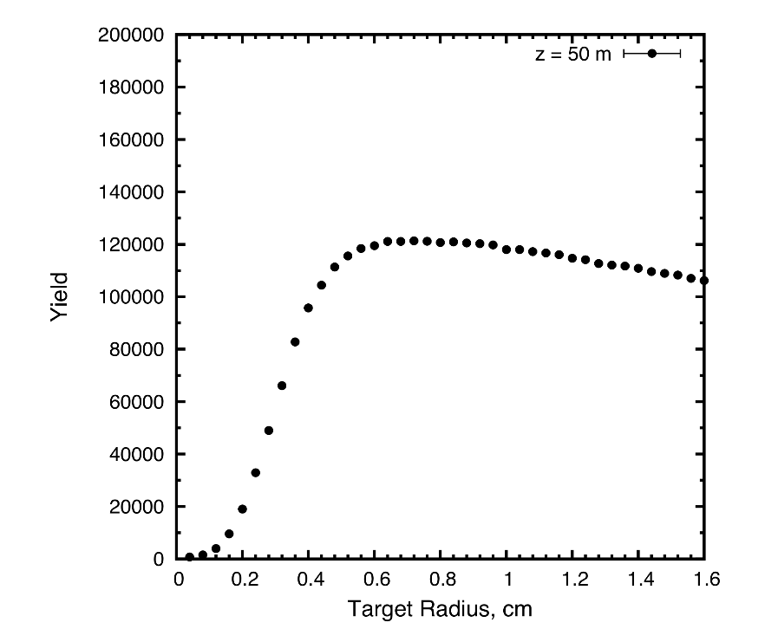
Optimization of Carbon Target Dimensions
X. Ding, UCLA
Target Radius
6cm < R < 12cm
Target/Solenoid Axis Angle
50 mrad < θ < 80 mrad
~15% advantage
for tilted target
Gaussian beam radius
constrained to ¼ target
radius

Slide 10
Energy Deposition in a Graphite Targets
Graphite targets of various radii (0.8 to 40cm). Proton beam has an rms radius of 2mm at the center of the target and β* = 80 cm. . N.Souchlas, PBL
Largest power deposition for R=8mm case is 4 cm into target, but at ~60cm in
targets with large radii...
B = 0 T
B = 20 T

Slide 11
Total power absorbed in the target
.
The steady-state power increases with magnetic field
For R=8mm
total power is
150kW for 4MW
protn beam

Slide 12
Peak Energy Deposition
N. Souchlas, PBL
80cm graphite target with various radii
Simulations for a 1.8g/cm³ graphite target
Peak energy deposition occurs 3 to 4 cm into the target.
Peak energy deposition is 3600J/g for a 4-MW, 6.75 GeV proton beam

Slide 13
Energy Deposition on Carbon Target
Beam Power | Rep Rate | Peak ED | Steady State ED
MW | Hz | J/g | kWatts
1 | 60 | 15 | 38
 | 15 | 60 | 38
2 | 60 | 30 | 75
 | 15 | 120 | 75
4 | 60 | 60 | 150
 | 15 | 240 | 150
Figure of Merit: T2K Graphite Target Peak ED Design Limit is 200 J/g

Slide 14
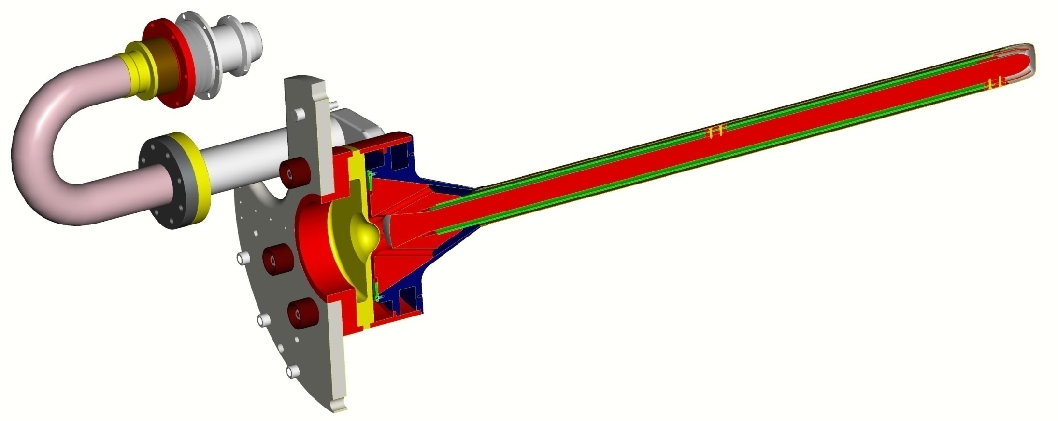
The T2K Target Design
Stainless pipe + flange
Remote connector + bellows + isolator (Al₂O₃)
Ti-6Al-4V tube and windows (0.5 mm thick)
Titanium pipe + flange
Titanium target body
Graphite (purified)
(ToyoTanso IG-430)
Graphite
(ToyoTanso IG-43)
Isolators
IG43 Graphite
L – 90cm
R=13mm
Graphite to titanium diffusion bond
Aluminium support plate

Slide 15
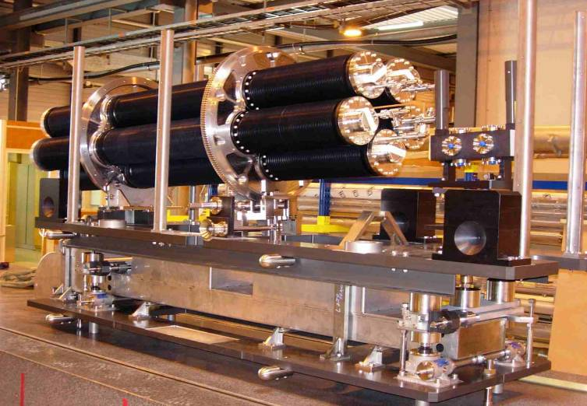
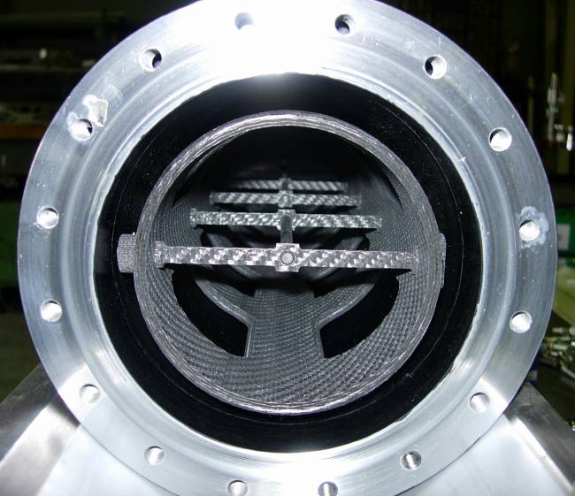
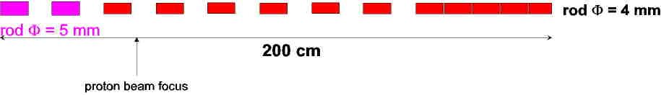
The CERN CNGS Target
13 graphite rods, each 10cm long,
Ø = 5mm and/or 4mm
2.7 interaction lengths
Target magazine holds 1 target plus
4 spares
Graphite Core
Carbon-Carbon Support

Slide 16
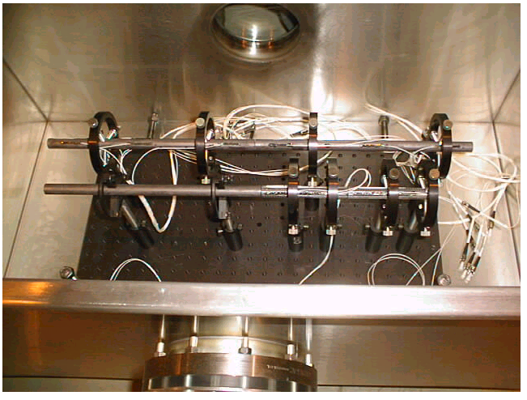
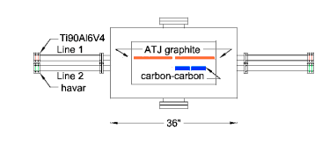
AGS E951: Graphite & Carbon-Carbon Targets
Key Material Properties
 | ATJ | CC X/U
Y, GPa | 10 | 54/5.3
α_{T} , 10⁻⁶/⁰K | 2.5 | ~0
Tensile Strength, MPa | 15 | 182/44

Slide 17
24 GeV, 3 x 10¹² protons/pulse
AGS E951: Strain Gauge Measurements

Slide 18

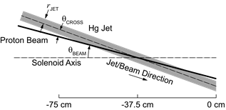
Consider High-Z Targets
Advantages:
30% enhanced π/μ production
If liquid then free jet mitigates shock damage
Disadvantages:
Enhanced energy deposition ➔ liquid targets
Enhanced radionuclide inventory

Slide 19
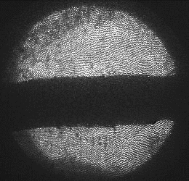
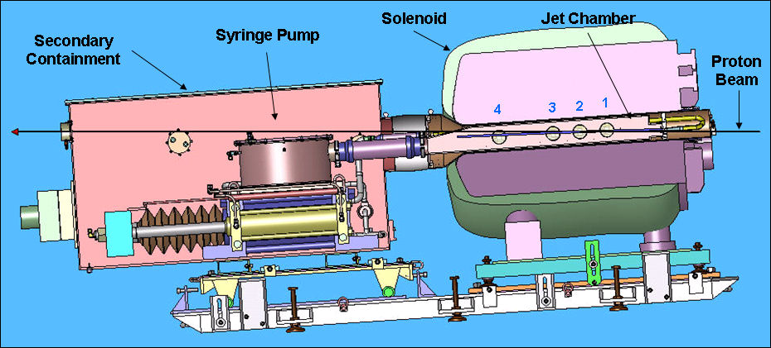
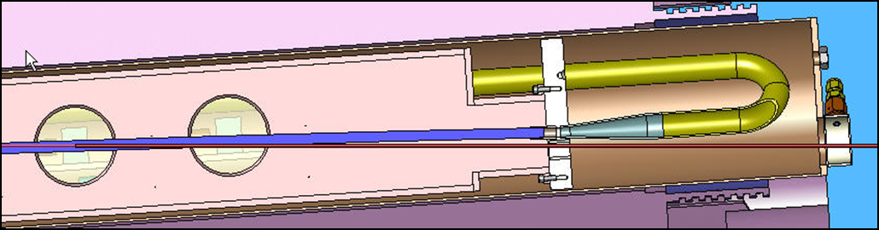
The MERIT Experiment
The MERIT Experiment at the CERN PS
  Proof-of-principle demonstration of a liquid Hg jet target in high-field solenoid
  Demonstrated a 20m/s liquid Hg jet injected into a 15 T solenoid a with a 115 KJ/pulse beam!
1 cm

Slide 20
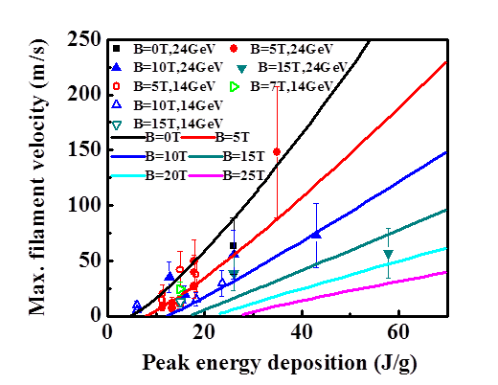
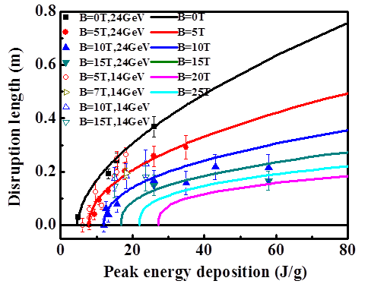
Key MERIT Results
Jet Disruption Length
Filament Ejection Velocity

Slide 21
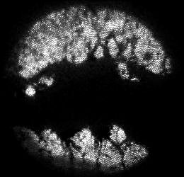
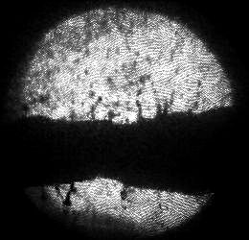
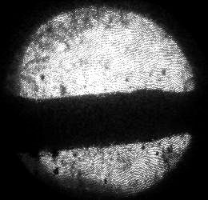
Study with 4 Tp + 4 Tp at 14 GeV, 10 T
Single-turn extraction
➔ 0 delay, 8 Tp
4-Tp probe extracted on subsequent turn
➔ 3.2 μs delay
4-Tp probe extracted
after 2nd full turn
➔ 5.8 μs Delay
PUMP: 8 bunches, 4 ×10¹² protons
Threshold of disruption is > 4 Tp at 14 Gev, 10 T.
⇒Target supports a 14-GeV, 4-Tp beam at 172 kHz rep rate without disruption.
PROBE: 8 bunches, 4×10¹² protons

Slide 22
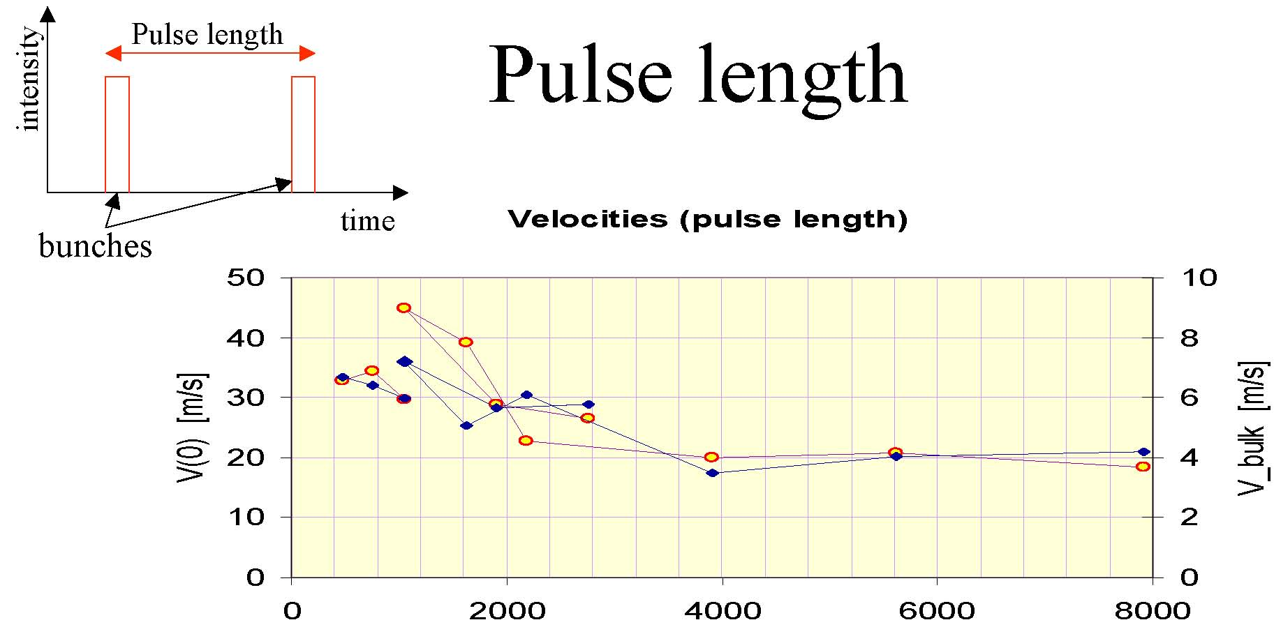
CERN ISOLDE Hg Target Tests
A. Fabich, J. Lettry, CERN
Proton beam
5.5 TP per
Bunch.
Bunch Separation [ns]

Slide 23
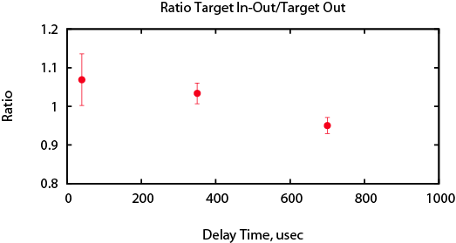
Pump-Probe Test
Production Efficiency: Normalized Probe / Normalized Pump
No loss of pion production for bunch delays of 40 and 350 μs,
A 5% loss (2.5-σ effect) of pion production for bunches delayed by 700 μs.

Slide 24
Key MERIT Results
Jet surface instabilities reduced by high-magnetic fields
Hg jet disruption mitigated by magnetic field
    20 m/s operations allows for up to 70Hz operations
115kJ pulse containment demonstrated
    8 MW capability demonstrated
Hg ejection velocities reduced by magnetic field
Pion production remains stable up to 350μs after previous beam impact
170kHz operations possible for sub-disruption threshold beam intensities

Slide 25
SUMMARY
  A solenoid capture system could be a source for intense muon beams
  A solid graphite based target looks promising for 1-MW and 2-MW drive beam applications and may be possible at 4-MW for high-rep rates (50-60 Hz)
  Liquid high-Z targets are more efficient in the production of π/μ beams and are suitable for low rep-rate, 4-MW class drive beams

Slide 26
Backup Slides

Slide 27
The Neutrino Factory Target Concept
Maximize Pion/Muon Production
  Soft-pion Production
  High-Z materials
  High-Magnetic Field
Palmer, PAC97

Slide 28
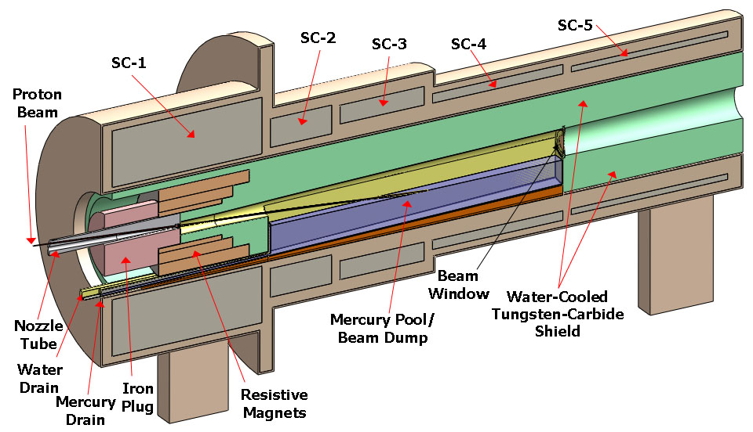
The NF Study 2 Target System
Neutrino Factory Study 2 Target Concept

