Slide 1
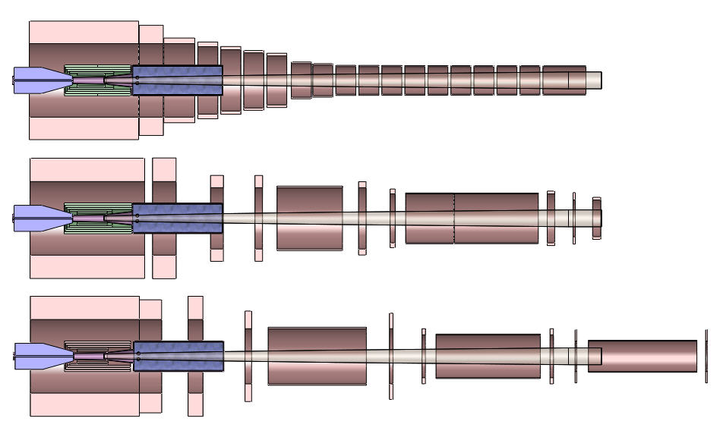

Slide 2
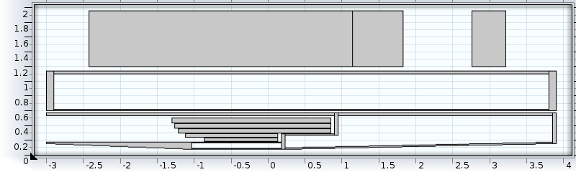
SC coils
Interaction point
W bead shielding
Resistive magnet
.
W bead shielding

Slide 4
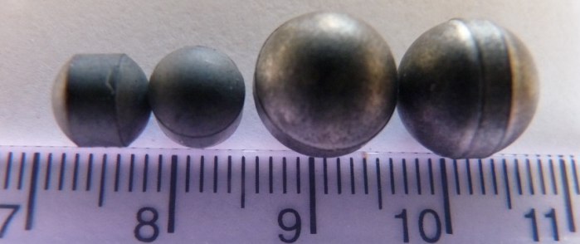

Slide 6
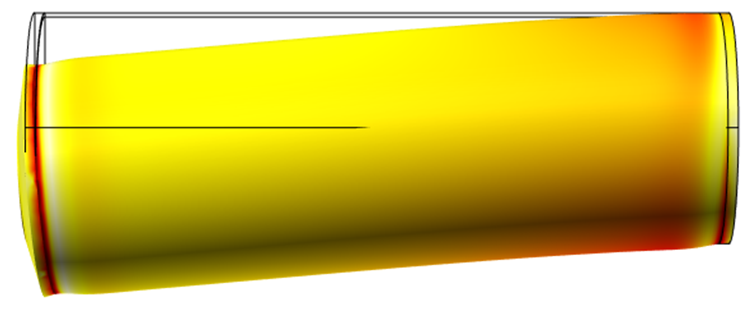

Slide 7
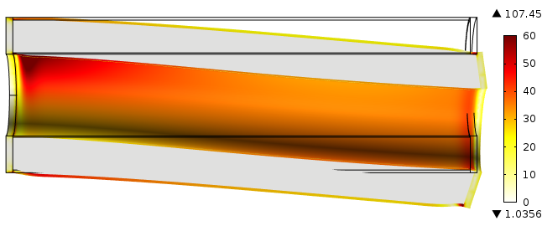

Slide 9
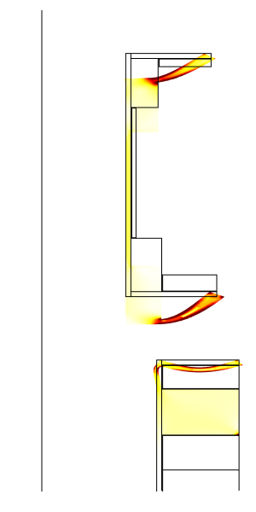
Cryostat #1
Cryostat #2
Magnetic axis

