Slide 1


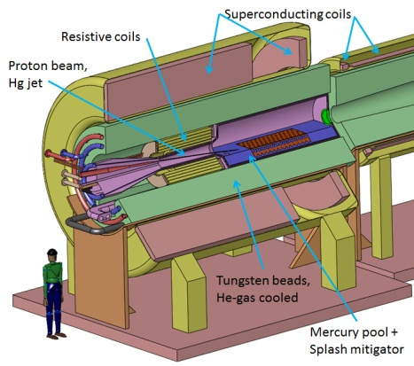
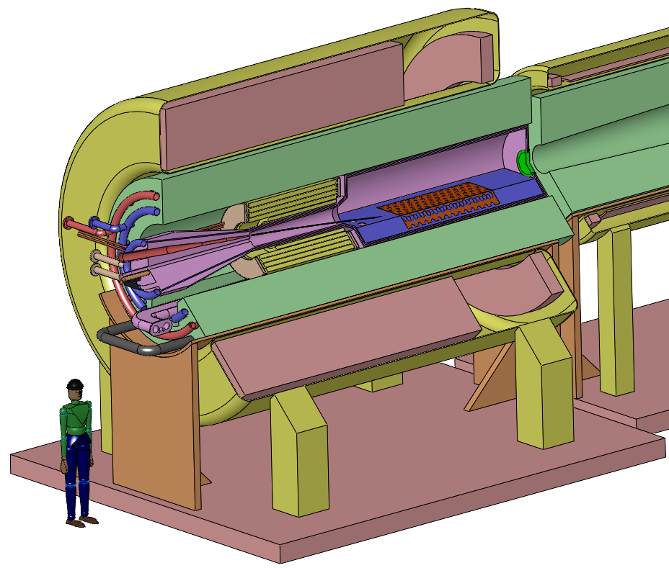
Optimizing Muon Capture and Transport for a Neutrino Factory Front End
(IPAC13, TUPFI075)
H. K. Sayed,^{*1} J.S. Berg¹, X. Ding², H.G Kirk,¹ K.T. McDonald³
¹ Brookhaven National Laboratory, Upton, NY 11953, USA
²UCLA, Los Angeles, CA 90095, USA
³ Joseph Henry Laboratories, Princeton University, Princeton, NJ 08544, USA
Abstract
  Target Tapered-Solenoid Profile
Muons within Acceptance Cuts at End of Transverse Cooling Channel
In the baseline scheme of the Neutrino Factory/Muon Collider a muon beam from pion decay is produced by bombarding a liquid-mercury-jet target with a 4-MW pulsed proton beam. The target is embedded in a high-field solenoid magnet that is followed by a lower field Decay Channel. The adiabatic variation in solenoid field strength along the beam near the target performs an emittance exchange that affects the performance of the downstream Buncher, Phase Rotator, and Cooling Channel. An optimization was performed using MARS1510 and ICOOL codes in which the initial and final solenoid fields strengths, as well as the rate of change of the field along the beam, were varied to maximize the number of muons delivered to the Cooling Channel that fall within the acceptance cuts of the subsequent muon-acceleration systems.
Inverse-Cubic Taper, defined by initial & final axial fields (B₁ & B₂), their derivatives, and position of end of taper (z_{end}):
Off-axis field approximation:
Dependency of Muon Capture and Transport on constant field of solenoid channel up to the cooling section
Target system and mercury jet geometry
Mercury-Target Parameters
  Angle of target to solenoid axis θ_{target}= 0.137 rad
  Target radius r_{target} = 0.404 cm
Proton Beam Parameters
  E = 8 GeV
  θ_{beam} = 0.117 rad
  σ_{x}= σ_{y}= 0.1212 cm (Gaussian distribution)
Dependence of Muon Capture and Transport on Initial proton Bunch Length
Longitudinal Phase Space
& Emittance exchange
Resistive coils
Superconducting coils
Proton beam,
Hg jet
Conclusion
Time-longitudinal momentum phase space distribution at the end of Decay Channel for a short (4 m) Taper and long (40 m) Taper (shifted in momentum & time).
A counterintuitive finding was that a short Taper Solenoid outperforms a long adiabatic Taper, as the shorter Taper deliveries a denser distribution of muons in longitudinal phase space, which permits more effective bunch formation in the Buncher and Phase Rotator, despite the fact that the longer Taper deliveries more muons to the Buncher.
Tungsten beads,
He-gas cooled
Mercury pool +
Splash mitigator
The shorter taper results in a denser distribution in longitudinal phase space, which is preferable for the ^{Buncher/Phase Rotator.}
*Email: hsayed@bnl.gov
Work supported in part by US DOE Contract No. DE-AC02-98CH10886.

