Slide 1


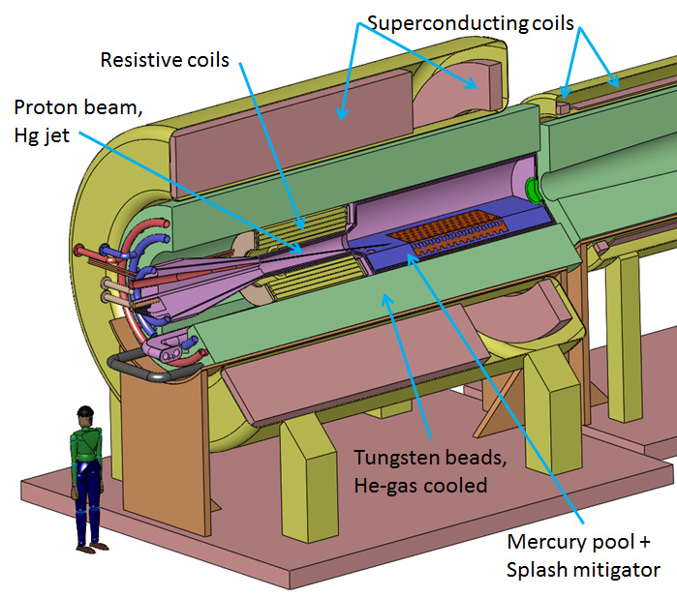
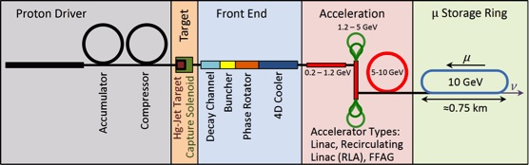
OPTIMIZATION OF THE CAPTURE SECTION OF A STAGED NEUTRINO FACTORY
H.K. Sayed,^{*1} H.G. Kirk,¹ K.T. McDonald²
¹ Brookhaven National Laboratory, Upton, NY 11973, USA
² Princeton University, Princeton, NJ 08544, USA
THPHO11
NAPAC’13
CONCEPT
A proposed staged Neutrino Factory producing lower muon intensity of 10²⁰ muons per year and 10-14 GeV muon beam energy initially requires target station for 1 MW proton beam power with a proton beam energy of 3 GeV, which could be upgraded to the full power of 4 MW at 8-GeV beam energy. The optimization of the initial Target Station and the following Decay Channel and Buncher/Phase Rotator Channels are discussed.
PION PRODUCTION & CAPTURE
PION-PRODUCTION TARGET SYSTEM
SOLENOID CAPTURE FIELD
TRANSVERSE MOMENTUM SPECTRUM
MUON FRONT END
OPTIMIZING THE CAPTURE SOLENOID & BUNCHER/PHASE ROTATOR RF PHASE
The figure of merit for the optimization: The number of positive muons per incident proton within the subsequent muon-accelerator
Momentum acceptance 100 < p_{z} < 300 MeV/c
Longitudinal phase space A_{z} < 150 mm
Transverse phase space A_{r} < 30 mm
The solenoid-taper length has a distinct influence on the number of the transported muons to the end of cooling channel. Optimum muons yields for L_{taper} = 3-4 m
RF-phase optimization
The taper length affects the longitudinal phase space ⇒ RF-phase optimization
Muon yield increased by ~ 16-40 %
*Email: hsayed@bnl.gov
Work supported in part by US DOE Contract No DE-AC02-98CHI10886

