Slide 1






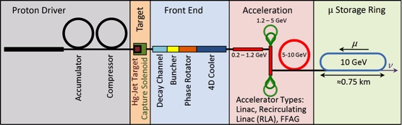
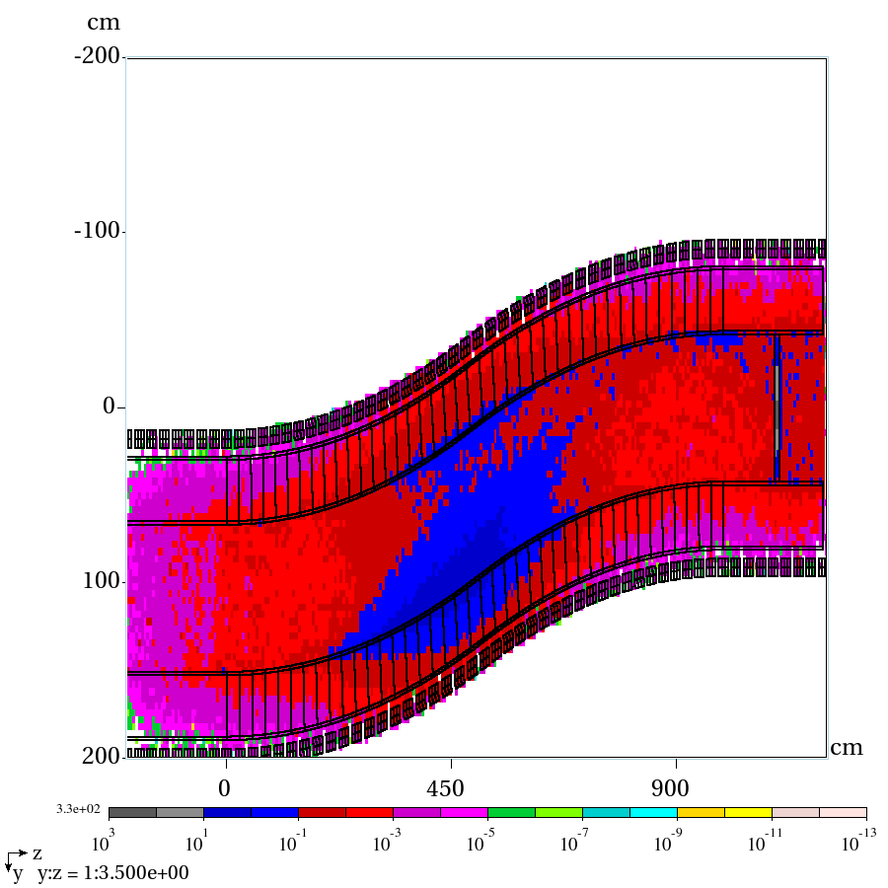
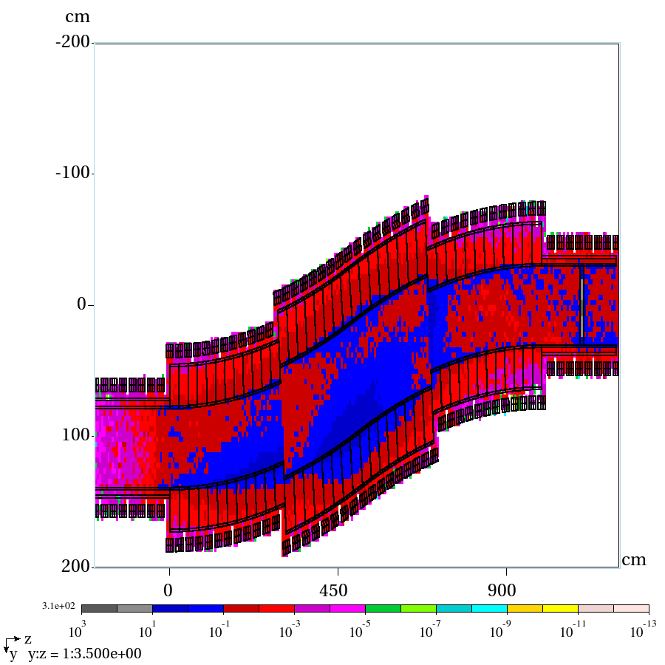
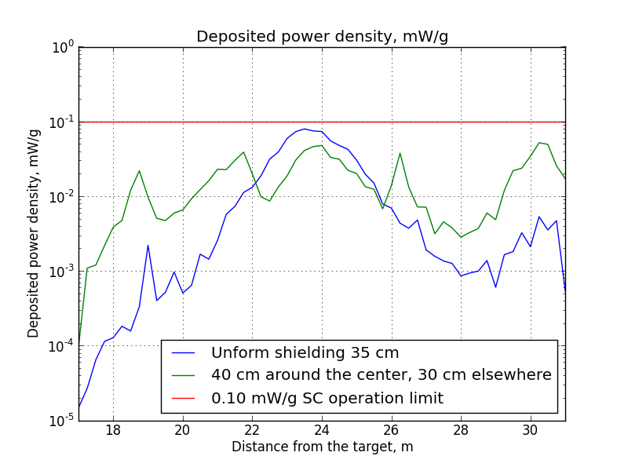
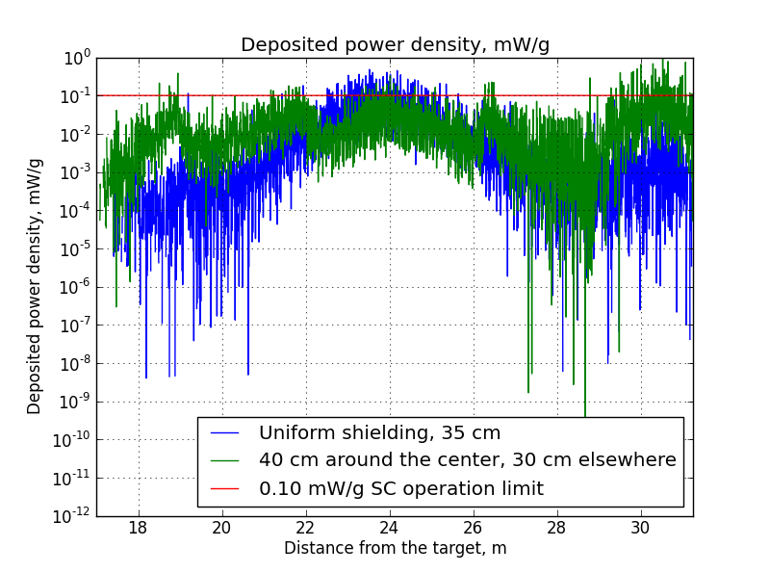
ENERGY DEPOSITION IN MAGNETS AND SHIELDING OF THE TARGET SYSTEM OF A STAGED NEUTRINO FACTORY
P. Snopok,² X. Ding,⁶ H.G. Kirk,¹ K.T. McDonald,⁴ C.T. Rogers,⁵ N. Souchlas³
¹ Brookhaven National Laboratory, Upton, NY 11973, USA
²Illinois Institute of Technology, Chicago, Illinois 60616, USA
³Particle Beam Lasers, Northridge, CA 91324, USA
⁴ Princeton University, Princeton, NJ 08544, USA
⁵Rutherford Appleton Laboratory, STFC ,Chilton, Didcot, Oxon OX11 0QX, UK
⁶UCLA, Los Angeles, CA 90095, USA
Particle Beam Lasers, Inc
THPMA10
NAPAC’13
The Challenge
10% of the energy of the proton beam that drives a Neutrino Factory is transported into the muon-capture solenoid channel, mostly via scattered beam protons and protons from target-nucleus breakup. A chicane in the π→µ Decay Channel removes higher-energy protons from the beam and a Be absorber removes lower-energy ones. But, the superconducting coils of the chicane must be protected against radation damage by the deflected protons by an internal shield of He-gas-cooled tungsten beads. The radiation level must be reduced to the “ITER Limit” of 0.1 mW/g for a 10-year operational lifetime.
We present MARS15(2012) simulations of shielding scenarios to achieve this goal.
Shielding Scenarios
The nominally circular muon beam of 30 cm radius becomes elliptical with 42 cm vertical radius at the center of the chicane due to “curvature drift.”
Scenario 1:
42 cm radius beampipe + 35 cm shielding
Scenario 2:
30 cm radius beampipe + 30 cm shielding outside chicane; 42 cm beampipe + 40 cm shielding in chicane.
Results of MARS15 Simulations: These scenarios come close to providing sufficient shielding everywhere.
Future Studies:
Consider elliptical beampipe inside circular coils, which would add thickness to the shielding where most needed near the center of the chicane.
Use MARS15 with MCNP data tables to model better the energy deposition by low-energy neutrons.
*Email: psnopok@iit.edu
Work supported in part by US DOE Contract No DE-AC02-98CHI10886

