Slide 1
“Conventional” neutrino beams: Target requirements
Phil Adamson
13th January 2012

Slide 2
Anatomy of a neutrino beam
Primary proton beam
Beam window
Target
Produce π,K
Focusing elements
Horns sign-select pions
Decay volume
π⁺ -> µ⁺ ν_{µ}
Beam Absorber
Absorb hadrons
Muons range out in rock
Neutrinos left
Target
Focusing Horns
π⁻
2 m
ν_{μ}
120 GeV protons
ν_{μ}
π⁺
15 m
30 m
675 m

Slide 3
Introduction
Will discuss the requirements on targets and target halls for high power neutrino beams
NOvA at 700kW
LBNE at 700kW
LBNE+Project X at 2.2MW
Low energy beam with Project X?
Discussion is mostly generic
Brand-name advice also available in the room

Slide 4
An example from NuMI
Scheduled summer shutdown
But wait – what’s happening over here
Solid consistent running delivered 3.2E20 protons to NuMI in FY10

Slide 5
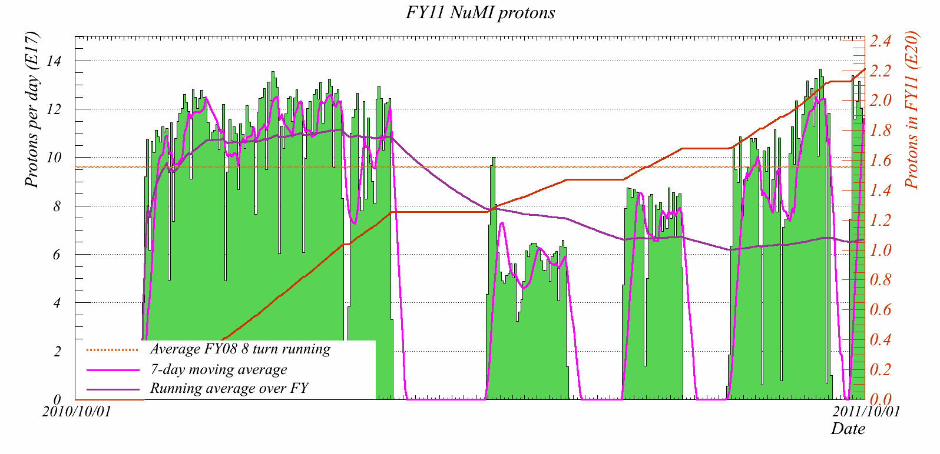
Annus Horribilis
(NT04)
NT05
NT06
NT01
NT02
Got 2.2E20 in FY11, thanks to heroic efforts from target folks (and delay to future projects)
Without target problems would have been 4E20

Slide 6
This was NT06
Water cooling lines sprang leak after a few days
Limped on for a month until outer can failed

Slide 7
Uptime is important!
…but uptime is a Heisenberg number
When you try to define it, it gets hard to measure
NuMI example: downtime is
Time removing broken target and installing new target
Time running at low intensity to try to extend life of dying target

Slide 8
Design Implications
Neutrino experiments care about integrated neutrino flux over the years)
New target design with 10% flux improvement?
Great, but if it needs replacing twice a year at 2 weeks or so downtime each, you just lost.
“Yield per proton vs design conservatism” – Tristan this morning
Probably guaranteed 4 weeks scheduled downtime per year
Target hall maintenance in shutdown is “free”
Replace consumable targets etc.
Otherwise, want target hall components to be quick to replace or robust

Slide 9
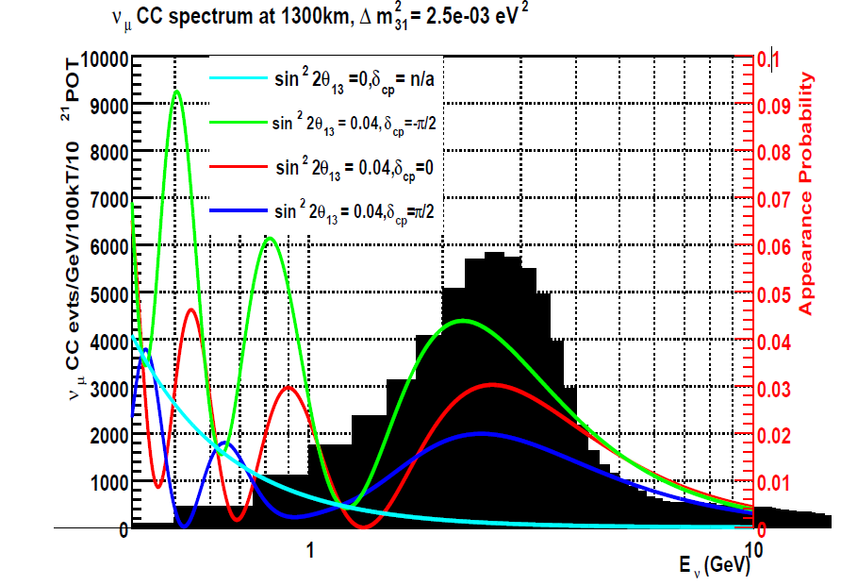
Neutrino Flux
Pions from target have few hundred MeV transverse momentum
$E_{ν}=0.43 E_{π}$
Place target far away from horn for high energy
Close (inside) for low
Depth of field etc. makes it a little more complicated
For LBNE, oscillation maxima at 2.5 and 0.8 GeV
Must place target inside horn (cf. NuMI LE)
Also low energy (cf. BNB)

Slide 10
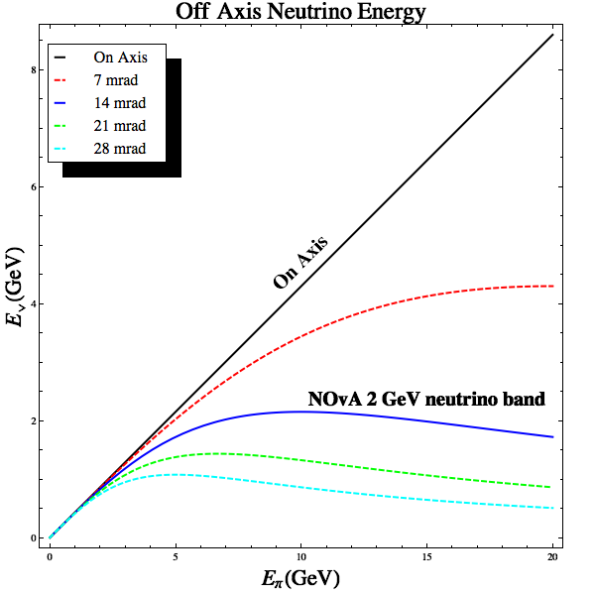
Off-axis this isn’t true: NOνA
Off-axis, neutrino energy driven by angle
Adjust focusing to optimize flux
Target goes upstream of horn
0
20

Slide 11
LBNE Flux optimization
More flux is always good, but in the real world there are tradeoffs
Zwaska FOM is a useful simple tool, but not intended to be more than that
What balance of flux required at 0.8 vs 2.5 GeV
High energy tail causes backgrounds for $ν_{e}$appearance (NC feeddown)
LAr detector is better than water
Answer is different for different measurements
Detailed analysis not done
Modifications in target width/length don’t change the design problems much
Hybrid Light-heavy target is different

Slide 12
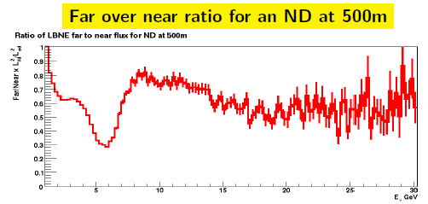
Predicting FD spectra
Oscillation experiments have near detector to measure beam
But you can’t put a near detector far enough away to make the beam look like a point source rather than a line source
Depend on modelling beam for F/N pred

Slide 13
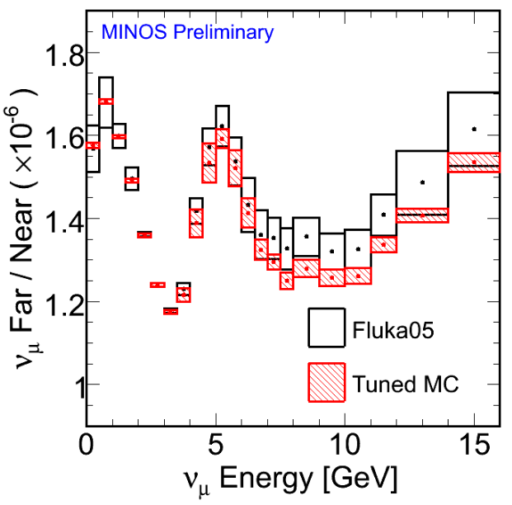
Predicting FD spectra
MINOS weights Fluka using ND data at different target positions & horn currents
T2K uses measured meson yields from NA61

Slide 14
Constraints from FD prediction
Rely on MC to know how spectra at ND and FD should differ
What’s in MC needs to match what’s in the target hall
Alignment
Mass budget
Beam size
NuMI requires horn 1, target aligned to 1mm, beam sigma known to better than 0.1mm.
For LBNE precision disappearance measurement, requirements should be the same (maybe a little tighter?)
This is less important for appearance
But need to understand backgrounds (beam $ν_{e}$)
beam $ν_{e}$ extrapolate to FD differently (different parent kinematics)
Need to optimize neutrino flux, but also need to know that that is what you have

Slide 15
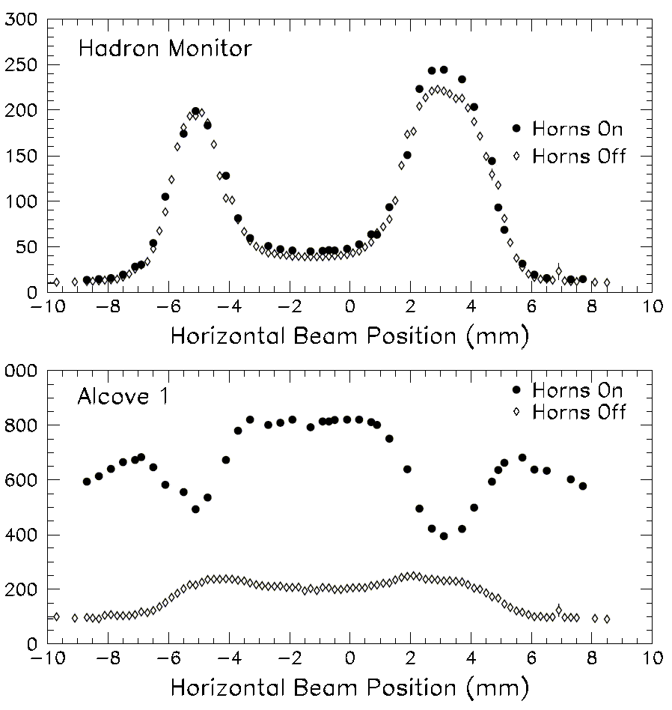
Target Alignment
Proton beam scanned horizontally across target and protection baffle
Also used to locate horns
Hadron Monitor and the Muon Monitors used to find the edges
Measured small (~1.2 mm) offset of target relative to primary beam instrumentation.
Baffle
Horn
p
Target
π
baffle
baffle
target
Graphite protection baffle
Water cooling line
Pulse Height in Chamber (arb.)
Horizontal Fin
21.4 mm
15.0 mm
11.0 mm
baffle
baffle
target
6.4 mm
Graphite target
Notes:
Harp on implementation

Slide 16
Alignment
Need beam-based alignment to be sure of what you’ve got
NuMI target hall moves when shielding blocks are installed
Thermal motion
Target, horns need features that can be located with beam scan
Monitoring alignment whilst running would be great
Hylen thermometer for NOvA – will it survive 2MW?
Particle yields must be insensitive to natural variation in proton beam position
Machine dependent
NuMI has 100um RMS
“Insensitive” is a function of the accuracy of the measurement
Issue for balls?

Slide 17
Proton beam alignment
Need to know/measure beam sigma
Variations greater than 100um are bad
NuMI has Ti SEM wires/foils
Won’t work for 2MW
Will carbon fibre survive?
Electron beam?

Slide 18
What’s in your target?
As mentioned, need target & horn model to extrapolate from near to far detector
Target has to be the same from pulse to pulse
Different from pbar or muon production target, where you don’t care too much exactly what comes out
For neutrino beam, the target is part of the physics of the experiment
Difficult to use liquid or powder target for this

Slide 19
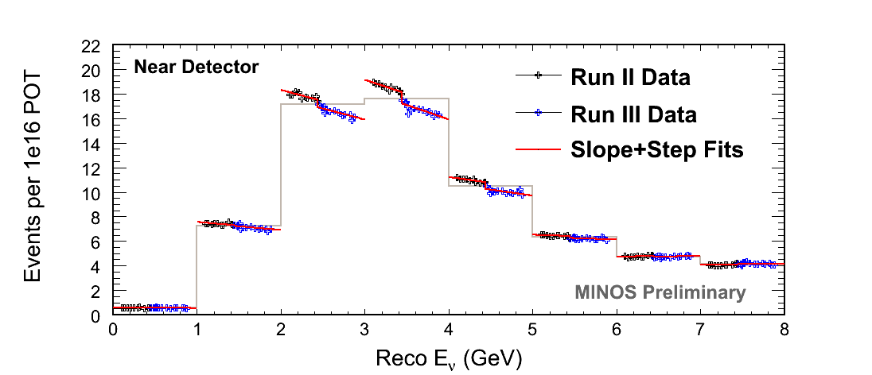
NuMI 2nd target depletion ( ZXF-5Q amorphous graphite ) NT-02 replaced when spectrum shift became too large.
Gradual decrease in neutrino rate attributed to target radiation damage
Decrease as expected when decay pipe changed from vacuum to helium fill
No change when horn 1 was replaced
No change when horn 2 was replaced
Each point in energy bin
represents ~ 1 month running,
time from 9/2006
Spectrum recovered when
new target was inserted

Slide 20
What’s in your target?
NuMI observed radiation damage to the graphite of target NT02 (change in neutrino yield)
Effect modelled by removing target fins in MC at maximum dpa from MARS model
NuMI coped with a loss of yield of 10% with a much better than 1% effect on Near -> Far extrapolation
Would prefer to replace a target before it got to that state
Want muon monitor able to track this
Don’t wait to integrate enough neutrino events to see issue.

Slide 21
Secondary beam monitoring
Target hall is a hostile environment
Want multiple complementary beam monitors to distinguish between real effects and dying instrumentation
Hadron monitor downstream of decay pipe
Survivability at 2MW?
Muon monitors
Muons and neutrinos come from same decays
Calibration, drifts, delta rays, …
Temperature rise in absorber is a great independent measure
This kind of monitoring feeds directly into experiment’s systematic error budget

Slide 22
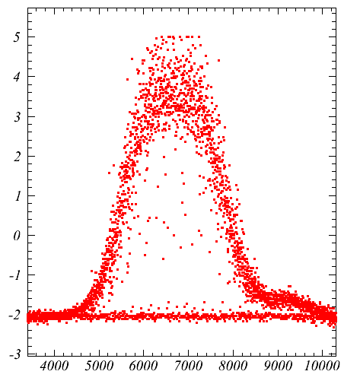
Project X / LBNE beam
LBNE beam still comes from Main Injector
New RF system, but not much change
53 MHz bunches
Bunch length < 2ns sigma
1.2s cycle time at 120 GeV
0.75s at 60 GeV
1.6E14 protons per spill
3.3E11 protons per bunch
Factor 4 increase over now
2.3 MW
3.5ns

Slide 23
Summary
Uptime (integrated neutrino yield)
For a given target, integrated number of protons
It’s probably worth paying a little pion yield for a more robust target
Robustness/fast replacement
Repeatability
Target is the same each pulse
Alignability
Target hall components can be aligned, and alignment monitored, with beam
Radiation damage
Model and monitor
Redundant instrumentation
If you see an effect in hadron monitor and muon monitor, it’s more likely to be real
At 2.2MW, expect the unexpected
Plan & mitigate risks, but…

