Slide 1
ISIS upgrades
David Findlay
Head, Accelerator Division
ISIS Department
Rutherford Appleton Laboratory / STFC
Proton Accelerators for Science and Innovation, 12–14 January 2012, FNAL

Slide 2
ISIS
  World’s most productive spallation neutron source
  (if no longer highest pulsed beam power)
  World-leading centre for research in the physical and life sciences
  National and international community of >2000 scientists — ISIS has been running since 1984
  Research fields include clean energy, the environment, pharmaceuticals and health care, nanotechnology, materials engineering and IT
  ~450 publications/year (~9000 total over 26 years)
  MICE (Muon Ionisation Cooling Experiment)

Slide 3
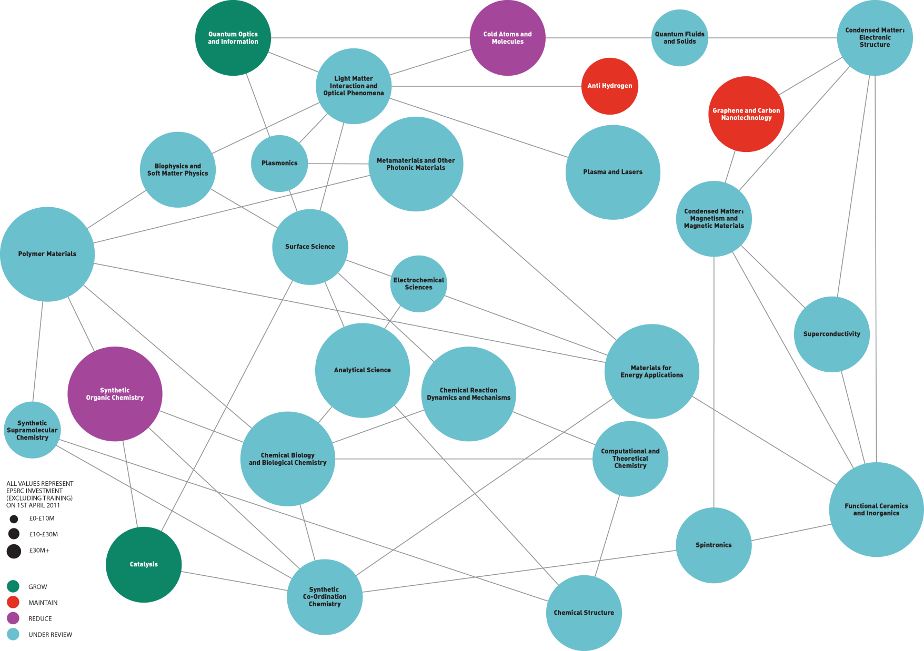

Slide 5
High-impact publications for ILL and ISIS
High-impact publications per instrument
High-impact publications ÷ facility budget
Average numbers of high-impact publications per year in 2008, 2009 and 2010: ISIS, 129; ILL, 162.

Slide 6
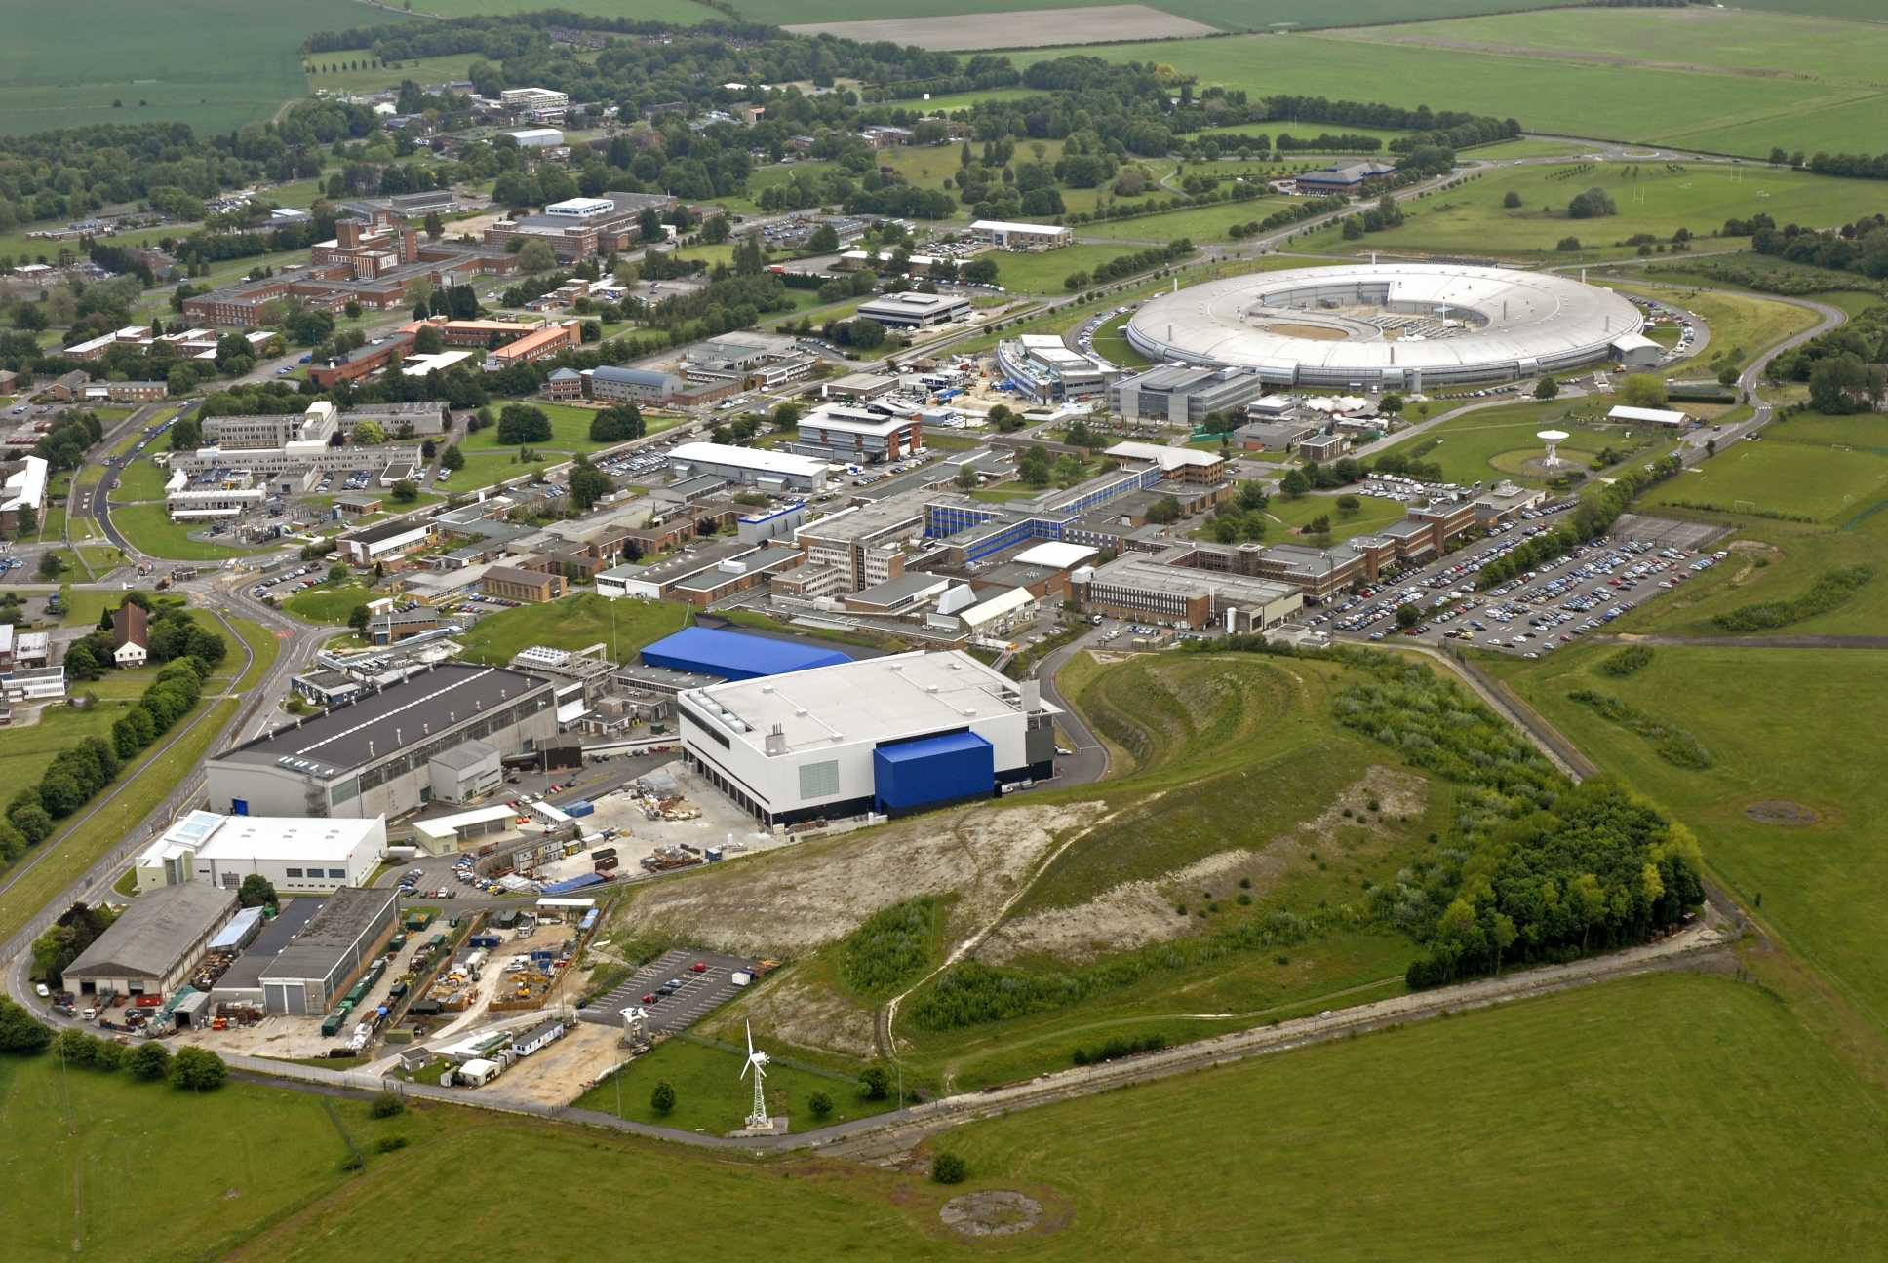
Diamond — X-rays
ISIS — neutrons
Rutherford Appleton Laboratory, Oxfordshire

Slide 7
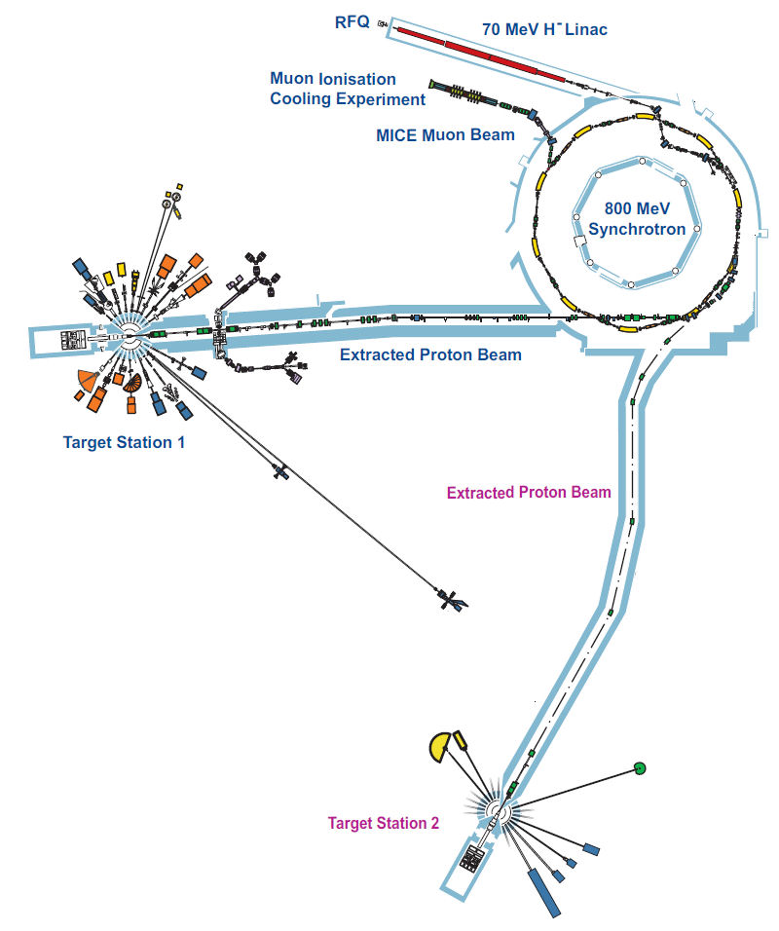

Slide 8
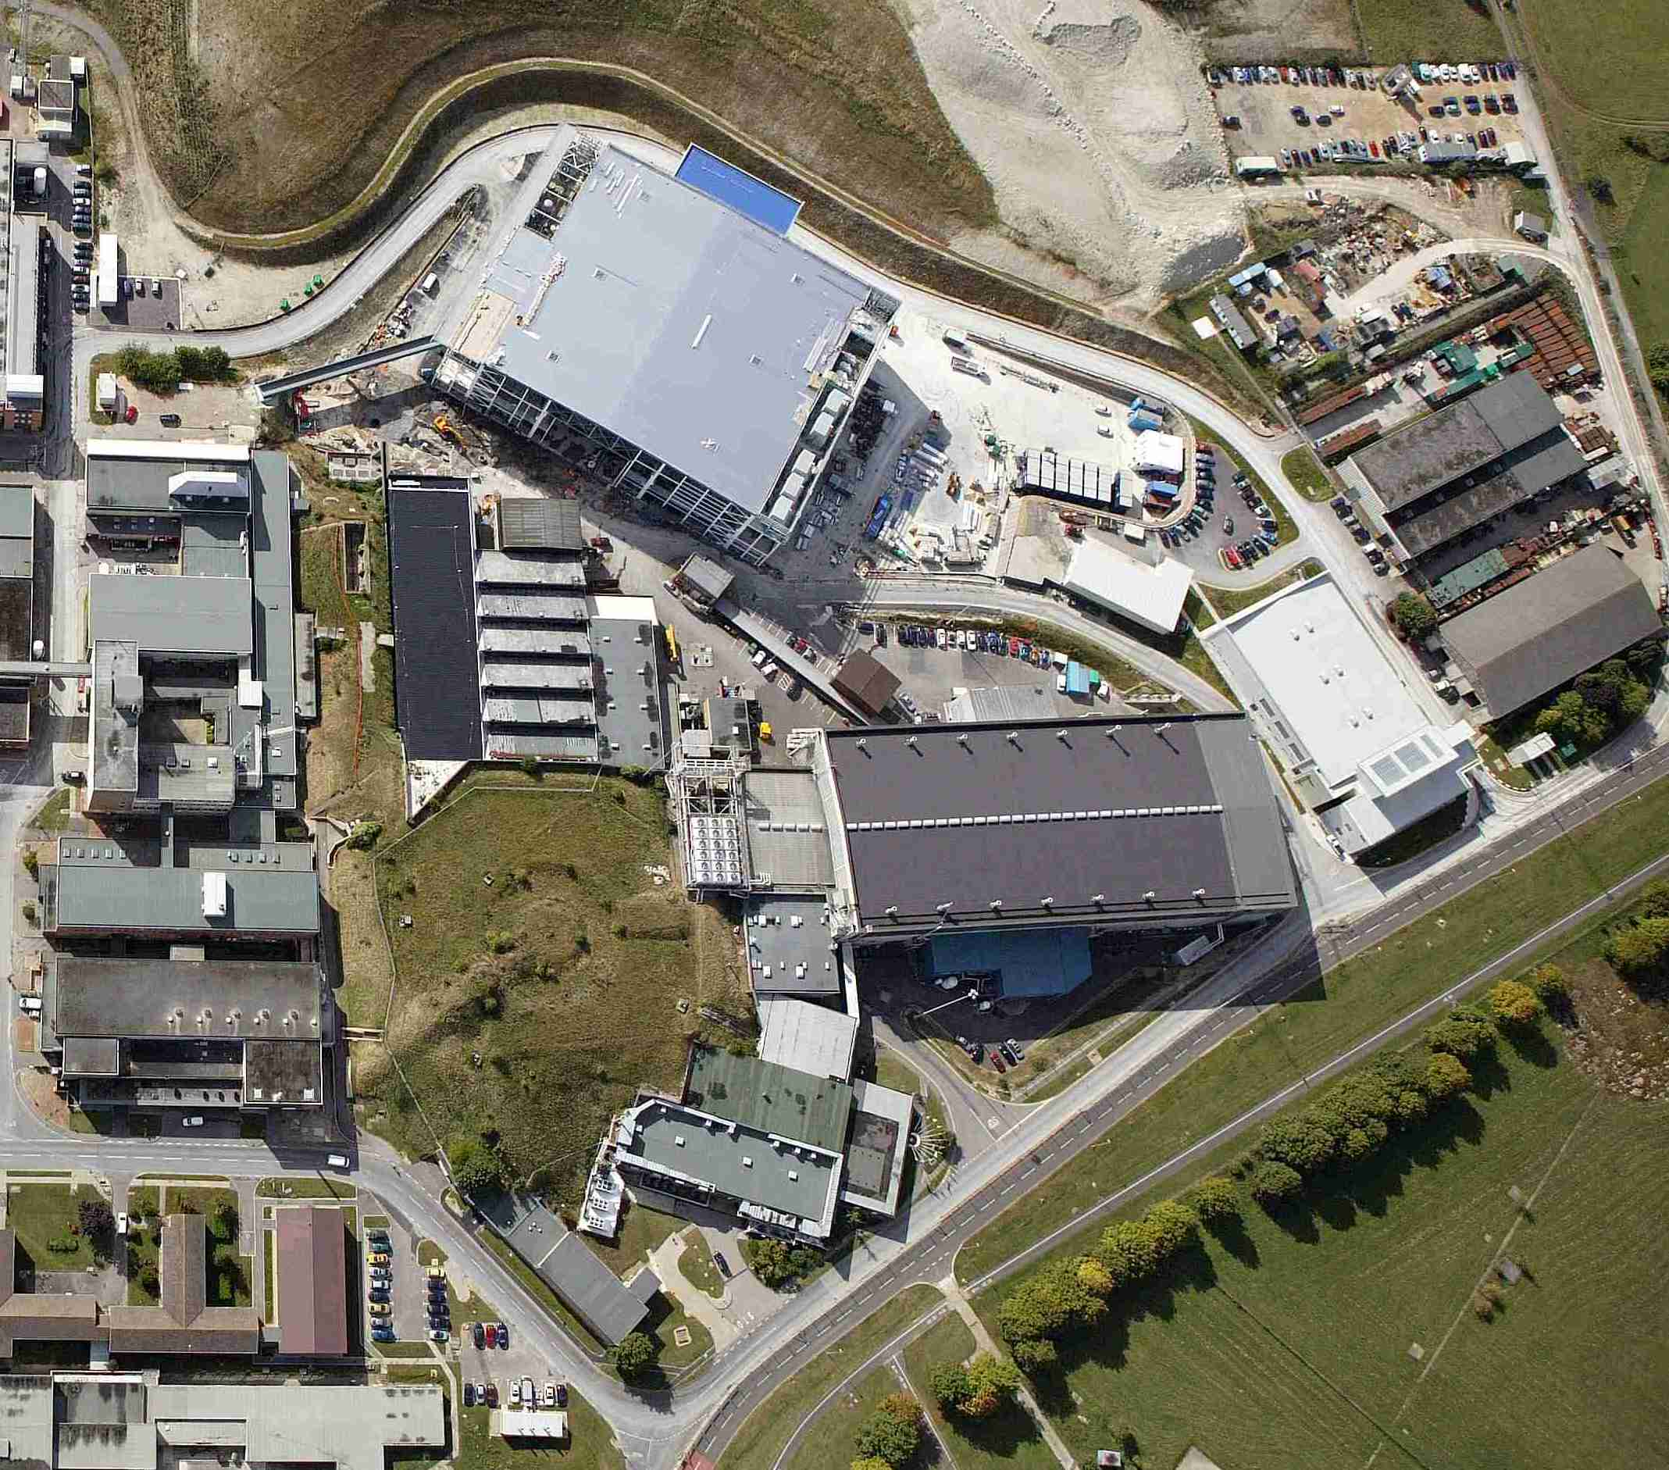
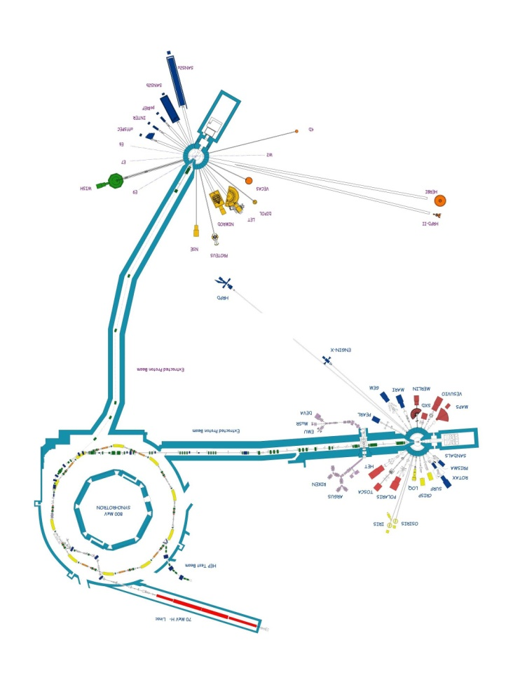
ISIS from air

Slide 9
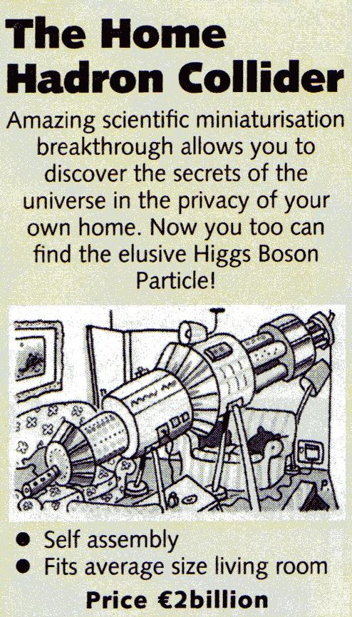

Slide 10
ISIS accelerators
  Juvenile RFQ
  Venerable linac
  Mature synchrotron ~0.2 MW, 50 pps
  Two target stations 40 pps to TS-1
  10 pps to TS-2

Slide 11
RFQ: 665 keV H–, 4-rod, 202 MHz
Linac: 70 MeV H–, 25 mA, 202 MHz, 200 µs, 50 pps
Synchrotron: 800 MeV proton, 50 Hz
5 µC each acceleration cycle
Dual harmonic RF system
Targets: 2 × W (Ta coated)
Protons: 2 × ~100 ns pulses, ~300 ns apart
Moderators: TS-1: 2 × H₂O, 1 × liq. CH₄, 1 × liq. H₂
TS-2: 1 × liq. H₂ / solid CH₄, 1 × solid CH₄
Instruments: TS-1: 20 TS-2: 7 (+ 4 more now funded)
~340 staff

Slide 12
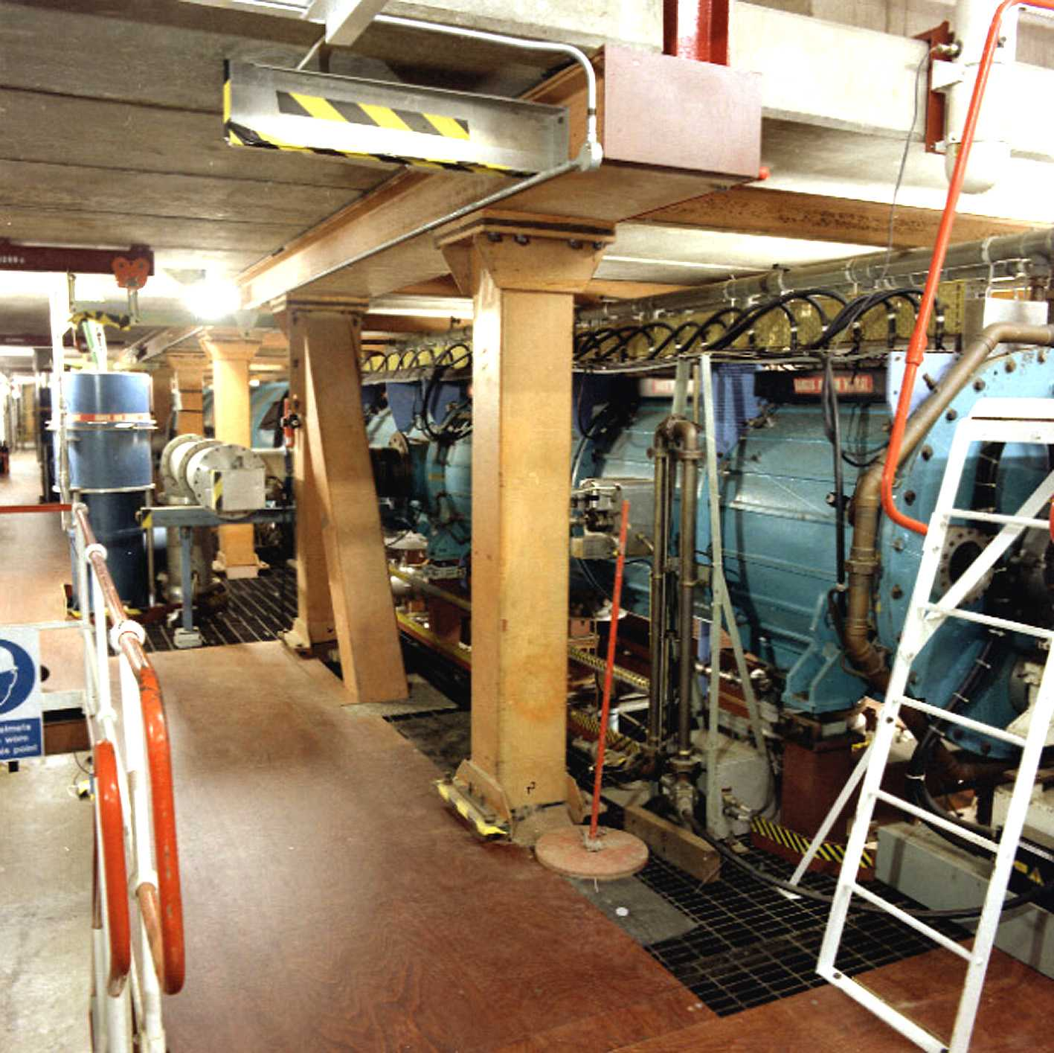
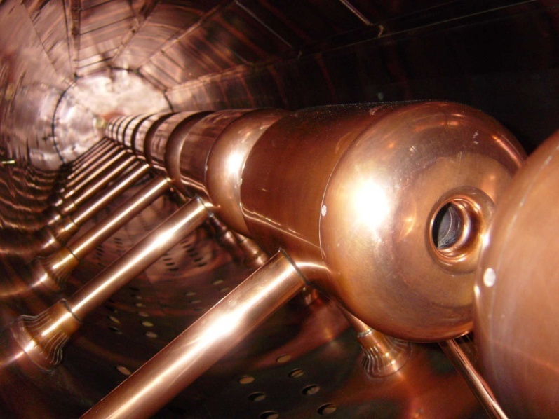
70 MeV 202 MHz 4-tank H– linac

Slide 13
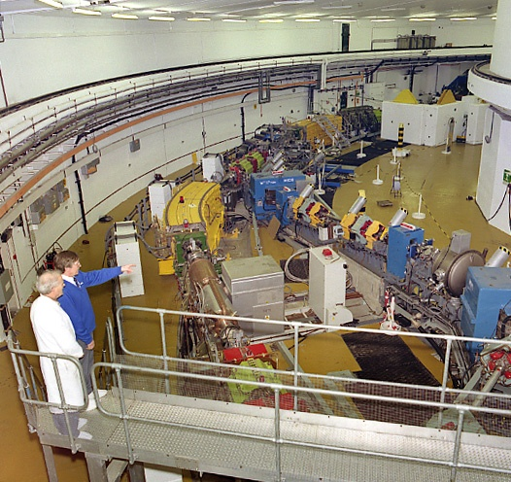
1.3–3.1 + 2.6–6.2 MHz 70–800 MeV proton synchrotron

Slide 14
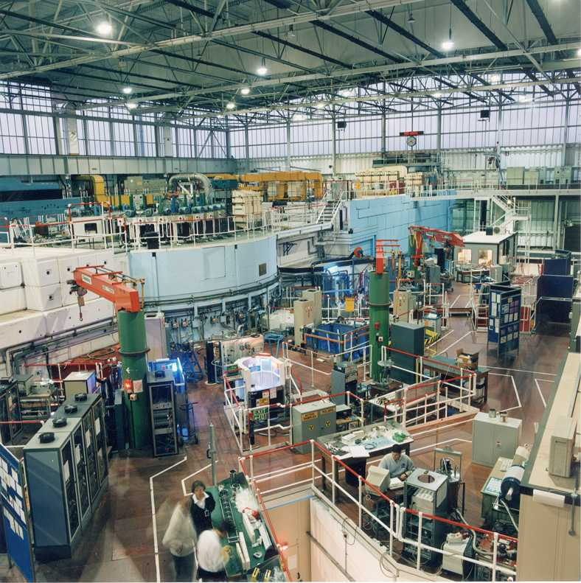
ISIS TS-1 experimental hall, 20 instruments

Slide 15
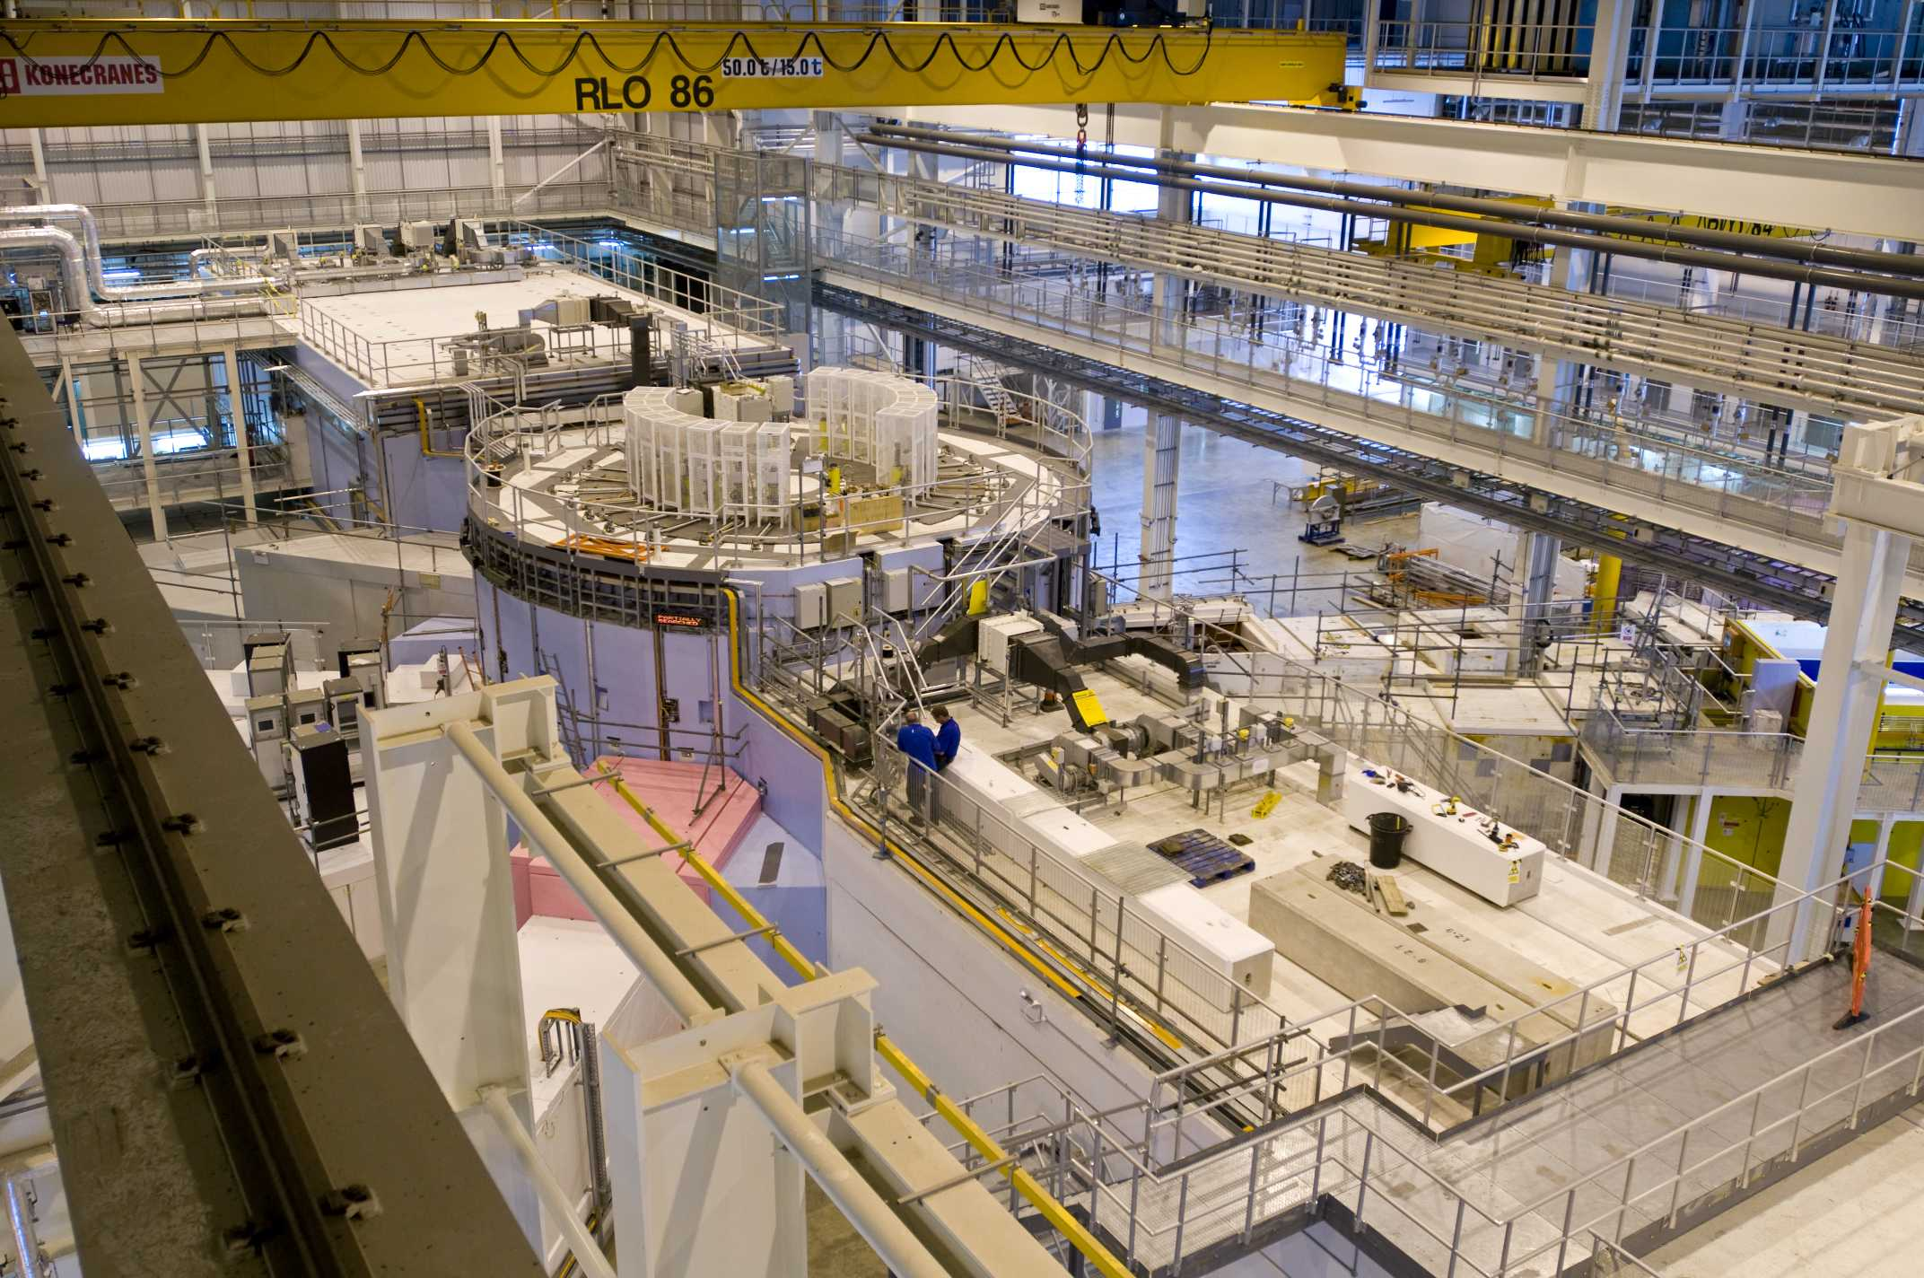
ISIS TS-2 experimental hall, 7 instruments + 4 under way

Slide 16
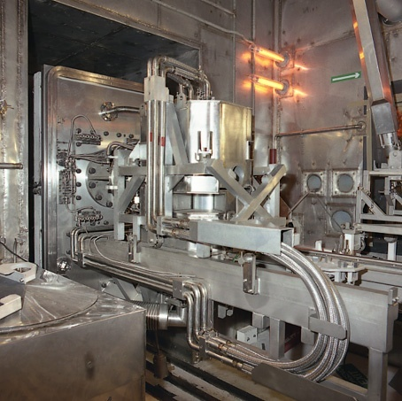
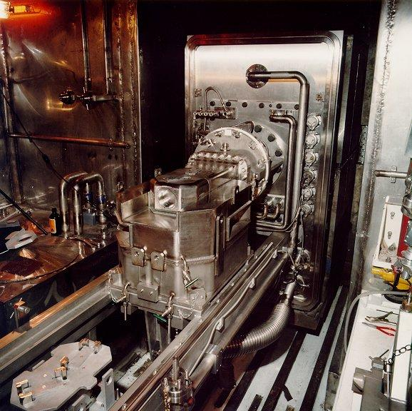
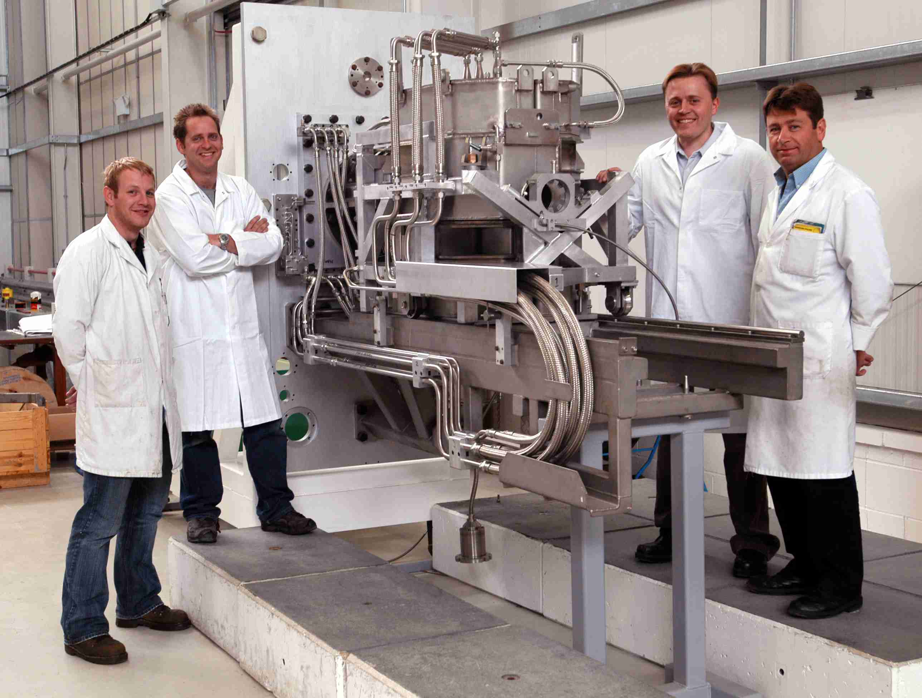
TS-1 tungsten target (plate target)
Notes:
16

Slide 17
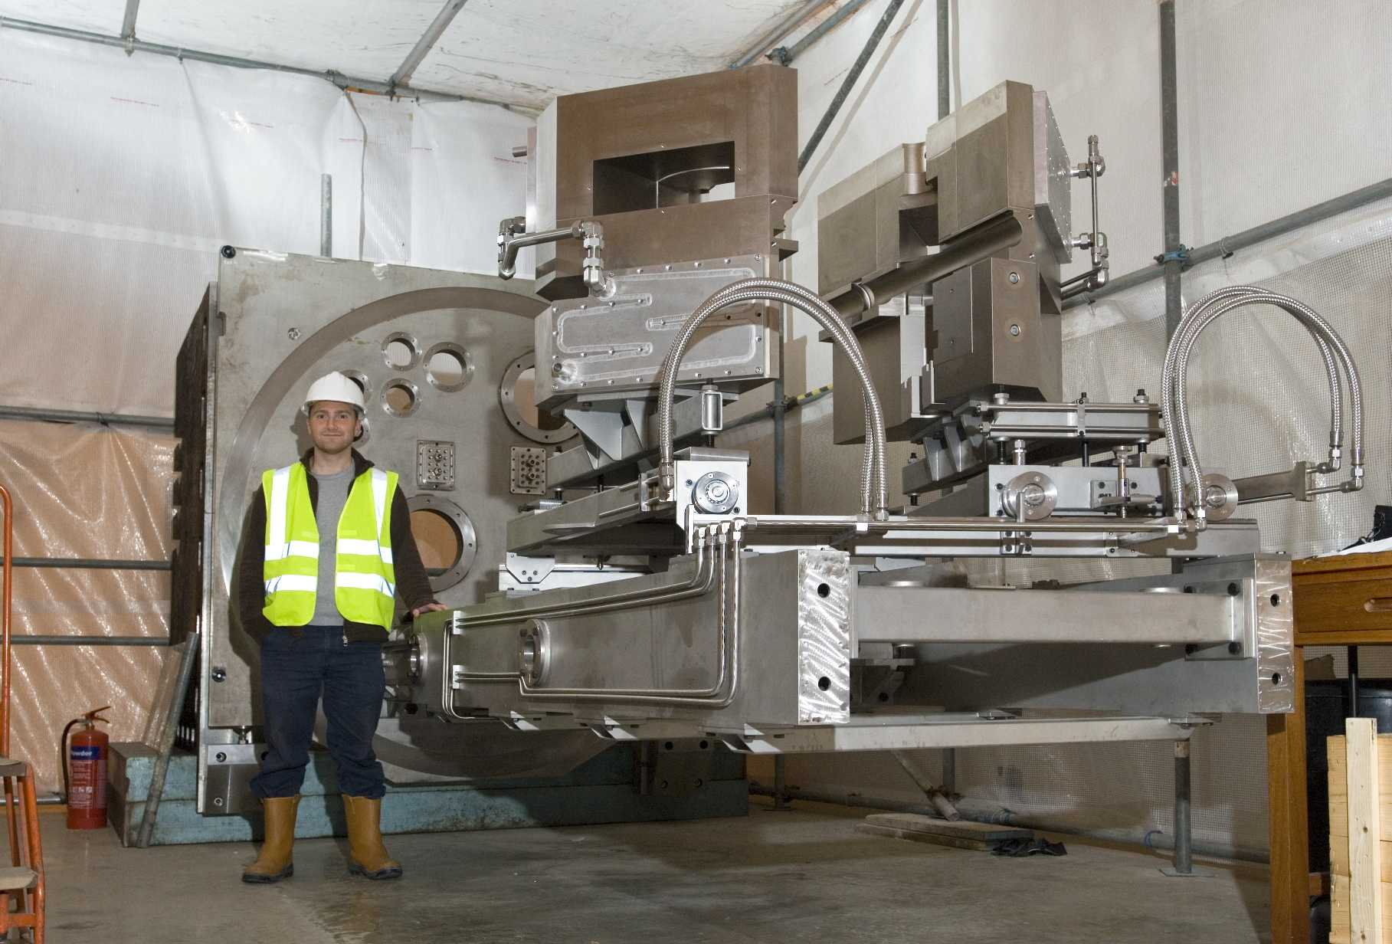
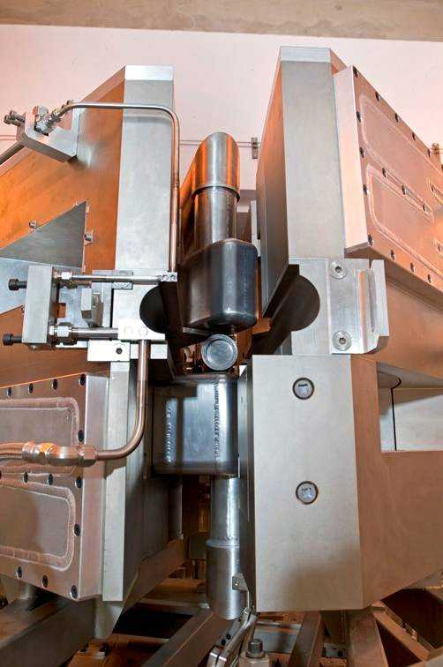
TS-2 tungsten target (~solid cylinder)
Notes:
17

Slide 18
ISIS Upgrades
0) Linac and TS-1 refurbishment
1) Linac upgrade, ~0.5 MW on TS-1
2) ~3 GeV booster synchrotron: MW target
3) 800 MeV direct injection: 2–5 MW target
Overlap with NF
proton driver
4) Upgrade 3) + long pulse mode option
Seen as one of four “big opportunities” for STFC

Slide 19
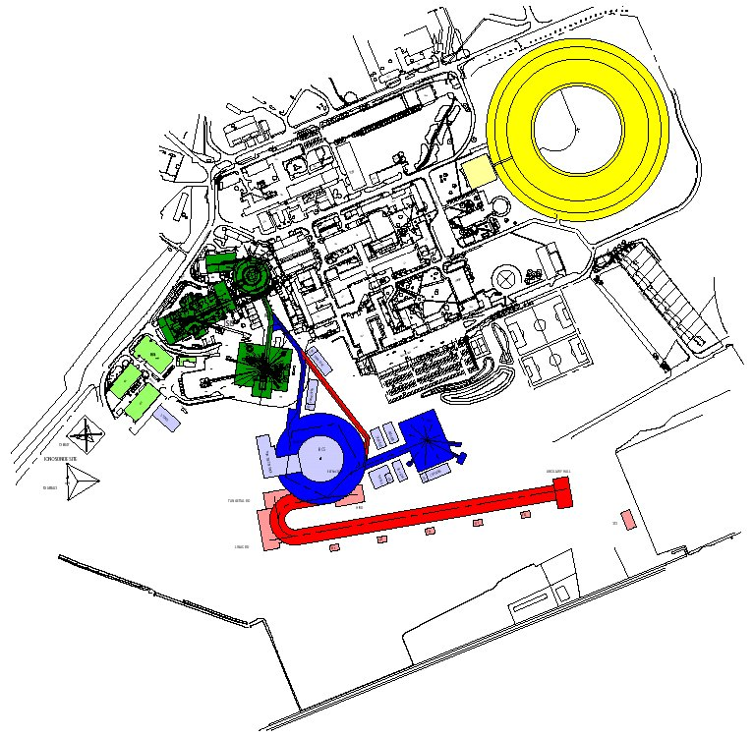
ISIS MW Upgrade Scenarios
1) Replace 70 MeV ISIS linac by new ~180 MeV linac (~0.5 MW)
2) ~3.3 GeV RCS fed by bucket-to-bucket transfer from ISIS 800 MeV synchrotron (1MW, perhaps more)
3) Charge-exchange injection from 800 MeV linac (2 – 5 MW)

Slide 20
ISIS MW Upgrade Scenarios
1) Replace 70 MeV ISIS linac by new ~180 MeV linac (~0.5 MW)
2) ~3.3 GeV RCS fed by bucket-to-bucket transfer from ISIS 800 MeV synchrotron (1MW, perhaps more)
3) Charge-exchange injection from 800 MeV linac (2 – 5 MW)

Slide 21
ISIS MW Upgrade Scenarios
1) Replace ISIS 70 MeV linac by new ~180 MeV linac (~0.5 MW)
2) Based on a ≈ 3.3 GeV RCS fed by bucket-to-bucket transfer from ISIS 800 MeV synchrotron (1MW, perhaps more)
3) Charge-exchange injection from 800 MeV linac (2 – 5 MW)
More details: John Thomason’s talk

Slide 22
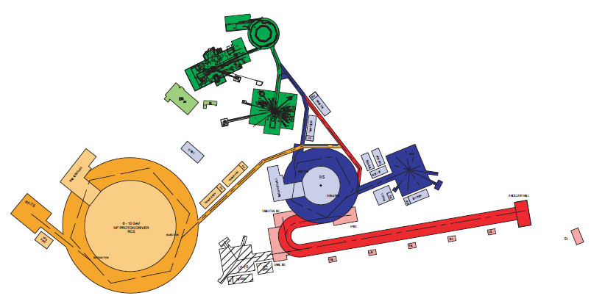
Common proton driver for neutrons and neutrinos
Based on MW ISIS upgrade
with 800 MeV Linac and 3.2
GeV RCS
Assumes a sharing of the beam
power at 3.2 GeV between the
two facilities
Both facilities can have the
same ion source, RFQ, chopper,
linac, H⁻ injection, accumulation
and acceleration to 3.2 GeV
Requires additional RCS machine in
order to meet the power and energy
needs of the Neutrino Factory

Slide 23
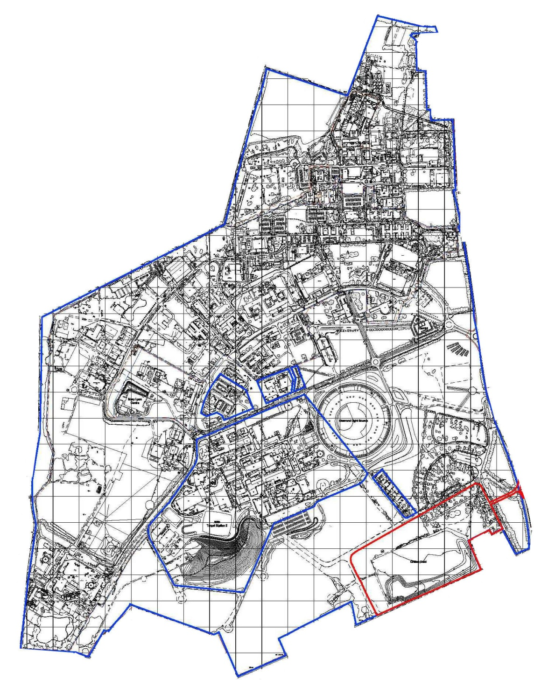

Neutrino factory on Harwell site
Extensive geological
survey data available,
but needs work to
understand implications
for deep excavation
muon
FFAG
decay ring to Norsaq
155 m below ground
UKAEA land now
not to be
decommissioned
until at least 2040
(unless we pay
for it!)
RLA 2
RLA 1
muon linac
cooling
phase rotation
bunching
decay ring to INO
440 m below ground

Slide 24
ISIS upgrade option Proton Rep. Mean Mean Neutrons
energy rate current power cf. present
Linac + TS-1 refurb. TS-1 800 MeV 40 pps 200 µA 0.16 MW × 2
TS-2 800 MeV 10 pps 50 µA 0.04 MW × 1
Linac upgrade TS-1 800 MeV 47 pps 552 µA 0.44 MW × 4
TS-2 800 MeV 3 pps 48 µA 0.04 MW × 1
3.2 GeV synch. TS-3 3.2 GeV 48 pps 308 µA 0.98 MW × 6
TS-2 3.2 GeV 2 pps 13 µA 0.04 MW × 1
800 MeV ch. exch. inj. TS-3 3.2 GeV 49 pps 1177 µA 3.77 MW × 12
TS-2 3.2 GeV 1 pps 24 µA 0.08 MW × 2
TS-3 3.2 GeV 48 pps 1153 µA 3.69 MW × 12
TS-2 800 MeV 2 pps 48 µA 0.04 MW × 1
Useful neutrons scale less than linearly with power

Slide 25
ISIS upgrade option Proton Energy Range Beam °C in target
energy per pulse in W diameter per pulse
Linac + TS-1 refurb. TS-1 800 MeV 3.2 kJ 23 cm 6 cm 1.8
TS-2 800 MeV 3.2 kJ 23 cm 3 cm 7.3
Linac upgrade TS-1 800 MeV 9.6 kJ 23 cm 6 cm 5.4
TS-2 800 MeV 9.6 kJ 23 cm 3 cm 22
3.2 GeV synch. TS-3 3.2 GeV 20kJ 130 cm 8 cm 1.2
TS-2 3.2 GeV 20kJ 130 cm 3 cm 8.3
800 MeV ch. exch. inj. TS-3 3.2 GeV 77 kJ 130 cm 8 cm 4.4
TS-2 3.2 GeV 77 kJ 130 cm 3 cm 31
TS-3 3.2 GeV 77 kJ 130 cm 8 cm 4.4
TS-2 800 MeV 19 kJ 23 cm 3 cm 44
Beam area × range, density, specific heat — very approximate

Slide 26
Let N_{f} (neutrons/s) be fast neutron source strength,
let P (kW) be proton beam power,
let r_{t} (cm) be characteristic dimension of fast-neutron-producing target,
let φ (neutrons/cm²/s) be fast flux intercepted by moderator,
assume N_{i} (neutrons/s) to be number of neutrons useful for neutron beam line instruments,
and assume volume of fast-neutron-producing target to scale with power (i.e. there is a limiting watts/cm³ for removing heat).
Then, very approximately,
N_{f} ∝ P,
r_{t} ∝ P^{1/3},
φ ∝ N_{f} / r_{t}²,
N_{i} ∝ φ,
and so N_{i} ∝ P /( P^{1/3})² = P^{1/3}

Slide 27
Simple three-dimensional analytic model of heat dissipated in target

Slide 28
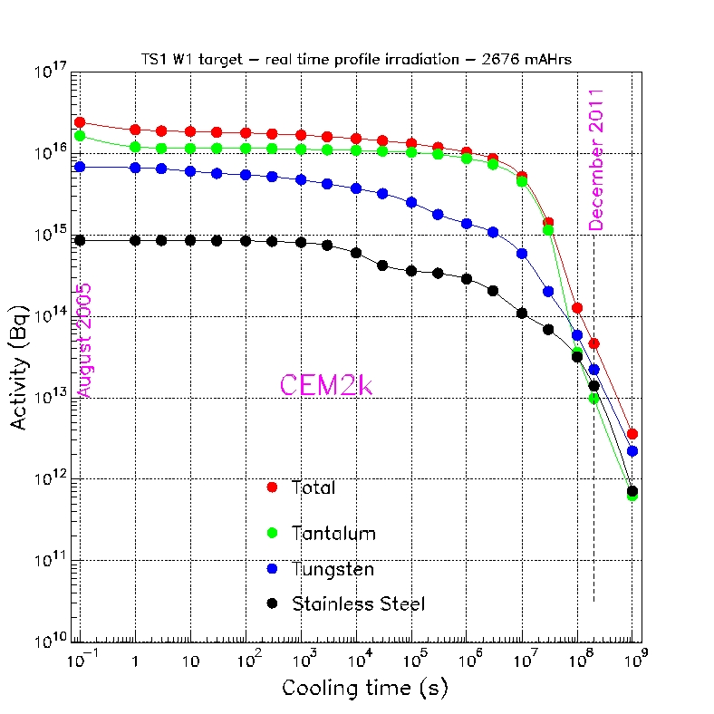
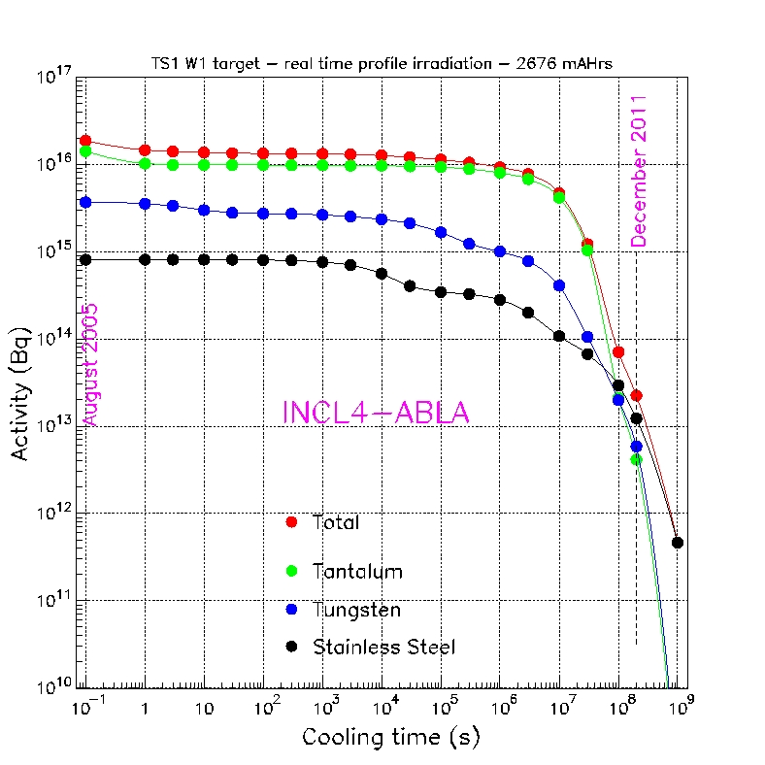
Activities of ISIS tungsten target removed in 2005

Slide 29
Summary
  Staged set of upgrades
  Lot of design work being done [other WG]
  We’ll certainly upgrade TS-1 — scenario 0
  Linac upgrade (to ~0.5 MW) possible nationally
  Higher powers internationally
  Interested in establishing limits for solid targets

Slide 30



Slide 31
STFC’s four “big opportunities”
  HiPER ¹
  Square Kilometre Array (SKA) ²
  Free Electron Light Source
  ISIS Upgrades
  ¹ European High Power laser Energy Research facility
  ² 3000 dishes each 15 m in diameter

Slide 32
ISIS operations
Typically 180 days a year running for users
Maintenance/shutdown
~1–2 weeks machine physics + run-up
~40-day cycle
~3-day machine physics
Machines run ~250 days per year overall
~5/year

Slide 33
Target Upgrade TS1
Matt Fletcher
Head, Design Division
ISIS Department
Rutherford Appleton Laboratory / STFC
Proton Accelerators for Science and Innovation, 12–14 January 2012, FNAL

Slide 34
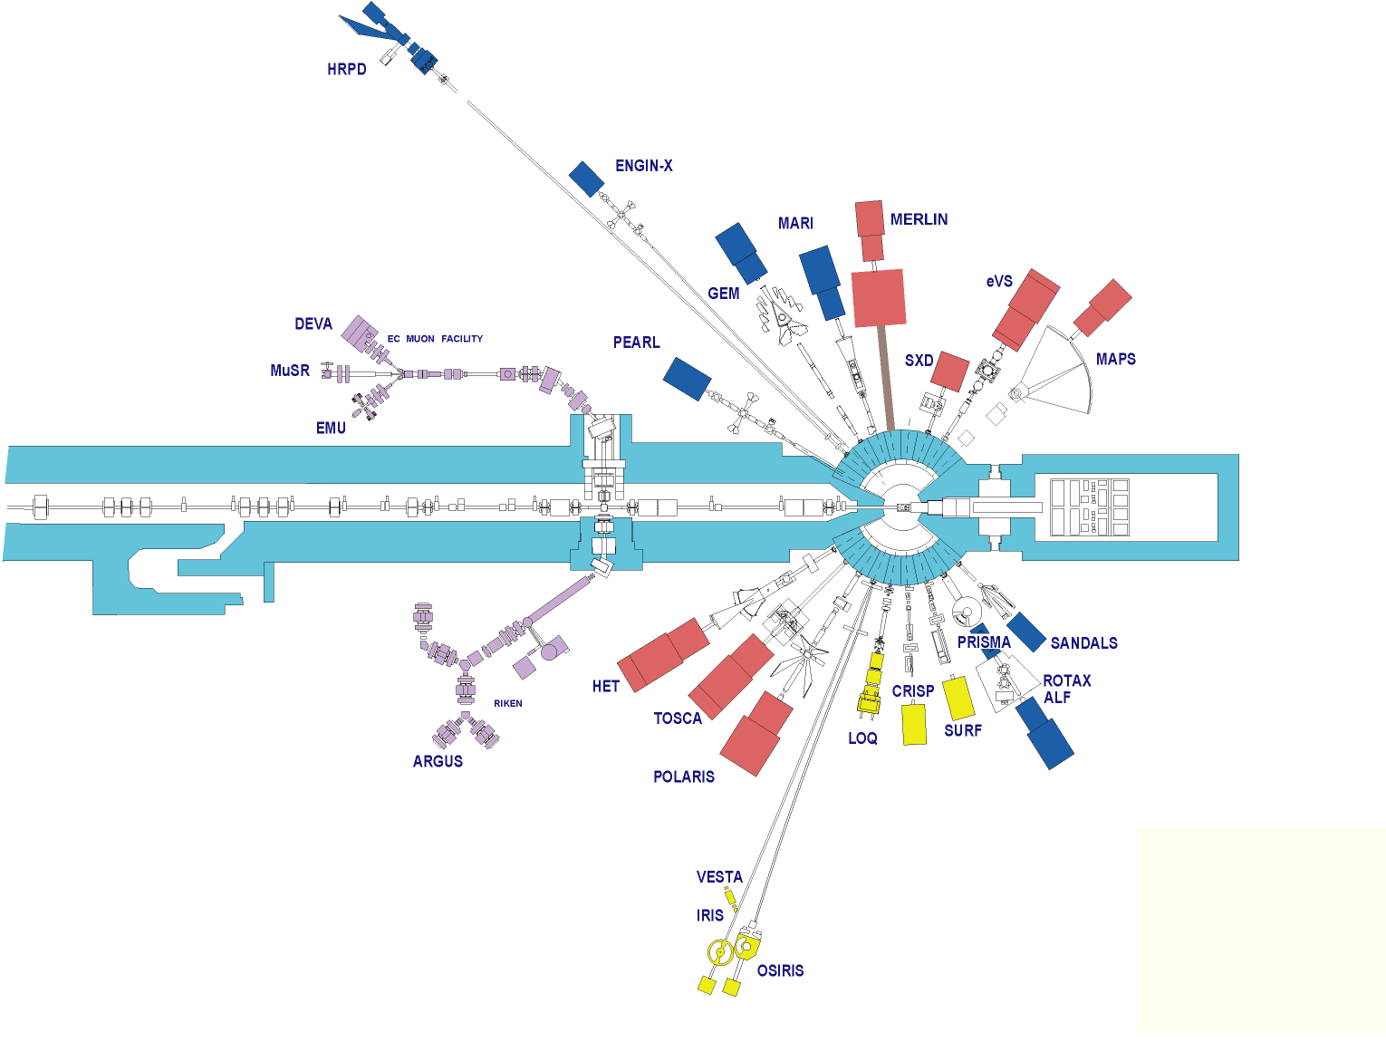
Tungsten target D₂O cooled
Moderators
  H₂O 0.5 l Gd poison Boral decoupler
  CH₄ 0.5 l Gd poison Boral decoupler
  H₂ 0.8 l no poison no Cd decoupler
Beryllium (D₂O cooled) reflector
18 Neutron Beam Holes

Slide 35
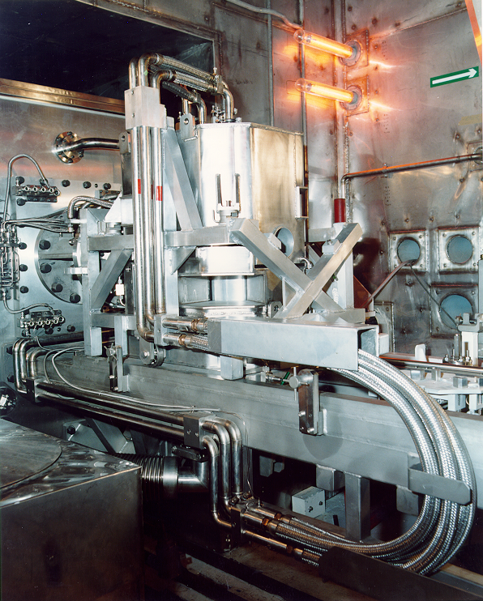

Slide 36
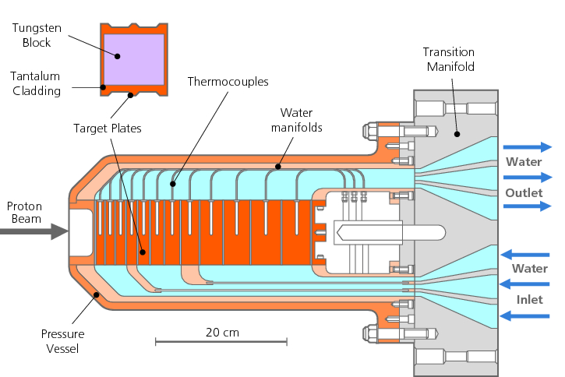

Slide 37
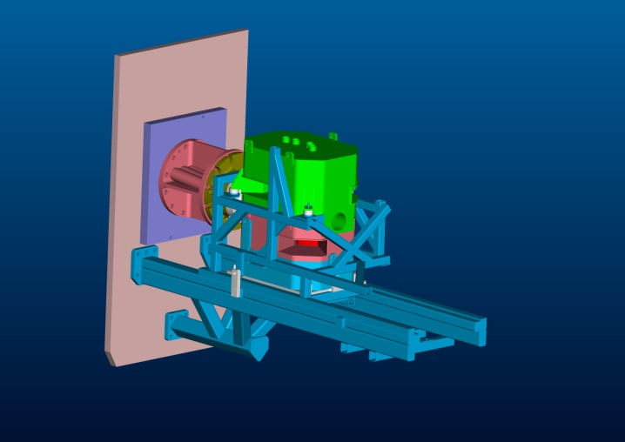
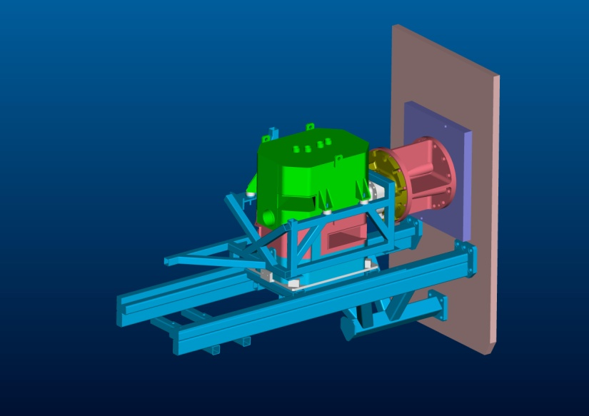
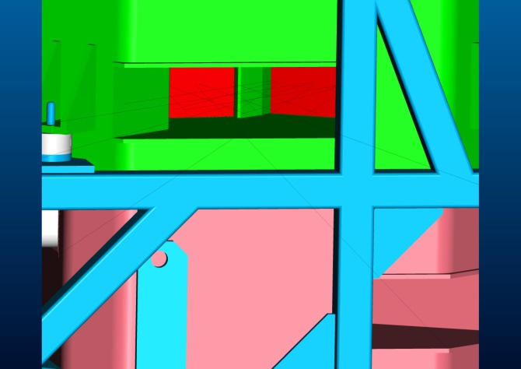
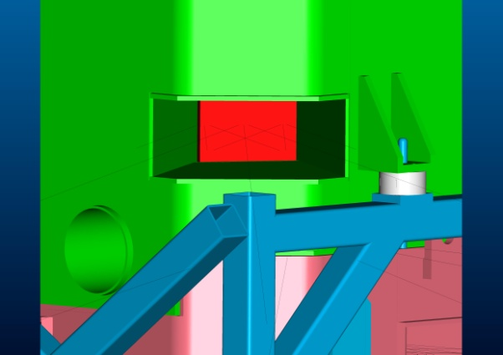

Slide 38
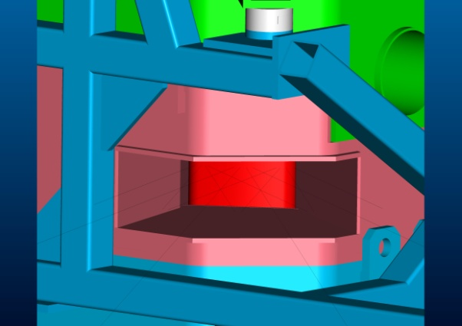
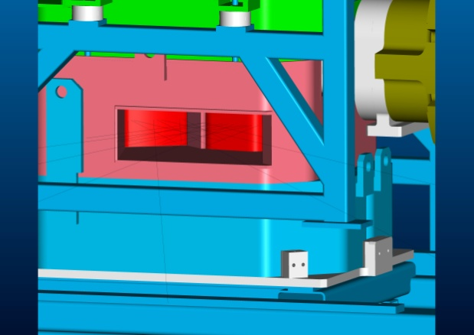

Slide 39
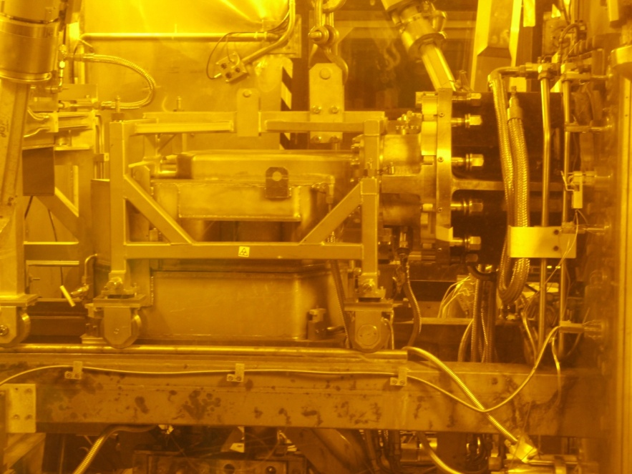
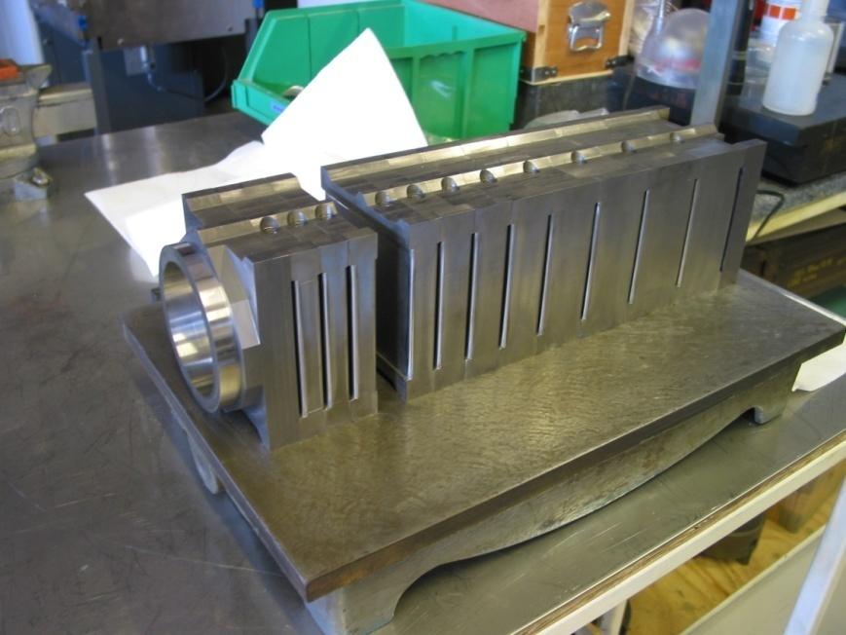
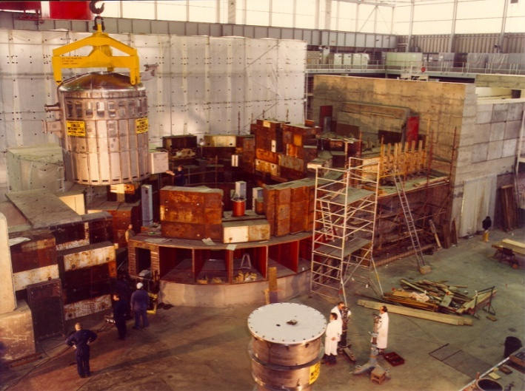
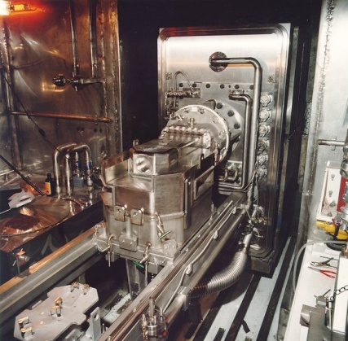

Slide 40
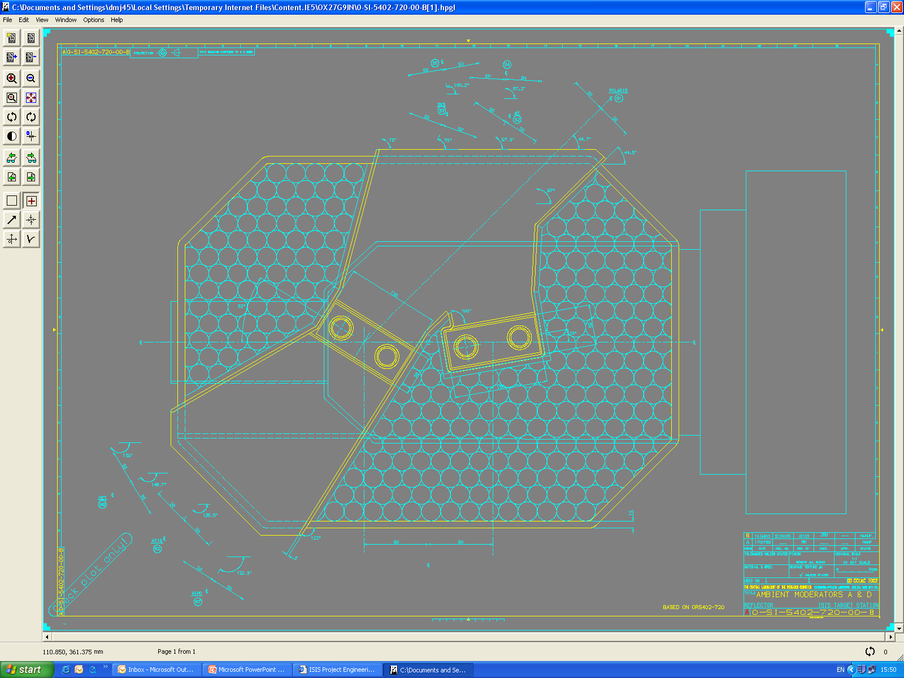
MERLIN
eVS
MAPS
SXD
HET
TOSCA
POLARIS

Slide 41
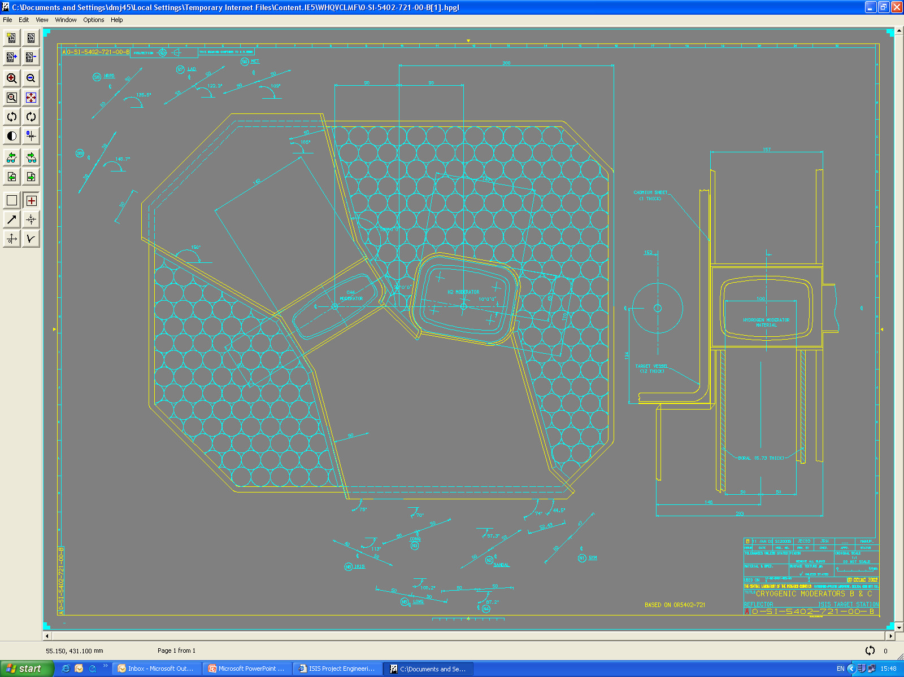
HRPD/ENGIN-X
GEM
MARI
PEARL
SANDALS
IRIS/OSIRIS/VESTA
PRISMA/ROTAX/ALF
LOQ
CRISP
SURF

Slide 42
Constraints on the design of new instruments for TS-1
Neutron beam line heights unchanged
  Avoid realigning half the instruments (costly, time consuming)
Beam lines aligned with current moderators (Except N3 - SURF which could be realigned to the bottom front moderator)
  Changing a void vessel window – 1-2 year shutdown and substantial risk to future operations
Two top moderators – ambient
  Making top moderators cryogenic is not practical with existing transfer lines
Two bottom moderators cryogenic

Slide 44
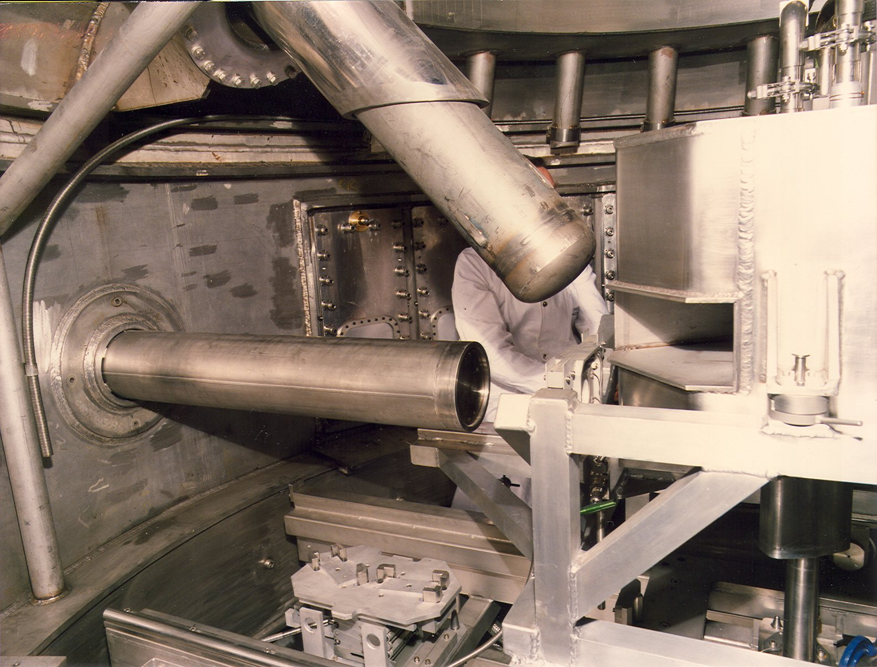
Void Vessel Window

Slide 45
Options for the design of new instruments for TS-1
Moderator materials
Target, moderator and reflector geometry
Poison and decoupler materials and arrangement
Addition of pre-moderator(s)
To perform an efficient optimisation each instrument should define a quantitative metric which is representative of its performance

Slide 46
Constraints
Existing, Operating and Old (25+ years)
Cost / Benefit
Beam Input – linked to Accelerator upgrade

Slide 47
Constraints
Flight line position
Shielding to be at least the same
Reliable
Upgradeable in the future
Life of targets >5 years
Risk Low
Change suspect parts
Time
Documentation
Diagnostics
Instrumentation upgrades not part of the project

Slide 48
Constraints
Conservative approach
  Known materials / cooling
  Bench tested where possible
  Manufacturing routes understood
Flexibility for change within moderators
Possible development moderator....

Slide 49
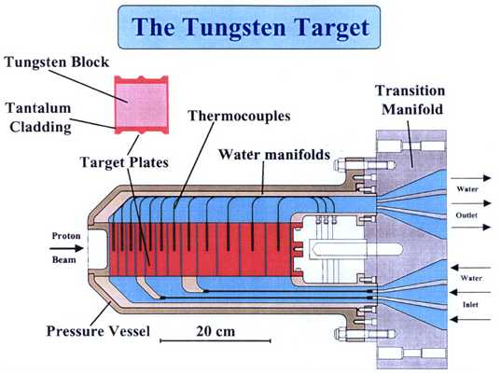
TS-1 tungsten target (plates)

Slide 50
Geometry and materials for MCNPX , ISIS W target #1

