Slide 1
Challenges for Flowing Targets
Bernie Riemer (ORNL)
(Jan. 13, 2012)
Fundamentally, target challenges are driven by:
  High power density
  High energy density (pulsed systems)
    Material limits on temperature, stress / shock
Notes:
Total power / energy is important, but if you have the space to spread it out …

Slide 2
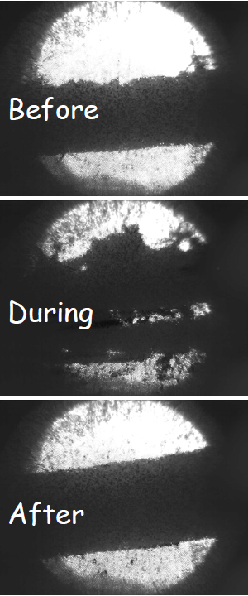
Complicating / exacerbating factors
Physics requirements
  Geometry
    E.g., interaction with system components, stability
  Materials (Z)
  Environment (e.g., vacuum, magnetic field, temperature)
Required target lifetime
  Radiation damage tolerance, target maintainability
Facility / safety / regulatory issues
  Material hazards, toxicity
  Credited safety components
  Waste disposition
Herein lies difficulty for collaborations:
These are facility and mission specific
MERIT Experiment
1300 J/cc/pulse

Slide 3
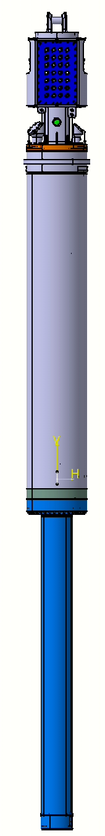
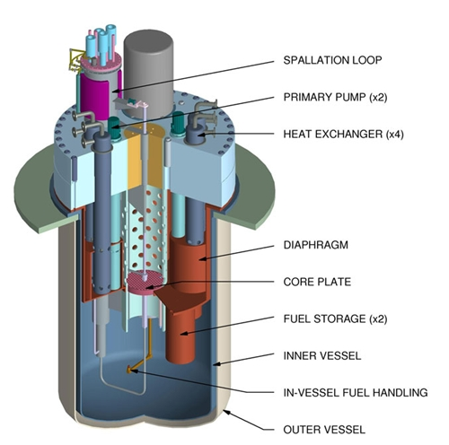
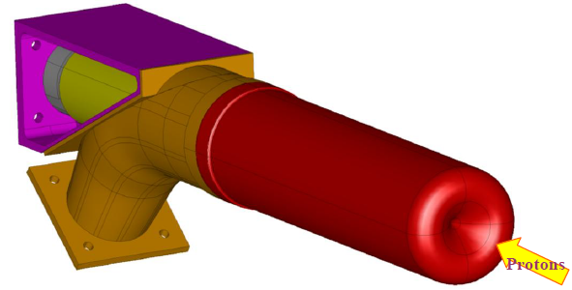
Flowing targets are one way to deal with high power / energy density
Liquid Metal Targets
High power spallation targets:
  SNS, JSNS (Hg, pulsed)
  MEGAPIE (LBE, CW)
ADS for waste transmutation:
  MYRRHA (LBE, CW, “windowless” option)
Neutrino factories:
  MERIT (Free Hg jet , pulsed)
RIB & ISOL targets:
  EURISOL (Hg, CW)
  ISOLDE (molten Pb, pulsed)
Material test facilities
  IFMIF (Lithium, CW)
  MTS (hybrid W/LBE option, pulsed)
MYRRHA core & target
MEGAPIE Target
EURISOL Target
Notes:
By moving target mass through the beam interaction zone, the volume is effectively increased and power / energy density decreased

Slide 4
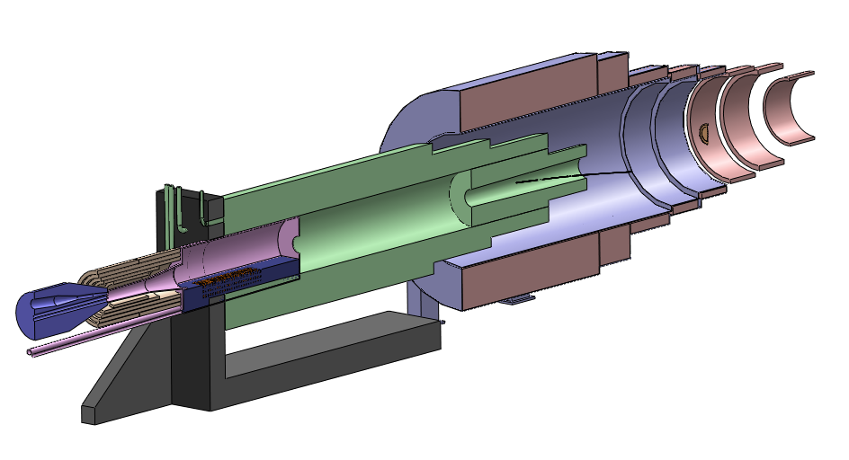
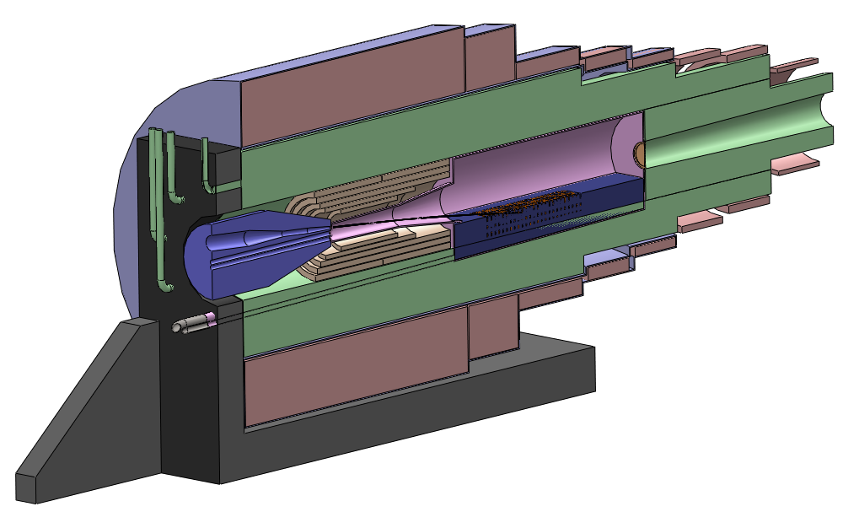
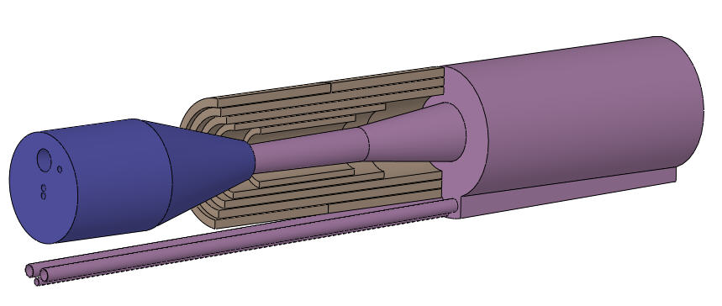
Spatial challenge example:
Neutrino Factory Target Concept
Target System design challenges
  Shallow beam / nozzle angles lead to mechanical interferences
  Nozzle & drain piping require loss of SC magnet shielding
  Components are large & heavy but require precise alignment
  Inner resistive magnets severely complicates mercury system, forces an hourglass-shaped mercury volume
Resistive
Magnets
Mercury Pool
Vessel
Nozzle & Beam Pipe
Module

Slide 5
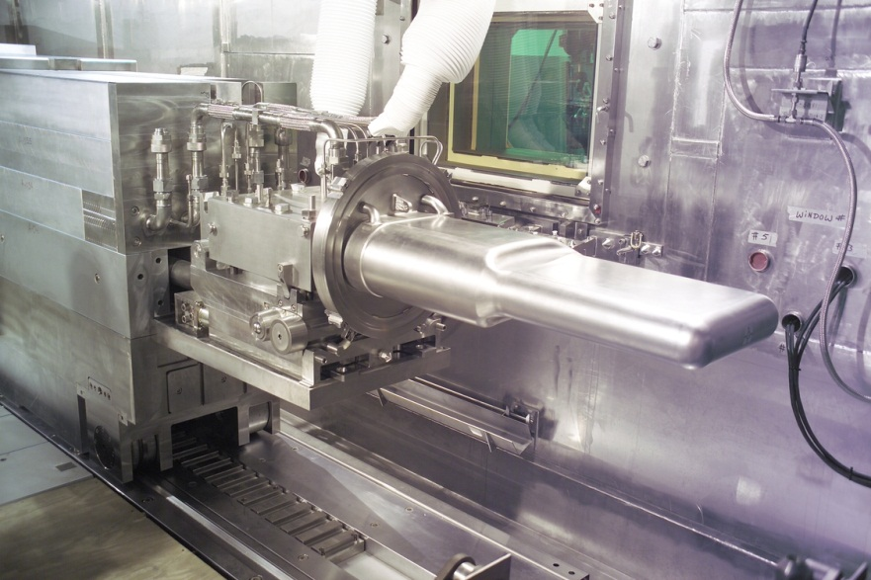
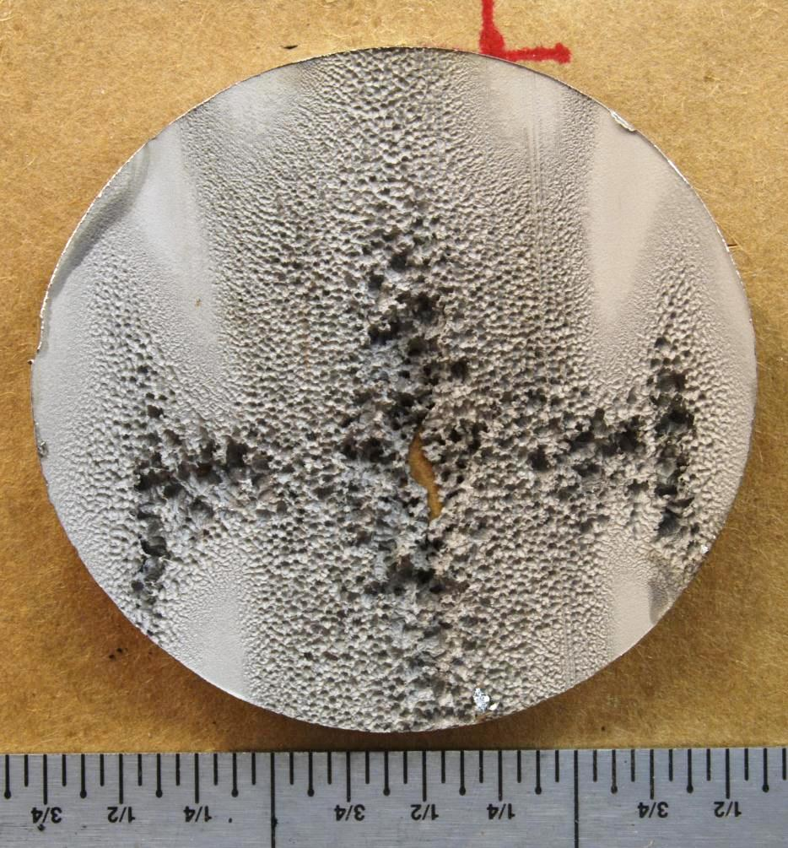
SNS mercury target challenges
Target power capacity and lifetime are limited by
  Beam-induced cavitation damage
  Radiation damage
    10 dpa “soft” limit for SS316L
Requirements for high facility production hours (5000/yr) and availability (>90%)
  No more than 4 target replacements per year; fewer better
Early target challenges were addressed with R&D
  Target beam window cooling
  Vessel fatigue from pressure pulse
  Mercury compatibility with SS316
  Remote handling
  Large mercury process system

Slide 6
Early R&D has paid off:
Target #3 leaked (internally contained) – interrupted user program 2 weeks

Slide 7
Three of first four SNS targets operated without incident
Although we strongly suspect cavitation damage, we have not located nor characterized T3’s leak
  PIE is a big challenge (difficult and expensive)
Have not reached accelerator design power of 1.4 MW
Energy upgrade to 1.3 GeV → 1.8 MW
Other upgrades → 2+ MW possible
SNS power / energy density is not so extreme
  At 2 MW beam power, maximum power density is ca. 750 W/cc; maximum energy density ca. 13 J/cc/pulse

Slide 8
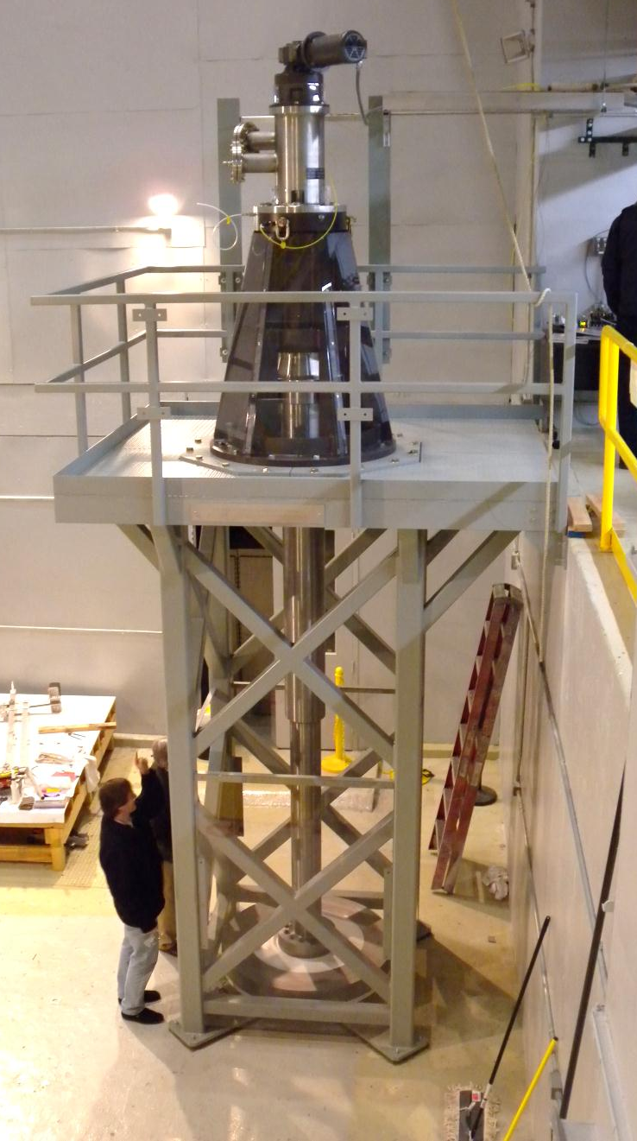
“Flowing” might also include rotating solid targets, or powder metal jets
In the same way that liquid metal targets increase the effective target-beam volume
STS at SNS (Rotating W – water cooled, 30 – 60 rpm)
ESS (Rotating tungsten target – gas cooled)
FRIB (400 kW)
  Fragmentation target (C, 20-60 MW/cm³, 5k rpm)
  Beam dump (10 MW/cm³)
Tungsten powder jet for neutrino factories
Riken / RIBF / BigRIPS
STS rotating target test

Slide 9
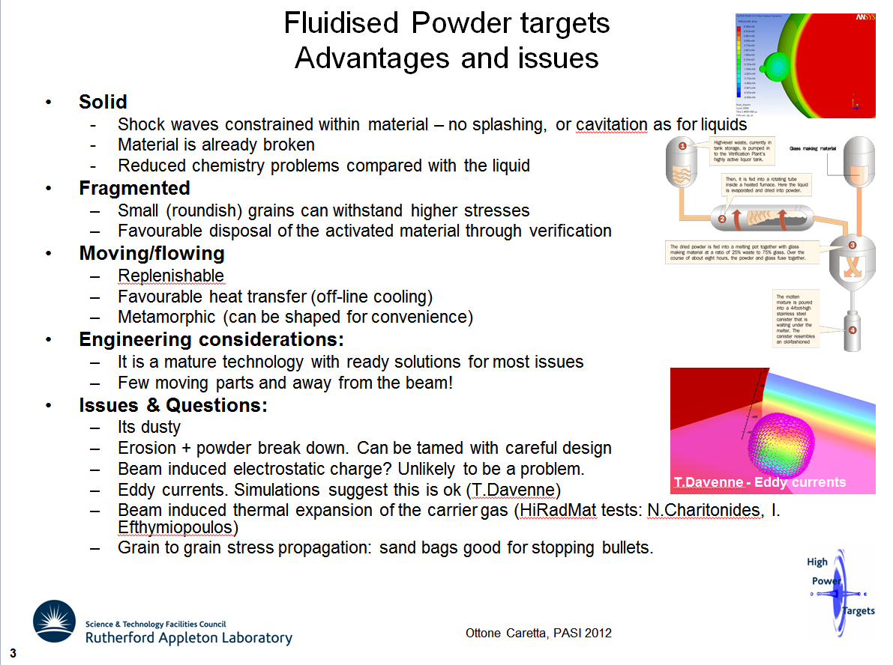

Slide 10
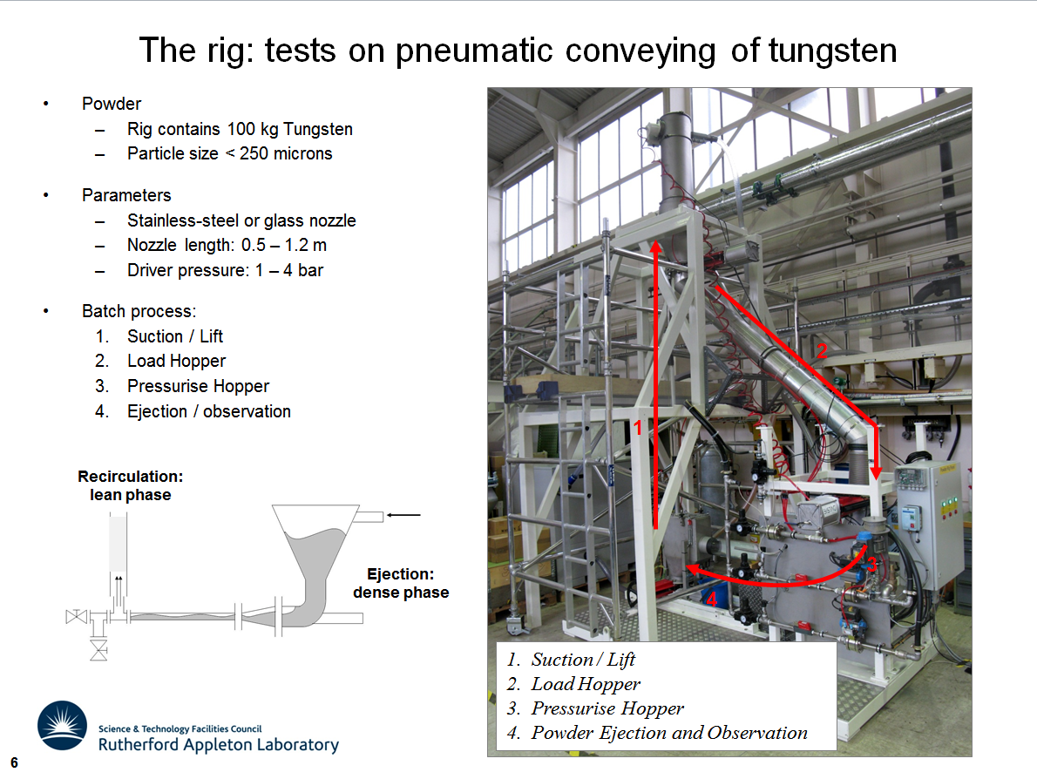

Slide 11
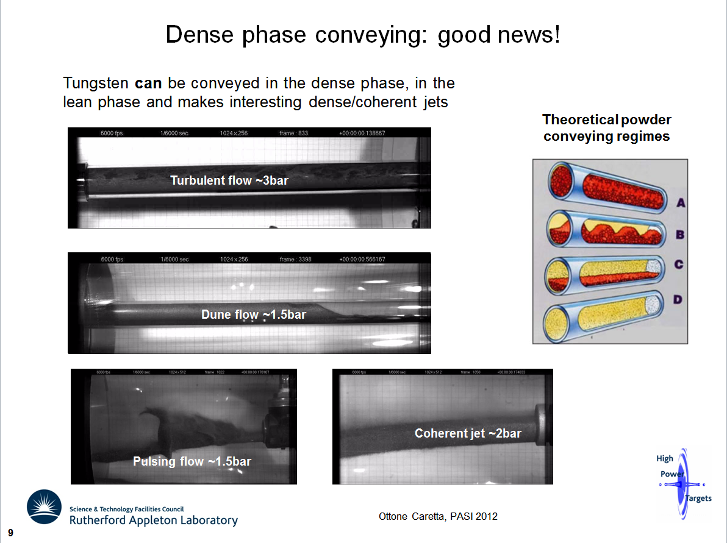

Slide 12
Challenges for future flowing targets using high power and / or energy density
Steady state heat removal to limit temperature and stress
  Target material limits
  Target containers
  Beam windows
Pulsed:
  Shock induced cavitation, target stability
Both:
  Irradiated target and container properties
  Process systems for liquid metals (or powders)
  Remote handling requirements
  Waste disposition
Notes:
To be more precise, we have to select mission / facility specific requirements

Slide 13
Challenges specific to short-pulse, liquid metal spallation targets
Cavitation damage mitigation
  Protective gas walls
    Two-phase modeling, validation experiments
  Small gas bubbles
    Bubble generation and measurement
    In-beam evaluation of mitigation efficacy
  Post irradiation examination

Slide 14
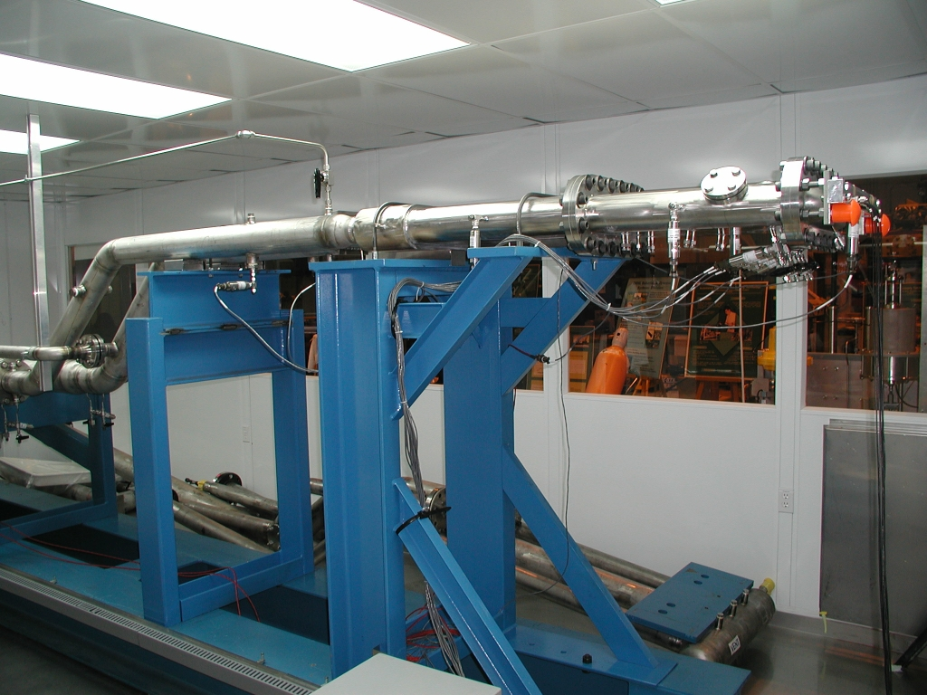
Modifications to the SNS Target Test Facility supporting gas mitigation
Entire target section has been removed and experiment hardware procured

Slide 15
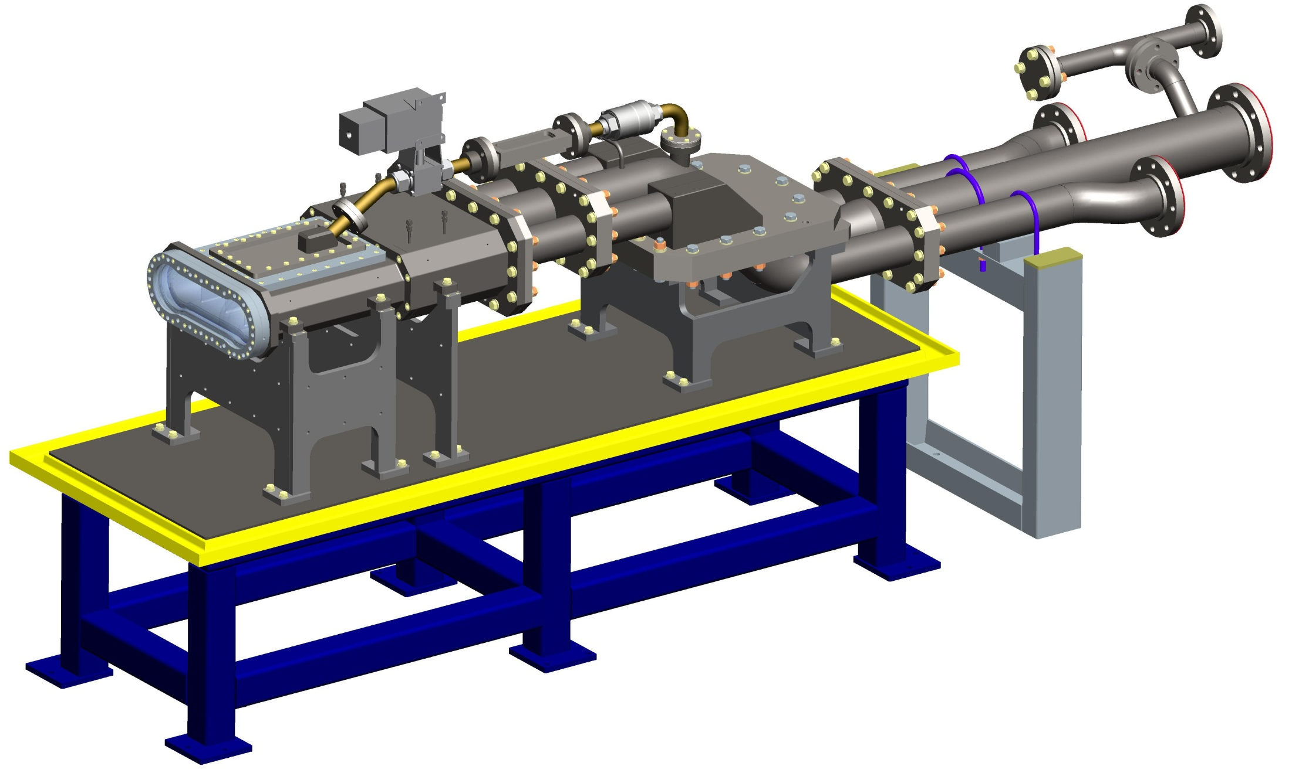
Experiments for gas mitigation in the SNS Target Test Facility
Target top surface can be replaced with viewports or transducers
Pitot tube viewport for small bubble measurements
abc
Bulk mercury flow in modified TTF matches the SNS target
Transition sections can accommodate bubblers
Transparent front window for gas-wall tests
Notes:
Installation is on hold

Slide 16
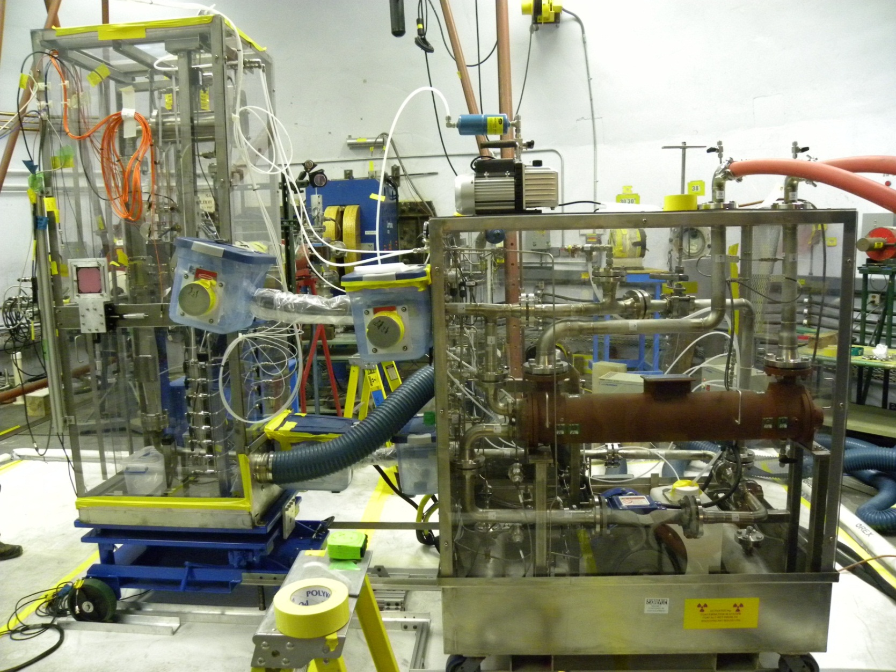
Small gas bubble mitigation experiment at LANSCE - WNR
Collaboration with J-PARC
Irradiations done in 2011
Bubbler /
test section
Mercury pump enclosure
Notes:
Ten SNS experiments at LANSCE (including 1 at pRad)
Seven of these related to cavitation R&D
This likely the last one

Slide 17
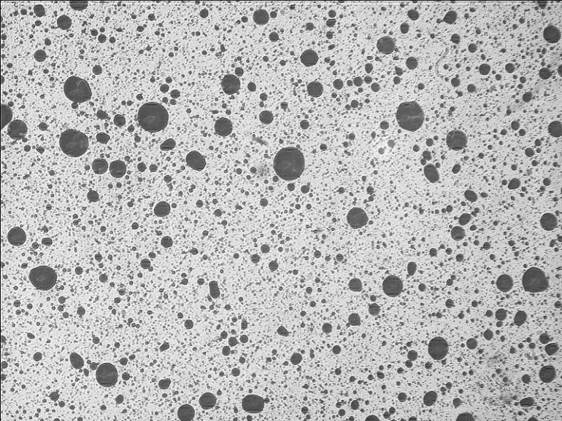
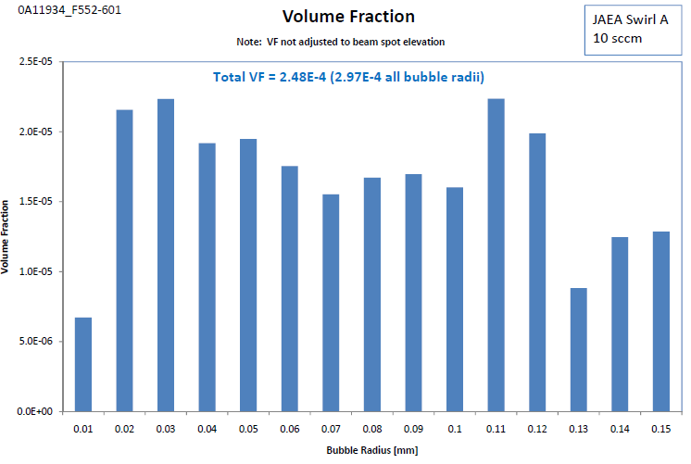
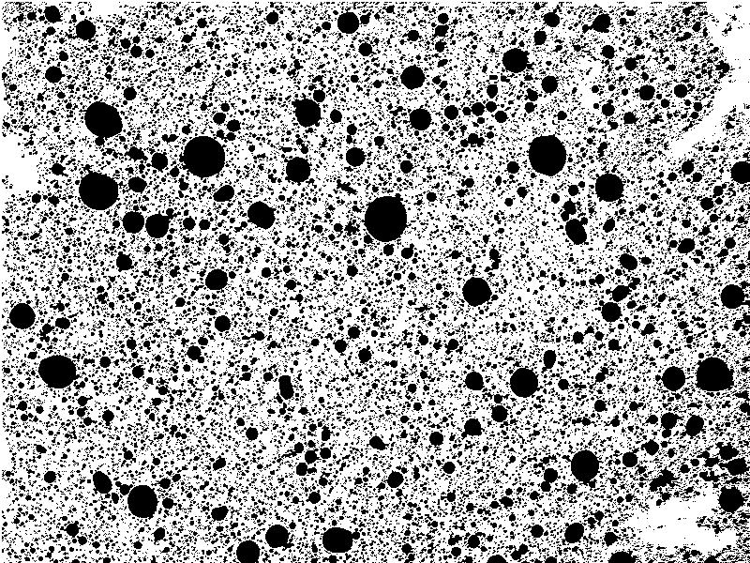
Ten candidate bubblers were evaluated
Bright field image of bubbles that rise up to horizontal view port (FOV: 10 x 7.5 mm)
Three selected for in-beam testing
Damage evaluation now underway
Analyzed image provides bubble size distribution data (ImageJ)
Notes:
Adjustment of VF to beam spot location essentially reduces VF by ~2x
R correction includes surface tension effect
Injected gas fraction is 1.67E-4; at the DTS it is 6.60E-5
Hg flow is 1 L/s

Slide 18
More generic target challenges
Target / container irradiated mechanical property data
  Raise dpa limit for SS316L, other “standard” alloys
  Establish relevant data for other alloys, e.g., titanium, duplex steels
Compatibility of liquid metals with vessel and window materials
  Corrosion, liquid metal embrittlement

Slide 19
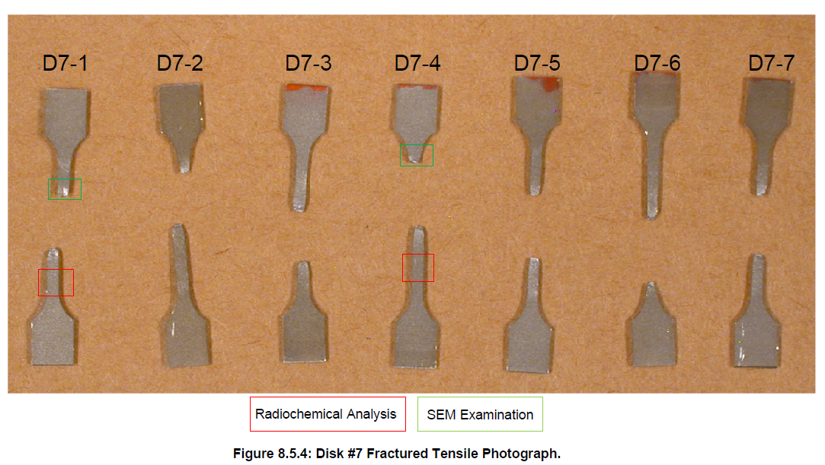
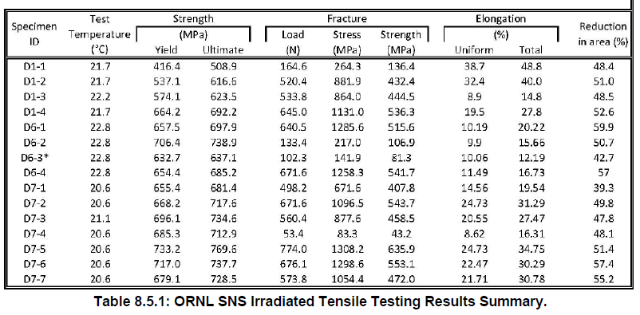
Tensile specimens were machined from samples cut from SNS target #1 disks and pulled to failure

