Slide 1
Target System Concept
for a Muon Collider/Neutrino Factory
K.T. McDonald
Princeton University
(May 28, 2014)

Slide 2
Specifications from the Muon Accelerator Staging Scenario
6.75 GeV (kinetic energy) proton beam with 3 ns (rms) pulse.
1 MW initial beam power, upgradable to 2 MW (perhaps even to 4 MW).
60 Hz initial rep rate for Neutrino Factory;
15 Hz rep rate for later Muon Collider.
The goal is to deliver a maximum number of soft muons,
~ 40 < KE < ~ 180 MeV.

Slide 3
Target System Concept
Graphite target (ρ ~ 1.8 g/cm³), radiation cooled (with option for convection cooling); liquid metal jet as option for 2-4 MW beam power.
Target inside high-field solenoid magnet (20 T) that collects both µ±.
Target and proton beam tilted with respect to magnetic axis.
Superconducting magnet coils shielded by He-gas-cooled W beads.
Proton beam dump via a graphite rod just downstream of the target.
Some of the proton and π/µ transport near the target is in air.

Slide 4
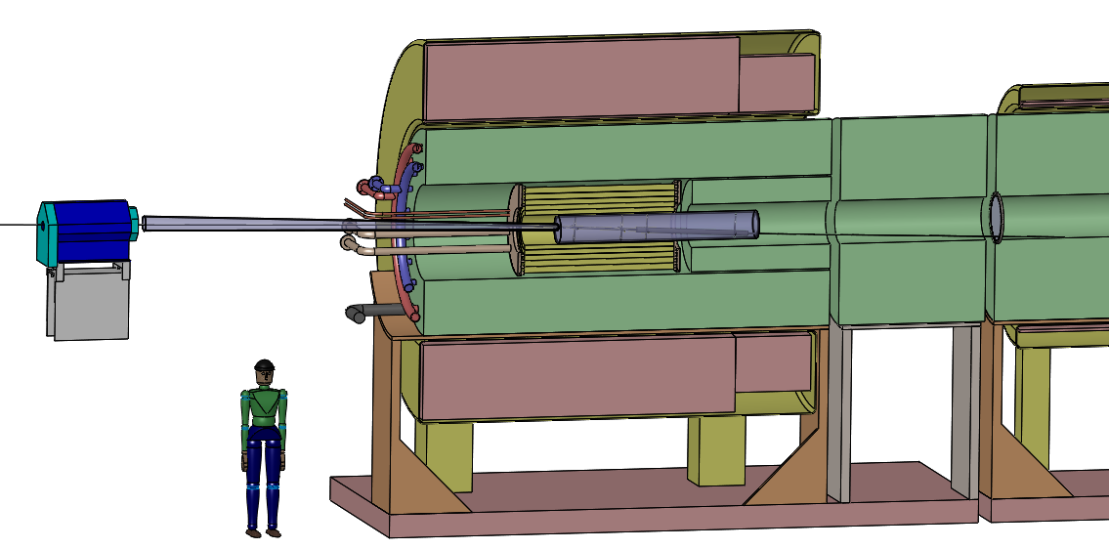
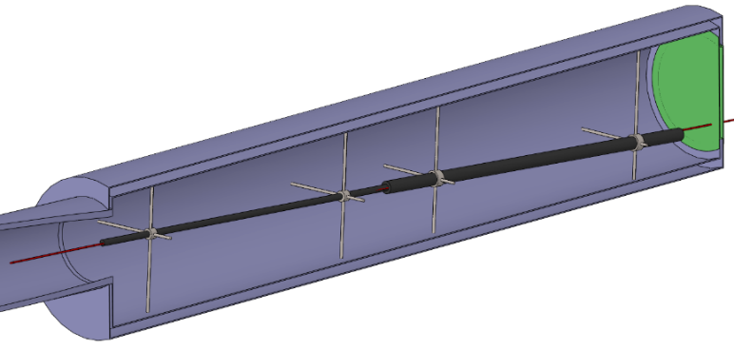
Target System Concept
15 T superconducting coil outsert,
Stored energy ~ 3 GJ, ~ 100 tons
Proton beam tube
Last
Final-Focus
quad
Stainless-steel target vessel (double-walled with intramural He-gas flow for cooling) with graphite target and beam dump, and downstream Be window.
This vessel would be replaced every few months at 1 MW beam power.
Upstream proton beam window
5 T copper-coil insert. Water-cooled,
MgO insulated
He-gas cooled W-bead shielding (~ 100 tons)

Slide 5
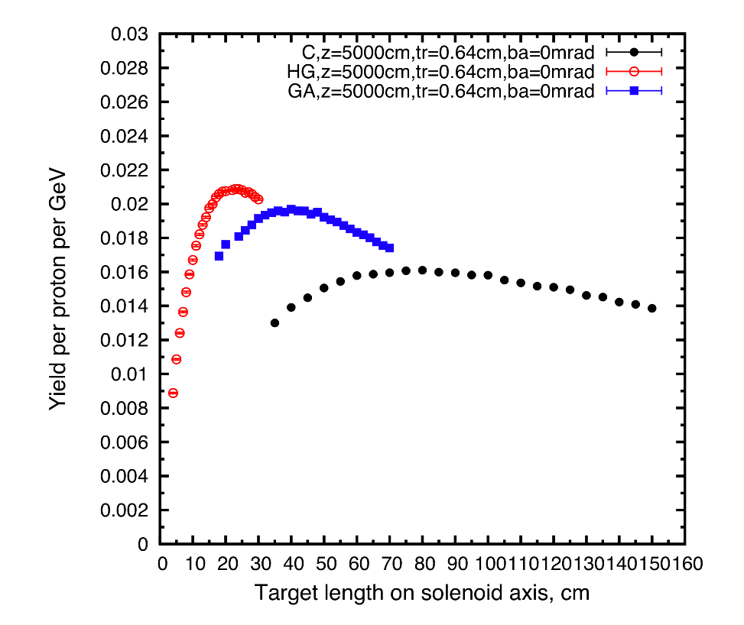
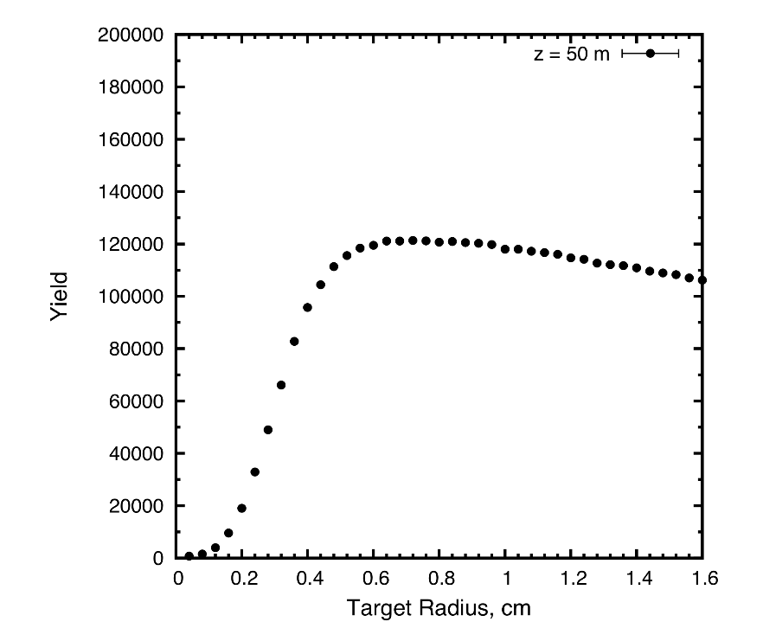
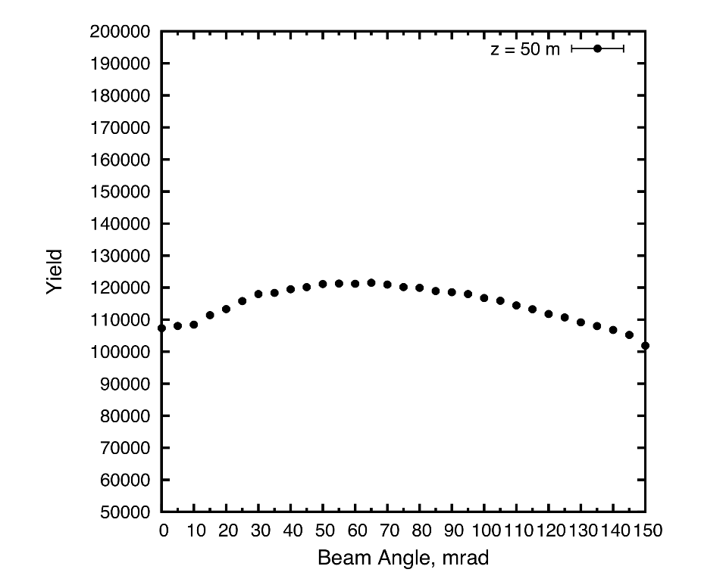
Target System Optimization

Slide 6
Target System Optimizations
High-Z favored.
Optima for graphite target: length = 80 cm,
radius ~ 8 mm (with σ_{r} = 2 mm (rms) beam radius),
tilt angle = 65 mrad,
nominal geometric rms emittance ε⊥ = 5 µm.
β* = σ_{r}² /ε⊥ = 0.8 m.
Graphite proton beam dump, 120 cm long, 24 mm radius to intercept most of the (diverging) unscattered proton beam.
The 20 T field on target should drop to the ~ 2 T field in the rest of the Front End over ~ 5 m.

Slide 7
Issues for Further Study
Thermal “shock” of the short proton pulse
Probably OK for 2 MW and 60 Hz operation;
15-Hz option needs study.
Cooling of target, and the W beads.
Lifetime of target against radiation damage.
Beam windows.
β* and beam emittance at the target.
To preserve liquid-metal-jet upgrade option, need related infrastructure installed at t = 0.

Slide 8
Thermal Issues for Solid Targets
When beam pulse length t is less than target radius r divided by speed of sound v_{sound}, beam-induced pressure waves (thermal shock) are a major issue.
Simple model: if U = beam energy deposition in, say, Joules/g, then the instantaneous temperature rise ∆T is given by ∆T = U /C, where C = heat\ capacity in Joules/g/K.
The temperature rise leads to a strain Δr/r given by ∆r/r = α ∆T = α U/C,
where α = thermal expansion coefficient.
The strain leads to a stress P (= force/area) given by P = E ∆r/r = E α U/C,
where E = modulus of elasticity.
In many metals, the tensile strength obeys P ≈ 0.002 E, α ≈ 10⁻⁵, and C ≈ 0.3 J/g/K,
in which case U_{max} ≈ P C / E α ≈ 0.002 ∙ 0.3 / 10⁻⁵ ≈ 60 J/g.
Graphite @ 1400° C: P = 42.4 Mpa, E = 7.2 Gpa, α = 4.8 × 10⁻⁵, C = 1.4 J/g, U_{max} ≈ 1700 J/g.
(α ≈ 1 × 10⁻⁵ for carbon-carbon composite)
[A nickel target at FNAL has operated with U_{max} ≈ 1500 J/g.]
These arguments are from A Short Course on Targetry, KTM,
NuFact03 Summer Institute

Slide 9
How Much Beam Power Can a Solid Target Stand?
What is the maximum beam power this material can withstand without cracking, for
a 6.75-GeV beam at 15 Hz with area 0.1 cm²?
Ans: MARS15 indicates that the peak energy deposition in a
“pencil” target is essentially just that of dE/dx,
⇒ 1.5 MeV/(g/cm²) for graphite.
Now, 1.5 MeV = 2.4 ∙ 10⁻¹³ J, so 1500 J/g requires a proton beam
intensity of (1500 J/g)/(2.4 ∙ 10⁻¹³ J⋅cm²/g) ≈ 6 ∙ 10¹⁵/cm².
⇒ P_{max} ≈ 15 Hz ∙ 6.75 ⋅ 10⁹ eV ∙ (1.6 ∙ 10⁻¹⁹ J/eV) ∙ (6 ⋅ 10¹⁵ /cm²) ∙ 0.1 cm² ≈ 1 ∙ 10⁷ J/s = 10 MW.
If graphite cracks under singles pulses of > 1500 J/g, then safe up to 10 MW beam power @ 15 Hz.

