Slide 1
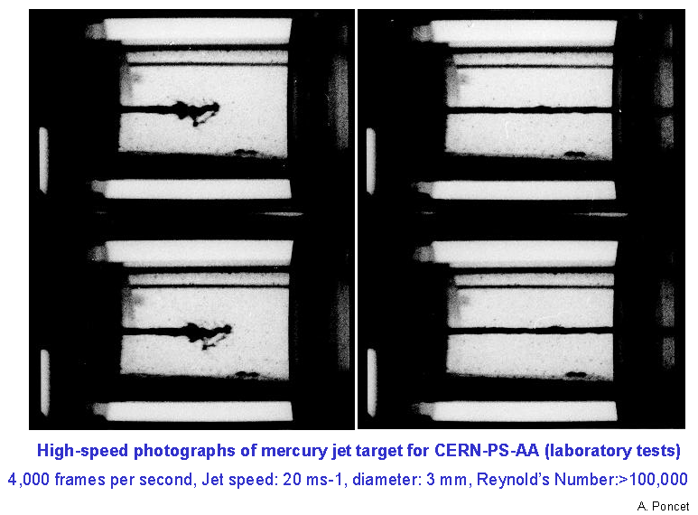
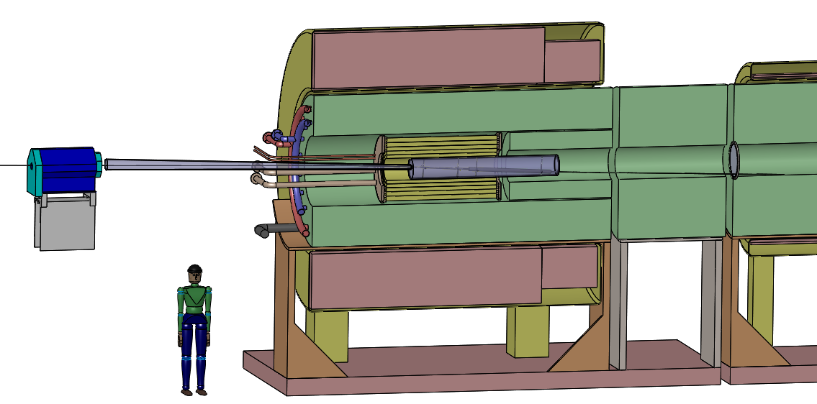
High-Power Targets for Muon (and Neutrino) Production
Context: Muon Collider and Neutrino Factory
1997: Colin Johnson argued that the next step after the ACOL antiproton production target should be a mercury jet target.
[U. Miss. Workshop, Jan 1997; my introduction to Muon Collider Targetry]
Present studies are for a carbon target in a 20-T solenoid, with a fast taper over 5 m down to 2 T.
The proton beam has 6.75 GeV, 1 MW power. 20to2T5m4PDL configuration.
With upgrade option for an Hg-jet target at 2-4 MW beam power.

Slide 2
Are We On the Right Track?
On April 14, 2015, Carlo Rubbia gave a talk on a possible Muon-Collider Higgs Factory at CERN.
https://indico.cern.ch/event/383634/
During the question period, Witek Krasny claimed that present Muon Collider designs are all wrong, and the right thing to do is generate muons via the Bethe-Heitler process in γ-N collisions, γ N → N μ+μ⁻, because the muons are produced with “zero” emittance, so no cooling is needed.
???????????????
The rate of Bethe-Heitler muon-pair production is only (m_{e}/m_{μ})² ~ 1/40,000 that of electron-positron production (when well above threshold), so about 0.001 of the efficiency of muon production via p-N interactions,
Need ~ 1-GW beam power to produce the same number of muons via Bethe-Heitler as via p-N interactions at 1-MW beam power.
[Rubbia: The B-H scheme might not be practical.]
But, if the muons are really produced with “zero” emittance, we wouldn’t need as many muons to obtain a specified luminosity at a muon collider via the B-H process…
[For neutrino production, what matters is beam rate, not emittance.]
However, pions produced in p-N interactions in a “pencil” target also have “zero” emittance!
So, why is cooling necessary in our present designs?

Slide 3
Theoretical and Practical Emittance
Density in phase volume is conserved in Hamiltonian processes, such as particle beam transport without energy loss (Liouville’s theorem).
Emittance is a measure of volume in phase space, so theoretically conserved.
A practical measure of emittance is its rms value, such as
If motion in different indices i is decoupled, we consider the subemittances,
Rms emittances are actually invariant only under “linear” (canonical) transformations.
Unfortunately, propagation of a beam across a field-free drift region is “nonlinear” (even though the particles move along straight lines).

Slide 4
Solenoidal Beam Transport
What about propagation in a constant (solenoidal) magnetic field?
Claim: if the diameter 2c p⊥/eB_{z} of the helical trajectory of a charge e with transverse momentum p⊥ ≤ σ_{p⊥} in a uniform axial magnetic field B_{z} is less than the rms radial extent σ⊥ of the bunch, the bunch does not appear to grow radially as it propagates, and the rms measure of transverse emittance remains invariant with time/distance.
This stabilization of transverse emittance occurs for (JS Berg, 2013).
The stabilized transverse emittance is
If the initial beam emittance is smaller than this, it will grow to this value as the beam propagates. See slide 10 of http://www.physics.princeton.edu/~mcdonald/mumu/target/emittrans1.pdf
That is, a source with “zero” theoretical transverse emittance quickly takes on a finite rms transverse emittance given by the above expression, which depends on the characteristic transverse momentum at the source, as well as the field strength of the solenoid magnet.
Note that for a given σ_{p⊥} of the beam, use of a larger solenoid field implies smaller transverse emittance.

Slide 5
Practical Source Emittance: p-N vs. Bethe-Heitler
For a Muon Collider source based on p-N interactions, we have sought to keep
If we used the Bethe-Heitler process, γ N → N μ+μ⁻, to avoid the threshold effect, we would need to operate with E_{γ} ~ 400 MeV, such that
Hence, the stabilized rms transverse emittance using a Bethe-Heitler source would be
(1/2.5)² ~ 1/6 of that of the p-N source.
This modest advantage does not outweigh the factor of 0.001 in efficiency compared to that of a
p-N source.
Use of a p-N source of muons is still advantageous.
This conclusion was also reached by WA Barletta and AM Sessler, NIM A 350, 36 (1994),
http://physics.princeton.edu/~mcdonald/mumu/physics/barletta_nim_a350_36_94.pdf
See also http://physics.princeton.edu/~mcdonald/mumu/target/betheheitler.pdf

Slide 6
The Target System Concept
A Muon Collider needs muon beams of both signs.
A Neutrino Factory based on neutrinos from muon decay could operate with only one sign of muons at a time, but advantageous to have both signs.
Could use two proton beams + 2 targets in solenoid horn (as per “conventional” neutrino beams from pion decay).
Or, could use one proton beam + solenoid capture system.
RC Fernow et al. reviewed options in March 1995: Li lenses, plasma lenses, toroidal horns, and solenoidal capture. http://physics.princeton.edu/~mcdonald/examples/accel/fernow_aipcp_352_134_95.pdf
All of the pulsed, toroidal systems would be well beyond present technology (then and now!), so the solenoid capture system began to be favored.

Slide 7
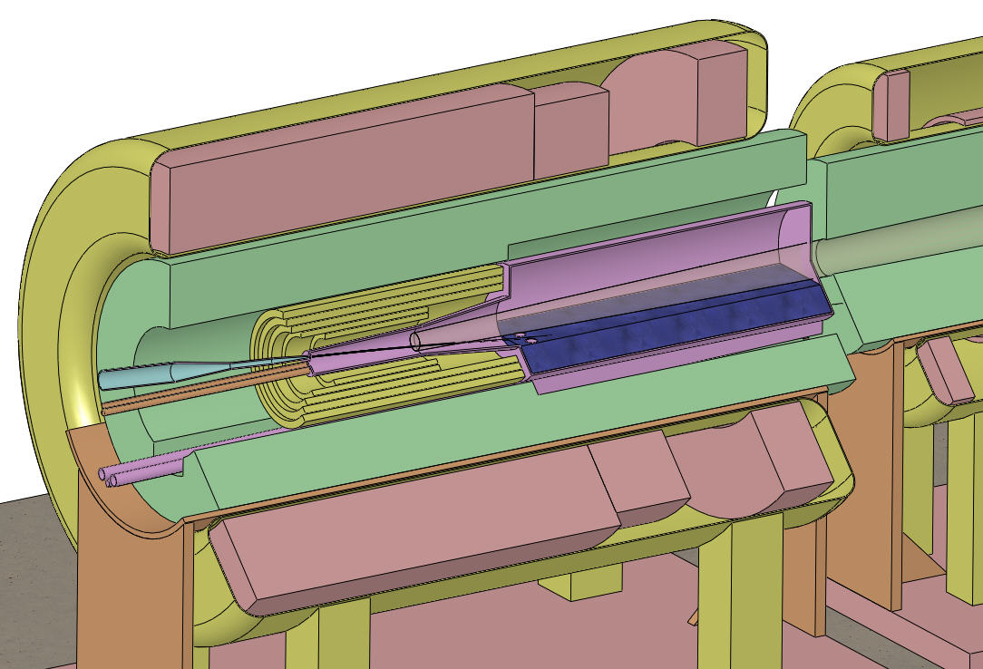
Target and Capture Topology: Solenoid
Desire ≈ 10¹⁴ μ/s from ≈ 10¹⁵ p/s (≈ 4 MW, 25-GeV proton beam)
R.B. Palmer (1994) proposed a 20→5-T solenoidal capture system.
Such field “taper” doubles P⊥ acceptance.
Low-energy π's collected from side of long, thin cylindrical target.
Solenoid coils can be some distance from proton beam.
≥ 10-year life against radiation damage at 4 MW.
Liquid mercury jet target replaced every pulse.
Proton beam readily tilted with respect to magnetic axis.
⇒ Beam dump (mercury pool) out of the way of secondary π's and μ's.
Superconducting magnets
IDS-NF Target Concept:
Tungsten beads,
He gas cooled
Proton beam and
Mercury jet
Be window
Mercury collection pool
With splash mitigator
Resistive magnets
Shielding of the superconducting magnets from radiation is a major issue.
Magnetic stored energy ~ 3 GJ!
5-T copper magnet insert; 15-T Nb₃Sn coil + 5-T NbTi outsert.
Desirable to replace the copper magnet by a 20-T HTC insert (or 15-T Nb coil).

Slide 8
Solenoidal Field Taper
We already noted that for a given σ_{p⊥} of the beam, use of a larger capture solenoid field implies smaller transverse emittance.
It is more practical to have a high magnetic field only for a short region around the target, with the field “tapering” down to a lower value throughout most of the beam transport.
It was appreciated early on by Palmer that such a taper implies a favorable exchanged of transverse and longitudinal momentum.
The magnetic flux through the helical trajectory of a particle is an adiabatic invariant,
Example,
This improvement in the transverse properties of the beam comes at the price of increasing the longitudinal momentum spread.
Pion decay to muons increases the transverse emittance, but the effect is less if the decay occurs in a high magnetic field (B Autin, 2003, http://physics.princeton.edu/~mcdonald/examples/accel/autin_nim_a503_363_03.pdf ), which favors a slower field taper.
Only recently, it was realized that use of a more rapid (less adiabatic) taper is favorable for capture of the muon beam by the Buncher of the Front End (O Hansen, H Sayed).
⇒ Need for global optimization of the entire Front End.

Slide 9
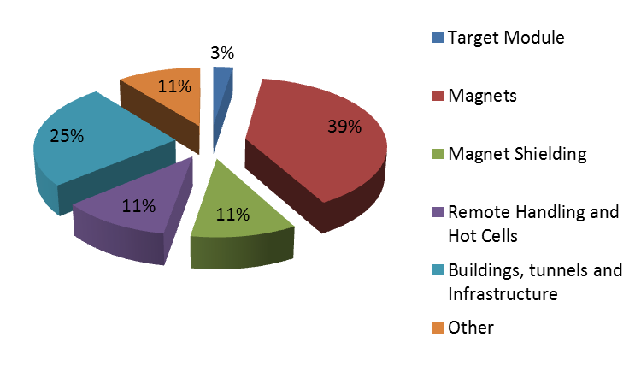
Target System Cost Driven by Shielding
Massive internal shielding ⇒ large radius of superconducting coils ⇒ 3 GJ stored energy.
Massive internal shielding required to protect superconducting coils from radiation damage.
The nominal target costs only a few % of the Target System.
Infrastructure costs are ~ 50%.
(A Kurup, International Design Study for a Neutrino Factory)

Slide 10
Solid vs. Liquid Targets
Early ambitions for a 4-MW target system led to doubt that a solid target could survive here.
Initial visions featured a tungsten target followed by a pulsed Li lens: D Neuffer, IEEETNS 28, 2034 (1981),
RJ Noble, AIPCP 279, 949 (1993)
Tungsten-powder target considered by KTM in 1998, http://www.physics.princeton.edu/~mcdonald/mumu/powder.pdf
Rotating tungsten band considered by BJ King in 1999, http://www.physics.princeton.edu/~mcdonald/mumu/target/King/king_THP38_pac99.pdf
A series of experiments, culminating in the MERIT project at CERN (2007), demonstrated proof of principle of a liquid-mercury-jet target in a 15-20 T magnetic field with a pulsed proton beam equivalent to 4-MW beam power.
A graphite target option was considered in Neutrino Factory Study 1 (2000) for 1.5-MW beam power, and considered again in the Muon Accelerator Staging Scenario (2012) for 1-MW beam power.
The yield of muons per unit beam power from a graphite target in 20 T is only slightly less that from a mercury target in 15 T (which latter seems the maximum compatible with mercury-jet infrastructure).
The limitation of a graphite target is perceived to be its short lifetime against radiation damage at high beam power.
Recent indications are that operation of graphite at high temperature (radiation cooling, ~ 2000 K) would permit long life even at 4-MW beam power (deserves verification in beam tests.)
Fernandes et al., NIM B 314, 125 (2013),
Pellemoine and Wittig (RaDIATE Meeting, May 2015): Radiation-induced carbon swelling fully annealed at 1900° C,
http://www.physics.princeton.edu/~mcdonald/mumu/target/FRIB/pellemoine_150519.pdf

Slide 11
Summary
The concept for a target station for a Muon Collider or Neutrino Factory is fairly advanced now, thanks to the efforts of many people:
USA: Xiaoping Ding, Harold Kirk, Van Graves, Foluso Ladiende, HeeJin Park, Roman Samulyak, Hisham Sayed, Nikolaos Simos, Nicholas Souchlas, Bob Weggel, Yan Zhan + consultation with the FNAL NuMI target team
CERN: Ilias Efthymiopoulos, Adrian Fabich, Ole Hansen, Jacques Lettry
UK: Roger Bennett, Chris Densham (and Chris’ J2K target team)
Optimization of target-system parameters has been carried out by Xiaoping Ding and Front-End global optimization by Hisham Sayed.
Magnet design issues have been addressed by Bob Weggel (+ Mike Green in early times, and Peter Titus for the MERIT magnet.
Shielding calculations for the superconducting coils have been carried out by Nicholas Souchlas, with support from Nikolai Mokhov and Sergei Striganov.
Mechanical design issues have been addressed by Van Graves (+ Phil Spampinato in early days).
(Magneto)hydrodynamic simulations of mercury-jet targets have been carried out by Roman Samulyak (+ students) and by Yan Zhan. (+ Ahmed Hassanein and Neil Morley in early days).
3 PhD’s have been awarded for this effort: A. Fabich, H.J. Park, and Y. Zhan.

