Slide 1
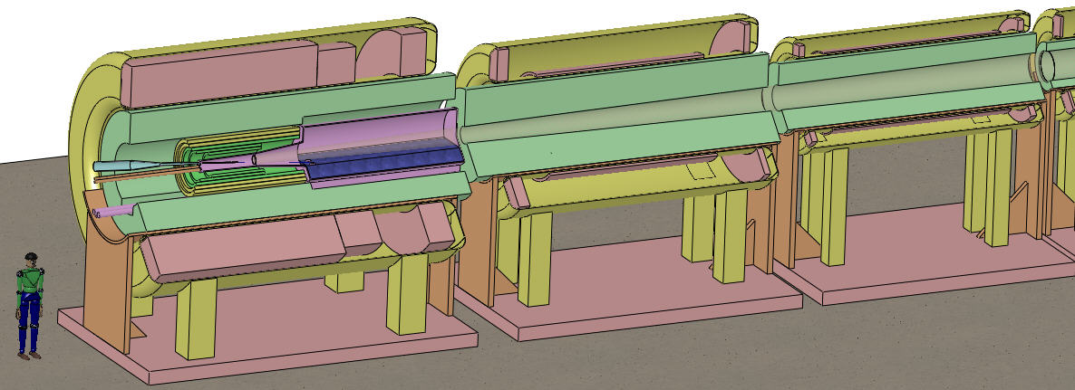
Target and Absorbers for a Muon Collider/Neutrino Factory
K.T. McDonald
Princeton U.
(August 30, 2012)
Muon Accelerator Program DoE Review
Fermilab (August 29-31, 2012)

Slide 2
Mission
Target:
Maximum production of μ± of energies ~ 100-400 MeV from a 4-MW proton beam (E ~ 8 GeV).
Both signs needed simultaneously at a Muon Collider.
Absorbers:
Absorb the 4-MW beam power inside the target system.
Absorb muon energy as a step in the process of ionization cooling.
Overview
Target:
Free liquid-metal-jet target inside a high-field superconducting solenoid magnet
Backup (not actively considered): solid target in toroidal horn; 2 needed for Muon Collider.
Absorbers:
Absorb primary proton beam in liquid-metal pool.
Absorb secondary particles in He-gas-cooled tungsten beads – inside solenoid magnets.
Low-Z solid/liquid muon absorbers under study in MICE (D. Kaplan)
High-pressure H₂-gas absorbers under study by Muons Inc (H. Kirk).

Slide 3
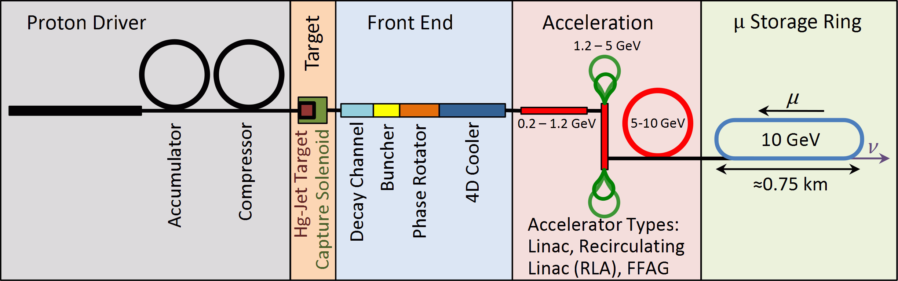
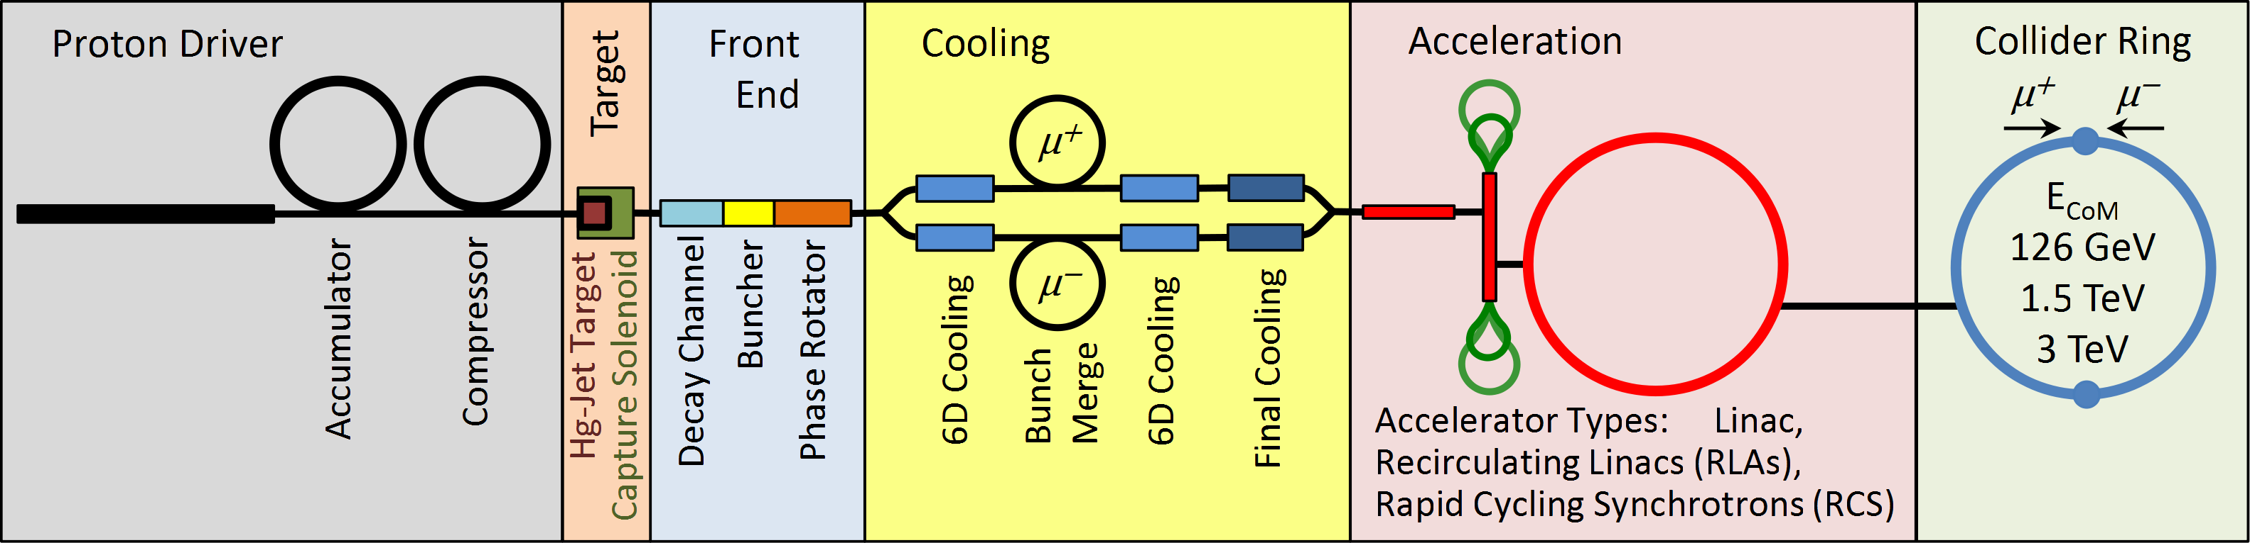
The Target System of a Muon-Collider or Neutrino Factory
Neutrino Factory
In the IDS-NF costing scenario, the Target System includes the production target and the magnetized pion-decay channel.
This system is about 50 m long. A very preliminary cost estimate now exists (slide 5).
Muon Collider

Slide 4
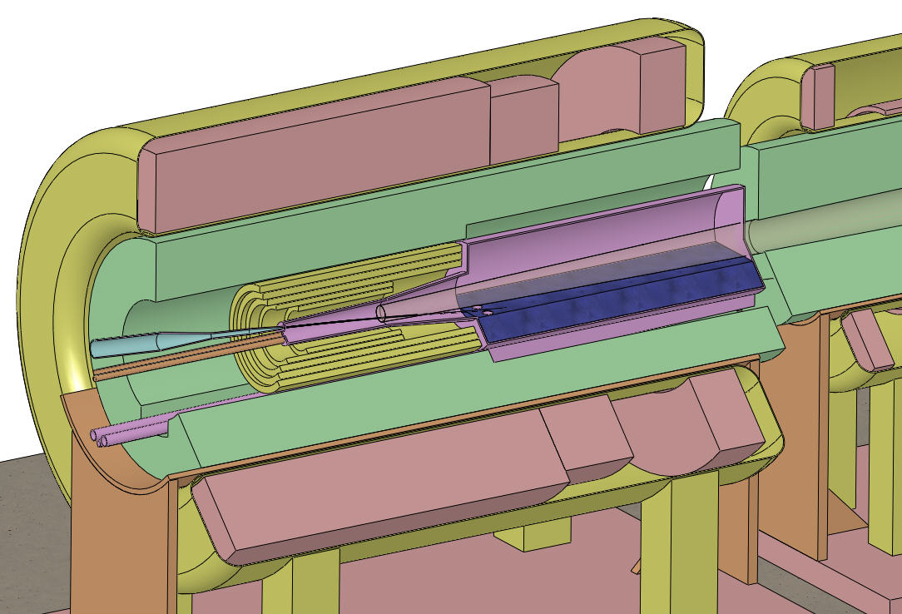
Target and Capture Topology: Solenoid
Desire ≈ 10¹⁴ μ/s from ≈ 10¹⁵ p/s (≈ 4 MW proton beam)
R.B. Palmer (BNL, 1994) proposed a 20-T solenoidal capture system.
Low-energy π's collected from side of long, thin cylindrical target.
Solenoid coils can be some distance from proton beam.
≥ 10-year life against radiation damage at 4 MW.
Liquid mercury jet target replaced every pulse.
Proton beam readily tilted with respect to magnetic axis.
⇒ Beam dump (mercury pool) out of the way of secondary π's and μ's.
Superconducting magnets
Present Target Concept
Tungsten beads,
He-gas cooled
Be window
Proton beam and
Mercury jet
Resistive magnets
Mercury collection pool
With splash mitigator
Shielding of the superconducting magnets from radiation is a major issue.
Magnet stored energy ~ 3 GJ!
5-T copper magnet insert; 10-T Nb₃Sn coil + 5-T NbTi outsert.
Desirable to eliminate the copper magnet (or replace by a 20-T HTS insert).

Slide 5
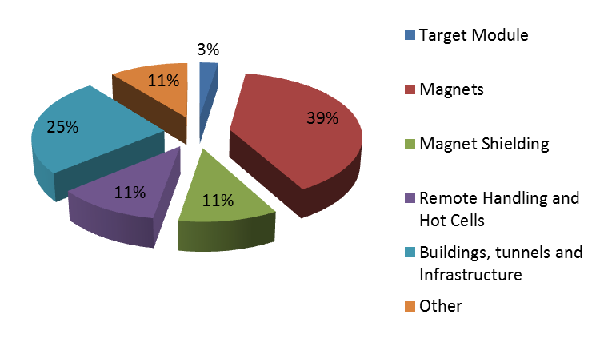
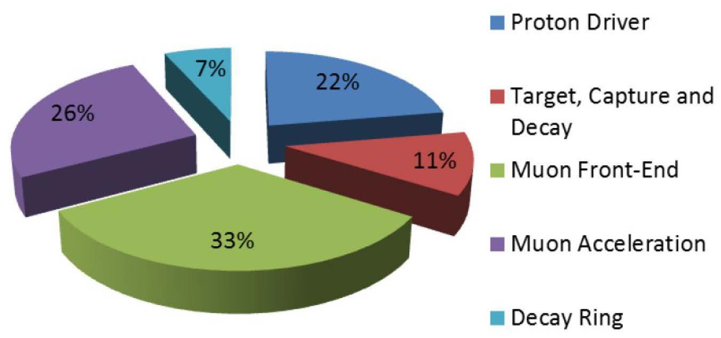
From A. Kurup’s IDS-NF Costing Talk
(= Mercury Module)
[See Backup Slides for supporting details.]
Target System Cost Breakdown
Neutrino Factory Cost Breakdown

Slide 6
Targetry Activities
Simulation of beam-jet interaction in a magnetic field (R. Samulyak, T. Guo).
Simulation of turbulent flow inside, and out of, the nozzle (F. Ladiende, Y. Zhan).
Simulation of particle production vs. beam & target parameters (X. Ding).
Simulation of the effect of the magnetic configuration on particle production (H. Sayed).
Simulation of secondary-energy deposition in the target system (N. Souchlas).
Design of the magnets and shielding for the target system (R.J. Weggel).
Design of the mercury-handling system (V.B. Graves).
Coordination of the above, and interface with other MC/NF Systems (J.S. Berg, H.G. Kirk, K.T. McDonald).
The above activities are projected to continue well beyond FY15.
Past activities included a proof-of-principle demonstration of a free mercury jet in a 15-T magnetic field in an intense proton beam (CERN MERIT experiment).

Slide 7
MERIT Experiment Summary
The MERIT experiment established proof-of-principle of a free mercury jet target in a strong magnetic field, with proton bunches of intensity equivalent to a 4 MW beam.
  The magnetic field stabilizes the liquid metal jet and reduces disruption by the beam.
  The length of disruption is less than the length of the beam-target interaction, ⇒ Feasible to have a new target every beam pulse with a modest velocity jet.
  Velocity of droplets ejected by the beam is low enough to avoid materials damage.
  The threshold for disruption is a few × 10¹² protons, permitting disruption-free operation at high power if can use a high-rep-rate beam.
  Even with disruption, the target remains fully useful for secondary particle production for ≈ 300 μs, permitting use of short bunch trains at high power.
  No apparent damage to stainless-steel wall only 1 cm from interaction region.
  [See Backup Slides for additional details.]

Slide 8
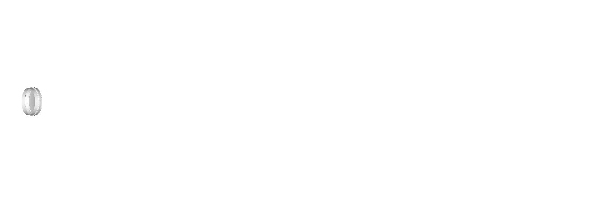
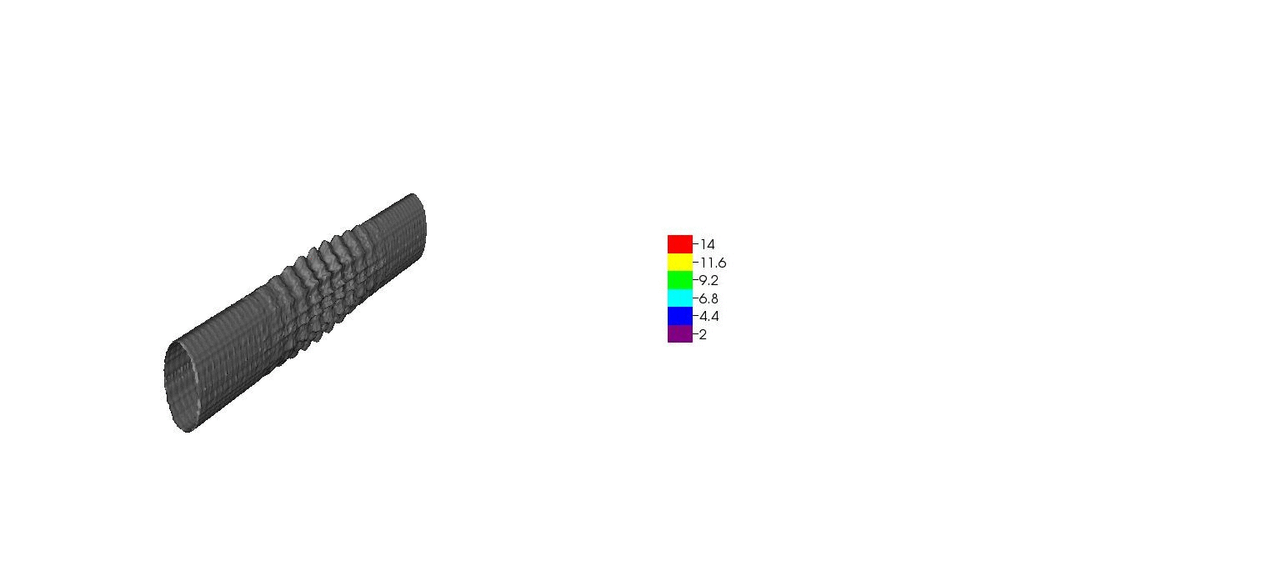
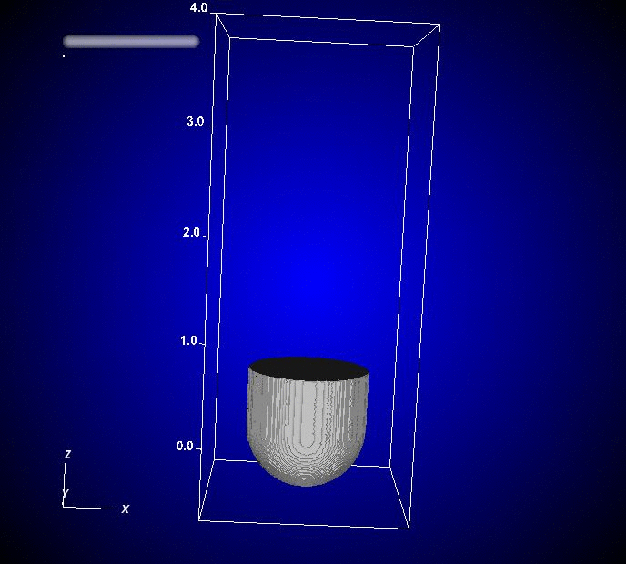

Simulation of Beam-Jet Interaction in a Magnetic Field
(R. Samulyak, T. Guo, SUNY Stony Brook)
FronTier simulation of high-speed-jet cavitation and breakup:
Simulation of mercury thimble experiments
(2001) using the Lagrangian particle code:
Smoothed-Particle-Hydrodynamics
simulation of MERIT beam-jet interaction:

Slide 9
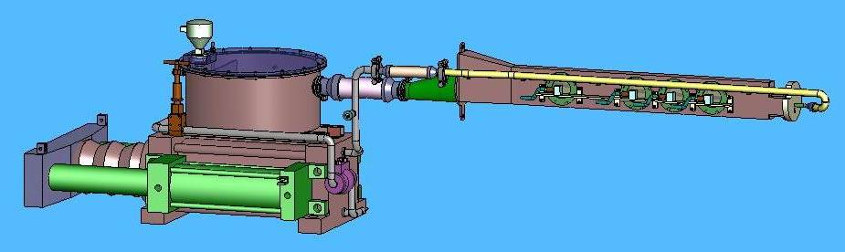
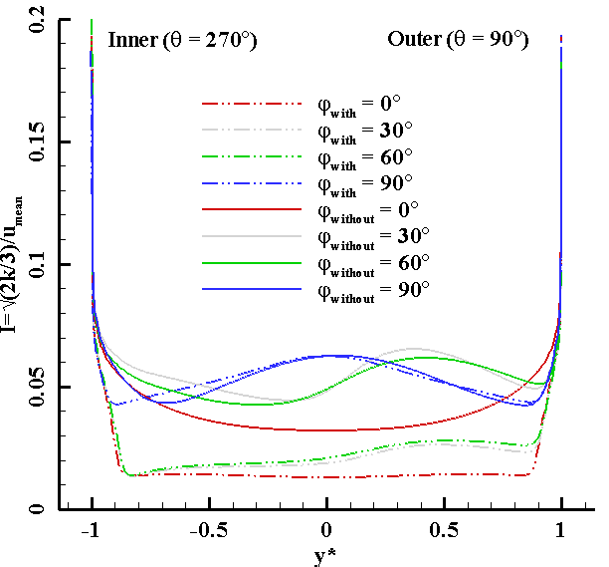
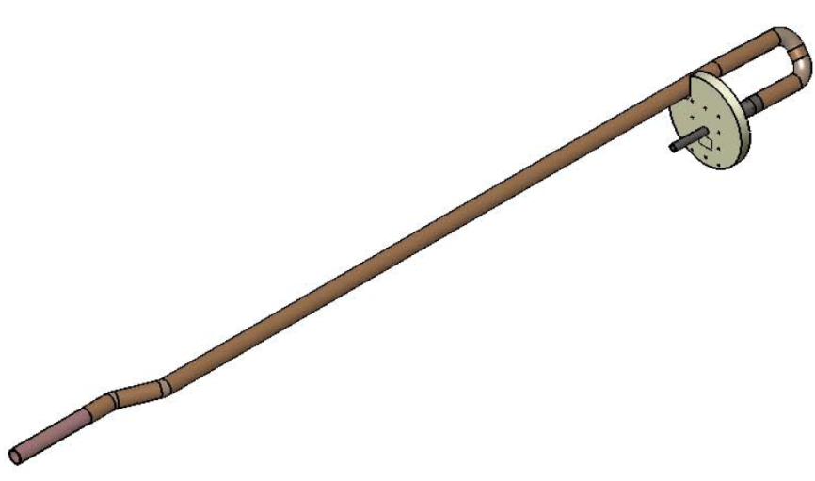
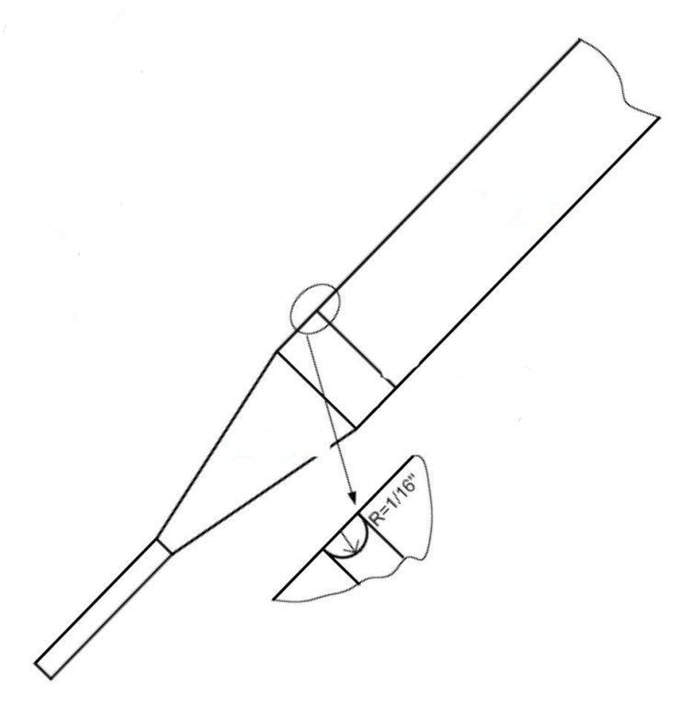
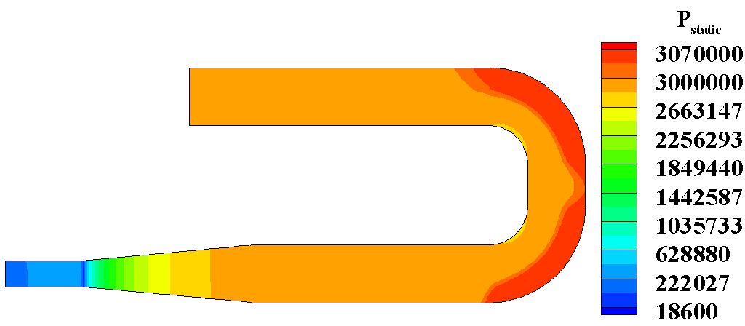
Simulation of Turbulent Flow in the Nozzle
(F. Ladiende, Y. Zhan, SUNY Stony Brook)
Issue in MERIT: Free jet took on elliptical cross section, major axis vertical.
FLUENT simulations indicate that if no perturbations inside the pipe, the flow out of the nozzle would be nearly axisymmetric.
Nozzle
The last weld of the titanium nozzle had an asymmetric weld bead. Simulation underway.
Pressure distribution in flowing mercury

Slide 10
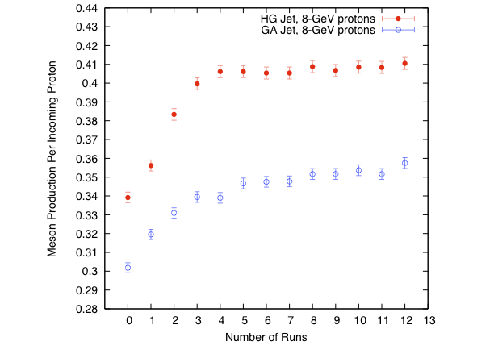
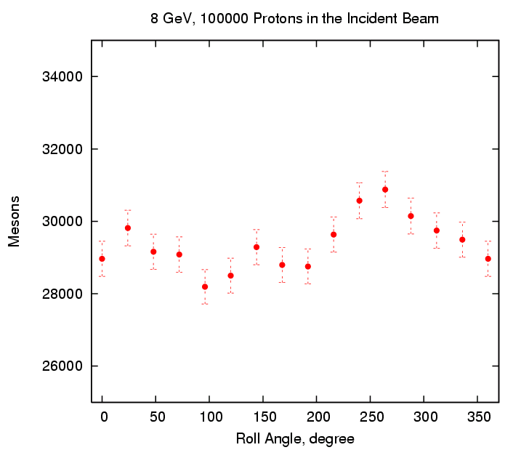
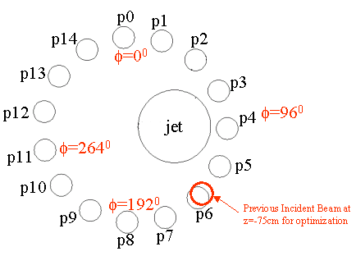
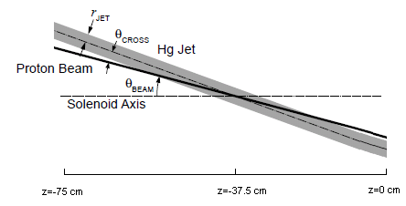
Simulation of Particle Production vs. Beam & Target Parameters
(X. Ding, UCLA)
Vary: beam energy, beam radius, beam angle,
target radius, target angle, target material
(MARS15 simulations)
Mercury
Mercury
Gallium
Production peaks at ~ 8 GeV
Hg ~ 1.15 Ga
Particle production best in only one quadrant, centered on p11
(baseline for single beam)
Consider option of multiple beams converging on the target from various azimuthal directions.

Slide 11
Effect of the Magnetic Configuration on Particle Production
(H. Sayed, BNL)
The magnetic field of the target system varies from B_{i} at the target to B_{f} at the front end, over distance z_{end}.
Vary B_{i}, B_{f} and z_{end}.
Results: Better production if
B_{i}, B_{f} and z_{end} are larger.
Present baseline:
B_{i} = 20 T, B_{f} = 1.5 T, z_{end} = 1500 cm.
Could reduce B_{i} from 20 to 15 T
if compensate with larger B_{f} and z_{end}.
[Reduce cost, and simplify the mercury target module.]
Issue: Can the Phase Rotator accept the increased muon yield?
Addition yield is for muons with large R, where acceptance of
the phase rotator/linac is low.
Muon yield vs. z_{end}
for various B_{i} and B_{f}
Z_{end} [cm]
Baseline acceptance in R
at various z.
Low acceptance at large
R at end of decay region.

Slide 12
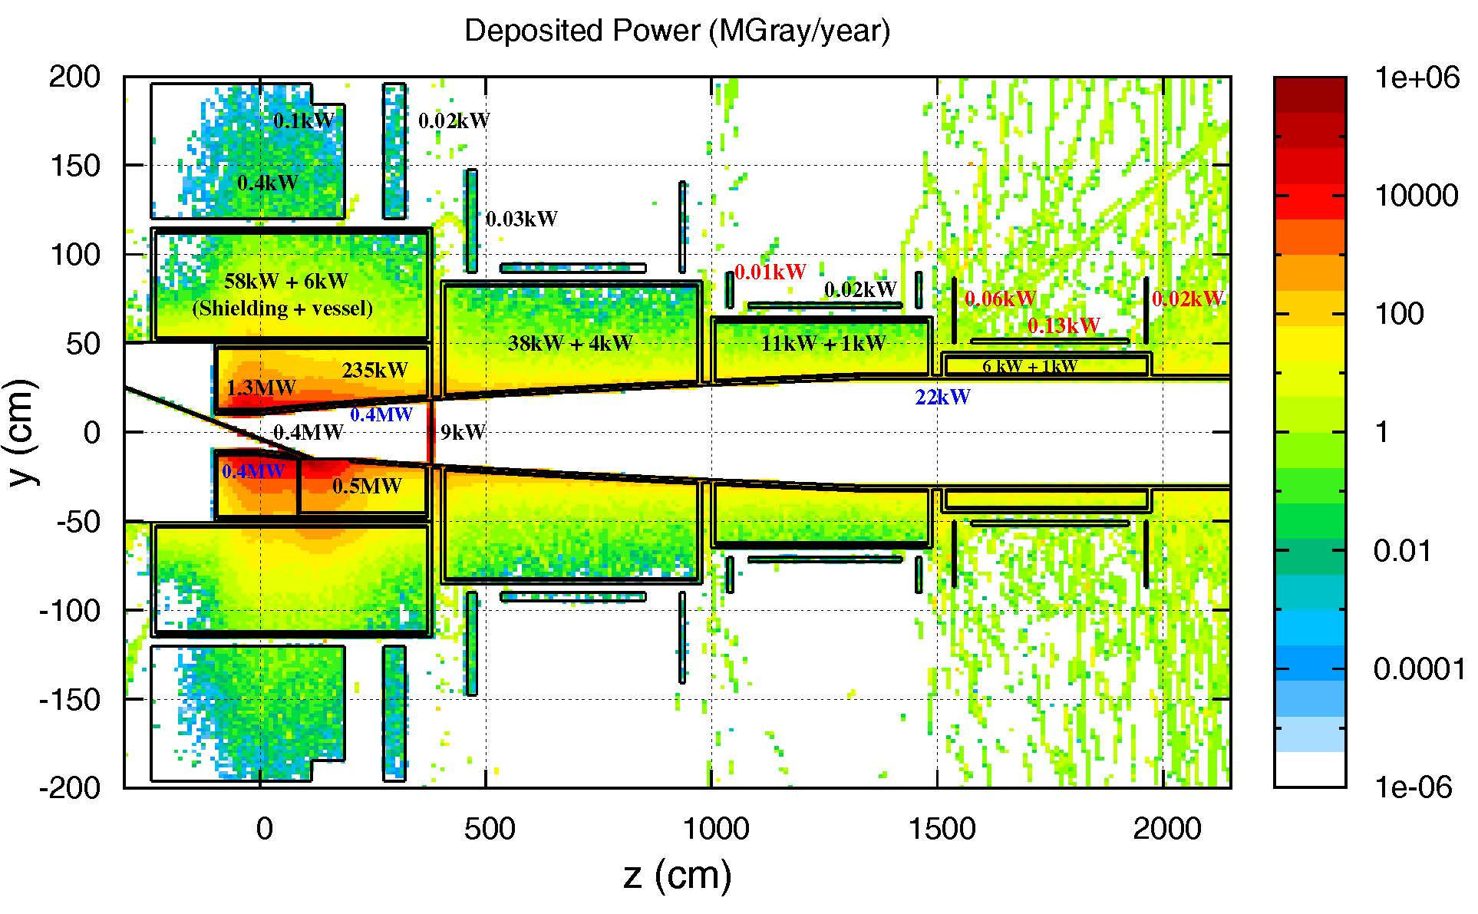
Secondary-Energy Deposition in the Target System
(N. Souchlas, PBL + J.Back, Warwick)
Practical lifetime of superconducting coils (insulation) against radiation damage is ~ 10 MGray = 10⁴ J/g.
For a lifetime of 10 “years” of 10⁷ s each, the peak rate of energy deposition would be 10⁴ J/g / 10⁸ s
= 10⁻⁴ W/g = 0.1 mW/g (= 1 MGray/year of 10⁷ s).
Use MARS15 (Souchlas) [and Fluka (Back)] to simulate energy deposition.
With shielding, most energy deposition in the SC magnets is due to 1-100 MeV neutrons.
Dense shield most effective. We now consider He-gas-cooled W beads.
Present baseline is R_{outer,shield} = R_{inner,magnet} = 120 cm.
~ 500 kW of power (mostly scattered protons) leaves target system and enters the front end.
Peak energy deposition vs.
outer radius of shield
Peak energy deposition ≤ 0.1 mW/g

Slide 13
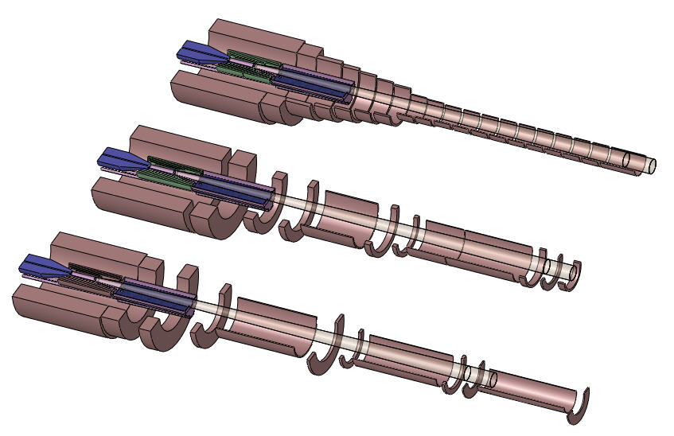
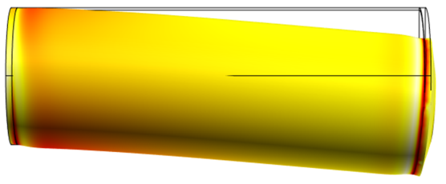
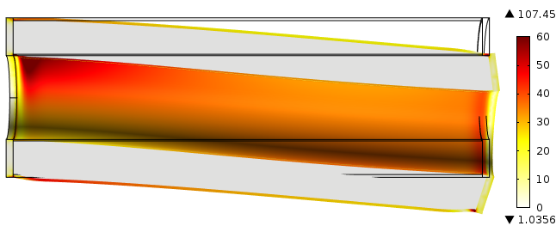
Design of the Magnets and Shielding for the Target System
(R.J. Weggel, PBL)
Evolution of coil design to permit gaps for services to the internal He-gas-cooled W-bead shielding:
Cable-in-conduit conductor, as in ITER Central Solenoid
3 GJ stored magnetic energy
(6 GJ in ITER Central Solenoid;
3 GJ in LHC octant)
15 T if no copper insert
Shield mass ~ 200 tons, ⇒ Sag when cantilevered.
Shield module inside first SC magnet

Slide 14
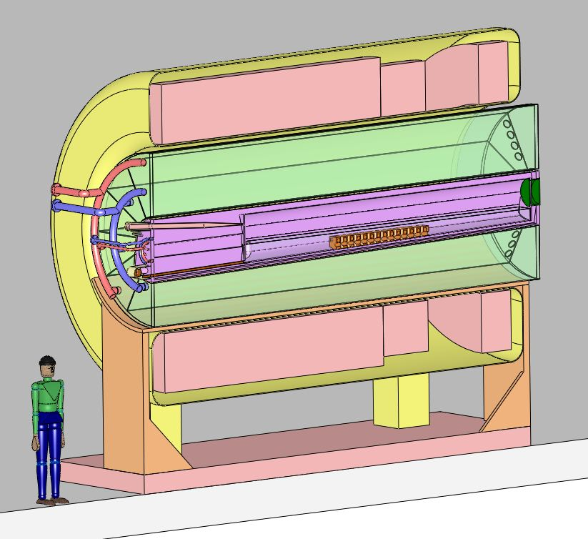
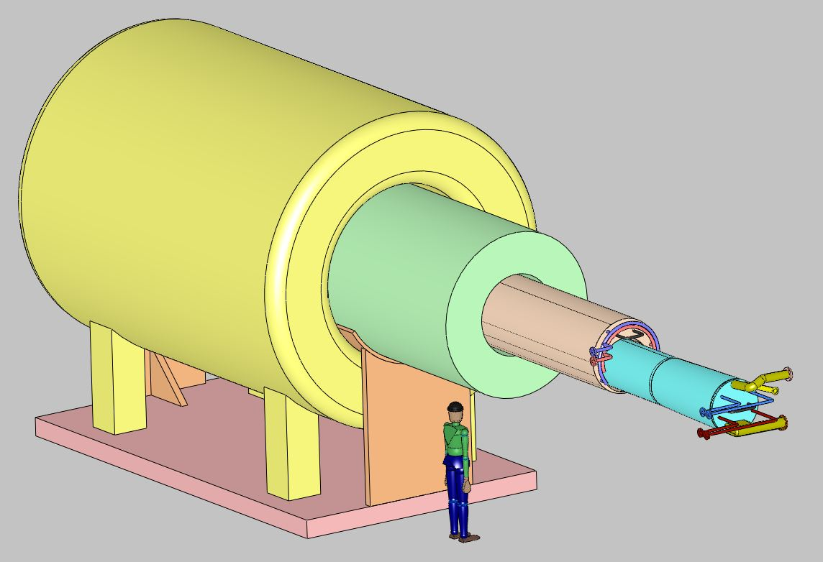
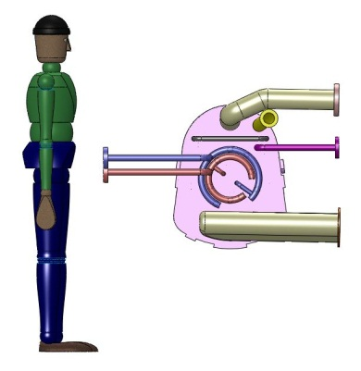
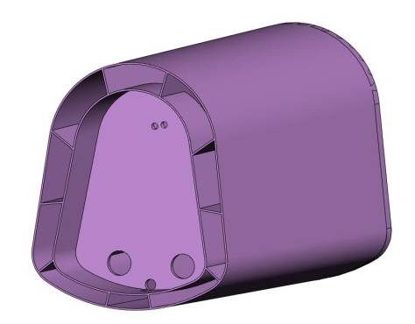
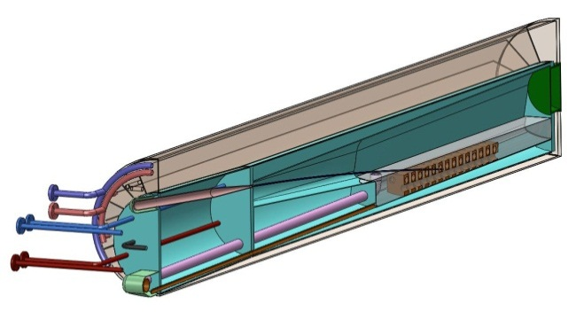
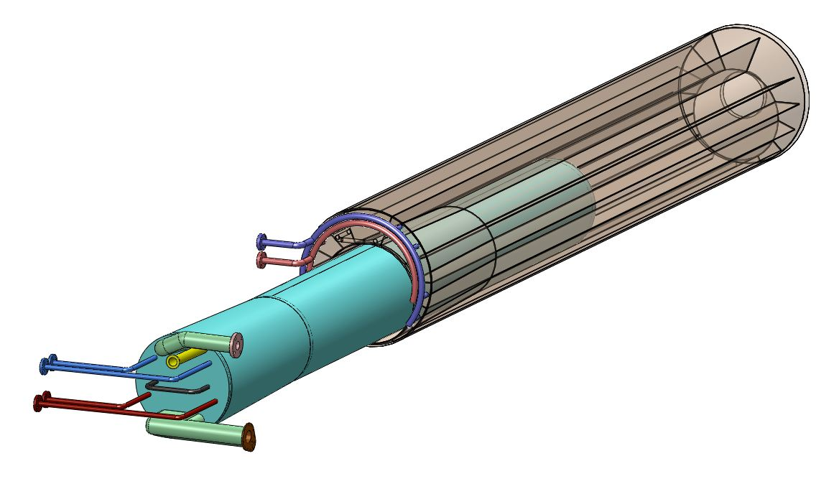
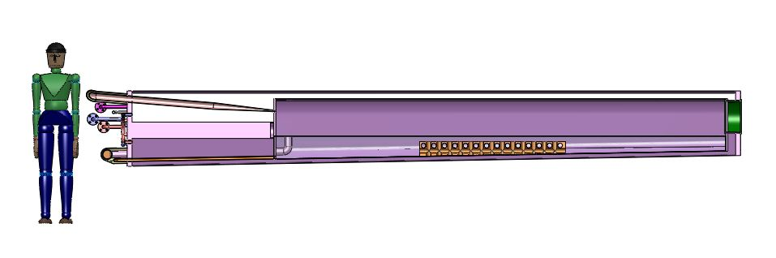
Design of the Mercury-Handling System
(V.B. Graves, ORNL)
Superconducting magnet
Outer shielding module
Inner shielding module
Mercury target module
Double containment
Mercury vessel
Mercury/He-gas services at upstream end of mercury module
Magnet/shielding/mercury modules weigh ~ 200 tons
Erosion in nozzle and splash mitigator an issue.
Splash mitigator in mercury collection pool

Slide 15
Targetry Effort in FY12-15
Targetry activities in FY13-15 will continue the engineering design studies listed on slide 6.
Beyond FY15: Similar level of effort, with addition of hardware studies of mercury-pool splash issues.
FTEs
FY12 FY13 FY14 FY15
H. Kirk (Admin) 0.7 0.7 0.7 0.7
J.S. Berg (Admin.) 0.1 0.1 0.1 0.1
H. Sayed (Particle production) 1 1 1 1
K.T.M (Admin.) 0 0.1 0.1 0.1
X. Ding (Particle production) 0.4 0.4 0.4 0.4
Samulyak Grad. (Beam/jet interaction) 1 1 1 1
Ladeinde Grad. (Nozzle hydrodynamics) 1 1 1 1
V. Graves (Mercury system) 0.15 0.3 0.3 0.3
N. Souchlas (Energy deposition) 0.5 0.5 0.5 0.5
B. Weggel (Magnet/shielding) 0.3 0.3 0.3 0.3
Total FTEs 5.15 5.25 5.25 5.25
M&S (FY12 k$)
BNL Travel 25 25 25 25
Princeton Travel 8.5 8.5 8.5 8.5
Total M&S 33.5 33.5 33.5 33.5

Slide 16
Backup

Slide 17
Extract from A. Kurup’s Sheet TCDCostSummary.xlsx

Slide 18
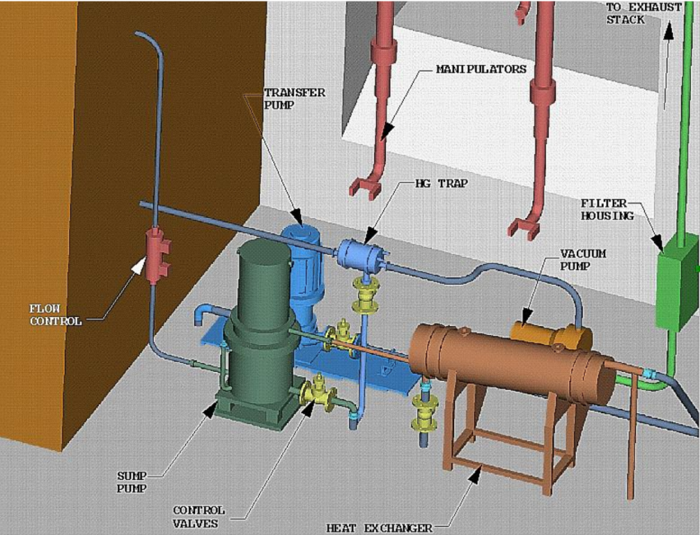
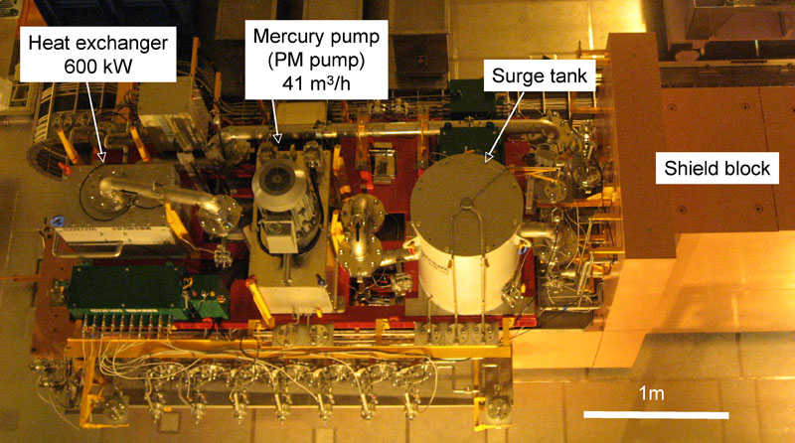
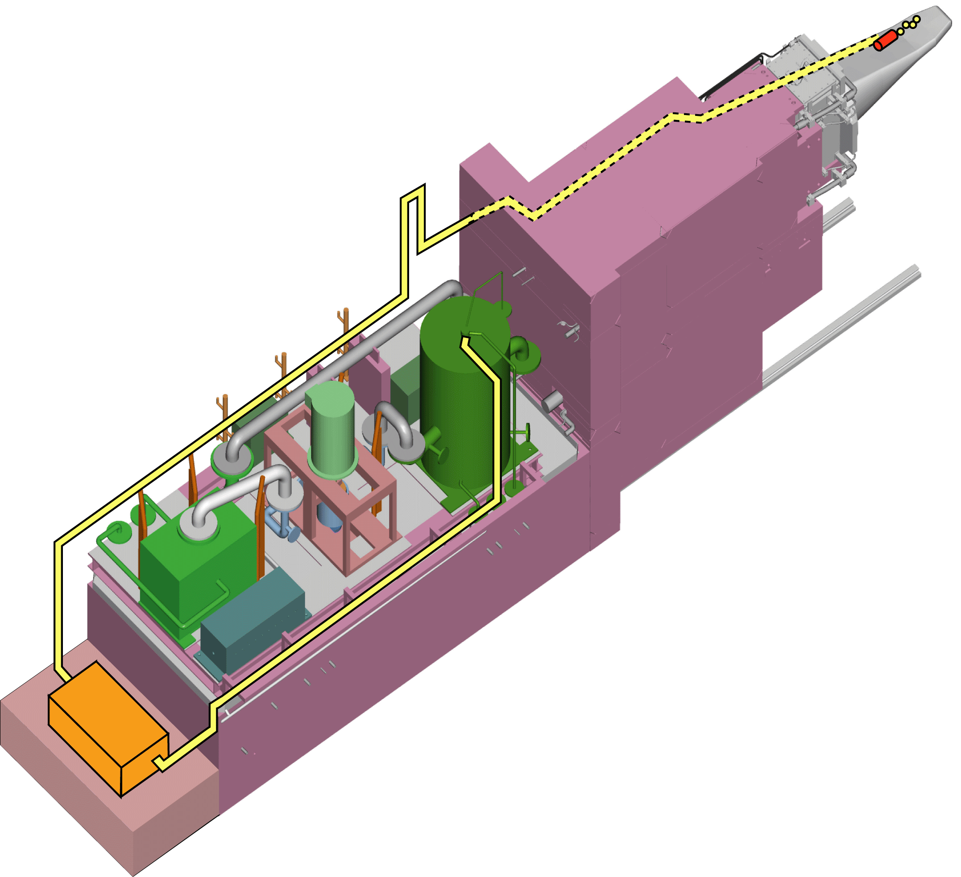
Target Module Costs Scaled from SNS (ORNL)
SNS/JNS Mercury target
Neutrino Factory Study 2 concept
Mercury-loop utilities

Slide 19
Magnet and Shielding Costing by Bob Weggel

Slide 20
Weggel’s cost estimate agrees to within 2% with the Green-Strauss algorithm (A. Bross).

Slide 21
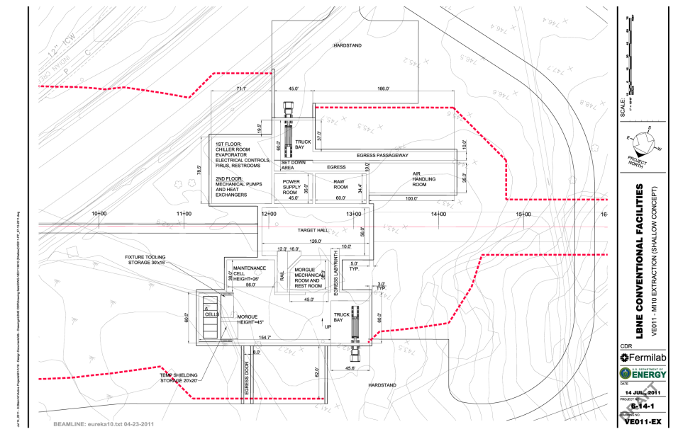
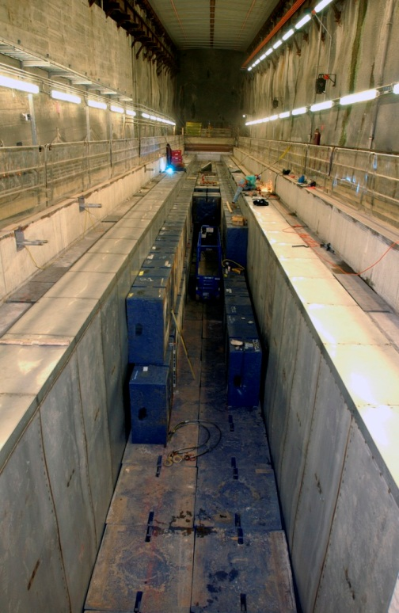
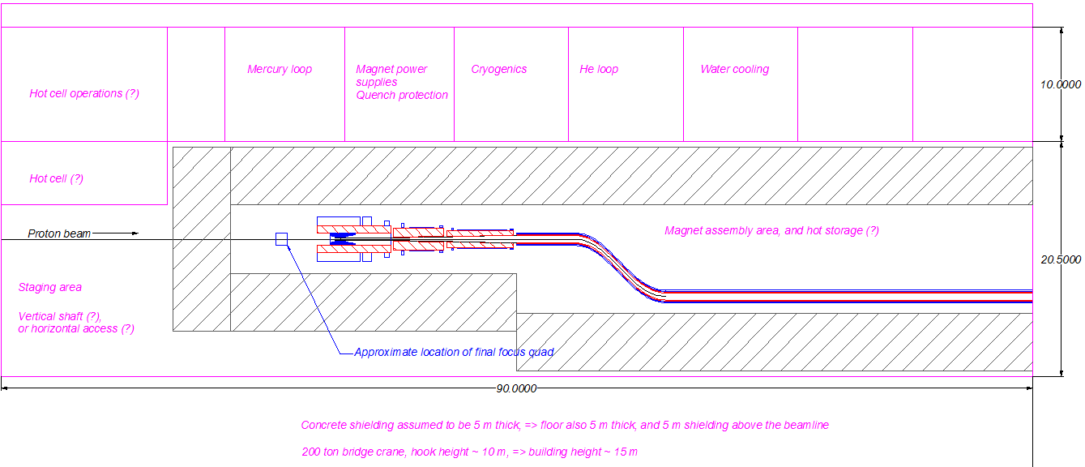
Target Hall
A major cost driver will be civil construction and shielding.
LBNE 2-MW target station
~ $175m
Crude sketch to start IDS-NF costing
NuMI target hall

Slide 22
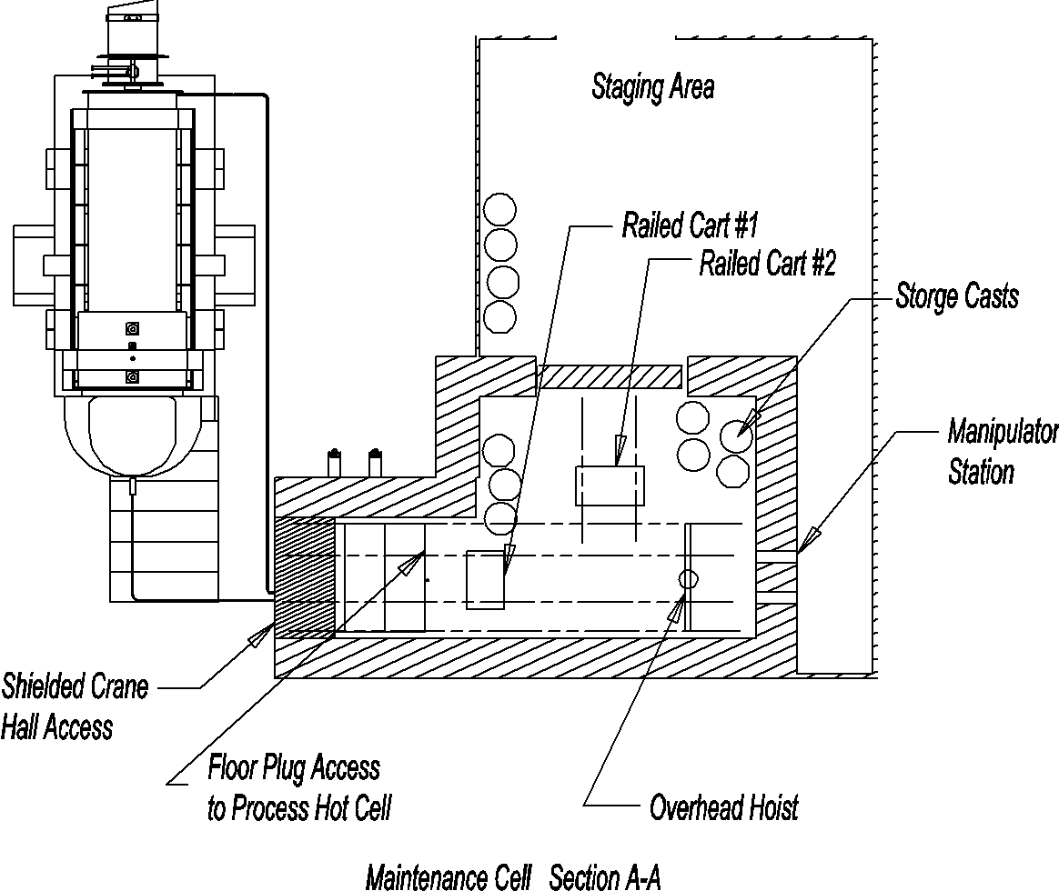
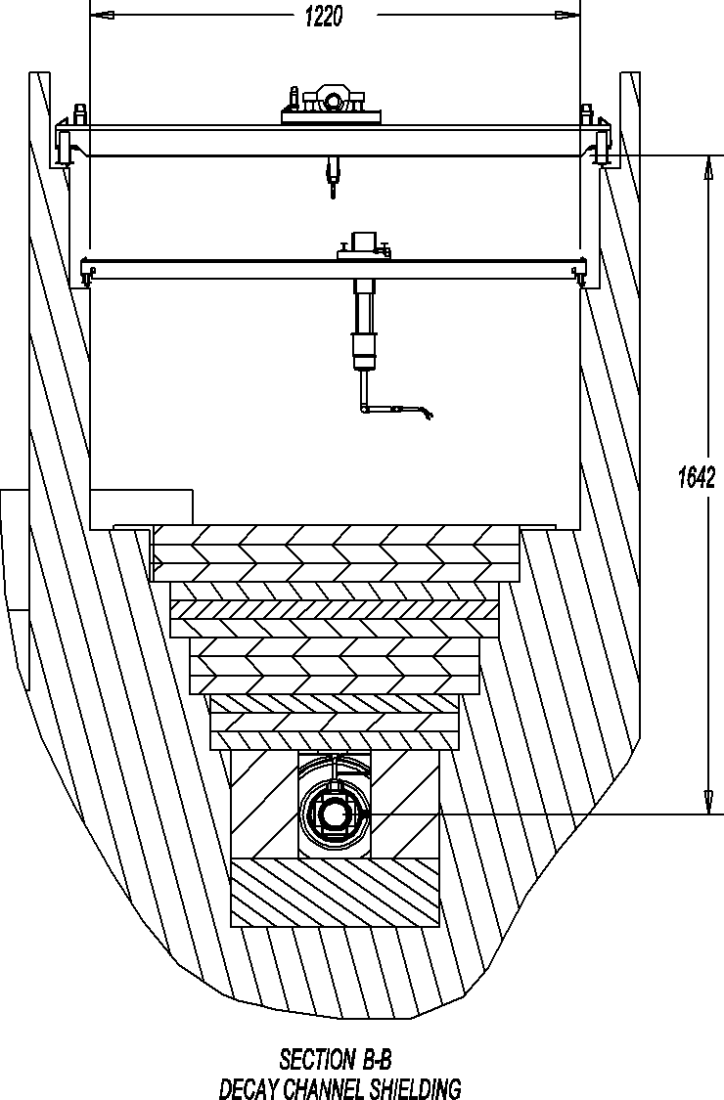
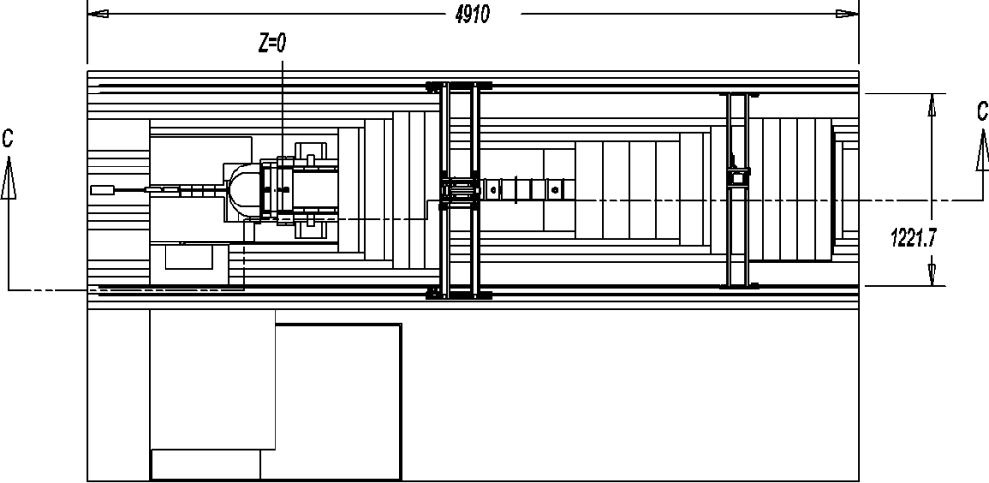
Neutrino Factory Study 2 Concepts

Slide 23
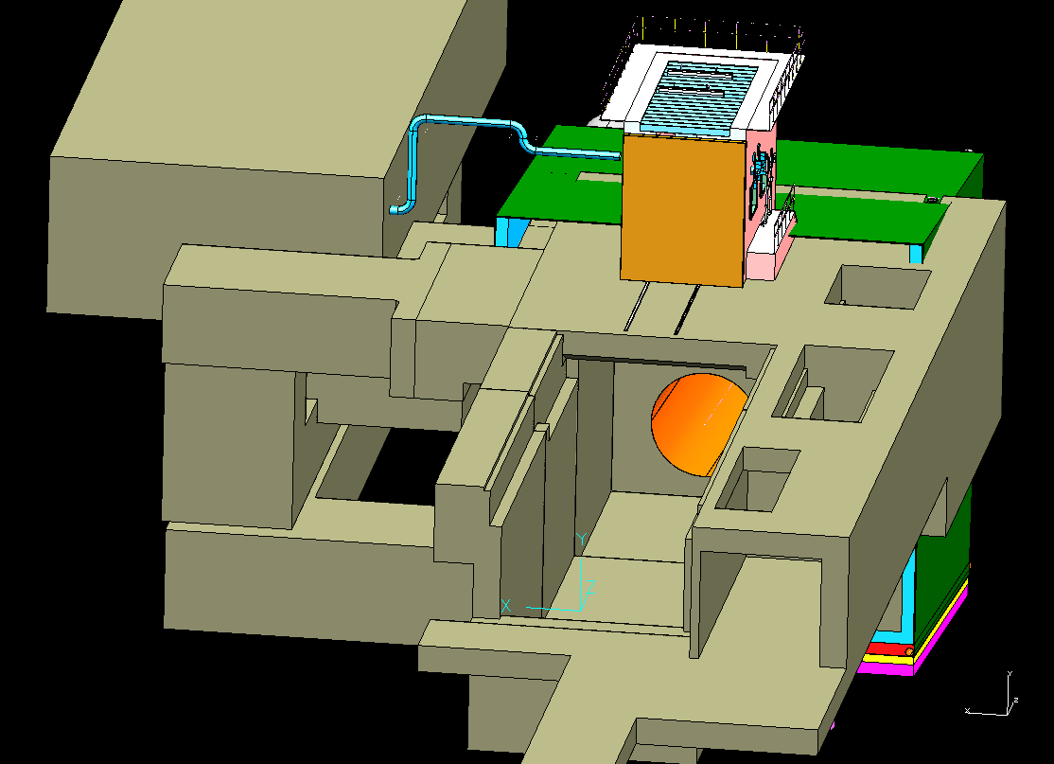
LBNE Target Hall Concept

Slide 24
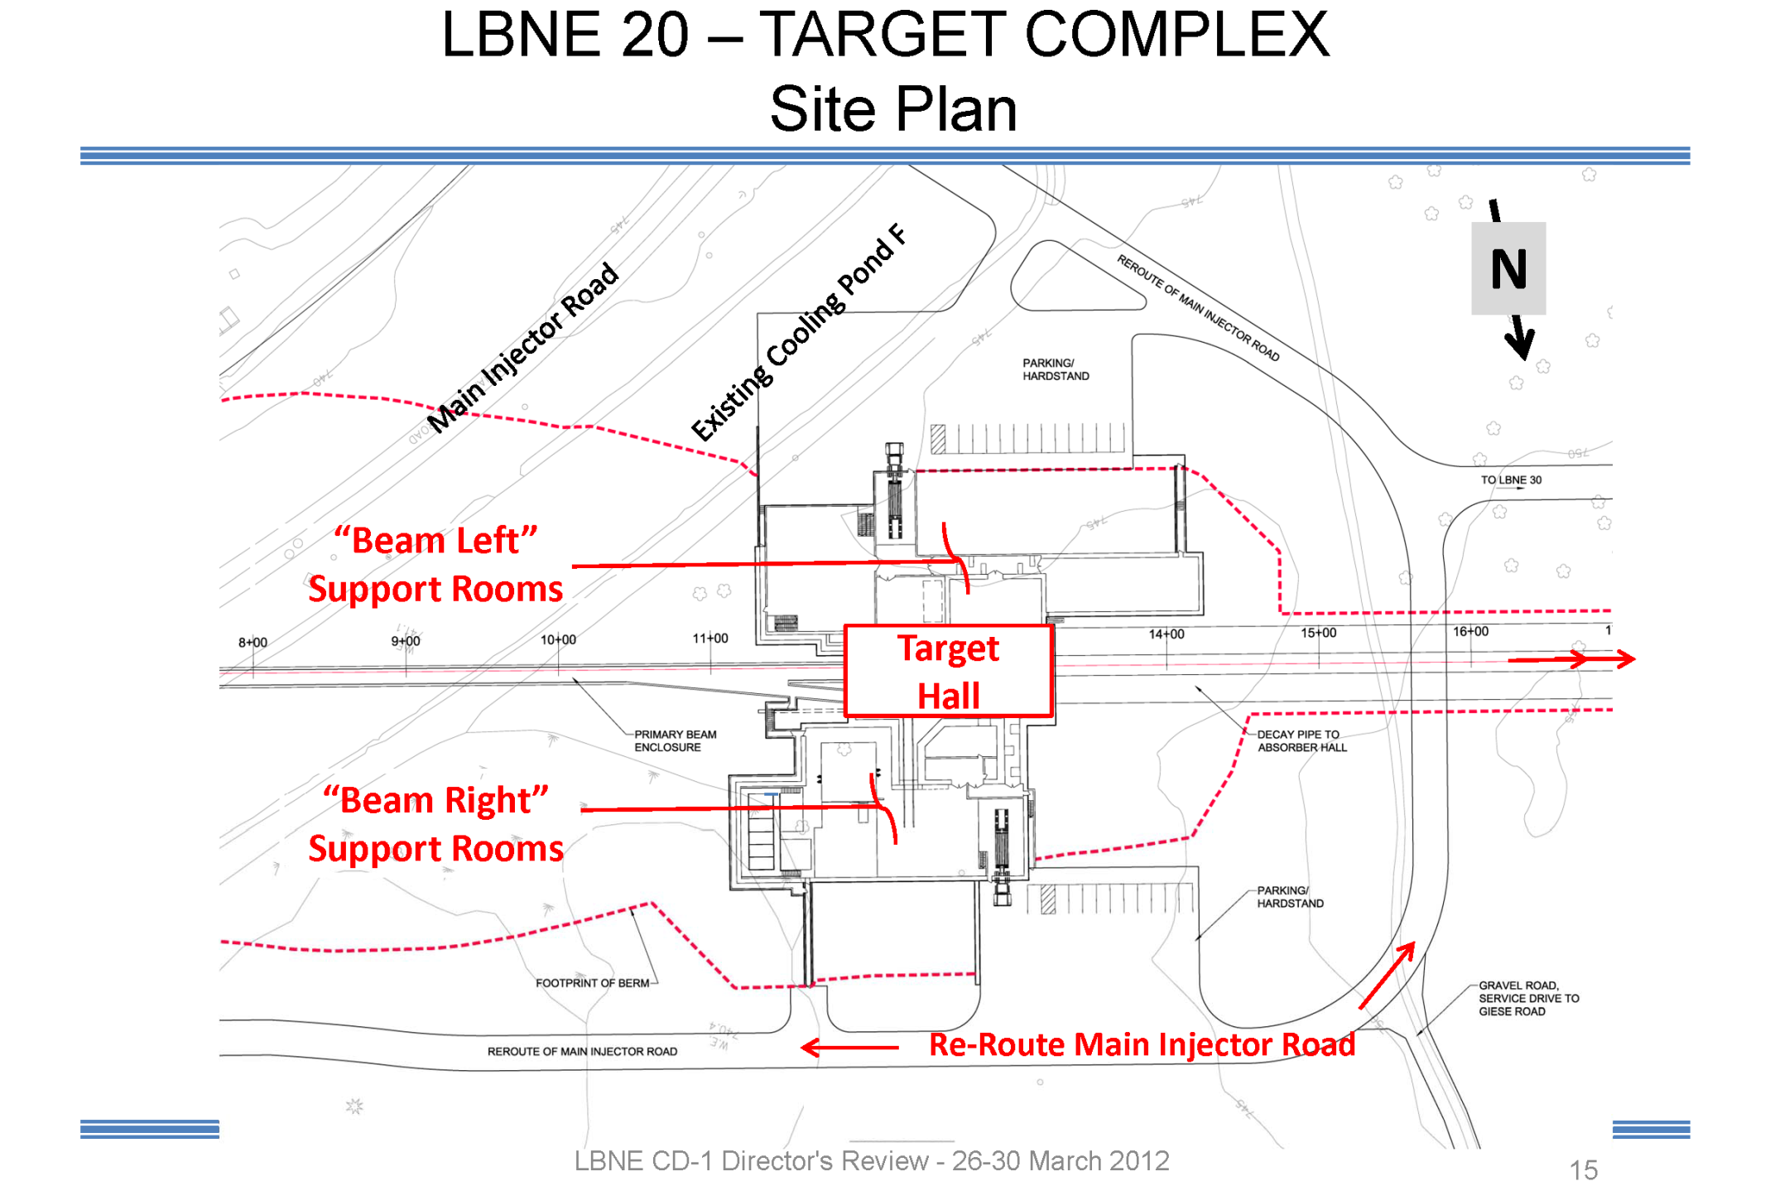

Slide 25
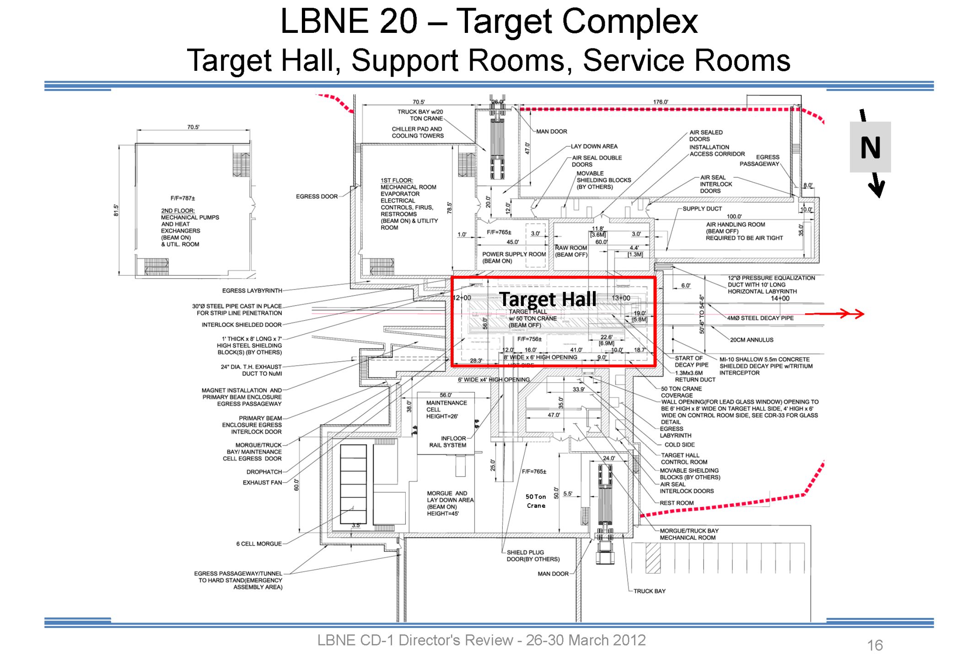

Slide 26
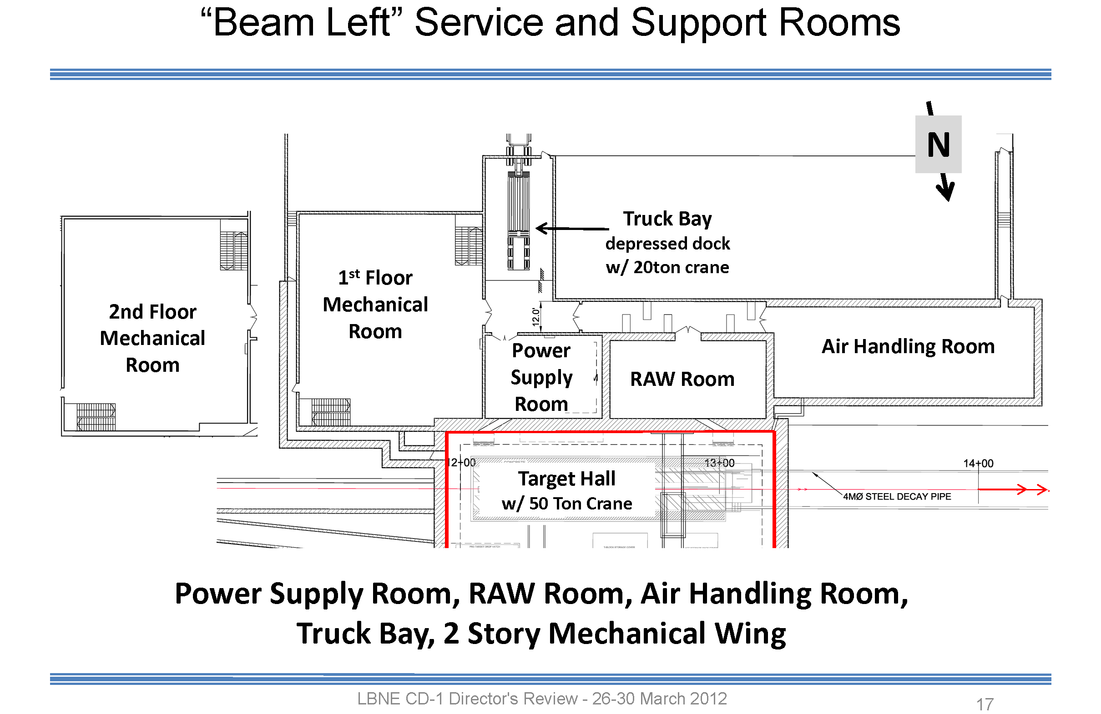

Slide 27
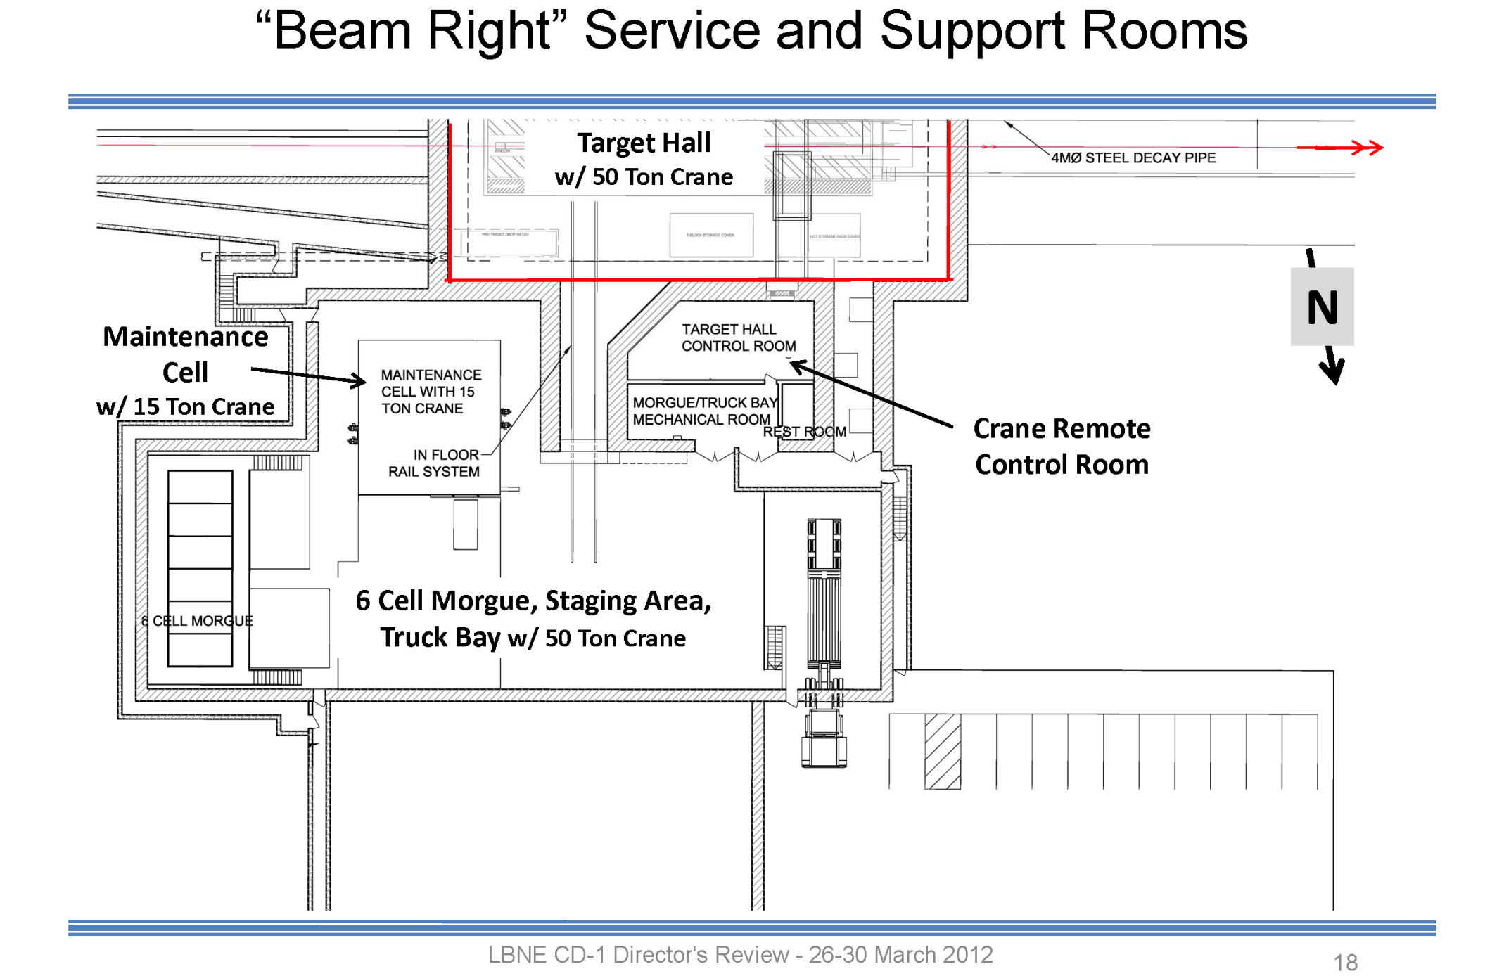

Slide 28
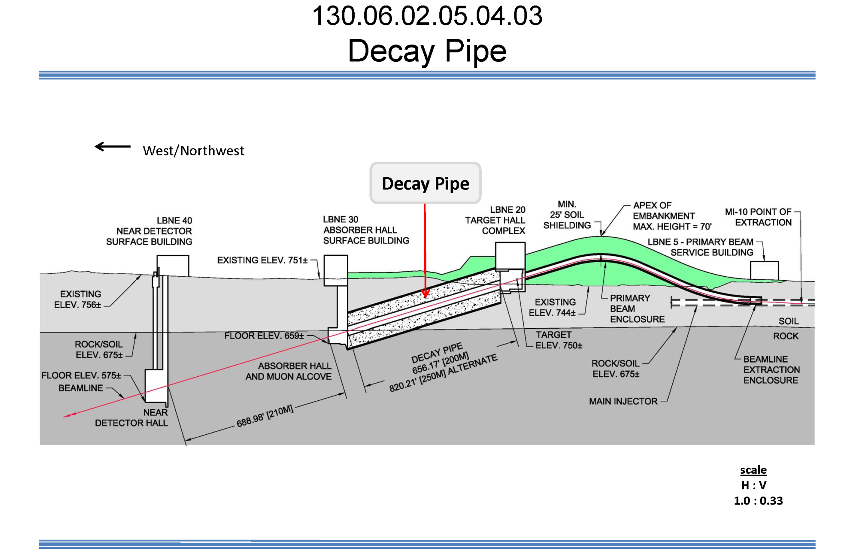
The NF Target System Hall is equivalent in many ways to the LBNE Decay Pipe.

Slide 29
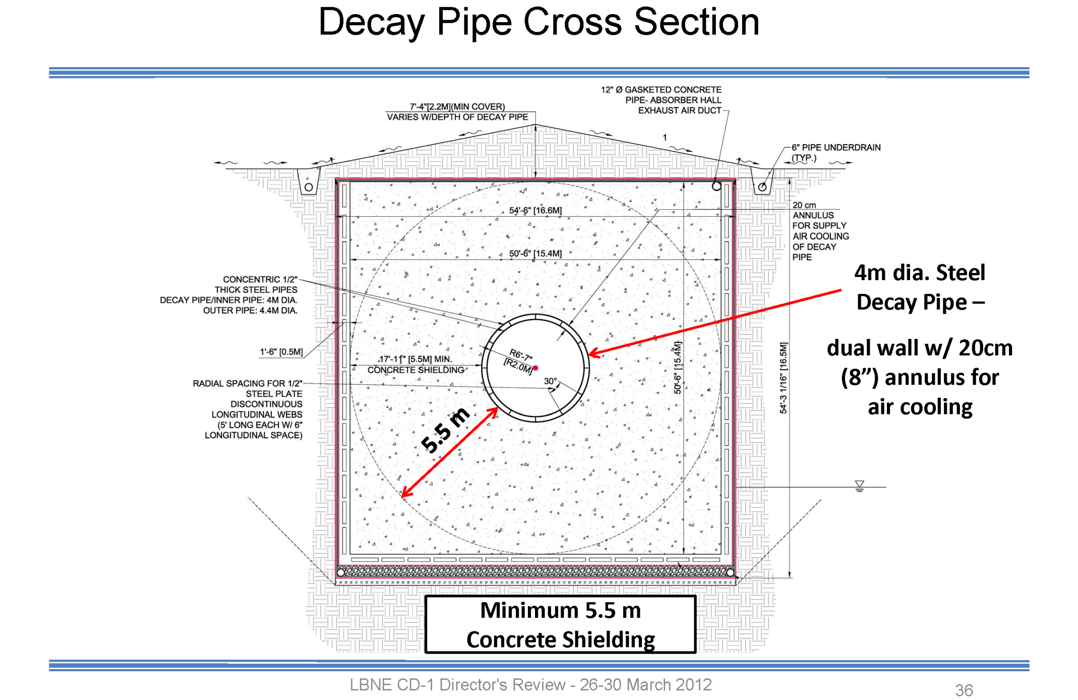
We may need concrete shielding ~ 5.5 m thick around the entire target system.

Slide 30
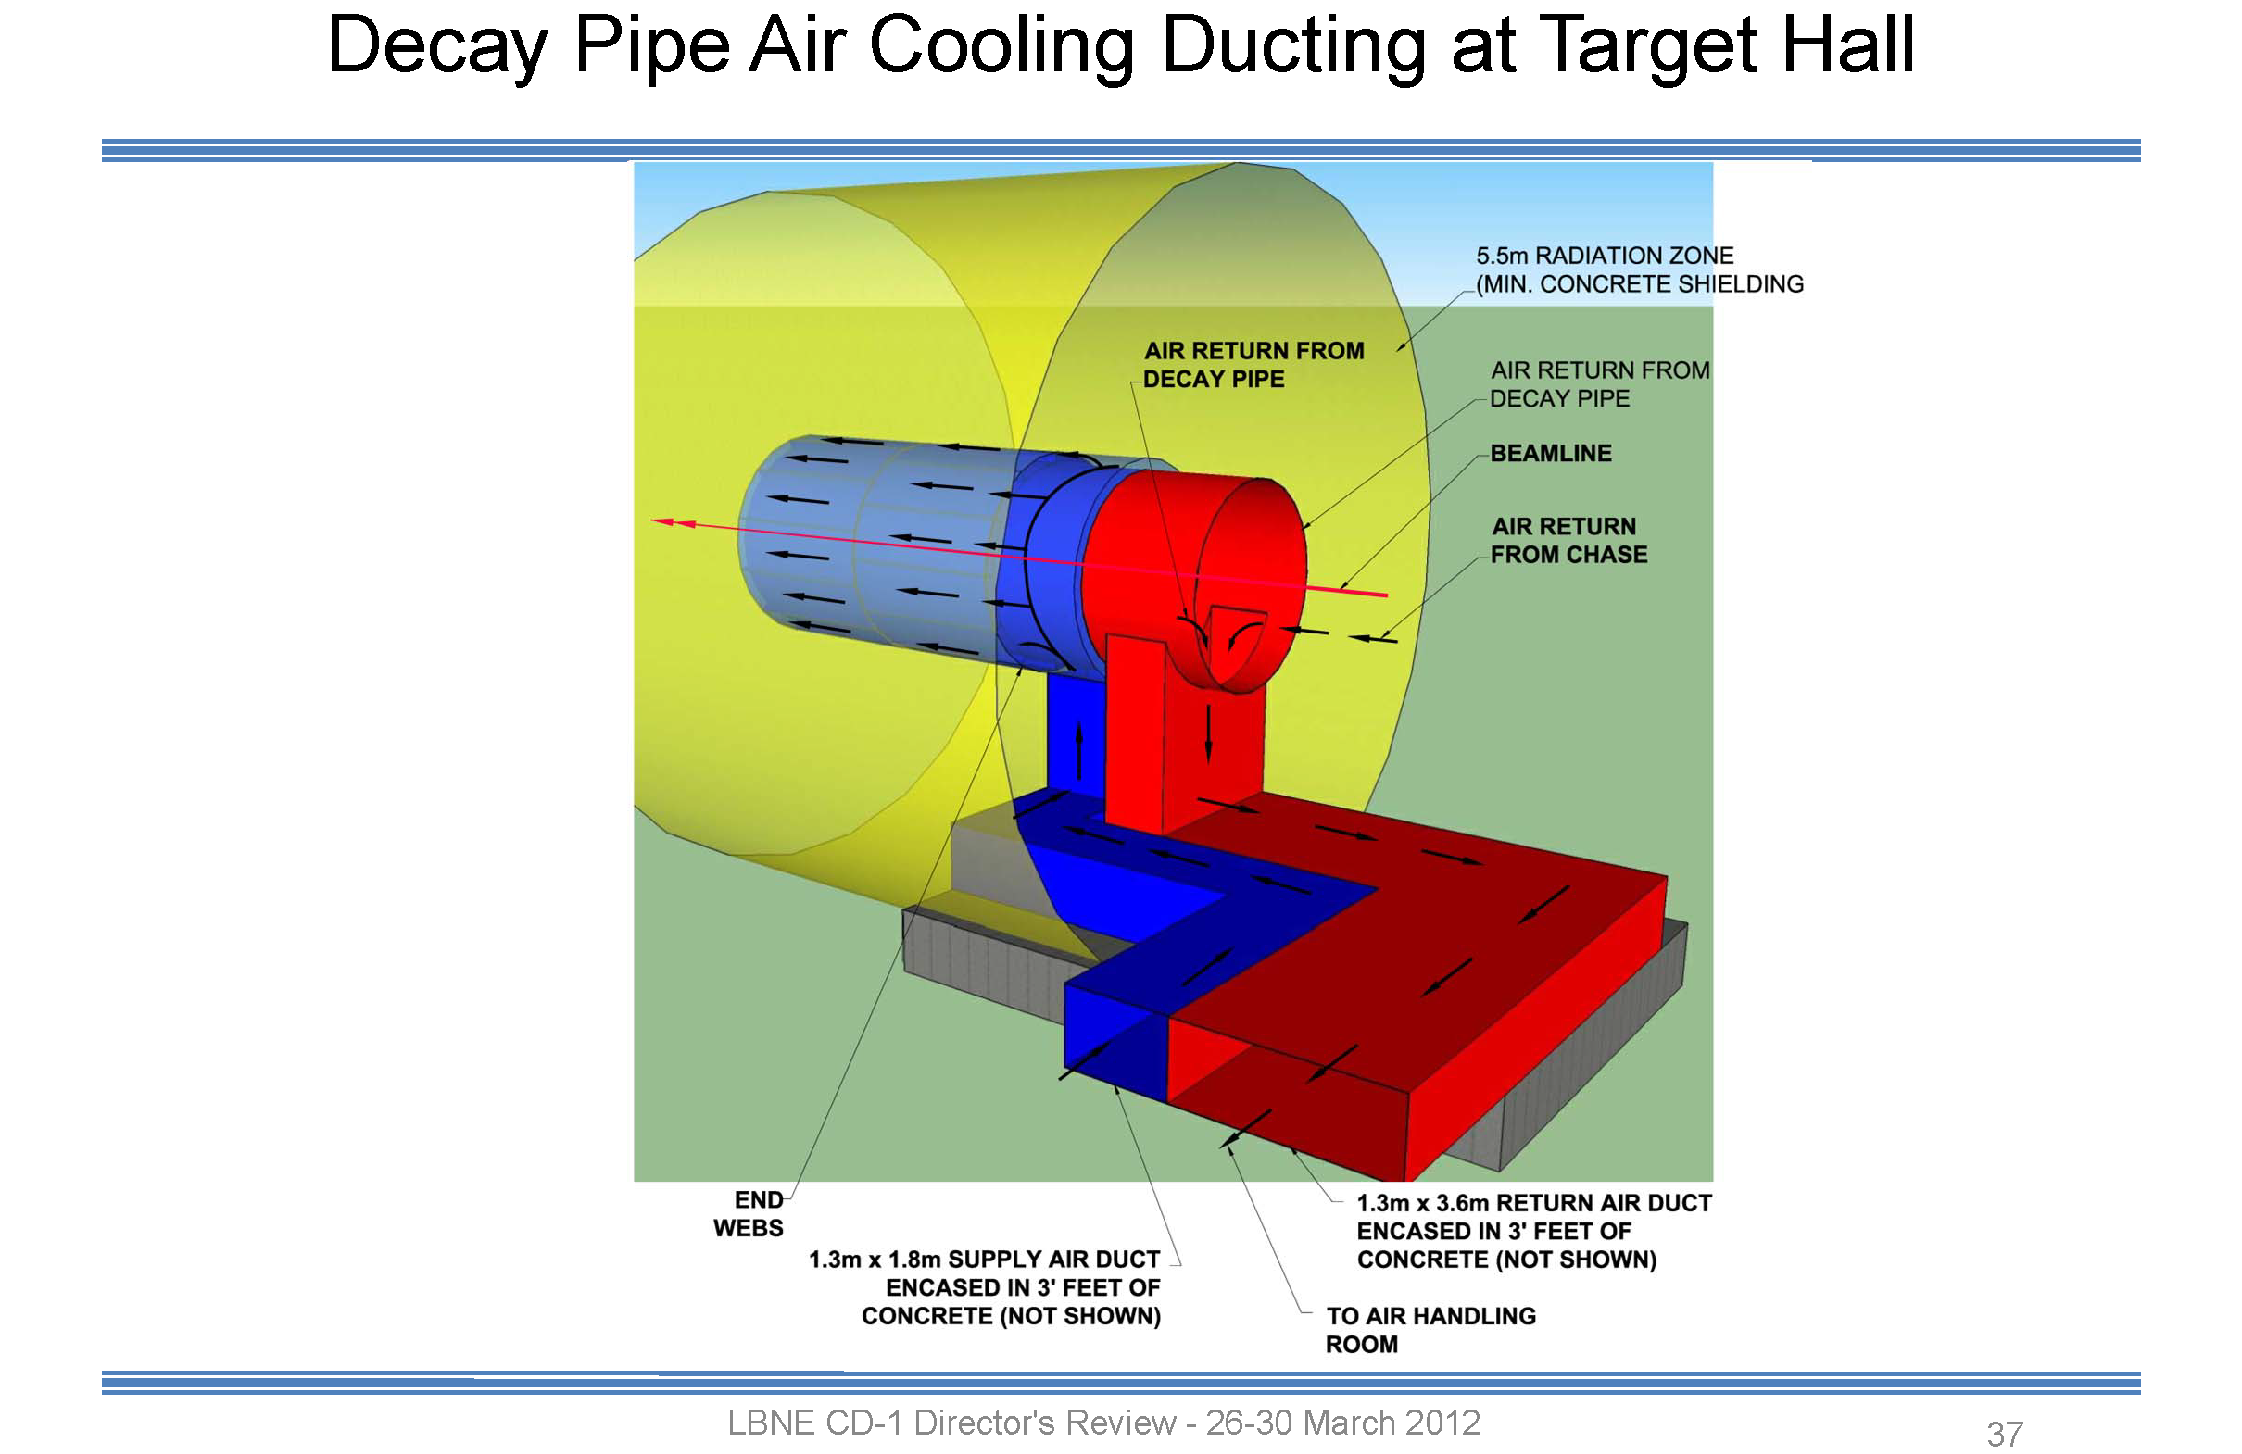
We must have an activated-air-handling system for the Target System Hall.

Slide 31
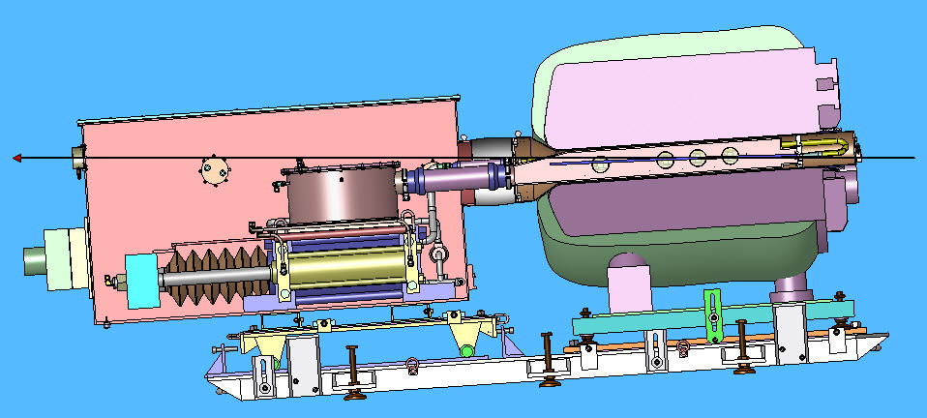
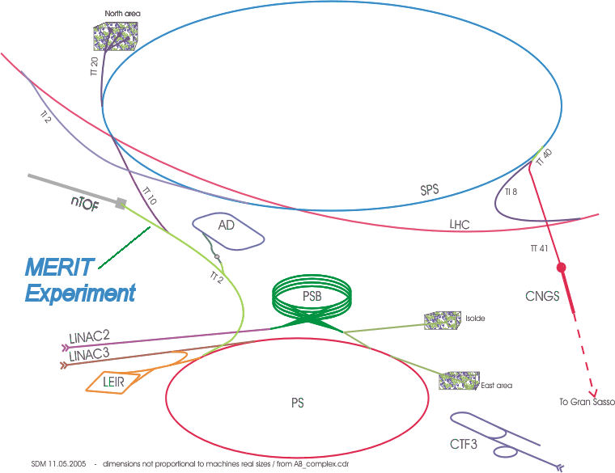
CERN MERIT Experiment
Proof-of-principle demonstration of a mercury jet target in a strong magnetic field, with proton bunches of intensity equivalent to a 4-MW beam.
Performed in the TT2A/TT2 tunnels at CERN, Nov. 2007.
Proton
Beam
Viewports
Solenoid
Secondary
Containment
Syringe Pump
1
2
3
4
Jet Chamber

Slide 32
Disruption Length Analysis (H. Park, PhD Thesis)
Observe jet at viewport 3 at 500 frames/sec, measure total length of disruption of the mercury jet by the proton beam.
Images for 10 Tp, 24 GeV, 10 T:
0 T
5 T
10 T
Before
During
After
15 T
Curves are global fits
Disruption length never longer than region of overlap of jet with proton beam.
No disruption for pulses of < 2 Tp in 0 T (< 4 Tp in 10 T).
Disruption length shorter at higher magnetic field.

Slide 33
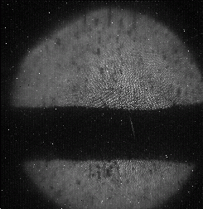
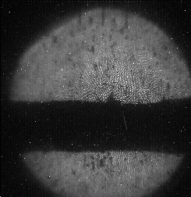






Filament Velocity Analysis (H. Park)
Measure position of tip of filament in each frame, and fit for t_{v} and v.
Curves are global fits
5 T
Slope ∝ velocity
10 T
0 T
15 T
20 T
t_{v} = time at which filament is first visible
25 T
Peak energy deposition at 4 MW, 50 Hz
Filament velocity suppressed by high magnetic field.
Filament start time >> transit time of sound across the jet.
⇒ New transient state of matter???

Slide 34




Pump-Probe Studies
? Is pion production reduced during later bunches due to disruption of the mercury jet by the earlier bunches?
At 14 GeV, the CERN PS could extract several bunches during one turn (pump), and then the remaining bunches at a later time (probe).
Pion production was monitored for both target-in and target-out events by a set of diamond diode detectors.
PUMP: 12 bunches, 12 ×10¹² protons
PROBE: 4 bunches, 4×10¹² protons
Single-turn extraction
➔ 0 delay, 8 Tp
4-Tp probe extracted on
next turn ➔ 3.2 μs delay
4-Tp probe extracted
after 2nd full turn
➔ 5.8 μs Delay
Results consistent with no loss of pion production for bunch delays of 40 and 350 μs, and a 5% loss (2.5-σ effect) of pion production for bunches delayed by 700 μs.

