Slide 1
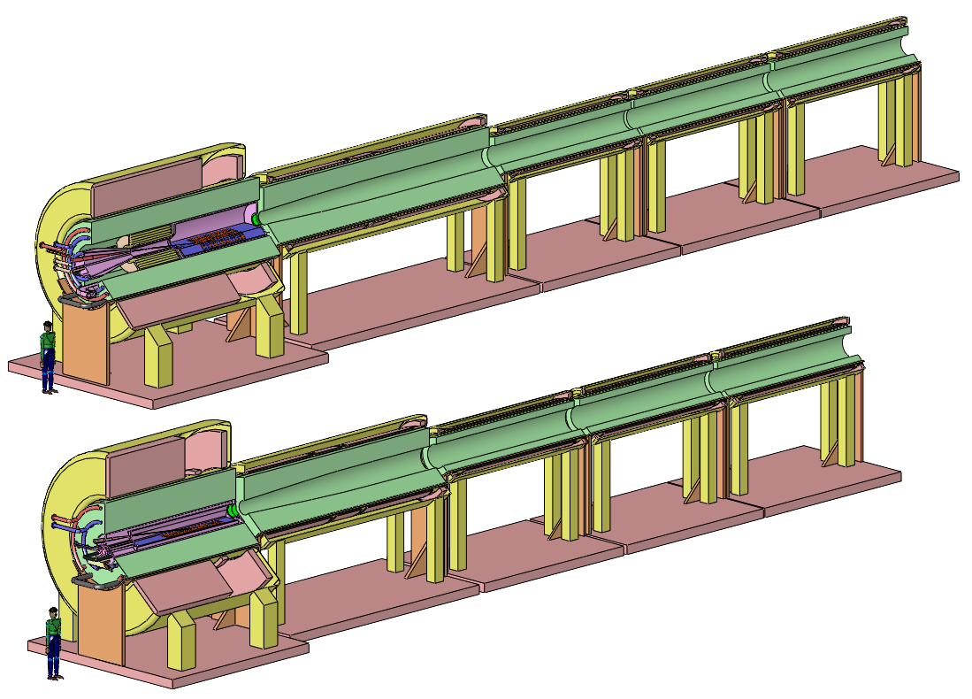
Front End – Target Options
K.T. McDonald
Princeton University
(January 7, 2014)

Slide 2
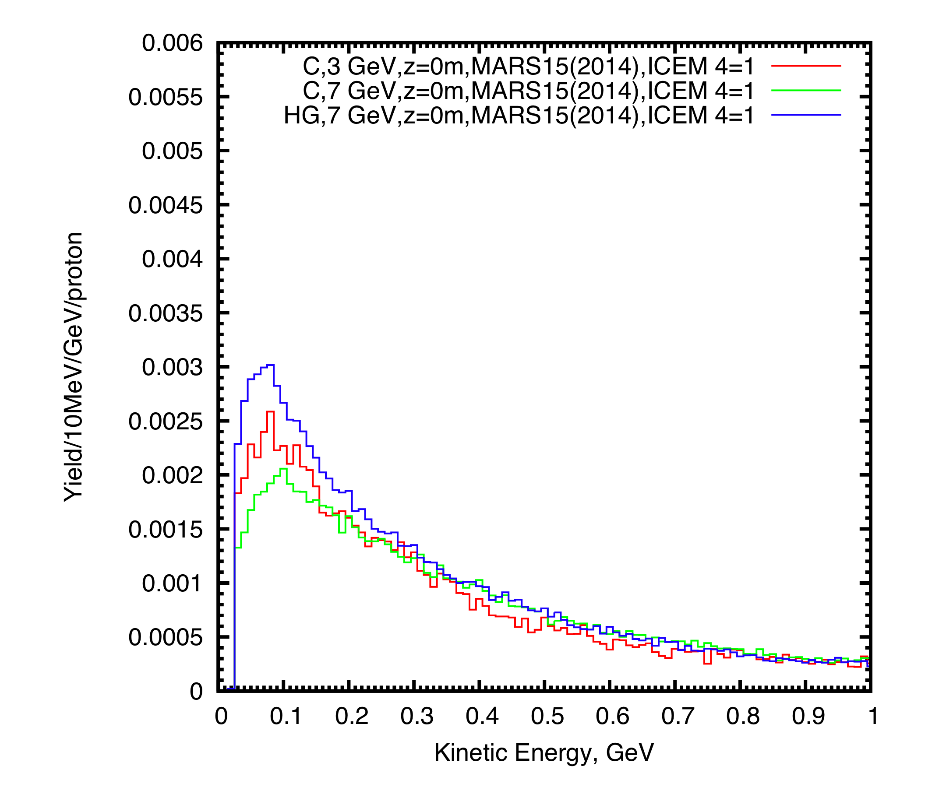
Target System Challenges
A target costs “$1”, but a high-power Target System costs a significant fraction of $1B.
Muon Colliders and Neutrino Factories need a copious source of muons, from decay of pions produced by the interaction of a proton beam with a target.
Pions so produced are most numerous with KE ~ 100 MeV.
They have MeV/c, ⇒ Large angles.
High-Z targets are favored.
The proton beam is pulsed at ≈ 50 Hz, and has 1-4 MW average power.
The Target System must dissipate this power.
Both signs of π/μ are desired simultaneously.
Nueffer (1981) considered (toroidal-field) Li lenses, ⇒ 2 target stations to collect both signs.
http://puhep1.princeton.edu/~mcdonald/examples/accel/neuffer_ieeetns_28_2034_81.pdf
Fernow et al. reviewed options in 1995: Li lenses, plasma lenses, toroidal horns, and solenoidal capture., http://puhep1.princeton.edu/~mcdonald/examples/accel/fernow_aipcp_352_134_95.pdf
All of the pulsed, toroidal systems would be well beyond present technology (then and now!), so the solenoid capture system began to be favored.

Slide 3
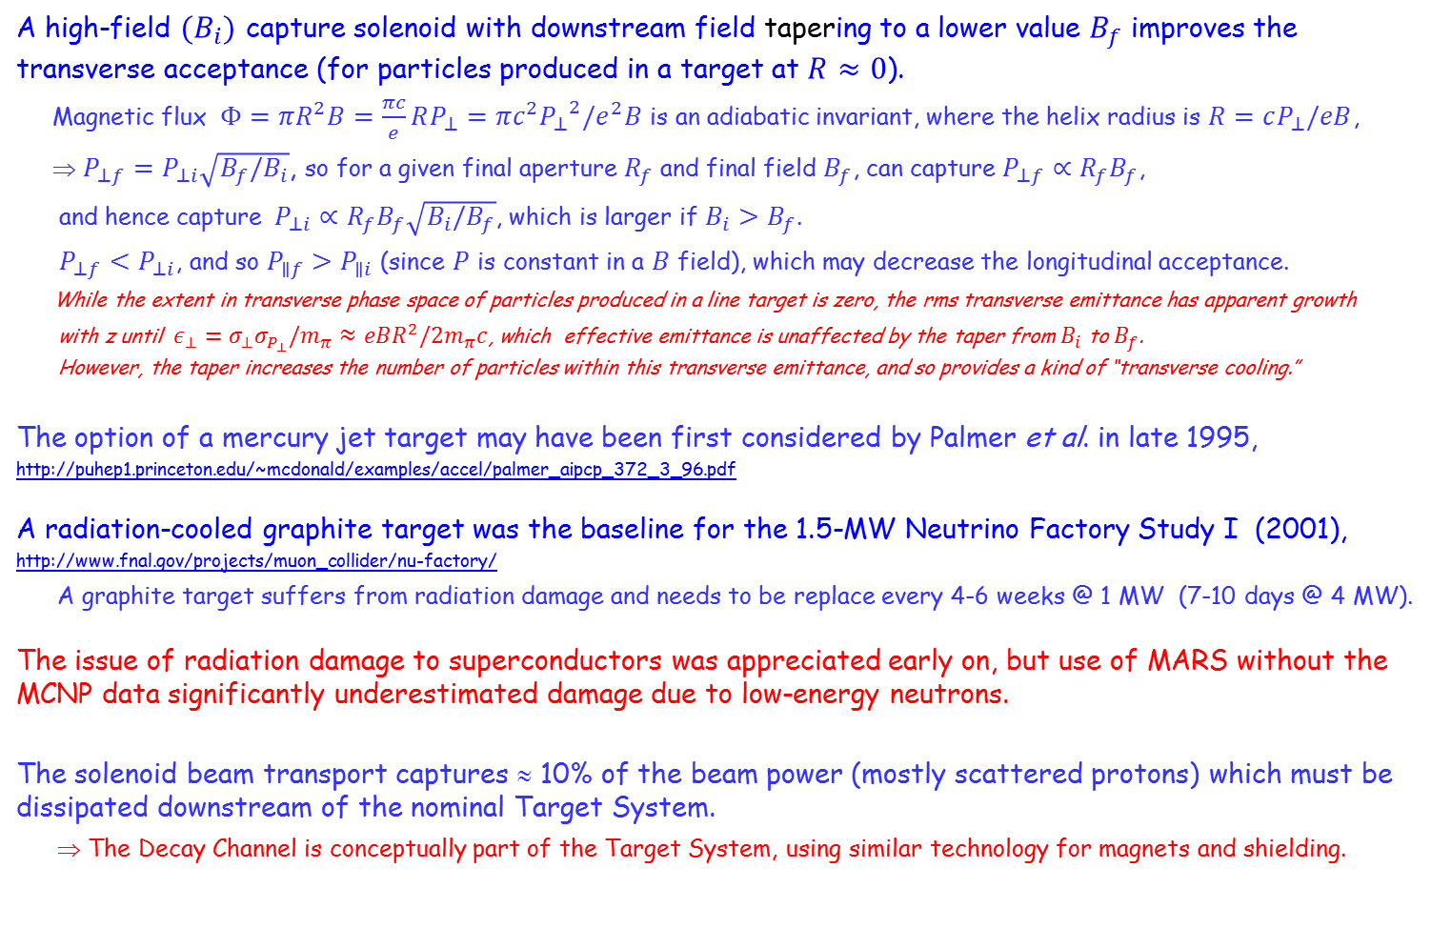
Target System Challenges II
A high-field $(B_{i})$ capture solenoid with downstream field tapering to a lower value $B_{f}$ improves the transverse acceptance (for particles produced in a target at $R≈0$).
Magnetic flux $Φ=πR^{2}B=\frac{πc}{e}RP_{⊥}=πc^{2}{P_{⊥}}^{2}/e^{2}B$ is an adiabatic invariant, where the helix radius is $R=cP_{⊥}/eB$,
⇒ $P_{⊥f}=P_{⊥i}\sqrt{B_{f}/B_{i}}$, so for a given final aperture $R_{f}$ and final field $B_{f}$, can capture $P_{⊥f}∝R_{f}B_{f}$,
and hence capture $P_{⊥i}∝R_{f}B_{f}\sqrt{B_{i}/B_{f}}$, which is larger if $B_{i}>B_{f}$.
$P_{⊥f}<P_{⊥i}$, and so $P_{∥f}>P_{∥i}$ (since $P$ is constant in a $B$ field), which may decrease the longitudinal acceptance.
While the extent in transverse phase space of particles produced in a line target is zero, the rms transverse emittance has apparent growth
with z until $ε_{⊥}=σ_{⊥}σ_{P_{⊥}}/m_{π}≈eBR^{2}/2m_{π}c$, which effective emittance is unaffected by the taper from $B_{i}$ to $B_{f}$.
However, the taper increases the number of particles within this transverse emittance, and so provides a kind of “transverse cooling.”
The option of a mercury jet target may have been first considered by Palmer et al. in late 1995,
http://puhep1.princeton.edu/~mcdonald/examples/accel/palmer_aipcp_372_3_96.pdf
A radiation-cooled graphite target was the baseline for the 1.5-MW Neutrino Factory Study I (2001),
http://www.fnal.gov/projects/muon_collider/nu-factory/
A graphite target suffers from radiation damage and needs to be replace every 4-6 weeks @ 1 MW (7-10 days @ 4 MW).
The issue of radiation damage to superconductors was appreciated early on, but use of MARS without the MCNP data significantly underestimated damage due to low-energy neutrons.
The solenoid beam transport captures ≈ 10% of the beam power (mostly scattered protons) which must be dissipated downstream of the nominal Target System.
⇒ The Decay Channel is conceptually part of the Target System, using similar technology for magnets and shielding.

Slide 4
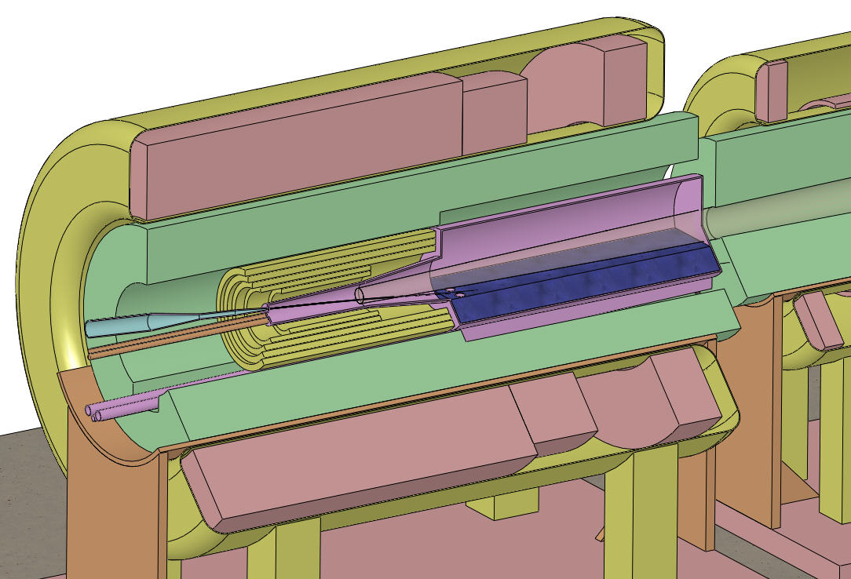
Target and Capture Topology: Solenoid
Superconducting magnets
Desire ≈ 10¹⁴ μ/s from ≈ 10¹⁵ p/s (≈ 4 MW proton beam).
R.B. Palmer (BNL, 1995) proposed a 20-T solenoidal capture system.
Low-energy π's collected from side of long, thin cylindrical target.
Solenoid coils can be some distance from proton beam.
≥ 10-year life against radiation damage at 4 MW, with sufficient shielding.
Liquid mercury jet target replaced every pulse (or graphite target replaced often).
Proton beam readily tilted with respect to magnetic axis.
⇒ Beam dump (mercury pool) out of the way of secondary π's and μ's (or additional graphite block as beam dump).
IDS-NF Target Concept:
Tungsten beads,
He gas cooled
Proton beam and
Mercury jet
Be window
Mercury collection pool
With splash mitigator
Resistive magnets
Shielding of the superconducting magnets from radiation is a major issue.
Magnetic stored energy ~ 3 GJ!
5-T copper magnet insert; 15-T Nb₃Sn coil + 5-T NbTi outsert.
If mercury target, desirable to replace the copper magnet by a 20-T HTC insert (or use only 15-T Nb coil).

Slide 5
Large Cable-in-Conduit Superconducting Magnets
The high heat load of the target magnet requires Nb₃Sn cable-in-conduit technology, more familiar in the fusion energy community than in high energy physics.
The conductor is stabilized by copper,
as the temperatures during conductor fabrication comes close to the melting point of aluminum.
The conductor jacket is stainless steel, due to the high magnetic stresses.
A high-temperature superconducting insert of 6+ T is appealing – but its inner radius would also have to be large to permit shielding against radiation damage.

Slide 6
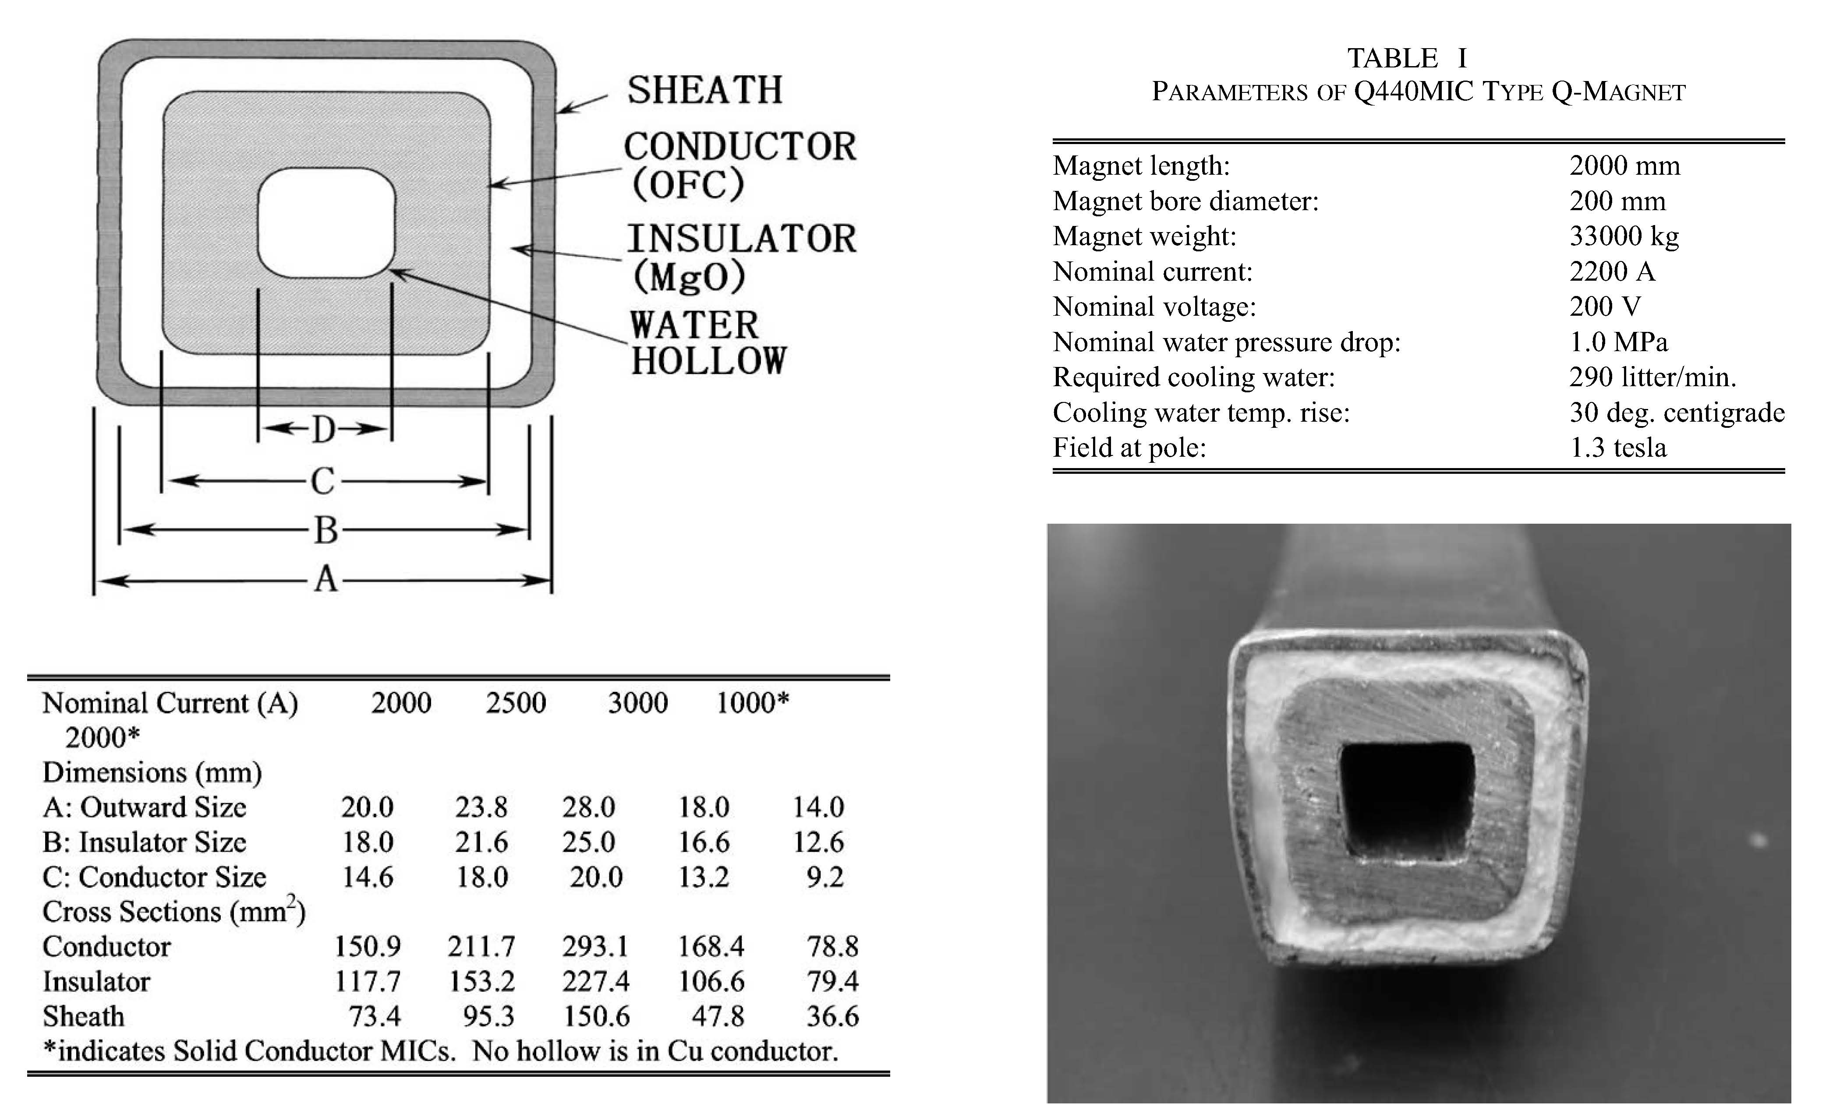
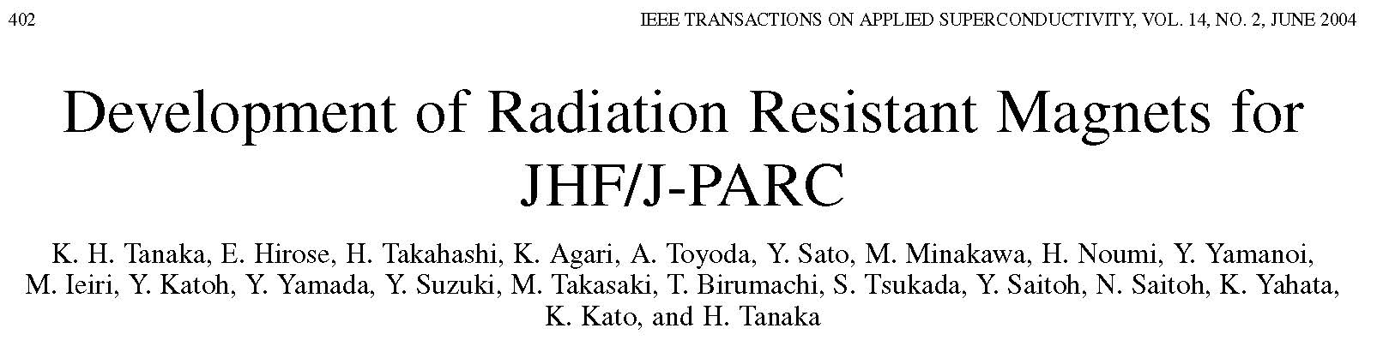
Copper Conductor for Radiation-Resistant Magnets
Organic insulation cannot be used in copper coils in the Target System (or Decay Channel).
Radiation-resistant conductor with MgO (or spinel) insulation has been developed at KEK/JHF.

Slide 7
Recent Targetry Efforts
Xiaoping Ding (UCLA) Particle-Production Simulations (including comparison of C and Ga with Hg)
Ole Hansen (CERN) Target Optimization
Hisham Sayed (BNL) Configurations with shorter taper (matched to phase rotator)
Bob Weggel (MORE/PBL) Magnet and Shielding Configurations
Nicholas Souchlas (PBL) Energy-deposition simulations for the Target System (to determine whether the superconducting magnets are sufficiently well shielded from the 4-MW beam power)
Pavel Snopok (IIT) Energy-deposition simulations for the Decay Channel (soon N. Souchlas)
Van Graves (ORNL) Mercury module design + overall Target System layout
Yan Zhan (Stony Brook) Nozzle and Jet Studies (towards improving the jet quality)
Roman Samulyak (Stony Brook) MHD Simulations (including beam-jet interactions)

Slide 8
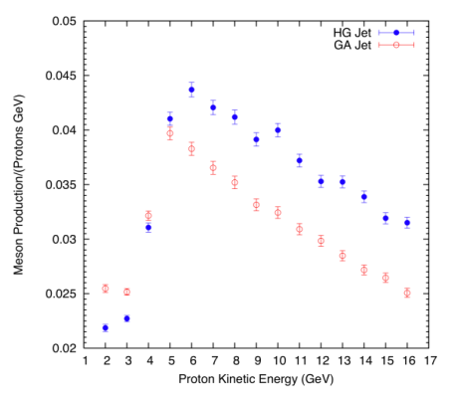
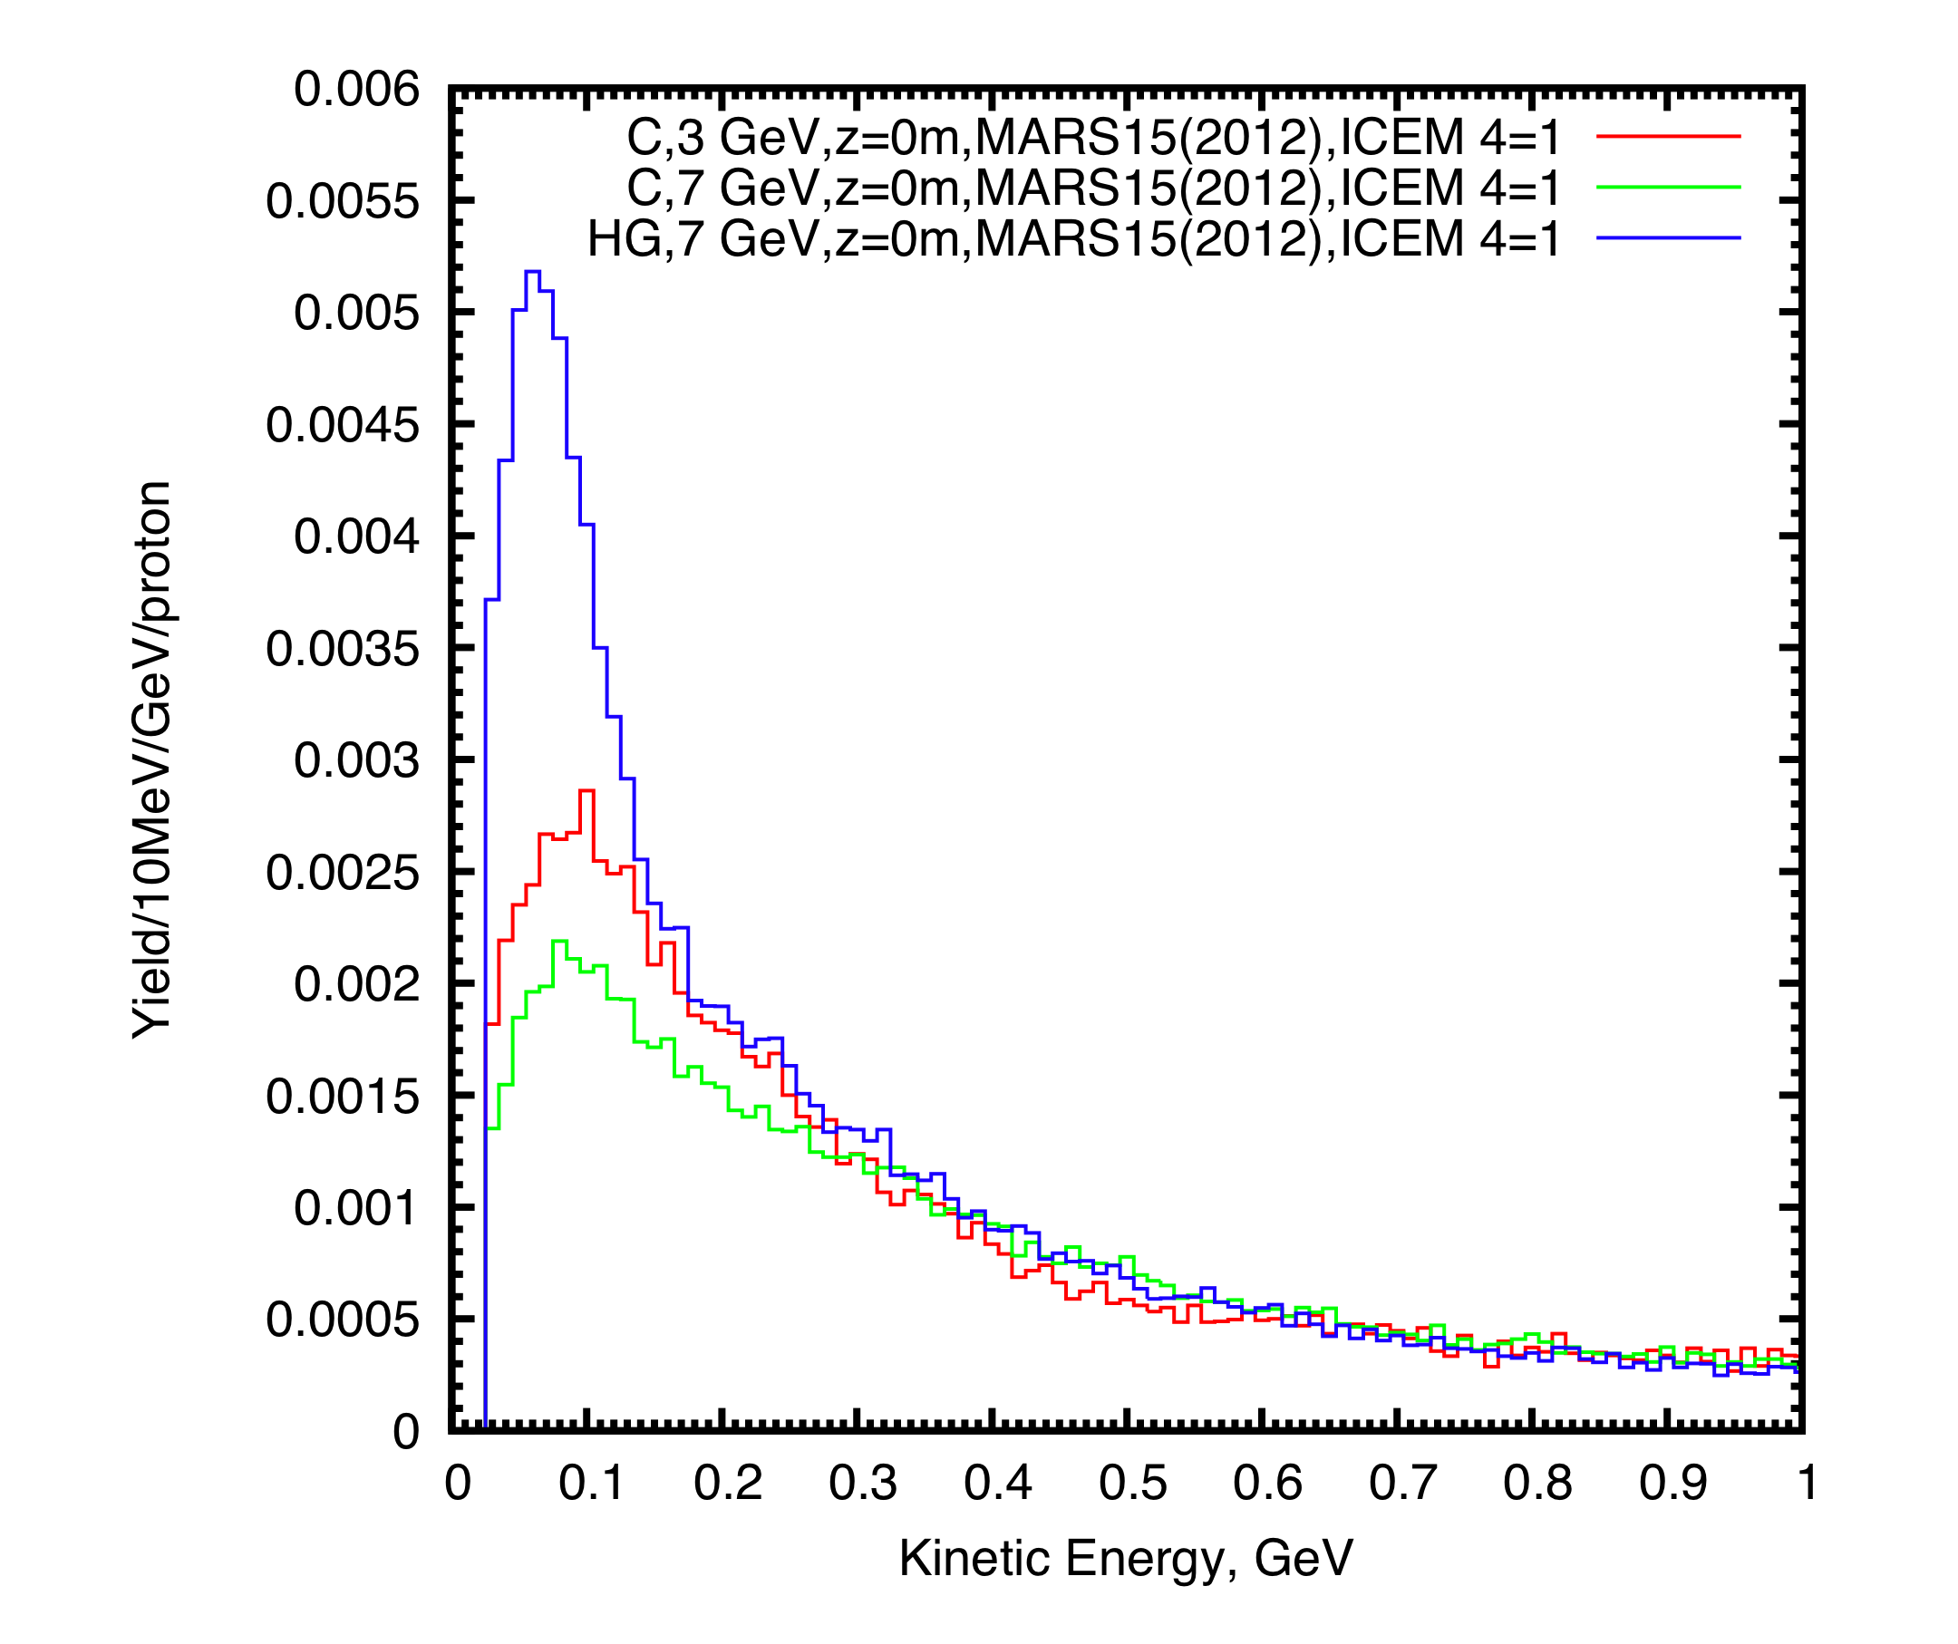
Particle Production Simulations
Xiaoping Ding (UCLA)
Extensive simulations using MARS15 showed that with a high-Z target, particle production peaks around 6-7 GeV, and that it is favored to use a long, thin target, tilted with respect to the magnetic axis (and tilted proton beam).
MARS15(2012) indicated that for 3-GeV proton beam, carbon is better than Hg (but MARS15(2012) has issues in the range 3-10 GeV).
MARS15(2014) just released, and indicates reduced production by high-Z targets, but Hg still favored over C at 7 GeV.
Hg
Ga
MARS15(2012)
Region of interest for Muon Collider is 40 < KE < 180 MeV
MARS15(2014)

Slide 9
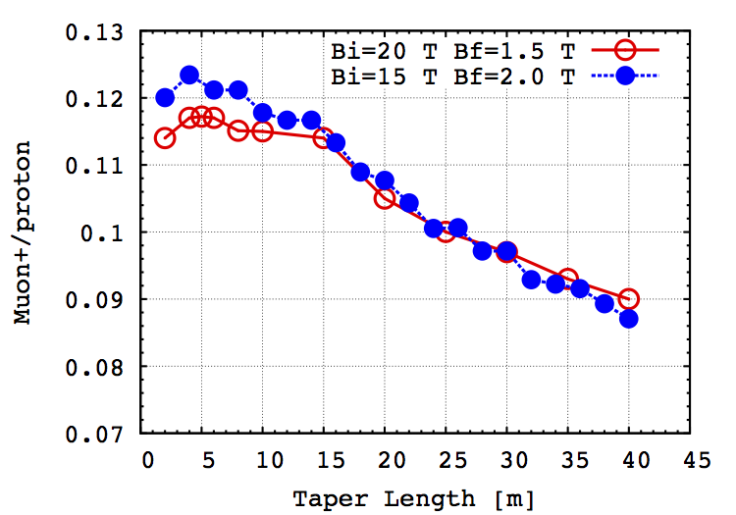
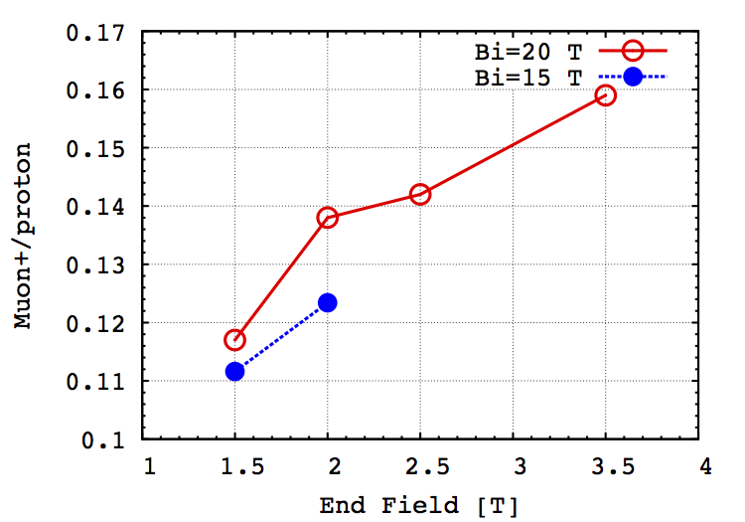
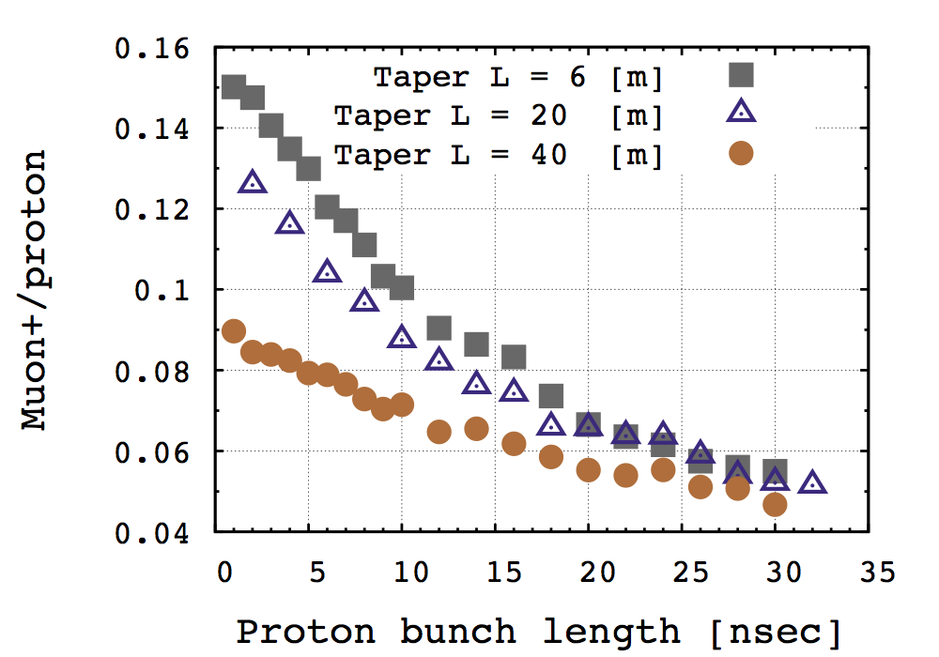

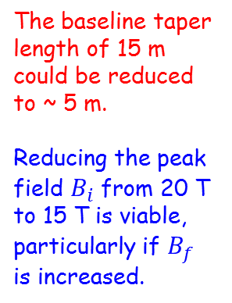
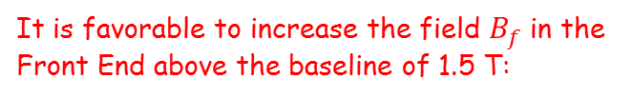
Configurations with a Shorter Taper
Hisham Sayed (BNL)
Following a hint from O. Hansen, the yield of useful muons out of the Phase Rotator (Front End), is improved by shifting the timing of the proton beam, and shortening the length of the taper between 20/15 T and 1.5/3.5 T.
It is favorable to increase the field $B_{f}$ in the Front End above the baseline of 1.5 T:
The baseline taper length of 15 m could be reduced to ~ 5 m.
Reducing the peak field $B_{i}$ from 20 T to 15 T is viable, particularly if $B_{f}$ is increased.
Aperture R = 30 cm fixed
Aperture R = 30 cm fixed
A short proton bunch continues to be favored:
The shorter taper results in a denser distribution in longitudinal phase space, which is preferable for the Buncher/Phase Rotator.
$B_{i}=20$ T
$B_{f}=3.5$ T

Slide 10
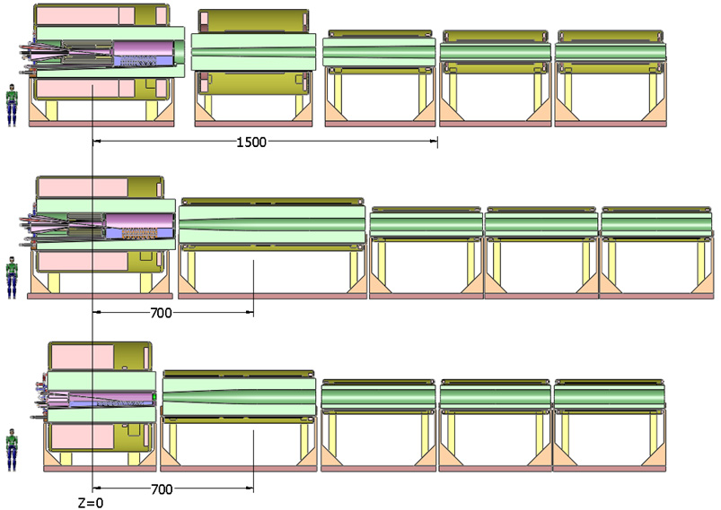
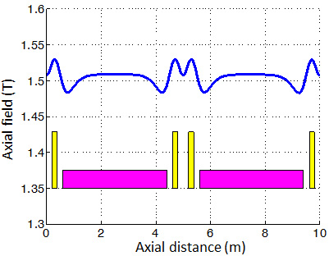
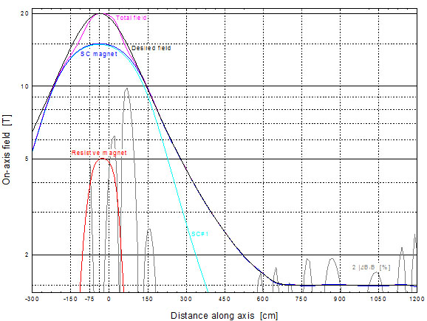
Magnet Coil Configurations
Bob Weggel (MORE/PBL)
Baseline (IDS-NF)
Field perturbations at the ends of the 5-m-long Decay Channel magnets can lead to “stop bands.”
2 configurations with 7-m taper and 15-T peak
Revised coil configuration has essentially no “stops bands” (H. Sayed):
Axial field profile for a 7-m taper:

Slide 11
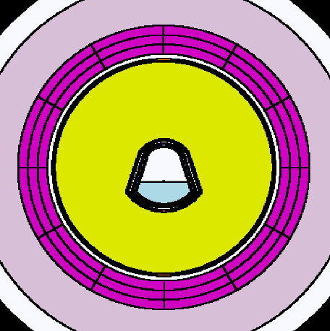
Energy-Deposition Simulations
Nicholas Souchlas (PBL)
Possibly noncircular target module could lead to “hot spots” in downstream coils.
Bell-shaped mercury target module
z = 0
z = 4.7 m
MARS15 simulations (with MCNP data files) are used to suggest changes in the W-bead shielding to keep the power deposition below 0.1 mW/g in superconducting coils (ITER limit), as needed to provide a 10-year operation lifetime against radiation damage.
http://puhep1.princeton.edu/~mcdonald/examples/magnets/schultz_ieeesfe_423_03.pdf
These simulations are very time consuming, ⇒ Run MARS at NERSC (N. Mokhov, R. Ryne), but need the MCNP data tables for this.

Slide 12
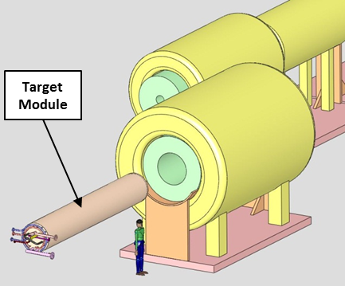
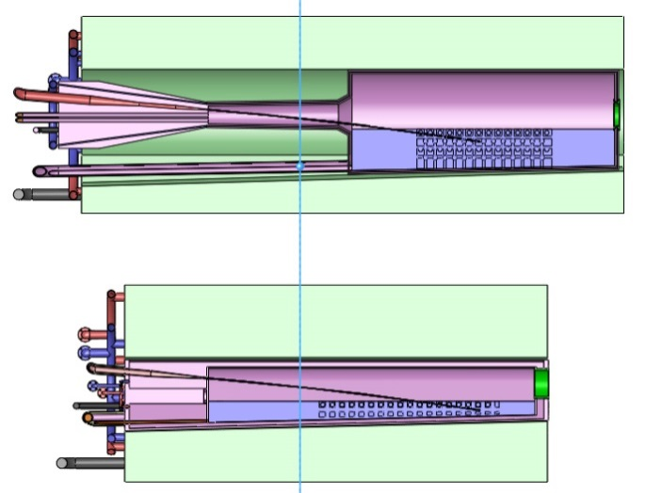
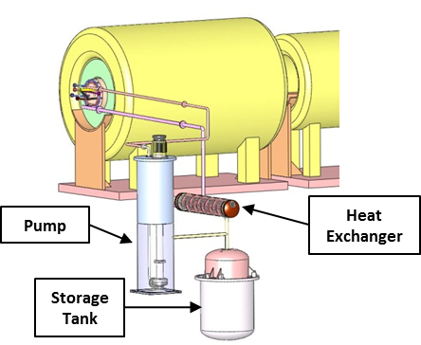
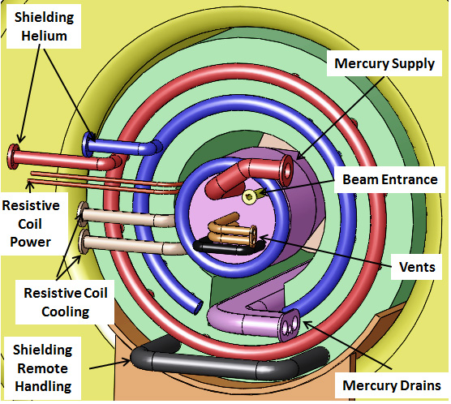
Mercury Target Module Design
Van Graves (ORNL)
IDS120_20-1.5T7m2+5
Cross
sections
of the
Mercury
Modules for 20 T and 15 T:
Insertion/
extraction
of the
Mercury
Module:
IDS120_15-1.5T7m3+4
Services
for the
Mercury
Module and the Shielding Module:
The mercury
flow loop:
The mercury module shown above could be replaced by a carbon-target module in the initial stages of a Muon Collider/Neutrino Factory.

Slide 13
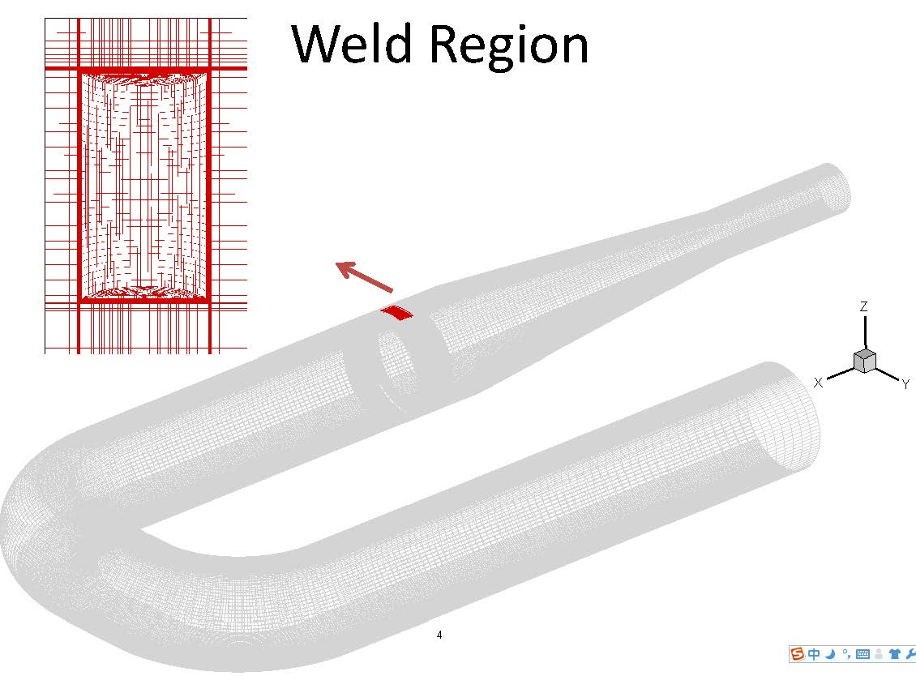
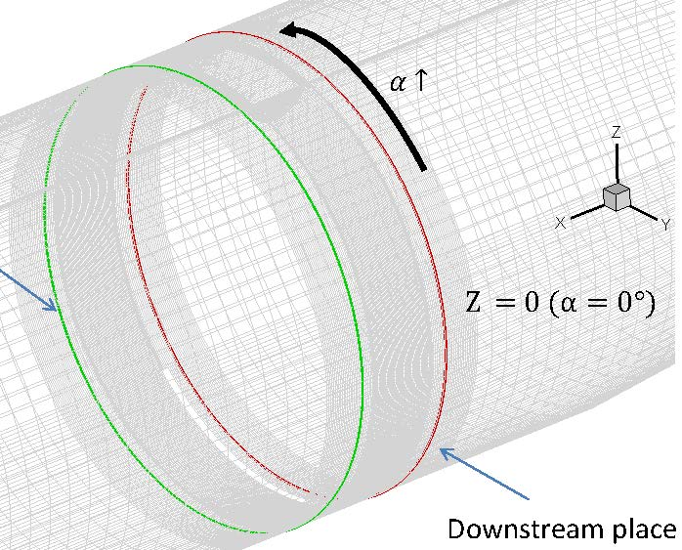
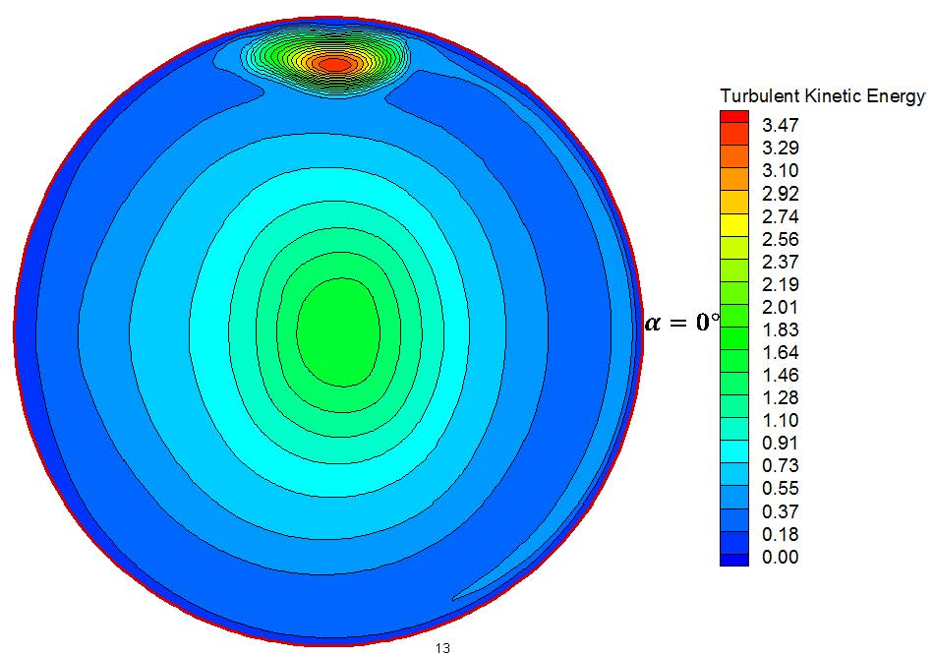
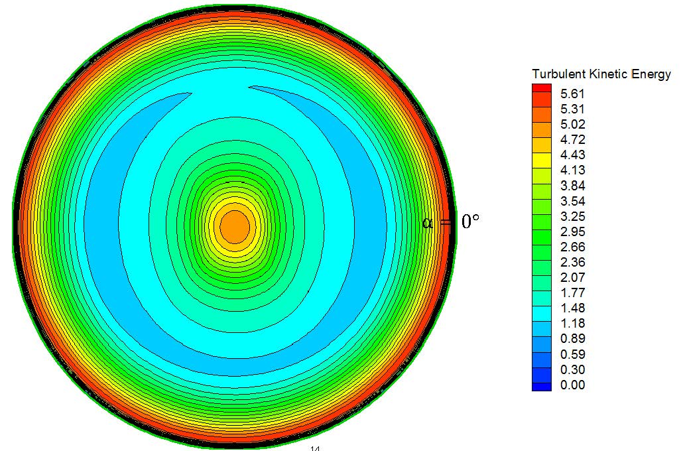
Mercury Nozzle Simulations
Yan Zhan (SUNY Stony Brook)
MERIT mercury jet was “elliptical,” possibly due to weld beads inside the Ti nozzle.
Turbulence profile just downstream of nozzle.
At nozzle exit:
ANSYS/FLUENT simulation suggests that weld-bead effect is damped at nozzle exit.
Next: model free jet outside nozzle:
t = 0.15 ms
t = 0.35 ms
t = 0.6 ms
t = 0.8 ms
13

Slide 14
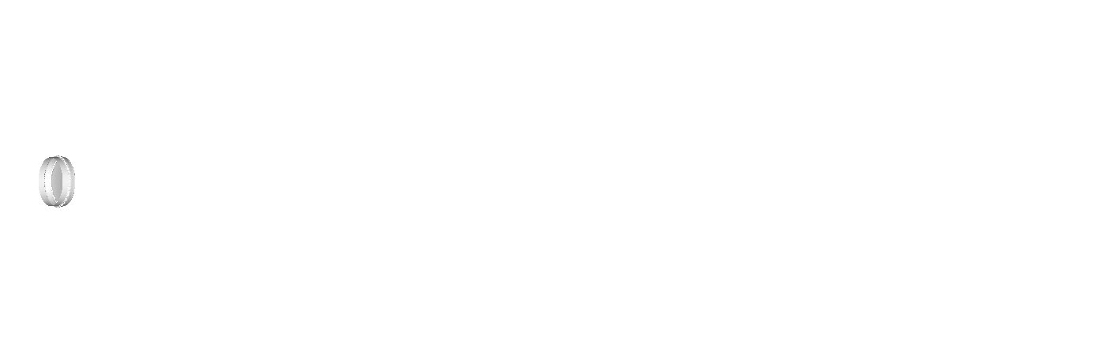
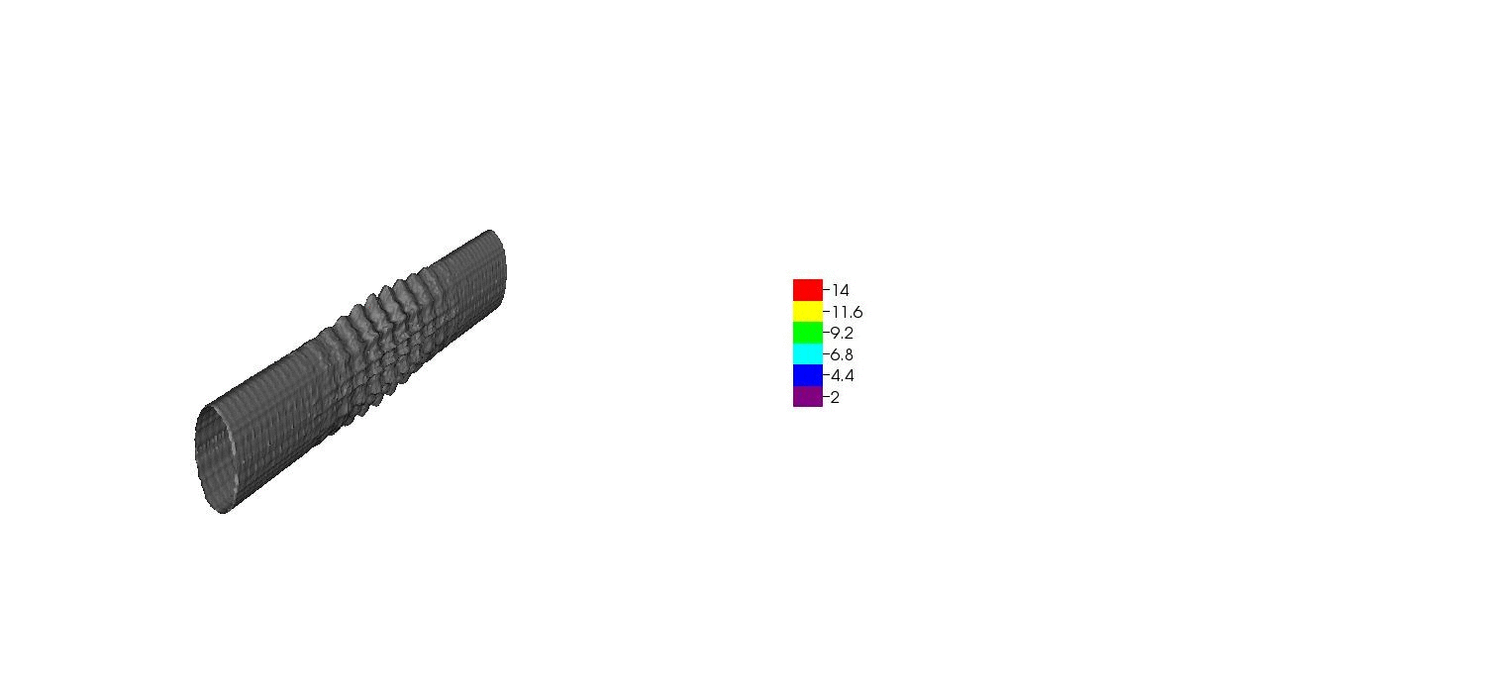
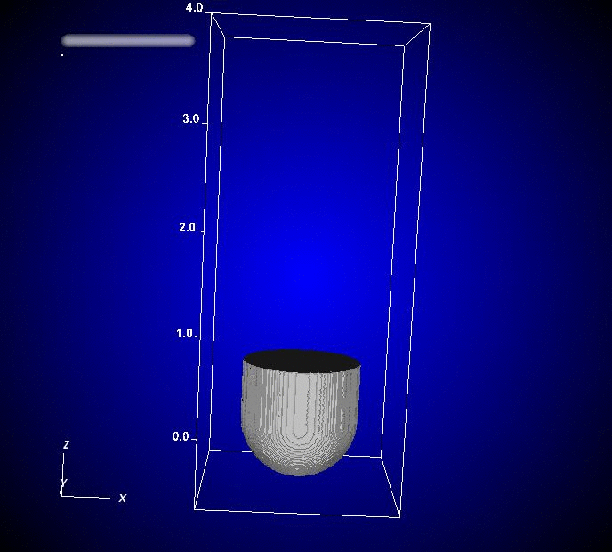

Beam-Jet Interaction Simulations
Roman Samulyak (SUNY Stony Brook)
FronTier simulation of high-speed-jet cavitation and breakup:
Simulation of mercury thimble experiments
(2001) using the Lagrangian particle code:
Smoothed-Particle-Hydrodynamics
simulation of MERIT beam-jet interaction:

Slide 15
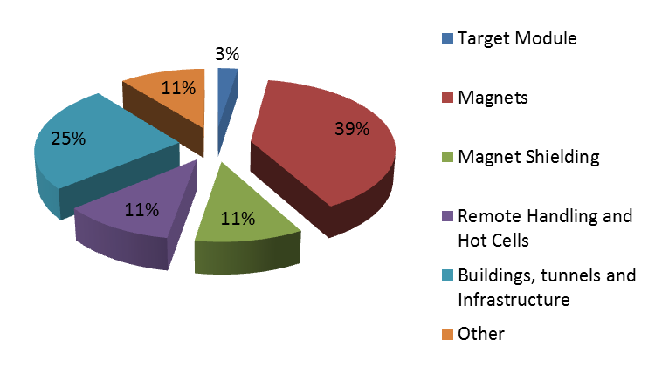
Preliminary Costing of a 4-MW Target System
The nominal target costs only a few % of the Target System.
Infrastructure costs are ~ 50%.
(A. Kurup, International Design Study for a Neutrino Factory)

Slide 16
Next Steps
Past Target efforts have been part of Technology Development, in close coordination with Front End Design and Simulation.
Outstanding issues related to target technology include:
Target Module
MAP Management has preselected a carbon-target module for initial use.
This module is to have the same envelope as a possible later mercury-target module.
A carbon-target module could include a 5-T copper-coil insert, which not does not fit well
in a mercury-target module. (This would compensate somewhat for the lower muon yield
from a carbon target at 7 GeV.)
Beam Dump
The Beam Dump is part of the Target Module. A graphite target would be followed by a
graphite beam dump (while a mercury target is followed by a mercury-pool beam dump).
Capture Solenoid (+ downstream Taper)
The 15/20-T coil configuration couples to that in the Taper, which is still under study.
The Taper ends with the same aperture as that of the Phase Rotator, not yet defined.
Chicane (The chicane dumps some of the beam but is not THE Beam Dump)
Can/should the chicane coils be superconducting, with internal shielding of He-gas-cooled
tungsten beads?

