Slide 1
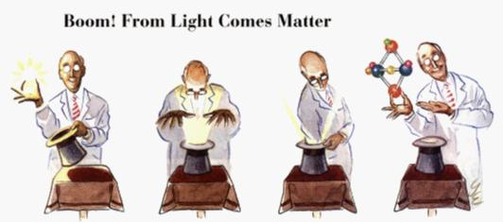
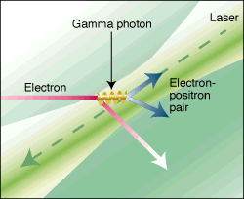
Nonlinear, Strong-Field QED
SLAC Experiment E-144
Gil Eisner, Photonics Spectra, Nov . 1997
D. Pugh, Science 277, 1202 (1997)
KT McDonald
Princeton U.
(September 17, 2021)
Extremely High Intensity Laser Physics Conference
(ExHILP 2021, Jena)
http://kirkmcd.princeton.edu/examples/mcdonald_210917.pptx

Slide 2
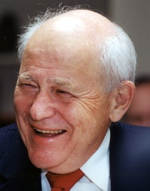
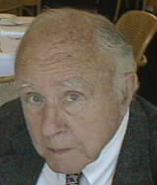
Fundamental Physics During Violent Accelerations
KTM
AIP Conf. Proc. 130, 23 (1985)
Abstract
When a powerful laser beam is focused on a free electron the acceleration of the latter is so violent that the interaction is nonlinear.
We review the prospects for experimental studies of nonlinear electrodynamics of a single electron, with emphasis on the most accessible effect, non-linear Thomson scattering.
We also speculate on the possibility of laboratory studies of a novel effect related to the Hawking radiation of a black hole.
From the Introduction:
An important qualitative feature distinguishes our understanding of the electromagnetic interaction from that of the strong, weak and gravitational interactions.
Namely that the latter are fundamentally non-linear, meaning that the bosonic quanta which mediate these interactions can couple to themselves.
As a step towards the elucidation of fundamental non-linear phenomena we consider the unusual case of very strong electromagnetic fields, in which non-linear effects can be induced.
An inspiration: J.S. Toll, Princeton PhD thesis (1952)
Birefringence of the Vacuum. Adviser: J.A. Wheeler

Slide 3

Hawking Radiation
An appropriate point of departure is the work of Hawking, in which he associated a temperature T with a black hole:
Here, is Planck’s (reduced) constant, g is the acceleration due to gravity measured by an observer at rest with respect to the black hole, c is the speed of light in vacuum, and k is Boltzmann's constant.
The significance of this temperature is that the observer will consider himself to be in a bath of black-body radiation of characteristic temperature T.
This is in some way due to the effect of the gravitational field on the ordinarily unobservable zero-point energy structure of the vacuum.
S.W. Hawking, Nature 248, 30 (1974)
Comm. Math. Phys. 43, 199 (1975)
AIP Conf. Proc. 130, 23 (1985) p. 25
(1942-2018)

Slide 4
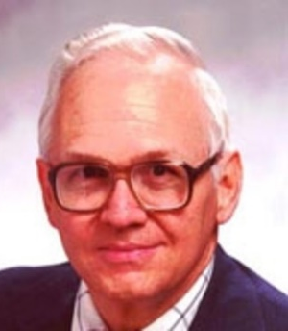
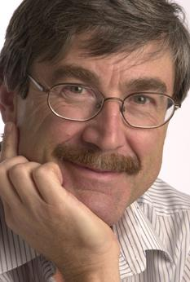
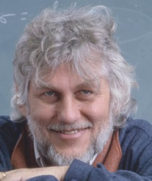
The (Fulling-Davies-)Unruh Effect
Contemporaneous with the work of Hawking, several people considered quantum field theory according to accelerated observers.
By the equivalence principle, we might expect accelerated observers to experience much the same thermal bath as Hawking's observer at rest near a black hole.
The efforts of Fulling, Davies, and Unruh indicate that this may well be so.
If a* is the acceleration as measured in the instantaneous rest frame of an observer, then (s)he is surrounded by an apparent bath of radiation of temperature,
S.A. Fulling, Phys. Rev. D 7, 2850 (1973)
P.C.W. Davies, J. Phys. A 8, 609 (1975)
W.G. Unruh, Phys. Rev D 14, 870 (1976)
Fulling’s contribution (prior to Hawking’s) was that the notion of a ”particle” can be different for acelerated and inertial observers.
The ”vacuum” can appear to contain no ”particles” to an inertial observer, but can contain them according to an accelerated observer.

Slide 5
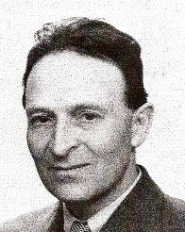
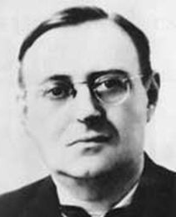
Unruh Radiation? AIP Conf. Proc. 130, 23 (1985) pp. 26-27
Of experimental interest is the case when the observer is an electron.
Then, the electron could scatter off the bath of radiation, producing photons which could be detected by inertial observers in the laboratory.
This new form of radiation, which we call Unruh radiation, is (hopefully) to be distinguished from the ordinary (Larmor) radiation of an accelerated electron.
In particular, the intensity of radiation in the thermal bath varies as T⁴.
Hence, we expect the intensity of the Unruh radiation to vary as T⁴ ∝ a^{*4}.
This contrasts with the a^{*2} dependence of the intensity of Larmor radiation,
where is the QED critical field strength, and is the acceleration.
The QED critical field was introduced by Sauter (1931), following suggestions of Bohr and Heisenberg as to the resolution of Klein’s paradox,
i.e., the production of e⁺e⁻ pairs in a strong electric field.
O. Klein, Z. Phys. 53, 127 (1929)
F. Sauter, Z. Phys. 69, 742 (1931)

Slide 6
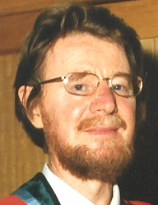
The Unruh Effect
The Unruh radiation effect is a QED correction to Larmor radiation, and is not likely to be directly observed. [For a more optimistic view, see Cozzella et al., Phys. Rev. Lett. 118, 161102 (2017).]
Strictly, the Unruh effect, in which an accelerated observer detects a blackbody spectrum in what an inertial observers considers to be empty space, holds only for uniform, linear acceleration.
However, the Unruh effect has been observed in the broader sense of excitations, by a quasithermal virtual-photon bath, of electrons in storage rings related to their centripetal acceleration.
Bell and Leinaas noted the Unruh effect gives a qualitative explanation of the limit of 92% of the transverse polarization of electrons in storage rings, ordinarily considered as due to quantum fluctuations in their synchrotron radiation.
J.S. Bell and J.M. Leinaas, Nucl. Phys. B 212, 131 (1983)
Furthermore, the effect of synchrotron-radiation damping rings in reducing the
phase volume of an electron bunch is limited by quantum fluctuations, which
correspond to an effective temperature, that excites transverse and longitudinal oscillations (beam height, width, and energy spread). KTM, PAC87, p. 1196
For the Unruh effect on damping of transverse oscillations in a linear focusing channel, see
KTM, linearchannel.pdf (1998)

Slide 7
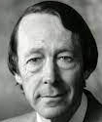
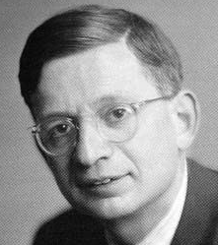
Strong-Field QED
For high acceleration, need strong electromagnetic fields.
The strongest macroscopic electromagnetic fields on Earth are in lasers.
Nonperturbative, strong-field QED is described by two dimensionless measures, and , of the strength of a plane wave with angular frequency and 4-potential
1.
governs the importance of multiple photons in the initial state, and characterizes the “mass shift”,
of a (quasi)electron in a “background “ electromagnetic wave (laser beam).
D.M. Volkov, Z. Phys. 94, 250 (1935), T.W.B. Kibble, Phys. Rev. 150, 1060 (1966)
[For electrons in metals, R. Peierls, Z. Phys. 80, 762 (1933), p. 779]
2.
governs the rate of “spontaneous” e⁺e⁻ pair creation (“sparking the vacuum”) in a wave probed
by an electron with 4-momentum
Symbol introduced in T. Erber, Rev. Mod. Phys. 38, 626 (1966)
[η is also defined for a periodic, static magnetic field = “wiggler”.]
or p_{z}B_{x} or p_{z}E_{x} for static B and E fields

Slide 8
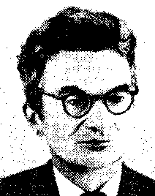
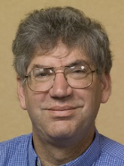

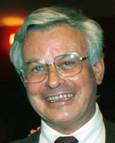
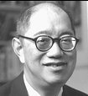
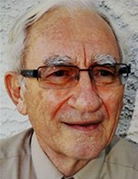
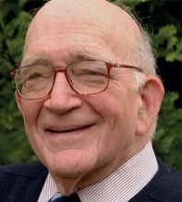
Where to Find Critical Fields
The magnetic field at the surface of a neutron star (magnetar) can exceed the critical field B_{crit} = 4.4 × 10¹³ Gauss. KTM, magnetars.pdf (1998)
During heavy-ion collisions, where
the critical field can be exceeded, and e⁺e⁻ production is expected,
G. Taubes, The One That Got Away? Science, 275, 148 (1997)
The Earth’s magnetic field appears to be of critical strength as seen by a cosmic-ray electron with > 10¹⁹ eV. I.Y. Pomeranchuk, J. Phys. USSR 2, 65 (1940)
The electric field of a bunch at a future e⁺e⁻ linear collider approaches the critical field in the frame of the oncoming bunch ⇒ “Beamstrahlung” limit, (but quantum suppression of classical radiation rate.)
T. Himel & J. Siegrist, AIP Conf. Proc. 130, 602 (1985)
M. Jacob & T.T. Wu, Phys. Lett. B 197, 253 (1987)
R. Blankenbecler & S.D. Drell, Phys. Rev. D 36, 277 (1987)
The electric field of a focused teraWatt laser appears critical to a counterpropagating 50-GeV electron ⇒ SLAC Experiment E-144.

Slide 9
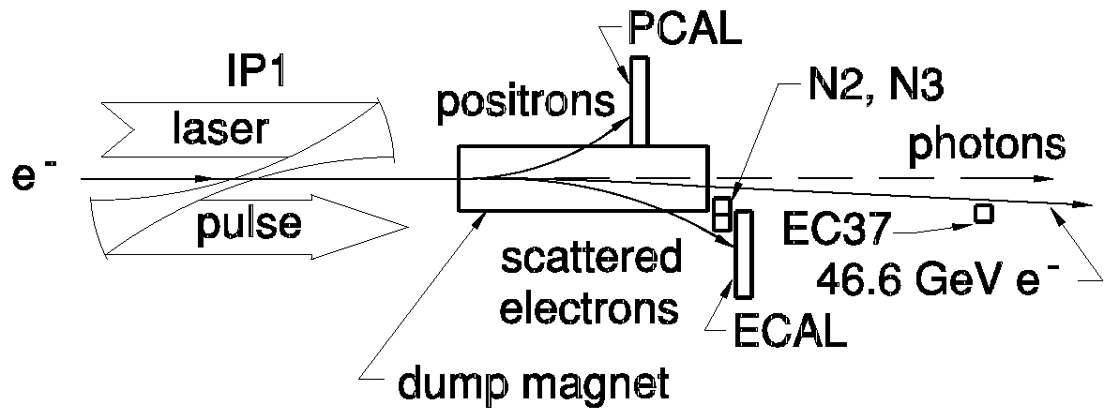
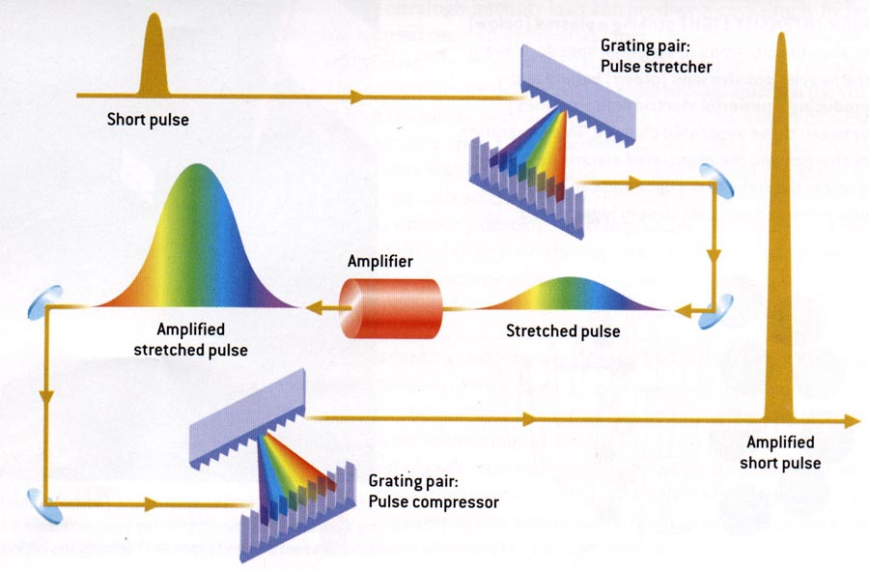
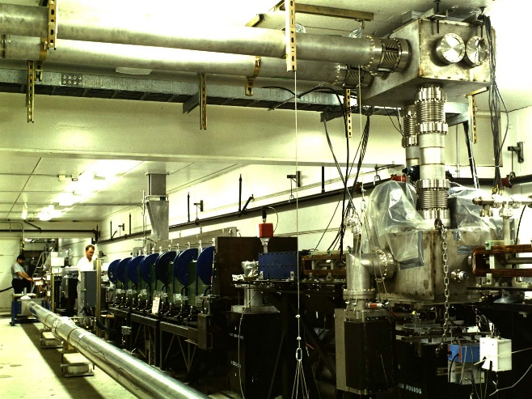
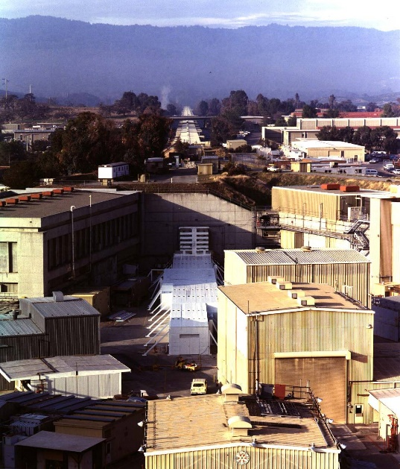
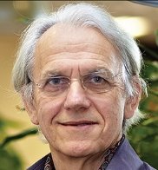
SLAC Experiment E-144
Performed in the Final Focus Test Beam, SLAC (1996-1997)
FFTB: V. Balakin et al., Phys. Rev. Lett. 74, 2479 (1995)
1 Joule, 1 ps
Terawatt laser system: Chirped-Pulse Amplification (CPA)
in a “slab” amplifier. (Special thanks to D. Meyerhofer.)
E144 laser system: C. Bamber et al., Laser Phys. 7, 135 (1997)
CPA: D. Strickland and G. Mourou, Opt. Comm. 56, 219 (1985)

Slide 10
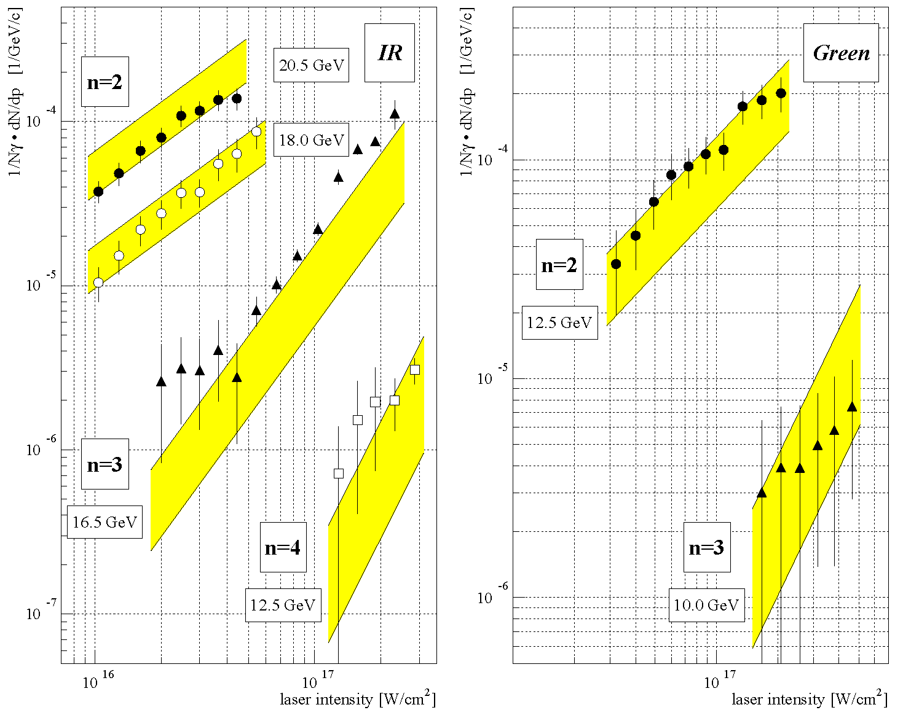
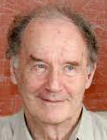
Nonlinear Compton Scattering
C. Bula et al. Phys. Rev. Lett. 76, 3116 (1996)
Rate (@ order n) ∝ I ^{n-1},
when normalized to
total scattered photon rate.
Process is still roughly describable as perturbative, though entering the nonperturbative regime.
Rate
I
I
Theory based on Volkov states of a (dressed) Dirac electron in a plane wave.
A.I. Nikishov & V.I. Ritus, Sov. Phys. JETP 19, 529 (1964)
A.I. Nikishov & V.I. Ritus, Sov. Phys. JETP 20, 22 (1965)

Slide 11
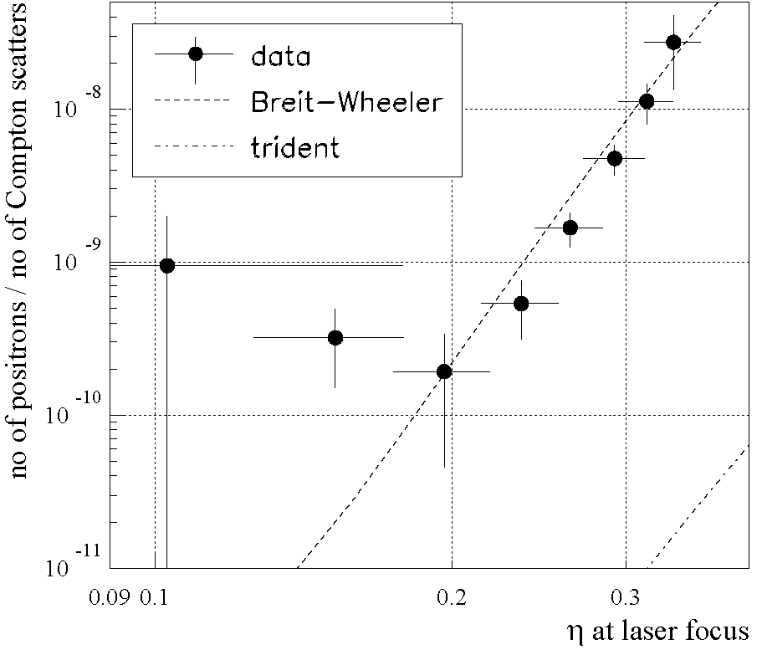
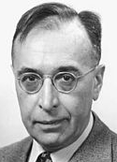
Physics at High U: Pair Creation by Light
Two-step process: then
106 ± 14 signal positrons, 22,000 laser pulses. (Inelastic light-by-light scattering)
D. Burke et al., Phys. Rev. Lett. 79, 1626 (1997), C. Bamber et al., Phys. Rev. D 60, 092004 (1999)
Rate ∝ η^{2n}, where
n = 5.1 ± 0.2 (stat.) ± 0.7 (syst.)
5 laser photons
Process is below threshold for 1 photon.
Process is still roughly describable as perturbative, though entering the nonperturbative regime.
Trident =
C. Bula & KTM, trident.pdf (1998)
Nonlinear (multiphoton) version of
Breit-Wheeler scattering,
G. Breit and J.A. Wheeler, Phys. Rev. 47, 1087 (1934)

Slide 12
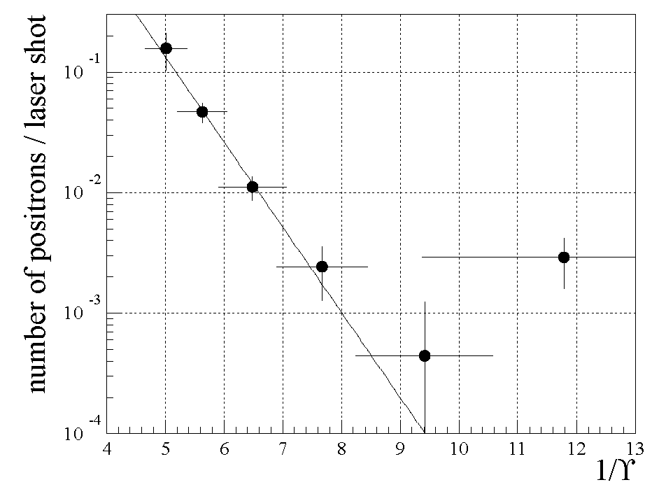
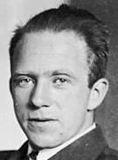
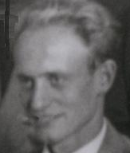
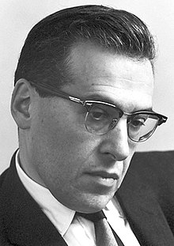
Strong-Field Pair Creation as Barrier Penetration
For a virtual e⁺e⁻ pair to materialize in a field E, the electron and positron must separate by distance d sufficient to extract energy 2mc² from the field:
The probability P of a separation d arising as a quantum fluctuation is related to penetration through a barrier of thickness d:
F. Sauter, Z. Phys. 69, 742 (1931)
W. Heisenberg and H. Euler, Z. Phys. 98, 714 (1936)
J. Schwinger, Phys. Rev. 82, 664 (1951)
Rate_{e+} ∝ exp{[-1.8 ± 0.2 (stat.) ± 0.2 (syst.)]/U}.

Slide 13
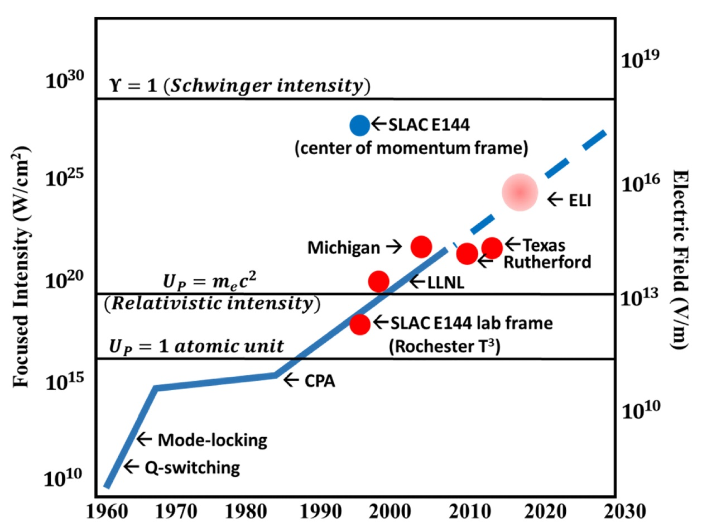
E-144 Was Ahead of Its Time
Reaching for the Brightest Light (2018)
US Natl. Acad. Sci., p. 15

Slide 14
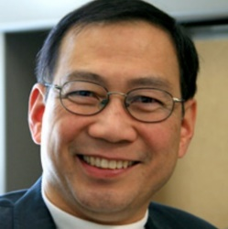

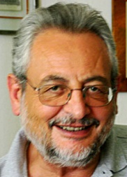
The technology now exists to have laser fields with when probed by GeV electrons.
Is new physics accessible in this regime?
A difficulty is that the interaction length of an electron in a strong wave field is about
for optical fields and GeV electrons.
Hence, for an electron will scatter in less than one wavelength, losing energy, reducing its value (and leading to an electromagnetic “shower”). [Beamstrahlung!]
That is, high-energy electrons have low probability to reach a region of and the physics of the few unscattered electrons that reach such a region will have a huge background associated with the majority of electrons that scattered on the way in.
There is some interest in the details of the electromagnetic cascades of electron in strong wave fields. P. Chen and R.B. Palmer, AIP Conf. Proc. 279, 888 (1992)
P. Chen and C. Pellegrini, QAPB, 1 (1998)
A fundamental limit to laser field strength, AIP Conf. Proc. 130, 23 (1985) pp. 35-36
for a laser beam focused to angle θ , above which “sparking the vacuum”.

Slide 15
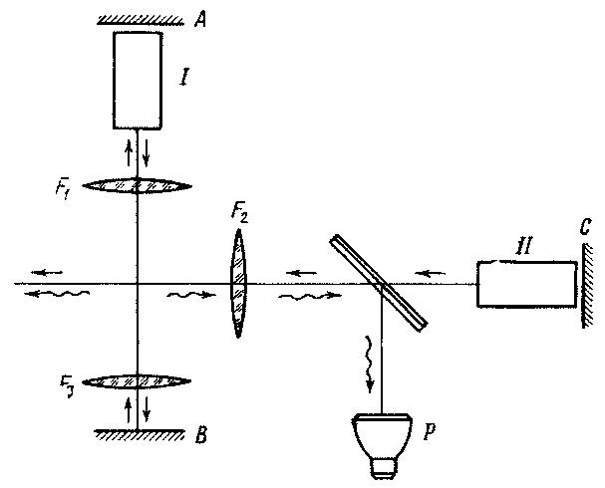
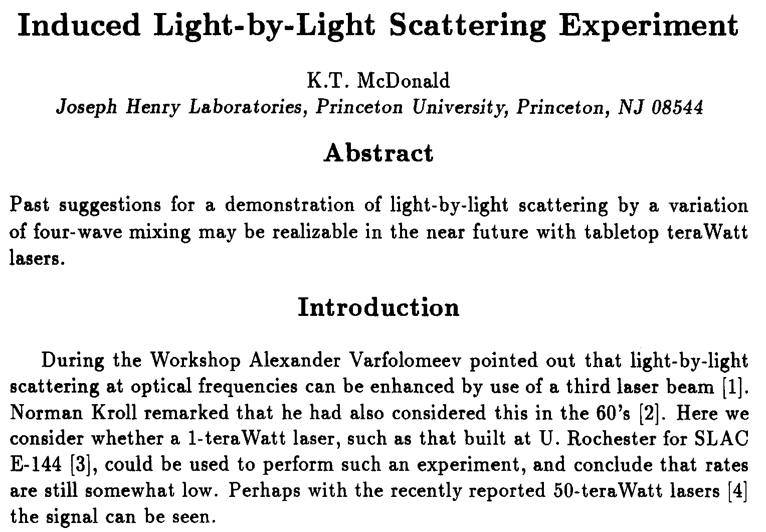
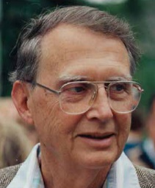
Induced Light-by-Light Scattering Experiment
ω₁ , ω₂
where final-state photon ω₃ goes into an intense laser beam, ⇒ amplitude gets boson enhancement.
ω₃
ω₄
Advanced Accelerator Concepts Workshop, AIP Conf. Proc. 279, 945 (1992)
[1] A. Varfolomeev, Sov. Phys. JETP 23, 681 (1966)
[2] N. Kroll, Phys. Rev. 127, 1207 (1962), footnote 9

Slide 16
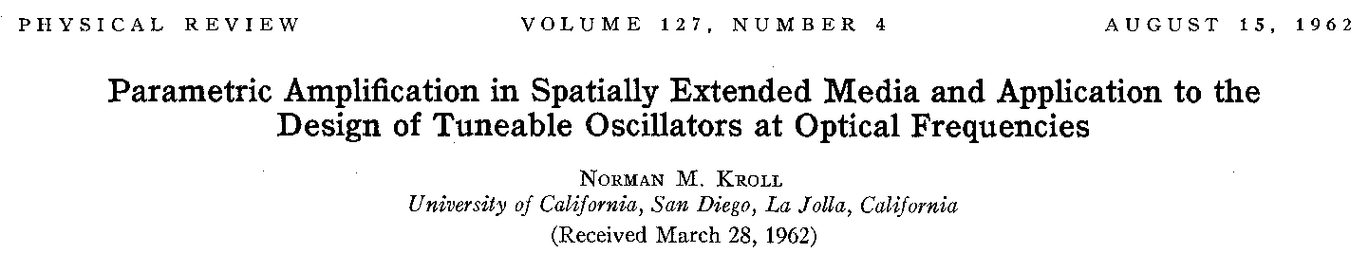
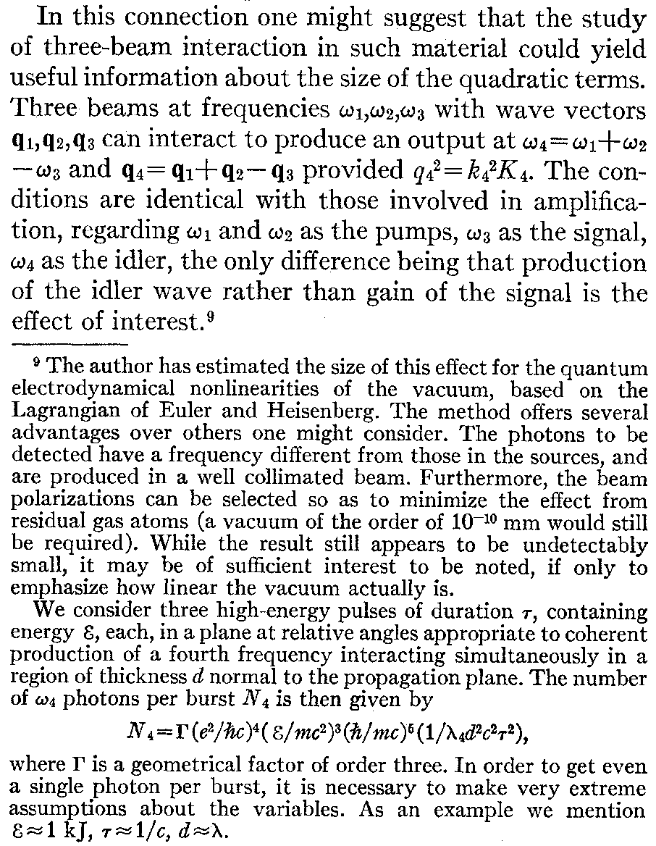
How Could One Have Missed This?
Vacuum should have less than 1 atom in the laser focal volume,
Separation of atoms
> 10 μm
⇒ Pressure < 10⁻⁹ mm.

Slide 17
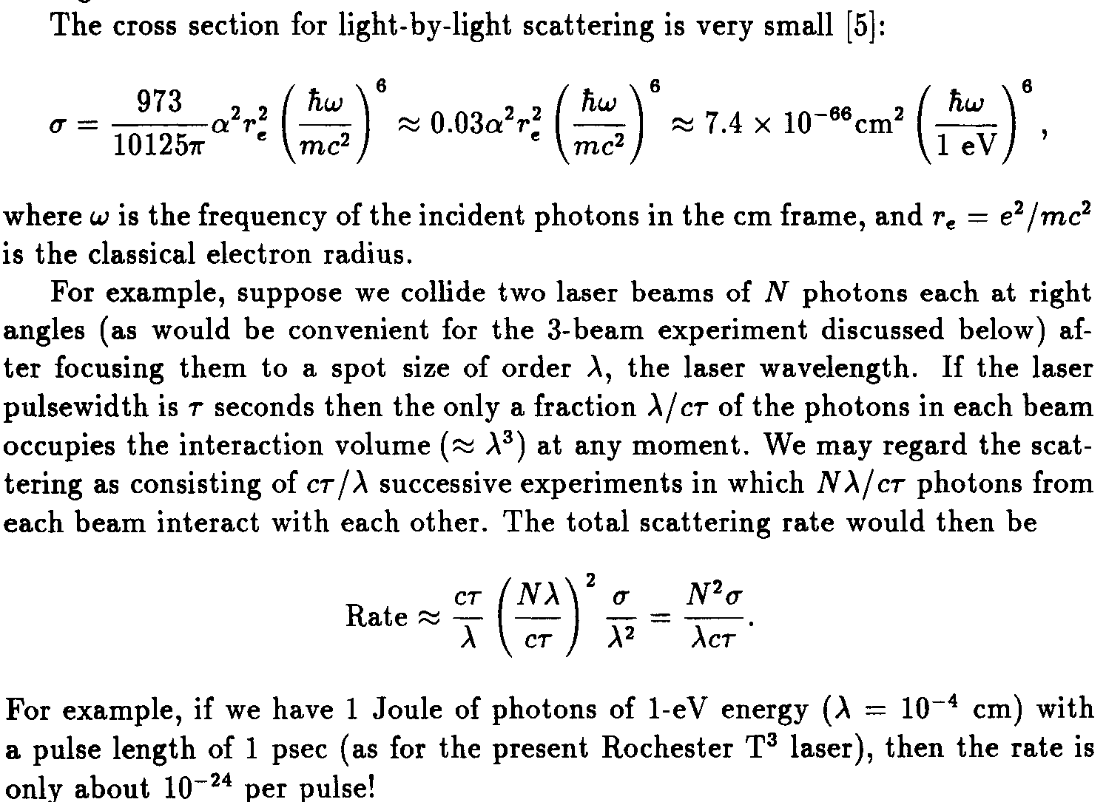
Usual Light-by-Light Scattering

Slide 18
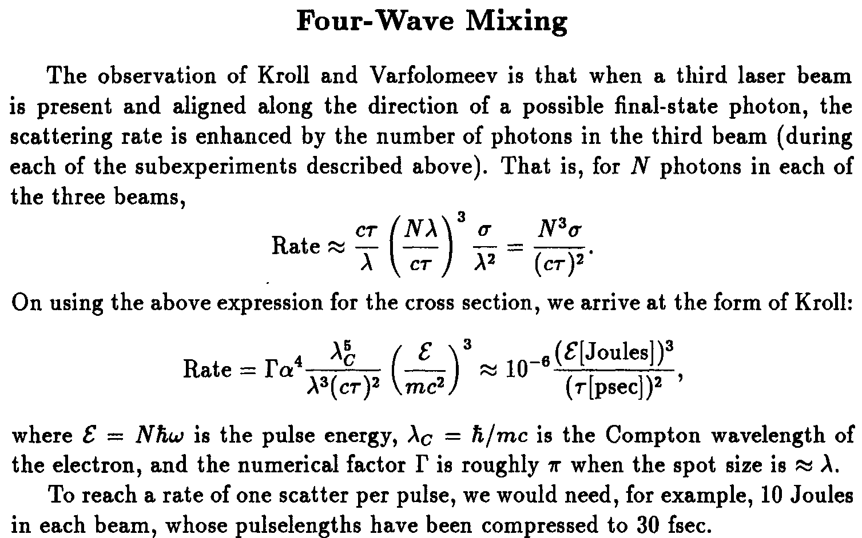

Slide 19
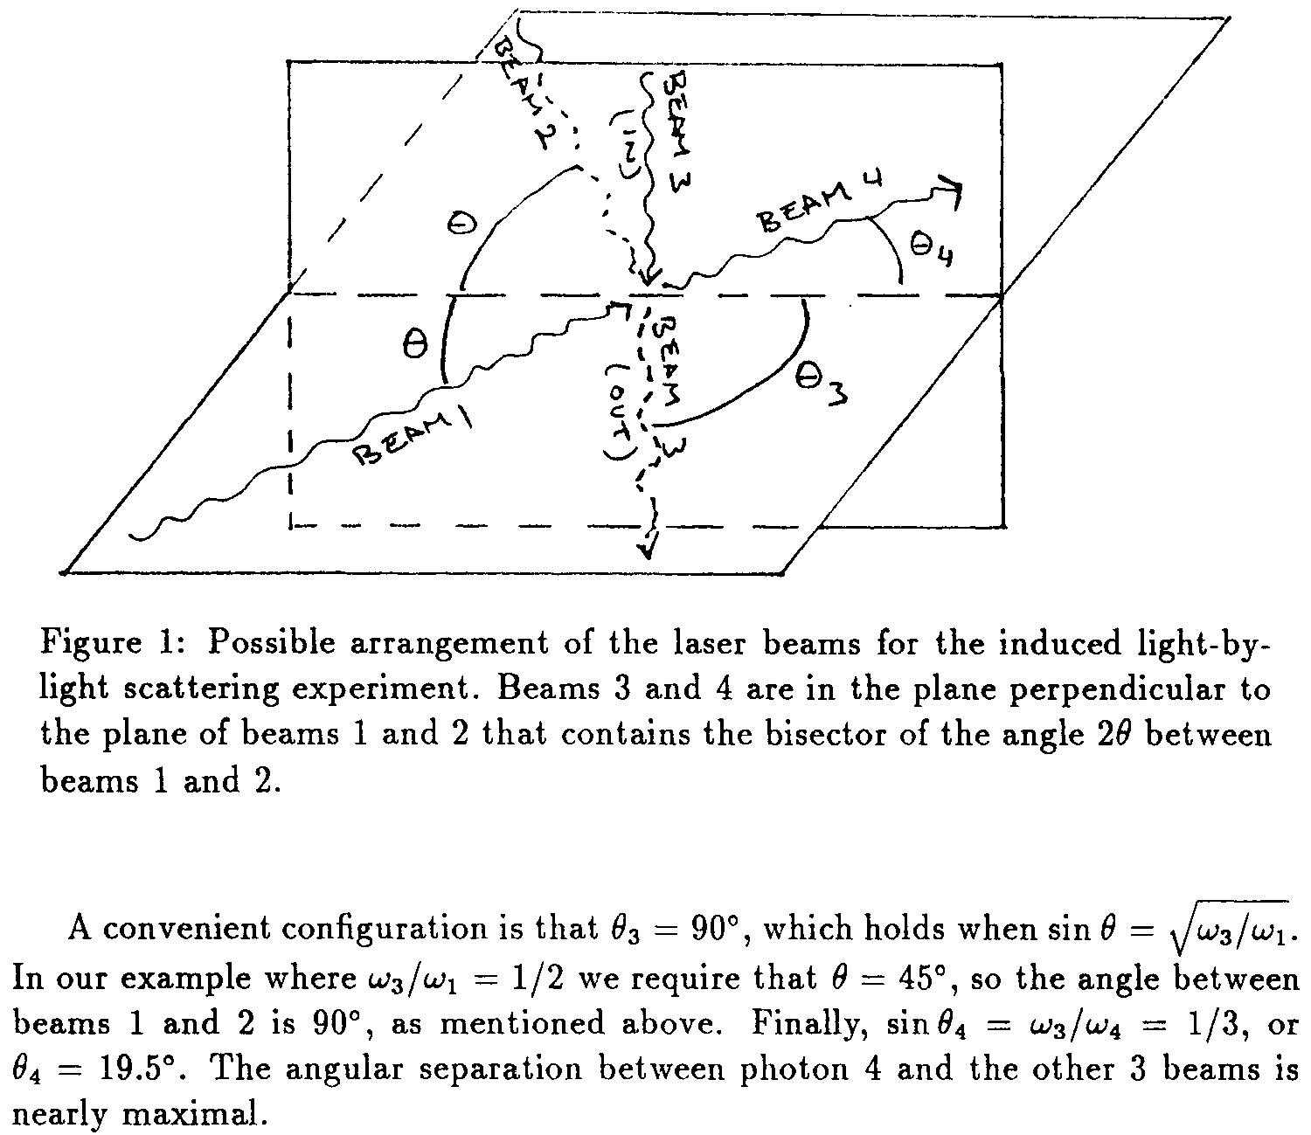
Configuration with ω₄ Different from ω₁ = ω₂ = 2ω₃

Slide 20
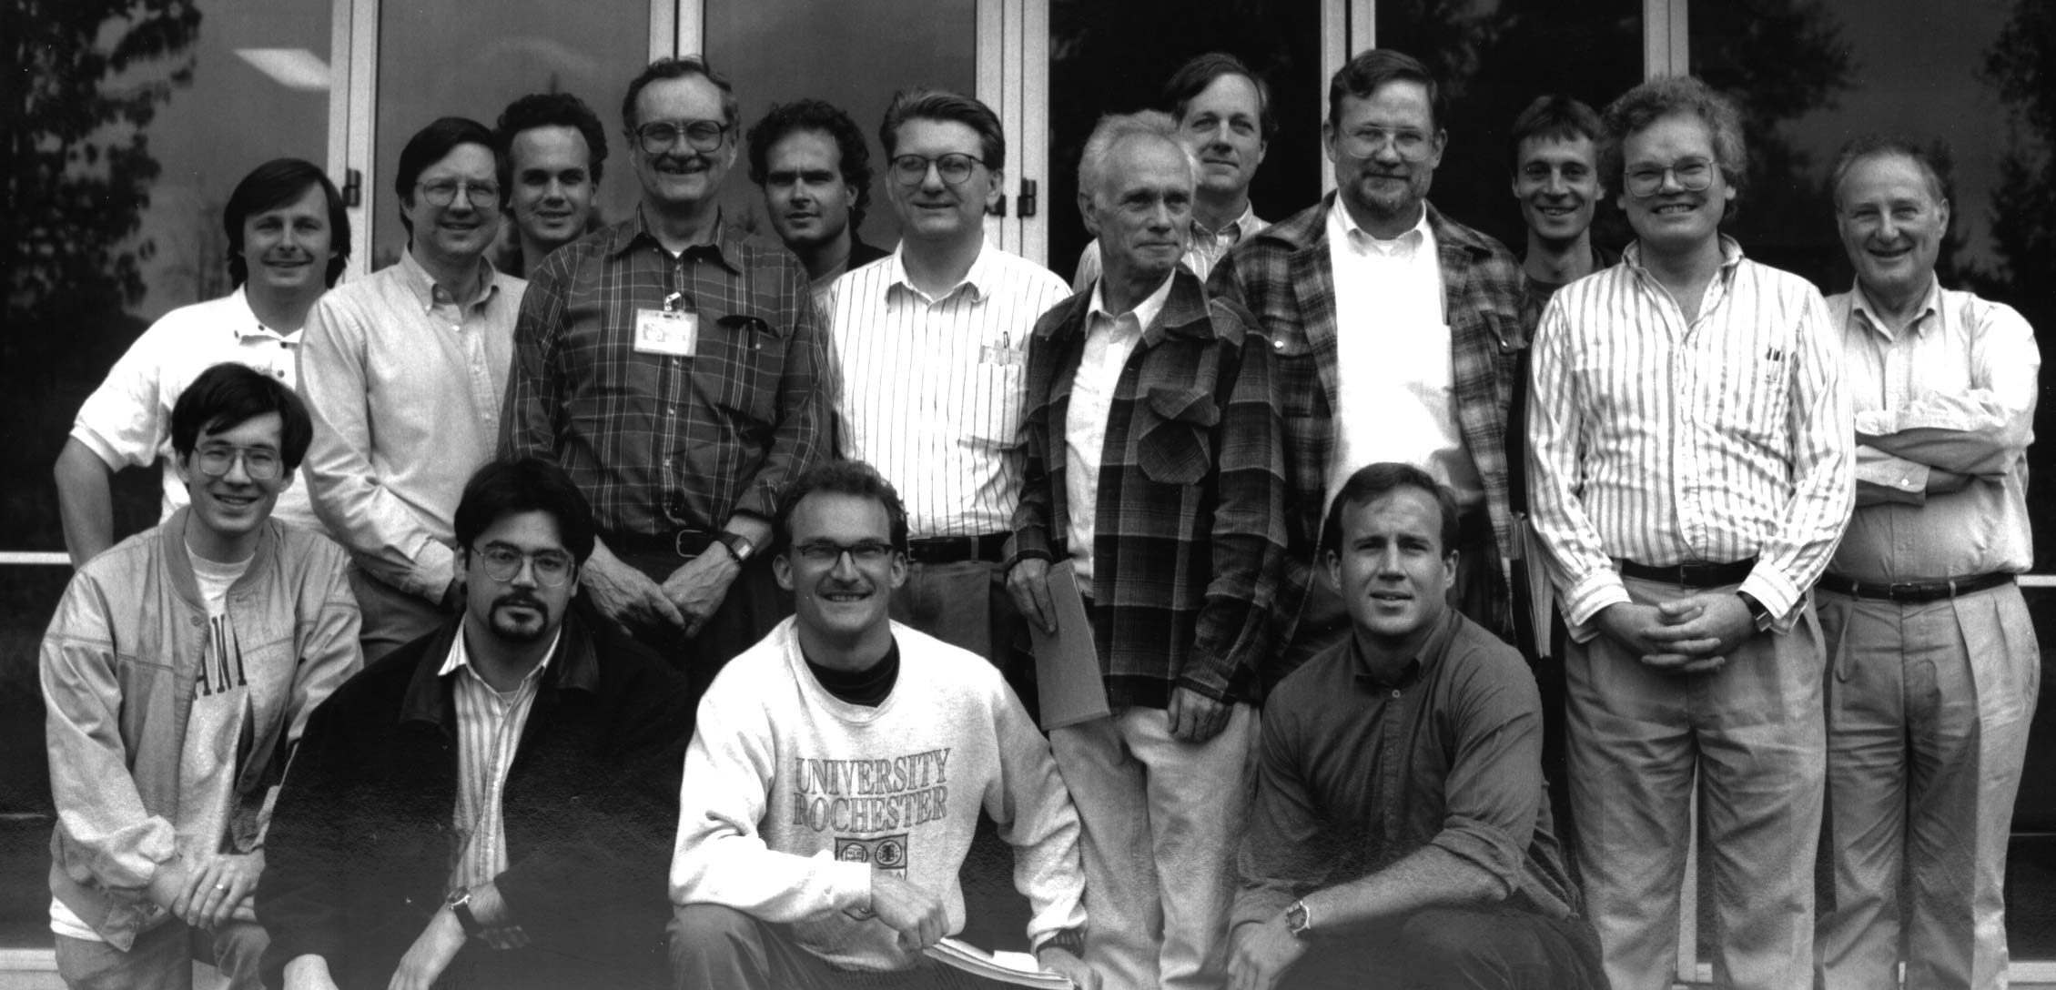
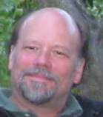
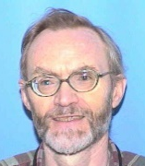


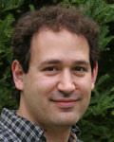
The E-144 Collaboration
Dave Meyerhofer Bill Bugg Achim Weidemann Dave Burke Christian Bula Adrian Melissinos
Kostya Shmakov Charles Bamber Uli Haug Dieter Walz Jim Spencer KTM
Glenn Horton-Smith Wolfram Ragg Steve Boege
Theo Kotseroglou
Steve Clive Thomas Eric David
Berridge Field Koffas Prebys Reis

Slide 21
Loose Ends in Strong-Field QED
Workshop on Quantum Aspects of Beam Physics (Monterey, CA, Jan. 4-9, 1998)
Loose End #1: Trident Production.
Loose End #2: Strong-Field Light-by-Light Scattering (photon splitting by a laser)
Loose End #2a: Vacuum Cerenkov Radiation (of an electron in a strong laser beam).
Loose End #3: QED Phase Transition. (Does it exist?)
Loose End #4: From Hawking to Unruh to ...
Loose End #5: Vacuum Laser Acceleration.
Puzzle #1: A charge is accelerated in the E field of a capacitor. Where does the energy come from?
Puzzle #2: A weak plane wave shakes a free electron transverse to the wave (momentum) vector; how
is momentum conserved? staticaccel.pdf (1998), transmom2.pdf (1998)
Puzzle #3: A free electron cannot absorb real photons unless it (a) radiates, or (b) changes its mass.
So how could a pulse of real photons add energy to a free electron? vacuumaccel.pdf (1998)
Puzzle #4: Compton scattering by a two-frequency wave.
Puzzle #5: An electron inside a (plane, monochromatic) wave is described by the Volkov solutions to
the Dirac equation as having a quasimomentum.
Puzzle #5a: If η is large, the threshold is raised for pair creation by light because the final electrons and positrons must be born with mass not mass m. Is this true for short pulses?
Puzzle #5b: Is neutron decay suppressed in a strong wave field, where could be
much larger than the neutron-proton mass difference?
Loose End #6: Classical Critical Field?

Slide 22
SLAC Experiment E-166
Undulator-Based Production of Polarized Positrons
Possible scheme for the positron source
at a future linear collider.
Demonstrated 80% longitudinal polarization of both e⁺ and e⁻.
Concept: V.E. Balakin and A.A. Mikhailichenko, Budker Inst. Report, BINP 79-85 (1979)
G. Alexander et al., Phys. Rev. Lett. 100, 210801 (2008)
G. Alexander et al., Nucl. Instrum. Meth. A 610, 451 (2009)

